Slide 1
Justin Daryl Dsouza
Al Orouba Boys School (5034)
G12 Adv T1 Revision 2022-23

Slide 2
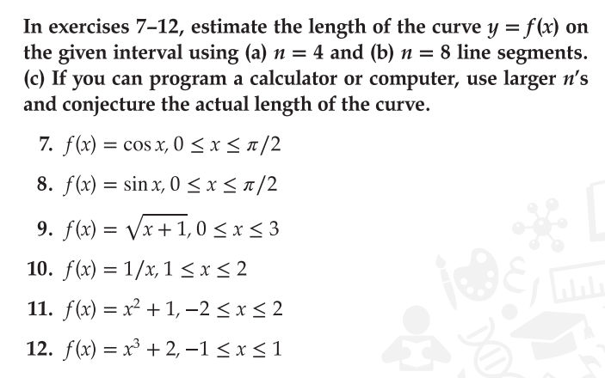

Slide 3
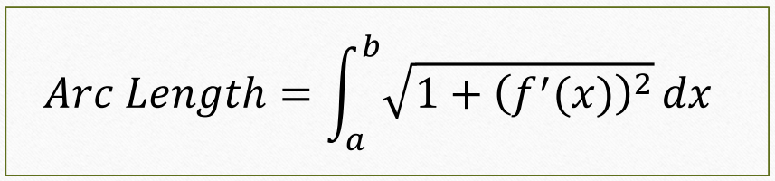
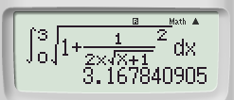


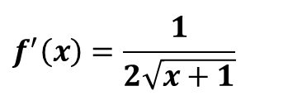

Example: Q9 Page: 68
Estimate the length of the curve of $f(x)=\sqrt{x+1}$ for $0≤x≤3$
$$f^{′}\left(x\right)=\frac{1}{2\sqrt{x+1}}$$
$$From Calculator:$$
Arc Length$≈$
$$3.167$$

Slide 4
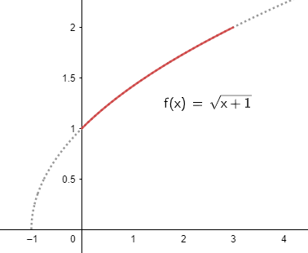
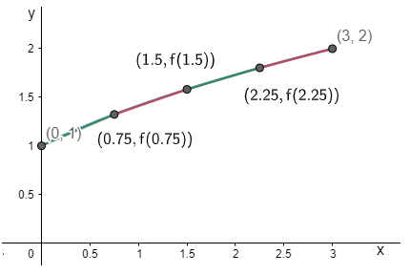



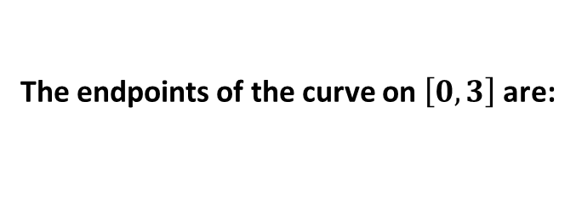













Example: Q9 Page: 68
Estimate the length of the curve of $f(x)=\sqrt{x+1}$ for $0≤x≤3$
Solution:
The endpoints of the curve on $\left[0\right.,\left.3\right]$ are:
$$\left(0,1\right), (3,2)$$
$n=4−line$ segments
Using five points (four segments): $\frac{3−0}{4}$ = 0.75 , $x=\text{0 , 0.75 , 1.5 , 2.25 , 3}$
Left
Right
Length
$$(0,1)$$
$$(0.75,1.323)$$
$$\sqrt{{(1.325−1)}^{2}+{(0.75−0)}^{2}}=0.817$$
(0$.75,1.323)$
$$(1.5,1.581)$$
$$\sqrt{{(1.581−1.325)}^{2}+{(1.5−0.75)}^{2}}=0.793$$
$$(1.5,1.581)$$
$$(2.25,1.803)$$
$$\sqrt{{(1.803−1.581)}^{2}+{(2.25−1.5)}^{2}}=0.782$$
$$(2.25,1.803)$$
$$(3,2)$$
$$\sqrt{{(2−1.803)}^{2}+{(3−2.25)}^{2}}=0.776$$
Arc Length$≈$
$$3.167$$

Slide 5
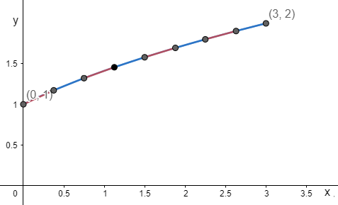




























$f(x)=\sqrt{x+1}$ for $0≤x≤3$
b. $n=8−line$ segments
Using nine points (eight segments): $\frac{3−0}{8}$ $\text{=}$ 0.375 , $x\text{= 0 , 0.375 , 0.75 , 1.125 , 1.5 , 1.875 , 2.25 , 2.625 , 3}$
Left
Right
Length
$$(0,1)$$
$$(0.375,1.17)$$
$$\sqrt{{(1.17−1)}^{2}+{(0.375−0)}^{2}}=0.413$$
$$(0.375,1.17)$$
$$(0.75,1.323)$$
$$\sqrt{{(1.323−1.17)}^{2}+{(0.75−0.375)}^{2}}=0.404$$
$$(0.75,1.323)$$
$$(1.125,1.46)$$
$$\sqrt{{(1.46−1.323)}^{2}+{(1.125−0.75)}^{2}}=0.399$$
$$(1.125,1.46)$$
$$(1.5,1.581)$$
$$\sqrt{{(1.581−1.46)}^{2}+{(1.5−1.125)}^{2}}=0.395$$
$$(1.5,1.581)$$
$$(1.88,1.696)$$
$$\sqrt{{(1.696−1.581)}^{2}+{(1.88−1.5)}^{2}}=0.392$$
$$(1.88,1.696)$$
$$(2.25,1.803)$$
$$\sqrt{{(1.803−1.696)}^{2}+{(2.25−1.88)}^{2}}=0.390$$
$$(2.25,1.803)$$
$$(2.63,1.904)$$
$$\sqrt{{(1.904−1.803)}^{2}+{(3−2.63)}^{2}}=0.388$$
The actual arc length $=3.168$
$$(2.63,1.904)$$
$$(3,2)$$
$$\sqrt{{(2−1.904)}^{2}+{(3−2.63)}^{2}}=0.387$$
You will learn how to find it using definite integral
Arc Length$≈$
$$3.168$$

Slide 6
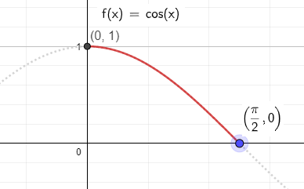
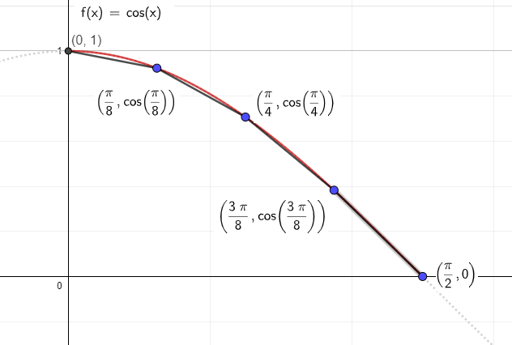


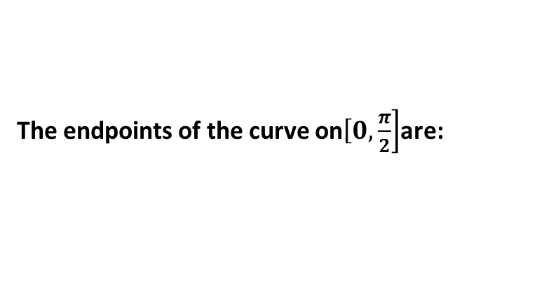










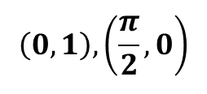


Exercise: Q7 Page: 68
Estimate the length of the curve of $f\left(x\right)=cosx$ for $0≤x≤\frac{π}{2}$
$$\left(0,1\right), \left(\frac{π}{2},0\right)$$
Solution:
The endpoints of the curve on$\left[0\right.,\left.\frac{π}{2}\right]$are:
$n=4−line$ segments
Using five points (four segments): $\frac{\frac{π}{2}−0}{4}$ = $\frac{π}{8}$ , $x\text{= }\text{0 , }\frac{π }{8}\text{, }\frac{π}{4 }\text{ , }\frac{3π }{8}\text{ , }\frac{π}{2}$
Left
Right
Length
$$\left(0,1\right)$$
$$\left(\frac{π}{8},0.92\right)$$
$$\sqrt{{(0.92−1)}^{2}+{(\frac{π}{8}−0)}^{2}}=0.4$$
$$\left(\frac{π}{8},0.92\right)$$
$$\left(\frac{π}{4},0.71\right)$$
$$\sqrt{{(0.71−0.92)}^{2}+{\left(\frac{π}{4}−\frac{π}{8}\right)}^{2}}=0.449$$
$$\left(\frac{π}{4},0.71\right)$$
$$\left(\frac{3π}{8},0.383\right)$$
$$\sqrt{{(0.383−0.71)}^{2}+{\left(\frac{3π}{8}−\frac{π}{4}\right)}^{2}}=0.509$$
$$\left(\frac{3π}{8},0.383\right)$$
$$\left(\frac{π}{2},0\right)$$
$$\sqrt{{(0−0.383)}^{2}+{\left(\frac{π}{2}−\frac{3π}{8}\right)}^{2}}=0.548$$
Arc Length$≈$
$$1.906$$

Slide 7
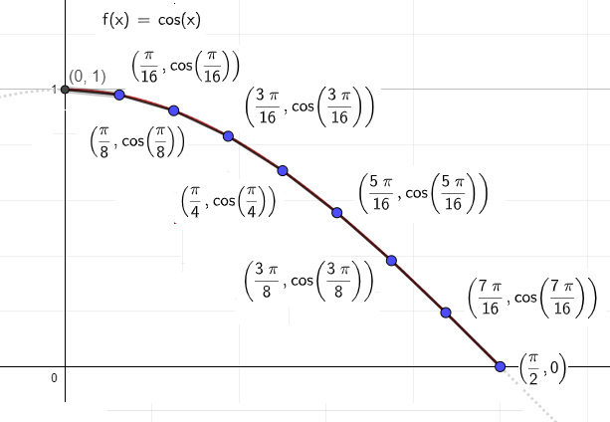





























$f\left(x\right)=cosx$ for $0≤x≤\frac{π}{2}$
b. $n=8−line$ segments
Using nine points (eight segments): $\frac{\frac{π}{2}−0}{8}$ = $\frac{π}{16}$ , $x\text{= 0 , }\frac{π}{16}\text{ , } \frac{π}{8}\text{, }\frac{3π}{16}\text{ , }\frac{π}{4}\text{ , }\frac{5π}{16}\text{ , }\frac{3π}{8}\text{ , } \frac{7π}{16}\text{, }\frac{π}{2}$
Left
Right
Length
$$\left(0,1\right)$$
$$\left(\frac{π}{16},0.98\right)$$
$$\sqrt{{(0.98−1)}^{2}+{(\frac{π}{16}−0)}^{2}}=0.197$$
$$\left(\frac{π}{16},0.98\right)$$
$$\left(\frac{π}{8},0.92\right)$$
$$\sqrt{{(0.92−0.98)}^{2}+{\left(\frac{π}{8}−\frac{π}{16}\right)}^{2}}=0.204$$
$$\left(\frac{π}{8},0.92\right)$$
$$\left(\frac{3π}{16},0.83\right)$$
$$\sqrt{{(0.83−0.92)}^{2}+{\left(\frac{3π}{16}−\frac{π}{8}\right)}^{2}}=0.217$$
$$\left(\frac{3π}{16},0.83\right)$$
$$\left(\frac{π}{4},0.71\right)$$
$$\sqrt{{(0.71−0.83)}^{2}+{\left(\frac{π}{4}−\frac{3π}{16}\right)}^{2}}=0.232$$
$$\left(\frac{π}{4},0.71\right)$$
$$\left(\frac{5π}{16},0.56\right)$$
$$\sqrt{{(0.56−0.71)}^{2}+{\left(\frac{5π}{16}−\frac{π}{4}\right)}^{2}}=0.248$$
$$\left(\frac{5π}{16},0.56\right)$$
$$\left(\frac{3π}{8},0.83\right)$$
$$\sqrt{{(0.83−0.56)}^{2}+{\left(\frac{3π}{8}−\frac{5π}{16}\right)}^{2}}=0.262$$
$$\left(\frac{3π}{8},0.83\right)$$
$$\left(\frac{7π}{16},0.195\right)$$
$$\sqrt{{(0.195−0.83)}^{2}+{\left(\frac{7π}{16}−\frac{3π}{8}\right)}^{2}}=0.272$$
$$\left(\frac{7π}{16},0.195\right)$$
$$\left(\frac{π}{2},0\right)$$
$$\sqrt{{(0−0.195)}^{2}+{\left(\frac{π}{2}−\frac{7π}{16}\right)}^{2}}=0.277$$
Arc Length$≈$
$$1.909$$
The actual arc length$≈1.909$

Slide 8
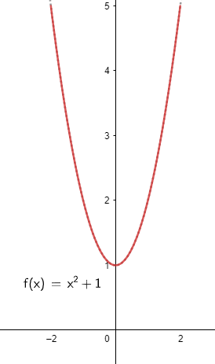
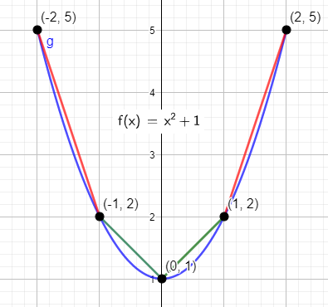


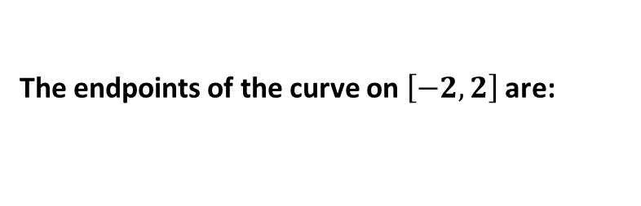













Exercise: Q11 Page: 68
Estimate the length of the curve of $f\left(x\right)=x^{2}+1$ for $−2≤x≤2$
Solution:
The endpoints of the curve on $\left[−2\right.,\left.2\right]$ are:
$$\left(−2,5\right), (2,5)$$
$n=4−line$ segments
Using five points (four segments): $\frac{2−−2}{4}$ = 1 , $x\text{= −2 , −1 , 0 , 1 , 2}$
Left
Right
Length
$$\left(−2,5\right)$$
$$(−1,2)$$
$$\sqrt{{(2−5)}^{2}+{(−1−−2)}^{2}}=3.162$$
$$(−1,2)$$
$$(0,1)$$
$$\sqrt{{(1−2)}^{2}+{(0−−1)}^{2}}=1.414$$
$$(0,1)$$
$$(1,2)$$
$$\sqrt{{(2−1)}^{2}+{(1−0)}^{2}}=1.414$$
$$(1,2)$$
$$(2,5)$$
$$\sqrt{{(5−2)}^{2}+{(2−1)}^{2}}=3.162$$
Arc Length$≈$
$$9.153$$

Slide 9
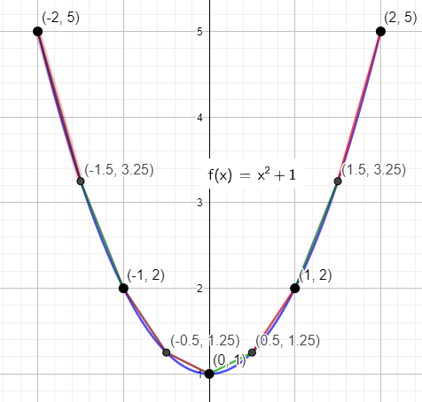




























$f\left(x\right)=x^{2}+1$ for $−2≤x≤2$
b. $n=8−line$ segments
Using nine points (eight segments): $\frac{2−−2}{8}$ = 0.5 , $x\text{= −2 , −1.5 , −1 , −0.5 , 0 , 0.5 , 1 , 1.5 , 2}$
Left
Right
Length
$$\left(−2,5\right)$$
$$(−1.5,3.25)$$
$$\sqrt{{(3.25−5)}^{2}+{(−1.5−−2)}^{2}}=1.820$$
$$(−1.5,3.25)$$
$$(−1,2)$$
$$\sqrt{{(2−3.25)}^{2}+{(−1−−1.5)}^{2}}=1.346$$
$$(−1,2)$$
$$(−0.5,−1.25)$$
$$\sqrt{{(−1.25−2)}^{2}+{(−0.5−−1)}^{2}}=0.901$$
$$(−0.5,−1.25)$$
$$(0,1)$$
$$\sqrt{{(1−−1.25)}^{2}+{(0−−0.5)}^{2}}=0.559$$
$$(0,1)$$
$$(0.5,1.25)$$
$$\sqrt{{(1.25−1)}^{2}+{(0.5−0)}^{2}}=0.559$$
$$(0.5,1.25)$$
$$(1,2)$$
$$\sqrt{{(2−1.25)}^{2}+{(1−0.5)}^{2}}=0.901$$
$$(1,2)$$
$$(1.5,3.25)$$
$$\sqrt{{(3.25−2)}^{2}+{(1.5−1)}^{2}}=1.346$$
$$(1.5,3.25)$$
$$(2,5)$$
$$\sqrt{{(5−3.25)}^{2}+{(2−1.5)}^{2}}=1.820$$
Arc Length$≈$
$$9.253$$
The actual arc length $=9.2936$

Slide 10


Slide 11
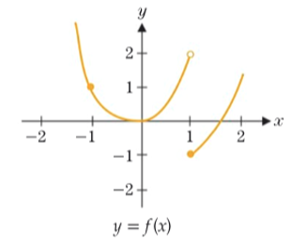






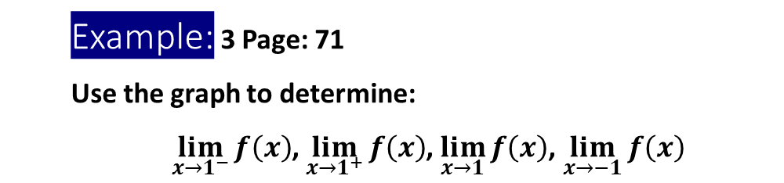








Example: 3 Page: 71
Use the graph to determine:
$\lim_{x→1^{−}}{f\left(x\right)}$, $\lim_{x→1^{+}}{f\left(x\right)}$, $\lim_{x→1}{f\left(x\right)}$, $\lim_{x→−1}{f\left(x\right)}$
Solution:
$$\lim_{x→1^{−}}{f\left(x\right)}$$
$$=2$$
As $x$approaches $1$ from the left ($x<1$) the graph approaches $y−$value of 2
$$\lim_{x→1^{+}}{f\left(x\right)}$$
$$=−1$$
As $x$ approaches $1$ from the right ($x>1$) the graph approaches $y−$value of $−1$
$$\lim_{x→1^{−}}{f\left(x\right)}≠\lim_{x→1^{+}}{f\left(x\right)}$$
$$\lim_{x→1}{f\left(x\right)}$$
$$does not exist$$
$$=1$$
$$\lim_{x→−1^{−}}{f\left(x\right)}$$
As $x$ approaches $−1$ from the left ($x<−1$) the graph approaches $y−$value of 1
$$\lim_{x→−1^{+}}{f\left(x\right)}$$
$$=1$$
As $x$ approaches $−1$ from the right ($x>−1$) the graph approaches $y−$value of $1$
$$\lim_{x→1^{−}}{f\left(x\right)}=\lim_{x→1^{+}}{f\left(x\right)=1}$$
$$\lim_{x→1}{f\left(x\right)}$$
$$=1$$

Slide 13
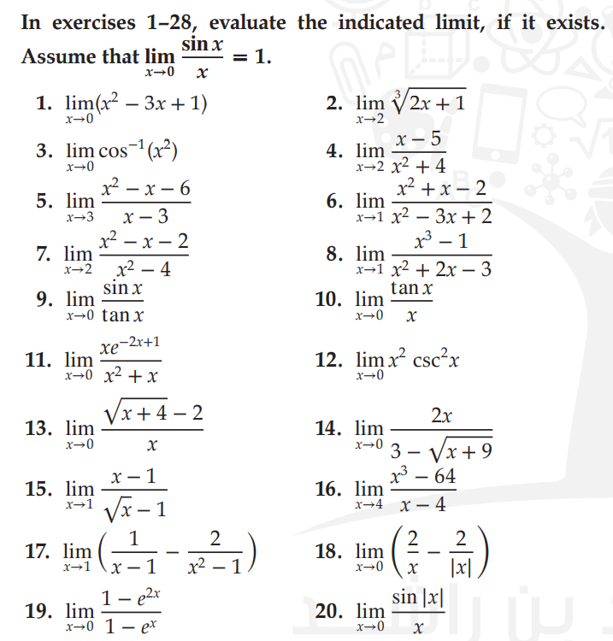

Slide 15
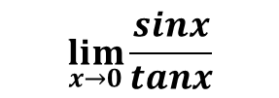
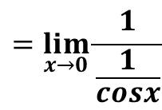


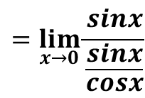

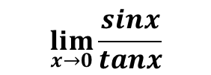

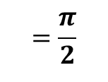




Exercise: Q3 Page: 85
$$\lim_{x→0} \cos^{−1}\left(x^{2}\right)$$
Evaluate:
Solution:
By substituting $x=0$
$$\lim_{x→0} \cos^{−1}\left(x^{2}\right)$$
$$=\frac{π}{2}$$
$${=cos}^{−1}\left(0^{2}\right){=cos}^{−1}\left(0\right)$$
Example: Q9 Page: 85
$\lim_{x→0}\frac{sinx}{tanx}$
Evaluate:
Solution:
$$\lim_{x→0}\frac{sinx}{tanx}$$
$$=\lim_{x→0}\frac{sinx}{\frac{sinx}{cosx}}$$
$$=\lim_{x→0}\frac{1}{\frac{1}{cosx}}$$
$$\lim_{x→0}\frac{sinx}{tanx}$$
Direct substitution gives $\frac{0}{0} Indeterminate$
$$=\lim_{x→0}cosx$$
$$=cos\left(0\right)=1$$

Slide 16
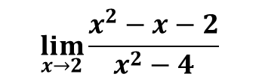
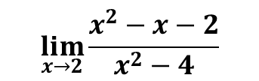
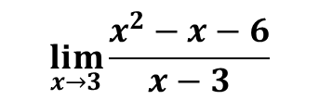

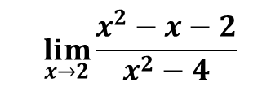
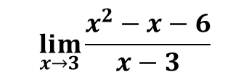
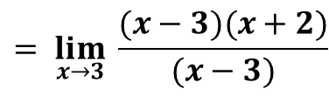
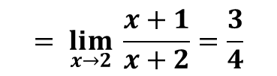
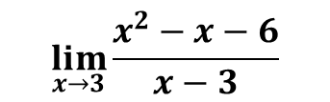
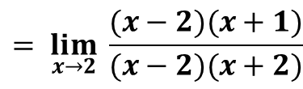


Exercise: Q5 Page: 85
Exercise: Q7 Page: 85
$$\lim_{x→3}{\frac{x^{2}−x−6}{x−3}}$$
$$\lim_{x→2}{\frac{x^{2}−x−2}{x^{2}−4}}$$
Evaluate:
Evaluate:
Solution:
Solution:
$$\lim_{x→3}{\frac{x^{2}−x−6}{x−3}}$$
$$\lim_{x→2}{\frac{x^{2}−x−2}{x^{2}−4}}$$
Direct substitution gives $\frac{0}{0} Indeterminate$
Direct substitution gives $\frac{0}{0} Indeterminate$
By Factoring:
By Factoring:
$$\lim_{x→2}{\frac{x^{2}−x−2}{x^{2}−4}}$$
$$\underset{ x→2}{= lim}{\frac{(x−2)(x+1)}{(x−2)(x+2)}}$$
$$\lim_{x→3}{\frac{x^{2}−x−6}{x−3}}$$
$$\underset{ x→3}{= lim}{\frac{(x−3)(x+2)}{(x−3)}}$$
$$\underset{ x→2}{= lim}{\frac{x+1}{x+2}=\frac{3}{4}}$$
$$\underset{ x→3}{= lim}\left(x+2\right)=5$$

Slide 17
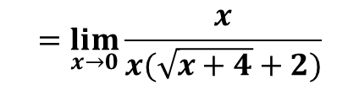
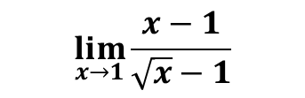


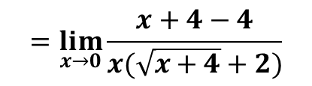
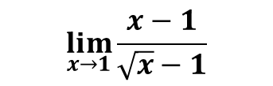
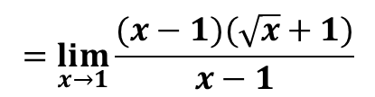
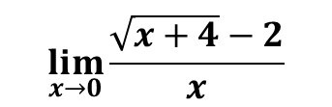
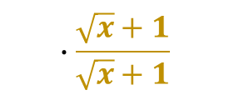
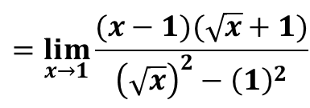
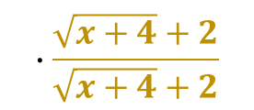
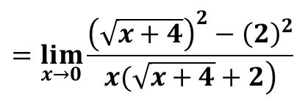
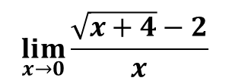
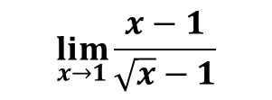
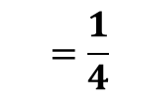

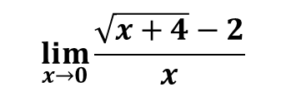
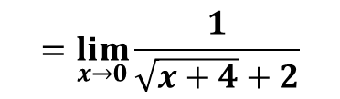

Exercise: Q13 Page: 85
Exercise: Q15 Page: 85
$$\lim_{x→0}{\frac{\sqrt{x+4}−2}{x}}$$
$$\lim_{x→1}{\frac{x−1}{\sqrt{x}−1}}$$
Evaluate:
Evaluate:
Solution:
Solution:
$$\lim_{x→0}{\frac{\sqrt{x+4}−2}{x}}$$
Direct substitution gives $\frac{0}{0} Indeterminate$
$$\lim_{x→1}{\frac{x−1}{\sqrt{x}−1}}$$
Direct substitution gives $\frac{0}{0} Indeterminate$
Rationalizing the Numerator
Rationalizing the Denominator
$$\lim_{x→0}{\frac{\sqrt{x+4}−2}{x}}$$
$$∙\frac{\sqrt{x+4}+2}{\sqrt{x+4}+2}$$
$$\lim_{x→1}{\frac{x−1}{\sqrt{x}−1}}$$
$$∙\frac{\sqrt{x}+1}{\sqrt{x}+1}$$
$$=\lim_{x→0}{\frac{{\left(\sqrt{x+4}\right)}^{2}−{\left(2\right)}^{2}}{\left.x(\sqrt{x+4}+2\right)}}$$
$$=\lim_{x→0}{\frac{x+4−4}{x(\sqrt{x+4}+2)}}$$
$$=\lim_{x→1}{\frac{(x−1)(\sqrt{x}+1)}{{\left(\sqrt{x}\right)}^{2}−{\left(1\right)}^{2}}}$$
$$=\lim_{x→1}{\frac{(x−1)(\sqrt{x}+1)}{x−1}}$$
$$=\lim_{x→1}{(\sqrt{x}+1)}$$
$$=\lim_{x→0}{\frac{x}{x(\sqrt{x+4}+2)}}$$
$$=\lim_{x→0}{\frac{1}{\sqrt{x+4}+2}}$$
$$=\frac{1}{4}$$
$$=2$$

Slide 18
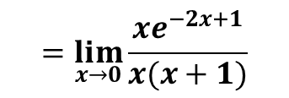
















Example: Q11 Page: 85
Exercise: Q19 Page: 85
$$\lim_{x→0}{\frac{xe^{−2x+1}}{x^{2}+x}}$$
$$\lim_{x→0}{\frac{1−e^{2x}}{1−e^{x}}}$$
Evaluate:
Evaluate:
Solution:
Solution:
$$\lim_{x→0}{\frac{xe^{−2x+1}}{x^{2}+x}}$$
Direct substitution gives $\frac{0}{0} Indeterminate$
$$\lim_{x→0}{\frac{1−e^{2x}}{1−e^{x}}}$$
Direct substitution gives $\frac{0}{0} Indeterminate$
$$\lim_{x→0}{\frac{xe^{−2x+1}}{x^{2}+x}}$$
$$=\lim_{x→0}{\frac{xe^{−2x+1}}{x(x+1)}}$$
$$\lim_{x→0}{\frac{1−e^{2x}}{1−e^{x}}}$$
$$\underset{x→0}{=lim}{\frac{1−{\left(e^{x}\right)}^{2}}{1−e^{x}}}$$
$$=\lim_{x→0}{\frac{e^{−2x+1}}{x+1}}$$
$$\underset{x→0}{=lim}{\frac{(1−e^{x})(1+e^{x})}{1−e^{x}}}$$
$$\underset{x→0}{=lim}{(1+e^{x})}$$
$$=\frac{e^{−2(0)+1}}{0+1}$$
$$=e$$
$$=1+e^{0}$$
$$=1+1=2$$

Slide 20






$$0.707=\frac{1}{\sqrt{2}}=\frac{\sqrt{2}}{2}=\sqrt{\frac{1}{2}}$$
$$0.707=\frac{1}{\sqrt{2}}=\frac{\sqrt{2}}{2}=\sqrt{\frac{1}{2}}$$
$$0.707=\frac{1}{\sqrt{2}}=\frac{\sqrt{2}}{2}=\sqrt{\frac{1}{2}}$$
$$1$$
$$\lim_{x→a^{+}}{f\left(x\right)}=h(a)$$

Slide 22


Slide 23


Exercise: Q21 Page: 95
Determine the interval(s) where $f$ is continuous, for
$$f\left(x\right)=\sqrt{x+3}$$
Solution:
Domain of $f(x)$:
$$x+3$$
$$x+3≥0$$
$x≥−3$
$f(x)$ is defined for $x≥−3$ , $x∈\left[−3,∞)\right.$
$f(x)$ is continuous on $x>−3$ , $x∈(−3,∞)$ Using Theorem 4.1 and Corollary 4.1
Test the endpoint:
$$f\left(−3\right)=\sqrt{−3+3}=0$$
$$\lim_{x→{−3}^{+}}{f(x)}=\lim_{x→{−3}^{+}}{\sqrt{x+3}}=\sqrt{−3+3}=0$$
$$f\left(−3\right)=\lim_{x→{−3}^{+}}{f(x)}$$
$f(x)$ is continuous on $x∈\left[−3,∞)\right.$

Slide 24

Exercise: Q23Page: 95
Determine the interval(s) where $f$ is continuous, for
$$f\left(x\right)=\sqrt[3]{x+2}$$
Solution:
Domain of $f(x)$:
$$x∈ℝ , x∈(−∞,∞)$$
$f(x)$ is defined for $x∈ℝ , x∈(−∞,∞)$
$f(x)$ is continuous on $x∈ℝ , x∈(−∞,∞)$
Using Theorem 4.1 and Corollary 4.1

Slide 25

Exercise: Q25 Page: 95
Determine the interval(s) where $f$ is continuous, for
$$f\left(x\right)=\sin^{−1}(x+2)$$
Solution:
$\sin^{−1}x$ is defined for $−1≤x≤1$
$\sin^{−1}(x+2)$ is defined for $−1≤x+2≤1$
$\sin^{−1}(x+2)$ is defined for $−3≤x≤−1 , x∈\left[−3\right.,\left.−1\right]$
$\sin^{−1}(x+2)$ is continuous on $−3<x<−1 ,$ $x∈(−3,−1)$ Using Theorem 4.1 and Corollary 4.1
Test the endpoint:
$$f\left(−3\right)=\sin^{−1}\left(−3+2\right)=\sin^{−1}(−1)=−\frac{π}{2}$$
$$f\left(−1\right)=\sin^{−1}\left(−1+2\right)=\sin^{−1}(1)=\frac{π}{2}$$
$$\lim_{x→{−3}^{+}}{f(x)}=\lim_{x→{−3}^{+}}{\sin^{−1}(x+2)}$$
$$\lim_{x→{−1}^{−}}{f(x)}=\lim_{x→{−1}^{−}}{\sin^{−1}(x+2)}$$
$$=\sin^{−1}(−3+2)=\sin^{−1}(−1)=−\frac{π}{2}$$
$$=\sin^{−1}(−1+2)=\sin^{−1}(1)=\frac{π}{2}$$
$$f\left(−3\right)=\lim_{x→{−3}^{+}}{f(x)}$$
$$f\left(−1\right)=\lim_{x→{−1}^{−}}{f(x)}$$
$f(x)$ is continuous on $x∈\left[−3\right.,\left.−1\right]$

Slide 26

Exercise: Q27 Page: 95
Determine the interval(s) where $f$ is continuous, for $f\left(x\right)=\frac{\sqrt{x+1}+e^{x}}{x^{2}−2}$
Solution:
Domain of $\sqrt{x+1}$
Zeros of denominator:
Domain of $f\left(x\right):$
$$x+1≥0$$
$$x^{2}−2=0$$
$$x≥−1 ,$$
$$x∈\left[−1\right.,∞)$$
$$x=±\sqrt{2}$$
Domain of $f\left(x\right)=$ $Domain ofnumerator$ $∩$ $Domain ofdenominator$ $− \left\{Zeros \right.\left.of denominator\right\}$
Domain of $f\left(x\right)=(\left[−1\right.,∞)∩ℝ)−\left\{±\right.\left.\sqrt{2}\right\}$
Domain of $f\left(x\right)=\left[−1\right.,∞)−\left\{\left.\sqrt{2}\right\}\right.$
$f\left(x\right)$ is continuous on $(−1,∞)\backslash \left\{\left.\sqrt{2}\right\}\right.$
Test endpoint
$$f\left(−1\right)=\frac{\sqrt{−1+1}+e^{−1}}{{(−1)}^{2}−2}=−\frac{1}{e}$$
$$\lim_{x→{−1}^{+}}{f(x)}=\lim_{x→{−1}^{+}}\left(\frac{\sqrt{x+1}+e^{x}}{x^{2}−2}\right)=\frac{\sqrt{−1+1}+e^{−1}}{{(−1)}^{2}−2}=−\frac{1}{e}$$
$$f\left(−1\right)=\lim_{x→{−1}^{+}}{f(x)}$$
$f(x)$ is continuous on $x∈\left[−1\right.,∞)\backslash \left\{\left.\sqrt{2}\right\}\right.$

Slide 28



Slide 29

Q11 Page: 106
Example:
$$\lim_{ x→−∞}{\frac{−x}{\sqrt{4+x^{2}}}}$$
Evaluate:
Solution:
$$\lim_{ x→−∞}{\frac{−x}{\sqrt{4+x^{2}}}}$$
$$\underset{ x→−∞}{=lim}{\frac{1}{\sqrt{\frac{4}{x^{2}}+1}}}$$
, $\frac{4}{x^{2}}→0$
As $x→−∞$
$$\underset{ x→−∞}{=lim}{\frac{−x}{\sqrt{x^{2}\left(\frac{4}{x^{2}}+1\right)}}}$$
$$=\frac{1}{\sqrt{0+1}}=1$$
$$\sqrt{x^{2}}=|x|$$
$$\underset{ x→−∞}{=lim}{\frac{−x}{|x|∙\sqrt{\frac{4}{x^{2}}+1}}}$$
$$\left|x\right|=\left\{\begin{aligned}x, x> 0 \\ −x, x<0\end{aligned}\right.$$
The function $y=\frac{−x}{\sqrt{4+x^{2}}}$ has horizontal asymptote $y=1$
$$\lim_{ x→−∞}{\frac{−x}{−x∙\sqrt{\frac{4}{x^{2}}+1}}}$$

Slide 30


Example: Q12 Page: 106
$$\lim_{ x→∞}{\frac{{2x}^{2}−1}{{4x}^{3}−5x−1}}$$
Evaluate:
Solution:
Divide both numerator and denominator by the highest power in the denominator
$$=\lim_{x→∞}{\frac{\frac{{2x}^{2}−1}{x^{3}}}{\frac{{4x}^{3}−5x−1}{x^{3}}}}$$
$$\lim_{ x→∞}{\frac{{2x}^{2}−1}{{4x}^{3}−5x−1}}$$
$$\underset{x→∞}{=lim}{\frac{\frac{2}{x}−\frac{1}{x^{3}}}{4−\frac{5}{x^{2}}−\frac{1}{x^{3}}}}$$
Result:
$\lim_{x→±∞}{\frac{p(x)}{q(x)}}=0$ Where $p\left(x\right)$ and $q(x)$ are polynomials
$$degree of p\left(x\right)<degree of q(x)$$
Using Theorem 5.1
$$= \frac{0}{4} = 0$$
$$deg=2$$
$$\lim_{x→∞}{\frac{{2x}^{2}−1}{{4x}^{3}−5x−1}}$$
$$=0$$
$$deg=3$$
The function$f(x)=\frac{{2x}^{2}−1}{{4x}^{3}−5x−1}$has horizontal asymptote $y=0$

Slide 31


Q15 Page: 106
Exercise:
$$\lim_{x→0^{+}}{e^{− \frac{2}{x^{2}}}}$$
Evaluate:
Solution:
$$\lim_{x→0^{+}}{e^{− \frac{2}{x^{2}}}}$$
Let $u=\frac{2}{x^{2}}$
$$x→0^{+}$$
Then
$$u→∞$$
$$\lim_{x→0^{+}}{e^{− \frac{2}{x^{2}}}}$$
$$\underset{ u→∞}{=lim}{e^{−u}}$$
$$=0$$

Slide 32

Q16 Page: 106
Exercise:
$$\lim_{ x→∞}{e^{− \frac{x+1}{x^{2}+2}}}$$
Evaluate:
Solution:
$$\lim_{ x→∞}{e^{− \frac{x+1}{x^{2}+2}}}$$
Let $u=\frac{x+1}{x^{2}+2}$
$$x→∞$$
Then
$$u→0$$
$$\lim_{ x→∞}{e^{− \frac{x+1}{x^{2}+2}}}$$
$$=\lim_{u→0}{e^{−u}}=e^{−0} =1$$
The function $y=e^{− \frac{x+1}{x^{2}+2}}$ has horizontal asymptote $y=1$

Slide 33


Q21 Page: 106
Exercise:
Evaluate:
$$\lim_{x→\frac{π}{2}}{e^{−tanx}}$$
Solution:
$$y=tanx$$
From the graph of $y=tanx$
$$\lim_{x→{\frac{π}{2}}^{+}}{tanx=−∞}$$
$$\lim_{ x→{\frac{π}{2}}^{−}}{tanx=∞}$$
To find
$$\lim_{x→\frac{π}{2}}{e^{−tanx}}$$
We need to find one-sided limits
Let $u=tanx$
Let $u=tanx$
$$x→{\frac{π}{2}}^{+}$$
$$x→{\frac{π}{2}}^{−}$$
Then
$$u→∞$$
Then
$$u→−∞$$
$$\lim_{x→{\frac{π}{2}}^{+}}{e^{−tanx}}$$
$$=\lim_{u→−∞}{e^{−u}}=∞$$
$$\lim_{ x→{\frac{π}{2}}^{−}}{e^{−tanx}}$$
$$=\lim_{u→∞}{e^{−u}}=0$$
$$\lim_{x→{\frac{π}{2}}^{+}}{e^{−tanx}}≠\lim_{ x→{\frac{π}{2}}^{−}}{e^{−tanx}}$$
$$\lim_{x→\frac{π}{2}}{e^{−tanx}} does not exist$$

Slide 35


Slide 36


Slide 37


Slide 39


Slide 40

Exercise: Q3 Page: 141
Find an equation of the tangent line to $y=x^{2}−3x$at $x=−2$
Solution:
$$m_{tan}=\lim_{h→0}{\frac{f\left(a+h\right)−f(a)}{h}}$$
Equation of tangent line at $\left(a, f\left(a\right)\right):$
$$m_{tan}=\lim_{h→0}{\frac{f\left(−2+h\right)−f(−2)}{h}}$$
$$y=m_{tan}\left(x−a\right)+f(a)$$
$$=\lim_{h→0}{\frac{\left[{(−2+h)}^{2}−3(−2+h)\right]−\left[{(−2)}^{2}−3(−2)\right]}{h}}$$
at $x=−2$ $y={(−2)}^{2}−3(−2)=10$
$$=\lim_{h→0}{\frac{4−4h+h^{2}+6−3h−10}{h}}$$
at point $(−2,10)$
$$=\lim_{h→0}{\frac{−4h+h^{2}−3h}{h}=\lim_{h→0}{\frac{h^{2}−7h}{h}}}$$
$$y=−7\left(x+2\right)+10$$
$$=\lim_{h→0}{\frac{h(h−7)}{h}}$$
$$y=−7x−14+10$$
$$y=−7x−4$$
$$=\lim_{h→0}\left(h−7\right)$$
$$m_{tan}=0−7=−7$$

Slide 41

Example: Q5 Page: 141
Find an equation of the tangent line to $y=\frac{2}{x+1}$at $x=1$
Solution:
$$m_{tan}=\lim_{h→0}{\frac{f\left(a+h\right)−f(a)}{h}}$$
Equation of tangent line at $\left(a, f\left(a\right)\right):$
$$m_{tan}=\lim_{h→0}{\frac{f\left(1+h\right)−f(1)}{h}}$$
$$y=m_{tan}\left(x−a\right)+f(a)$$
$$=\lim_{h→0}{\frac{\frac{2}{1+h+1}−\frac{2}{1+1}}{h}}$$
at $x=1 then y=\frac{2}{1+1}=1$
$$=\lim_{h→0}{\frac{\frac{2}{2+h}−1}{h}}$$
at point $(1,1)$
$$=\lim_{h→0}{\frac{\frac{2}{2+h}−1∙ \frac{2+h}{2+h}}{h}=\lim_{h→0}{\frac{\frac{2}{2+h}− \frac{2+h}{2+h}}{h}}}$$
$$y=\frac{−1}{2}\left(x−1\right)+1$$
$$\underset{h→0}{=lim}{\frac{\frac{2−2−h}{2+h}}{h}} =\lim_{h→0}{\frac{−h}{h(2+h)}}$$
$$y=−\frac{1}{2}x+\frac{1}{2}+1$$
$$=\lim_{h→0}{\frac{−1}{(2+h)}}$$
$$y=−\frac{1}{2}x+\frac{3}{2}$$
$$m_{tan}=\frac{−1}{2+0}=\frac{−1}{2}$$

Slide 42

Exercise: Q7 Page: 141
Find an equation of the tangent line to$f\left(x\right)=\sqrt{x+3}$ at $x=−2$
Solution:
$$m_{tan}=\lim_{h→0}{\frac{f\left(a+h\right)−f(a)}{h}}$$
Equation of tangent line at $\left(a, f\left(a\right)\right):$
$$m_{tan}=\lim_{h→0}{\frac{f\left(−2+h\right)−f(−2)}{h}}$$
$$y=m_{tan}\left(x−a\right)+f(a)$$
$$=\lim_{h→0}{\frac{\sqrt{−2+h+3}−\sqrt{−2+3}}{h}}$$
at $x=−2$ then $y=\sqrt{−2+3}=1$
$$=\lim_{h→0}{\frac{\sqrt{1+h}−1}{h}}$$
$$∙\frac{\sqrt{1+h}+1}{\sqrt{1+h}+1}$$
at point $(−2,1)$
$$y=\frac{1}{2}\left(x+2\right)+1$$
$$=\lim_{h→0}{\frac{1+h−1}{h(\sqrt{1+h}+1)}=\lim_{h→0}{\frac{h}{h(\sqrt{1+h}+1)}}}$$
$$y=\frac{1}{2}x+1+1$$
$$=\lim_{h→0}{\frac{1}{\sqrt{1+h}+1}}$$
$$y=\frac{1}{2}x+2$$
$$m_{tan}=\frac{1}{\sqrt{1+0}+1}=\frac{1}{2}$$

Slide 44



Slide 45


Slide 46












Exercise: Q13 Page: 151
Given the graph of $f\left(x\right)$ sketch a plausible graph of derivative $f^{′}\left(x\right)$
Solution:
Analyze the behavior of $f(x)$, discontinuities, and turning points
For $x<0$:
The function is leveling out (decreasing)
Slope of tangent is negative
Derivative: negative
For $x>0$:
The function is rising (increasing)
Slope of tangent is positive
Derivative: positive
Turning Points:
At $x=0$:
The function has a horizontal tangent
Slope of tangent$=0$
Derivative= zero
$$f\left(x\right)$$
decreasing
increasing
$$0$$
$$f^{′}\left(x\right)$$
_____
0
+++
$$0$$

Slide 47



















Example: Q15 Page: 151
Given the graph of $f\left(x\right)$ sketch a plausible graph of derivative $f^{′}\left(x\right)$
Solution:
Analyze the behavior of $f(x)$, discontinuities, and turning points
The function is leveling out (decreasing)
Slope of tangent is negative
Derivative: negative
At $x=−2$:
The function has Vertical Asymptote
$$x→{−2}^{−}$$
tangent get much steep with negative slope
$$→−∞$$
$$x→{−2}^{+}$$
tangent get much steep with negative slope
$$→−∞$$
At $x=2$:
The function has Vertical Asymptote
$$f\left(x\right)$$
decreasing
decreasing
decreasing
$$x→2^{−}$$
tangent get much steep with negative slope
$$→−∞$$
$$−2$$
$$2$$
_____
_____
_____
$$x→2^{+}$$
tangent get much steep with negative slope
$$f^{′}\left(x\right)$$
$$→−∞$$
$$−2$$
$$2$$

Slide 48











Exercise: Q16 Page: 151
Given the graph of $f\left(x\right)$ sketch a plausible graph of derivative $f^{′}\left(x\right)$
Solution:
Analyze the behavior of $f(x)$, discontinuities, and turning points
For $x<1$:
The function is rising (increasing)
Slope of tangent is positive
Derivative: positive
Slope of tangent is constant (Linear Function)
For $x>1$:
The function is leveling out (decreasing)
Slope of tangent is negative
Derivative: negative
Slope of tangent is constant (Linear Function)
At $x=1$:
The function has jump discontinuity(not differentiable)
Slope of tangent as $x→1^{−}$ $≠$ Slope of tangent as $x→1^{+}$
increasing
decreasing
$$f\left(x\right)$$
The function is not differentiable at $x=1$
$$1$$
+++
_____
$$f^{′}\left(x\right)$$
0
$$1$$

Slide 49












Exercise: Q17 Page:151
Given the graph of $f^{′}\left(x\right)$sketch a plausible graph of function $f\left(x\right)$
Solution:
Analyze the graph of$f^{′}\left(x\right):$
The Derivative does not exist at $x=0$, $x=2$
_____
+++
Constant
Constant
0
x
x
$$f^{′}\left(x\right)$$
$$−3$$
$$0$$
$$2$$
Linear
Slope=2
Linear
Slope=1
decreasing
increasing
$$f\left(x\right)$$
$$−3$$
$$0$$
$$2$$
Turning point at $x=−3$
Corner: at $x=0,x=2$

Slide 51


Slide 52


Finding the Equation of the Tangent Line
Example: Q33 Page: 161
Determine the value(s) of $x$ for which the tangent line to $y=f(x)$ is horizontal
Determine the value(s) of $x$ for which the tangent line to $y=f(x)$ intersects the $x−axis$ at a $45°$angle
$$f\left(x\right)=x^{3}−3x+1$$
Solution:
Tangent line intersects $x−axis$ at a $45°$angle:
Slope of horizontal tangent $=0$
Slope of tangent$=\tan\left(45°\right)=1$
Slope of tangent for $f(x)$ at $x_{0}=f′(x_{0})$
Find values of $x$ for which $f^{′}\left(x_{0}\right)=1$
Find values of $x$ for which $f^{′}\left(x\right)=0$
$$f\left(x\right)=x^{3}−3x+1$$
$$f\left(x\right)=x^{3}−3x+1$$
$$f′\left(x\right)=3x^{2}−3$$
$$f′\left(x\right)=3x^{2}−3$$
$$3x^{2}−3=1$$
$$3x^{2}−3=0$$
$$3x^{2}=4$$
$$3x^{2}=3$$
$$x^{2}=\frac{4}{3}$$
$$x^{2}=1$$
$$x=±\frac{2}{\sqrt{3}}$$
$$x=±1$$

Slide 53


Finding the Equation of the Tangent Line
Exercise: Q34 Page: 161
Determine the value(s) of $x$ for which the tangent line to $y=f(x)$ is horizontal
Determine the value(s) of $x$ for which the tangent line to $y=f(x)$ intersects the $x−axis$ at a $45°$angle
$$f\left(x\right)=x^{4}−4x+2$$
Solution:
b. Tangent line intersects $x−axis$ at a $45°$angle:
a. Slope of horizontal tangent $=0$
Slope of tangent$=\tan\left(45°\right)=1$
Slope of tangent for $f(x)$ at $x_{0}=f′(x_{0})$
Find values of $x$ for which $f^{′}\left(x\right)=1$
Find values of $x$ for which $f^{′}\left(x\right)=0$
$$f\left(x\right)=x^{4}−4x+2$$
$$f\left(x\right)=x^{4}−4x+2$$
$$f′\left(x\right)=4x^{3}−4$$
$$f′\left(x\right)=4x^{3}−4$$
$$4x^{3}−4=1$$
$$4x^{3}−4=0$$
$$4x^{3}=5$$
$$x^{3}=\frac{5}{4}$$
$$4x^{3}=4$$
$$x^{3}=1$$
$$x=\sqrt[3]{\frac{5}{4}}$$
$$x=1$$

Slide 54

Slope of Tangent Line Does Not Exist
Example: Q35 Page: 161
Determine the value of $x$ for which the slope of the tangent line to $y=f\left(x\right)$ does not exist
$f\left(x\right)=x^{\frac{2}{3}}$
Solution:
From the graph:
$$f\left(x\right)=x^{\frac{2}{3}}$$
Vertical tangent at $x=0$
$$f^{′}\left(x\right)=\frac{2}{3}x^{− \frac{1}{3}}$$
$$f^{′}\left(x\right)=\frac{2}{3\sqrt[3]{x}}$$
The derivative is undefined at $x=0$
No tangent line at $x=0$

Slide 55

Slope of Tangent Line Does Not Exist
Exercise: Q35 Page: 161
Determine the value of $x$ for which the slope of the tangent line to $y=f\left(x\right)$ does not exist
b. $f\left(x\right)=|x−5|$
Solution:
From the graph:
$$f\left(x\right)=|x−5|$$
Sharp Corner at $x=0$
$$f\left(x\right)=\left\{\begin{aligned}x−5, x≥5 \\ 5−x,x<5\end{aligned}\right.$$
$$f′\left(x\right)=\left\{\begin{aligned}1, x>5 \\ −1,x<5\end{aligned}\right.$$
The derivative is undefined at $x=5$
No tangent line at $x=5$

Slide 56

Slope of Tangent Line Does Not Exist
Exercise: Q35 Page: 161
Determine the value of $x$ for which the slope of the tangent line to $y=f\left(x\right)$ does not exist
c. $f\left(x\right)=|x^{2}−3x−4|$
Solution:
$$f\left(x\right)=|x^{2}−3x−4|$$
The derivative is undefined at $x=−1,x=4$
$$x^{2}−3x−4=0$$
No tangent line at$x=−1,x=4$
$$\left(x−4\right)\left(x+1\right)=0$$
$$x=4, x=−1$$
$$f\left(x\right)=\left\{\begin{aligned}x^{2}−3x−4, x≤−1 \\ {−x}^{2}+3x+4, −1<x≤4 \\ x^{2}−3x−4, x>4\end{aligned}\right.$$
$$f′\left(x\right)=\left\{\begin{aligned}2x−3, x<−1 \\ −2x+3, −1<x<4 \\ 2x−3, x>4\end{aligned}\right.$$

Slide 58


Slide 59
Finding the Derivative of a Sum
Exercise: Q1, Q5 Page: 160
$$,f\left(w\right)=\frac{3}{w}−8w+1$$
Find the derivative of the following functions:
$$f(x)=x^{3}−2x+1$$
Solution:
$$f\left(w\right)=\frac{3}{w}−8w+1$$
$$f\left(x\right)=x^{3}−2x+1$$
$$f^{′}\left(x\right)=\frac{d}{dx}\left(x^{3}\right)+\frac{d}{dx}\left(−2x\right)+\frac{d}{dx}\left(1\right)$$
$$f^{′}\left(w\right)=\frac{d}{dw}\left(\frac{3}{w}\right)+\frac{d}{dw}\left(−8w\right)+\frac{d}{dw}\left(1\right)$$
$$f^{′}\left(w\right)=3\frac{d}{dw}\left(w^{−1}\right)−8\frac{d}{dw}\left(w\right)+\frac{d}{dw}\left(1\right)$$
$$f^{′}\left(x\right)=\frac{d}{dx}\left(x^{3}\right)−2\frac{d}{dx}\left(x\right)+\frac{d}{dx}\left(1\right)$$
$$f^{′}\left(w\right)=3\left(−1w^{−2}\right)−8\left(1\right)+0$$
$$f^{′}\left(x\right)=3x^{2}−2(1)+0$$
$$f^{′}\left(w\right)=−3w^{−2}−8$$
$$f^{′}\left(x\right)=3x^{2}−2$$
$f^{′}\left(w\right)=−\frac{3}{w^{2}}−8$

Slide 60
Rewriting a Function before Computing the Derivatives
Exercise: Q11, Q13 Page: 160
$$f(x)=\frac{3x^{2}−3x+1}{x}$$
Find the derivative of the following functions:
$$, f\left(x\right)=x(3x^{2}−\sqrt{x})$$
Solution:
$$f\left(x\right)=\frac{3x^{2}−3x+1}{x}$$
$$f\left(x\right)=x(3x^{2}−\sqrt{x})$$
$$f\left(x\right)=\frac{3x^{2}}{x}−\frac{3x}{x}+\frac{1}{x}$$
$$f\left(x\right)=x(3x^{2}−x^{\frac{1}{2}})$$
$$f\left(x\right)=3x^{3}−x^{\frac{3}{2}}$$
$$f\left(x\right)=3x−3+x^{−1}$$
$$f^{′}\left(x\right)=3\left(3x^{2}\right)−\frac{3}{2}x^{\frac{1}{2}}$$
$$f^{′}\left(x\right)=3−0−1x^{−2}$$
$$f^{′}\left(x\right)=9x^{2}−\frac{3\sqrt{x}}{2}$$
$$f^{′}\left(x\right)=3−\frac{1}{x^{2}}$$

Slide 62


Slide 63

Derivatives of Trigonometric Functions
The derivatives of all six trigonometric functions are:
$$\frac{d}{dx}sinx$$
$$\frac{d}{dx}cosx$$
$$=cosx$$
$$=−sinx$$
$$\frac{d}{dx}tanx$$
$$\frac{d}{dx}cotx$$
$$=\sec^{2}x$$
$$={−csc}^{2}x$$
$$\frac{d}{dx}secx$$
$$\frac{d}{dx}cscx$$
$$=secx tanx$$
$$=−cscx cotx$$

Slide 64
The Derivatives of Some Similar Trigonometric Functions
6.3 Page: 182
Find the derivative of:$f\left(x\right)={cosx}^{3} , f\left(x\right)=\cos^{3}x , f\left(x\right)=cos3x$
Example
Exercise
Exercise
Solution:
$$f\left(x\right)={cosx}^{3}$$
$$={cos⁡(x}^{3})$$
$$f\left(x\right)=\cos^{3}x$$
$$={(cosx)}^{3}$$
$$f\left(x\right)=cos3x$$
$$=cos⁡(3x)$$
Using chain rule
Using chain rule
Using chain rule
$$∙\frac{d}{dx}\left[x^{3}\right]$$
$$∙\frac{d}{dx}\left[cosx\right]$$
$$f^{′}\left(x\right)=$$
$$−sin⁡(3x)$$
$$∙\frac{d}{dx}\left[3x\right]$$
$$f^{′}\left(x\right)=$$
$${−sin⁡(x}^{3})$$
$$f^{′}\left(x\right)=$$
$$3{(cosx)}^{2}$$
Derivative
of Outside
Derivative
of Inside
Derivative
of Outside
Derivative
of Inside
Derivative
of Outside
Derivative
of Inside
$$f^{′}\left(x\right)={−sin⁡(x}^{3})∙3x^{2}$$
$$f^{′}\left(x\right)=3{(cosx)}^{2}∙−sinx$$
$$f^{′}\left(x\right)=−sin⁡(3x)∙(3)$$
$$f^{′}\left(x\right)={−3x^{2}sin⁡(x}^{3})$$
$$f^{′}\left(x\right)=−3\cos^{2}x sinx$$
$$f^{′}\left(x\right)=−3sin⁡(3x)$$

Slide 66


Slide 67
Derivatives of Logarithms
Exercise: Q13, Q15, Q17 Page: 193
$$f\left(x\right)=ln2x$$
$$f\left(t\right)=ln(t^{3}+3t)$$
$$f\left(x\right)=ln(cosx)$$
Find the derivative of:
Solution:
$$f\left(x\right)=ln(2x)$$
Using Chain Rule
$$f\left(t\right)=ln(t^{3}+3t)$$
Using Chain Rule
$$f\left(x\right)=ln(cosx)$$
Using Chain Rule
$$\frac{d}{dx}\left[2x\right]$$
$$\frac{d}{dt}\left[t^{3}+3t\right]$$
$$\frac{d}{dx}\left[cosx\right]$$
$$f^{′}\left(x\right)=$$
$$f^{′}\left(t\right)=$$
$$f^{′}\left(x\right)=$$
$$2x$$
$$t^{3}+3t$$
$$cosx$$
$$f^{′}\left(x\right)=\frac{2}{2x}$$
$$=\frac{1}{x}$$
$$f^{′}\left(t\right)=\frac{{3t}^{2}+3}{t^{3}+3t}$$
$$f^{′}\left(x\right)=\frac{−sinx}{cosx}$$
$$=−tanx$$

Slide 68
Derivatives of Logarithms
Exercise: Q19Page: 193
Find the derivative of:
$$f\left(x\right)=sin(lnx^{2})$$
Solution:
$$f\left(x\right)=sin(lnx^{2})$$
Using Chain Rule
$$f^{′}\left(x\right)=cos(lnx^{2})$$
$$∙\frac{d}{dx}\left[lnx^{2}\right]$$
Derivative of Outside
Derivative of Inside
$$f^{′}\left(x\right)=cos(lnx^{2})∙\frac{d}{dx}\left[2lnx\right]$$
$$f^{′}\left(x\right)=cos(lnx^{2})∙(2)\frac{d}{dx}\left[lnx\right]$$
Using Theorem 7.4
$$f^{′}\left(x\right)=cos(lnx^{2})∙(2)∙\frac{1}{x}$$
$$f^{′}\left(x\right)=\frac{2cos(lnx^{2})}{x}$$

Slide 69
Derivatives of Logarithms
Exercise: Q20 Page: 193
$$a. f\left(x\right)=\frac{\sqrt{lnx}}{x}$$
Find the derivative of:
Solution:
$$∙\frac{2\sqrt{lnx}}{2\sqrt{lnx}}$$
$$f\left(x\right)=\frac{\sqrt{lnx}}{x}$$
$$f^{′}\left(x\right)=\frac{\frac{1}{2\sqrt{lnx}}−\sqrt{lnx} }{x^{2}}$$
Using Quotient Rule
$$\frac{d}{dx}\left[\sqrt{lnx}\right]$$
$$− \sqrt{lnx}$$
$$∙\frac{d}{dx}\left[x\right]$$
$$∙x$$
$$f^{′}\left(x\right)=$$
$$\frac{d}{dx}\left[lnx\right]$$
$$x^{2}$$
$$f^{′}\left(x\right)=\frac{\frac{1}{2\sqrt{lnx}}−\frac{2lnx}{2\sqrt{lnx}}}{x^{2}}$$
$$2\sqrt{lnx}$$
$$∙x$$
$$− \sqrt{lnx}$$
$$∙(1)$$
$$f^{′}\left(x\right)=$$
$$x^{2}$$
$$f^{′}\left(x\right)=\frac{\frac{\frac{1}{x}}{2\sqrt{lnx}}∙x−\sqrt{lnx}∙(1)}{x^{2}}$$
$$f^{′}\left(x\right)=\frac{1−2lnx}{2x^{2}\sqrt{lnx}}$$
$$f^{′}\left(x\right)=\frac{\frac{1}{2\sqrt{lnx}}−\sqrt{lnx}}{x^{2}}$$

Slide 70
Derivatives of Logarithms
Exercise: Q20 Page: 193
Find the derivative of:
b. $g\left(t\right)=\frac{ln\sqrt{t}}{t}$
Solution:
$$g\left(t\right)=\frac{ln\sqrt{t}}{t}$$
Using Quotient Rule
$$\frac{d}{dt}\left[ln\sqrt{t}\right]$$
$$∙\frac{d}{dt}\left[t\right]$$
$$g′\left(t\right)=\frac{\frac{1}{2}−ln\sqrt{t}}{t^{2}}$$
$$∙t$$
$$−ln\sqrt{t}$$
$$g′(t)=$$
$$t^{2}$$
$$\frac{d}{dt}\left[ln\left(t^{\frac{1}{2}}\right)\right]$$
$$−ln\sqrt{t}$$
$$∙(1)$$
$$g′\left(t\right)=\frac{\frac{1}{2}−ln\sqrt{t}∙\frac{2}{2}}{t^{2}}$$
$$∙t$$
$$g′\left(t\right)=$$
$$t^{2}$$
Using properties of logarithms
$$g′\left(t\right)=\frac{1−2ln\sqrt{t}}{2t^{2}}$$
$$lna^{b}=b∙lna$$
$$g^{′}\left(t\right)=\frac{\frac{1}{2}\frac{d}{dt}\left[lnt\right]∙t−ln\sqrt{t}}{t^{2}}$$
$$g′(t)=\frac{\frac{1}{2}∙\frac{1}{t}∙t−ln\sqrt{t}}{t^{2}}$$

Slide 72


Slide 73
Logarithmic Differentiation
Exercise: Q39 Page: 194
Find the derivative of:
$$f\left(x\right)=x^{sinx}$$
Solution:
$$f\left(x\right)=x^{sinx}$$
is not a power function because the exponent is not a constant.
It is not an exponential function because the base is not a constant.
$$f\left(x\right)=x^{sinx}$$
Take natural logarithm of both sides
$$\frac{f′(x)}{f(x)}cosx∙lnx+sinx∙\frac{1}{x}$$
$$ln\left[f\left(x\right)\right]=ln\left(x^{sinx}\right)$$
Using properties of logarithms
$$\frac{f^{′}\left(x\right)}{f\left(x\right)}=cosxlnx+\frac{sinx}{x}$$
$$ln\left[f\left(x\right)\right]=sinxlnx$$
Differentiate both sides
$$f^{′}\left(x\right)=\left(cosxlnx+\frac{sinx}{x}\right)f(x)$$
Using
Product Rule
Substitute $f\left(x\right)=x^{sinx}$
Using
Chain Rule
$$f^{′}\left(x\right)=\left(cosxlnx+\frac{sinx}{x}\right)x^{sinx}$$
$$\frac{\frac{d}{dx}\left[f\left(x\right)\right]}{f(x)}$$
$$=\frac{d}{dx}\left[sinx\right]∙lnx+sinx∙\frac{d}{dx}\left[lnx\right]$$
$$f^{′}\left(x\right)=\left(\frac{xcosxlnx+sinx}{x}\right)x^{sinx}$$

Slide 74
Logarithmic Differentiation
Exercise: Q41 Page: 194
Find the derivative of:
$$f\left(x\right)={(sinx)}^{x}$$
Solution:
$$f\left(x\right)={(sinx)}^{x}$$
is not a power function because the exponent is not a constant.
It is not an exponential function because the base is not a constant.
$$\frac{f′(x)}{f(x)}=(1)∙ln(sinx)+x∙\frac{\frac{d}{dx}\left[sinx\right]}{sinx}$$
$$f\left(x\right)={(sinx)}^{x}$$
Take natural logarithm of both sides
$$ln\left[f\left(x\right)\right]=ln\left[{(sinx)}^{x}\right]$$
Using properties of logarithms
$$\frac{f′(x)}{f(x)}=ln(sinx)+x∙\frac{cosx}{sinx}$$
$$ln\left[f\left(x\right)\right]=x∙ln(sinx)$$
Differentiate both sides
$$\frac{f′(x)}{f(x)}=ln(sinx)+x∙cotx$$
Using
Chain Rule
Using
Product Rule
$$f^{′}\left(x\right)=\left(ln(sinx)+x∙cotx\right)f(x)$$
$$\frac{\frac{d}{dx}\left[f\left(x\right)\right]}{f(x)}$$
$$=\frac{d}{dx}\left[x\right]∙ln(sinx)+x∙\frac{d}{dx}\left[ln(sinx)\right]$$
Substitute $f\left(x\right)={(sinx)}^{x}$
$$f^{′}\left(x\right)=\left(ln(sinx)+x∙cotx\right){∙(sinx)}^{x}$$
Using Chain Rule

Slide 75
Logarithmic Differentiation
Exercise: Q43, Q44 Page: 194
Find the derivative of:
$$f\left(x\right)=x^{\sqrt{x}}$$
$$f\left(x\right)=x^{lnx}$$
Solution:
$$f\left(x\right)=x^{\sqrt{x}}$$
$$f\left(x\right)=x^{lnx}$$
Take natural logarithm of both sides
Take natural logarithm of both sides
$$ln\left[f\left(x\right)\right]=ln\left(x^{lnx}\right)$$
Using properties of logarithms
$$ln\left[f\left(x\right)\right]=ln\left(x^{\sqrt{x}}\right)$$
Using properties of logarithms
Differentiate both sides
$$ln\left[f\left(x\right)\right]=lnx∙lnx$$
$$ln\left[f\left(x\right)\right]=\sqrt{x}lnx$$
$$ln\left[f\left(x\right)\right]={\left(lnx\right)}^{2}$$
Differentiate both sides Using Chain Rule
$$\frac{\frac{d}{dx}\left[f\left(x\right)\right]}{f(x)}$$
$$=\frac{d}{dx}\left[\sqrt{x}\right]∙lnx+\sqrt{x}∙\frac{d}{dx}\left[lnx\right]$$
$$\frac{\frac{d}{dx}\left[f\left(x\right)\right]}{f(x)}=2lnx∙\frac{d}{dx}\left[lnx\right]$$
$$\frac{f′(x)}{f(x)}=\frac{1}{2\sqrt{x}}∙lnx+\sqrt{x}∙\frac{1}{x}$$
$$\frac{f′(x)}{f(x)}=2lnx∙\frac{1}{x}$$
$$\frac{f^{′}\left(x\right)}{f\left(x\right)}=\frac{lnx}{2\sqrt{x}}+\frac{1}{\sqrt{x}}$$
$$\frac{f^{′}\left(x\right)}{f\left(x\right)}=\frac{2lnx}{x}$$
$$f^{′}\left(x\right)=\left(\frac{lnx}{2\sqrt{x}}+\frac{1}{\sqrt{x}}\right)f(x)$$
Substitute $f\left(x\right)=x^{\sqrt{x}}$
$$f^{′}\left(x\right)=\left(\frac{2lnx}{x}\right)f(x)$$
Substitute $f\left(x\right)=x^{lnx}$
$$f^{′}\left(x\right)=\left(\frac{lnx}{2\sqrt{x}}+\frac{1}{\sqrt{x}}\right)x^{\sqrt{x}}$$
$$f^{′}\left(x\right)=\left(\frac{2lnx}{x}\right)x^{lnx}$$

Slide 77



Slide 78
Finding the Derivative of an Inverse Trigonometric Function
Exercise: Q29(a), Q30(a) Page: 204
Find the derivative of the given function
$$f\left(x\right)=\sin^{−1}(x^{3}+1)$$
$$f\left(x\right)=\cos^{−1}(x^{2}+x)$$
Solution:
$$f\left(x\right)=\sin^{−1}(x^{3}+1)$$
$$f\left(x\right)=\cos^{−1}(x^{2}+x)$$
Using Chain Rule
Using Chain Rule
$$f^{′}\left(x\right)=\frac{1}{\sqrt{1−{(x^{3}+1)}^{2}}}$$
$$∙\frac{d}{dx}\left[x^{3}+1\right]$$
$$f^{′}\left(x\right)=\frac{−1}{\sqrt{1−{(x^{2}+x)}^{2}}}$$
$$∙\frac{d}{dx}\left[x^{2}+x\right]$$
Derivative of Outside
Derivative of Inside
Derivative of Outside
Derivative of Inside
$$f^{′}\left(x\right)=\frac{1}{\sqrt{1−{(x^{3}+1)}^{2}}}∙3x^{2}$$
$$f^{′}\left(x\right)=\frac{−1}{\sqrt{1−{(x^{2}+x)}^{2}}}∙(2x+1)$$
$$f^{′}\left(x\right)=\frac{−2x−1}{\sqrt{1−{(x^{2}+x)}^{2}}}$$
$$f^{′}\left(x\right)=\frac{3x^{2}}{\sqrt{1−{(x^{3}+1)}^{2}}}$$

Slide 79
Finding the Derivative of an Inverse Trigonometric Function
Exercise: Q32(a), Q33(b) Page: 204
Find the derivative of the given function
$$f\left(x\right)=\sqrt{2+\tan^{−1}x}$$
$$f\left(x\right)=4\sec^{−1}(x^{4})$$
Solution:
$$f\left(x\right)=\sqrt{2+\tan^{−1}x}$$
Using Chain Rule
$$f\left(x\right)=4\sec^{−1}(x^{4})$$
$$\frac{d}{dx}\left[2+\tan^{−1}x\right]$$
$$f′\left(x\right)=4∙\frac{d}{dx}\left[\sec^{−1}(x^{4})\right]$$
Using Chain Rule
$$f^{′}\left(x\right)=$$
$$2\sqrt{2+\tan^{−1}x}$$
$$f′\left(x\right)=4∙\frac{1}{|x^{4}|\sqrt{{(x^{4})}^{2}−1}}$$
$$∙\frac{d}{dx}\left[x^{4}\right]$$
$$\frac{d}{dx}\left[2\right]+\frac{d}{dx}\left[\tan^{−1}x\right]$$
$$f^{′}\left(x\right)=$$
Derivative of Outside
Derivative of Inside
$$2\sqrt{2+\tan^{−1}x}$$
$$f^{′}\left(x\right)=\frac{0+\frac{1}{1+x^{2}}}{2\sqrt{2+\tan^{−1}x}}$$
$$f′\left(x\right)=\frac{4}{x^{4}\sqrt{x^{8}−1}}∙{4x}^{3}$$
$$f^{′}\left(x\right)=\frac{{16x}^{3}}{x^{4}\sqrt{x^{8}−1}}$$
$$f^{′}\left(x\right)=\frac{1}{2(1+x^{2})\sqrt{2+\tan^{−1}x}}$$
$$=\frac{16}{x\sqrt{x^{8}−1}}$$

Slide 81


Slide 82






















Implicit Differentiation
Example: Q5 Page: 204
Find the derivative $y′(x)$ implicitly
$$x^{2}y^{2}+3y=4x$$
Solution:
$$x^{2}y^{2}+3y=4x$$
$$2xy^{2}+x^{2}∙(2y)∙y′(x)+(3)∙y′(x)=4$$
Differentiate Implicitly
$$\frac{d}{dx}\left[x^{2}y^{2}+3y\right]=\frac{d}{dx}\left[4x\right]$$
$$2xy^{2}+2x^{2}yy′(x)+3y′(x)=4$$
Collect terms with$y′(x)$on one side
$$\frac{d}{dx}\left[x^{2}y^{2}\right]+\frac{d}{dx}\left[3y\right]=\frac{d}{dx}\left[4x\right]$$
$$2x^{2}yy′(x)+3y′(x)=4−2xy^{2}$$
Factor out$y′(x)$
Using Product Rule
$$y′(x)(2x^{2}y+3)=4−2xy^{2}$$
$$\frac{d}{dx}\left[x^{2}\right]∙y^{2}$$
$$+x^{2}∙\frac{d}{dx}\left[y^{2}\right]$$
$$+\frac{d}{dx}\left[3y\right]$$
$$=4$$
$$\frac{d}{dx}g\left(y\right)=g^{′}\left(y\right)y′(x)$$
Solve for $y′(x)$
$$y′(x)=\frac{4−2xy^{2}}{2x^{2}y+3}$$
Use Chain Rule
Use Chain Rule
$$+x^{2}∙\frac{d}{dy}\left[y^{2}\right]∙\frac{dy}{dx}$$
$$+\frac{d}{dy}\left[3y\right]∙\frac{dy}{dx}$$
$$(2x)∙y^{2}$$
$$=4$$

Slide 83





















Implicit Differentiation
Exercise: Q7 Page: 204
Find the derivative $y′(x)$ implicitly
$$\sqrt{xy}−4y^{2}=12$$
Solution:
$$(1)∙y+x∙(1)∙\frac{dy}{dx}$$
$$\sqrt{xy}−4y^{2}=12$$
$$−(8y)∙\frac{dy}{dx}$$
$$=0$$
Differentiate Implicitly
$$2\sqrt{xy}$$
$$\frac{d}{dx}\left[\sqrt{xy}−4y^{2}\right]=\frac{d}{dx}\left[12\right]$$
$$\frac{y+xy′(x)}{2\sqrt{xy}}−8yy′(x)=0$$
$$2\sqrt{xy}∙\left(\frac{y+xy′(x)}{2\sqrt{xy}}−8yy′(x)=0\right)$$
$$\frac{d}{dx}\left[\sqrt{xy}\right]−\frac{d}{dx}\left[4y^{2}\right]=\frac{d}{dx}\left[12\right]$$
$$\frac{\frac{d}{dx}\left[xy\right]}{2\sqrt{xy}}−\frac{d}{dx}\left[4y^{2}\right]=0$$
$$y+xy′(x)−16y\sqrt{xy}y′(x)=0$$
Collect terms with$y′(x)$on one side
$$xy′(x)−16y\sqrt{xy}y′(x)=−y$$
Using Product Rule
Factor out$y′(x)$
$$\frac{d}{dx}\left[x\right]∙y+x∙\frac{d}{dx}\left[y\right]$$
$$y′(x)(x−16y\sqrt{xy})=−y$$
$$−\frac{d}{dx}\left[4y^{2}\right]=0$$
Solve for $y′(x)$
$$y′(x)=\frac{−y}{x−16y\sqrt{xy}}$$
$$2\sqrt{xy}$$
Using Chain Rule

Slide 84
















Implicit Differentiation
Exercise: Q9 Page: 204
$$\frac{x+3}{y}=4x+y^{2}$$
Find the derivative $y′(x)$ implicitly
Solution:
$$\frac{x+3}{y}=4x+y^{2}$$
$$1−4y=4xy′(x)+3y^{2}y′(x)$$
Rewrite the equation
Factor out$y′(x)$
$$x+3=4xy+y^{3}$$
$$1−4y=y′(x)(4x+3y^{2})$$
Differentiate Implicitly
$$\frac{d}{dx}\left[x+3\right]=\frac{d}{dx}\left[4xy+y^{3}\right]$$
Solve for $y′(x)$
$$y^{′}\left(x\right)=\frac{1−4y}{4x+3y^{2}}$$
$$\frac{d}{dx}\left[x+3\right]=\frac{d}{dx}\left[4xy\right]+\frac{d}{dx}\left[y^{3}\right]$$
Using Product Rule
$$The answer in the previous slide$$
$$1=\frac{d}{dx}\left[4x\right]∙y+4x∙\frac{d}{dx}\left[y\right]+\frac{d}{dx}\left[y^{3}\right]$$
$$y′(x)=\frac{y−4y^{2}}{x+3+2y^{3}}$$
$$substitute x+3=4xy+y^{3}$$
$$1=4∙y+4x∙(1)∙\frac{dy}{dx}+3y^{2}\frac{dy}{dx}$$
$$y′(x)=\frac{y−4y^{2}}{4xy+y^{3}+2y^{3}}=\frac{y(1−4y)}{y(4x+3y^{2})}=\frac{1−4y}{4x+3y^{2}}$$
Collect terms with$y′(x)$on one side

Slide 86


Slide 87



(Rolle’s Theorem)
Suppose that
f is continuous on the interval [a, b],
differentiable on the interval (a, b) and
f (a) = f (b).
Then there is a number c ∈ (a, b) such that f (c) = 0.
Solution First, we verify that the hypotheses of the theorem are satisfied:
f is differentiable and continuous for all x [since f (x) is a polynomial and all polynomials are continuous and differentiable everywhere].
Also, f (0) = f (1) = 2.
We have f‘(x) = 3x² − 6x + 2.

Slide 88



Solution
Notice that f is continuous on [0, 2] and differentiable on (0, 2).
The Mean Value Theorem then says that there is a number c in (0, 2) for which
f ‘(c) = $\frac{\text{f} \text{(2) }\text{− }\text{f} \text{(0)}}{\text{2 }\text{− }\text{0 }}$ = $\frac{\text{3}\text{− }\text{1}}{\text{2 }\text{− }\text{0 }}$ = 1.
To find this number c, we set
f ‘(c) = 1
3c²− 2c − 1 = 1
3c²− 2c − 2 = 0.

Slide 90


Slide 91





















Finding a Linear Approximation
Exercise
Q1 Page: 236
Find the linear approximation to $f\left(x\right)=\sqrt{x}$ at $x_{0}=1$and use it to approximate $\sqrt{1.2}$
Solution:
To approximate$\sqrt{1.2}$
$$L\left(x\right)=f\left(x_{0}\right)+f′\left(x_{0}\right)(x−x_{0})$$
$$x=1.2$$
$$f\left(x\right)=\sqrt{x}$$
Notice that $x_{0}=1$is the closest to $1.2$ at which we know the value of the square root exactly
$$x_{0}=1$$
$$⇒$$
$$f\left(x_{0}\right)=f\left(1\right)=\sqrt{1}=1$$
$$f\left(x\right)=\sqrt{x}$$
$$f^{′}\left(x\right)=\frac{1}{2\sqrt{x}}$$
$$f^{′}\left(x_{0}\right)=f^{′}\left(1\right)=\frac{1}{2\sqrt{1}}=\frac{1}{2}$$
$$L\left(x\right)=1+\frac{1}{2}\left(x−1\right)$$
$$⇒$$
Linear approximation of $\sqrt{x}$at $x_{0}=1$
$$\sqrt{1.2}≈L\left(1.2\right)=1+\frac{1}{2}\left(1.2−1\right)$$
$$L\left(x\right)=1+\frac{1}{2}\left(x−1\right)$$
$$L\left(x\right)=\frac{1}{2}x+\frac{1}{2}$$
$$⇒$$
$$\sqrt{1.2}≈1.1$$
The value produced by calculator
Which is the tangent line of $f\left(x\right)=\sqrt{x}$at $x_{0}=1$
$$\sqrt{1.2}≈1.095445115$$
Which is very close to our approximation

Slide 92





















Finding a Linear Approximation
Exercise
Q5 Page: 236
Find the linear approximation to $f\left(x\right)=sin3x$ at $x_{0}=0$ and use it to approximate $sin(0.3)$
Solution:
To approximate $sin(0.3)$
$$L\left(x\right)=f\left(x_{0}\right)+f′\left(x_{0}\right)(x−x_{0})$$
$$3x=0.3$$
$$⇒$$
$$x=0.1$$
$$f\left(x\right)=sin3x$$
Notice that $x_{0}=0$is the closest to 0.1 at which we know the value of the sine exactly
$$x_{0}=0$$
$$f\left(x_{0}\right)=f\left(0\right)=sin\left(3\left(0\right)\right)=sin0=0$$
$$⇒$$
$$f\left(x\right)=sin3x$$
$f^{′}\left(x\right)=3cos3x$
$$f^{′}\left(x_{0}\right)=f^{′}\left(0\right)=3cos(3\left(0\right))=3$$
$$L\left(x\right)=3x$$
$$⇒$$
Linear approximation of $sin3x$at $x_{0}=0$
$$sin(0.3)≈L\left(0.1\right)=3(0.1)$$
$$L\left(x\right)=0+3\left(x−0\right)$$
$$sin\left(0.3\right)≈0.3$$
$$L\left(x\right)=3x$$
The value produced by calculator
Which is the tangent line of $sin3x$ at $x_{0}=0$
$$sin\left(0.3\right)≈0.2955202067$$
Which is very close to our approximation

Slide 94



Slide 95




















The Indeterminate Form $\frac{0}{0}$
Exercise
Q9 Page: 247
$$\lim_{x→0}{\frac{sin2x}{sinx}}$$
Find the indicated limit.
Solution:
$$→0$$
Direct substitution gives $\frac{0}{0}$ ,
which is indeterminate form
$$\lim_{x→0}{\frac{sin2x}{sinx}}$$
Alternative Method
$$→0$$
Without Using L'Hôpital’s Rule
Using L'Hôpital’s Rule
Taking the quotient of derivatives
$$\frac{d}{dx}[sin2x]$$
$$\lim_{x→0}{\frac{sin2x}{sinx}}$$
$$\underset{ x→0}{=lim}{\frac{2sinx cosx}{sinx}}$$
$$\lim_{x→0}{\frac{sin2x}{sinx}}$$
$$\underset{ x→0}{=lim}$$
$$\frac{d}{dx}[sinx]$$
$$\underset{ x→0}{=lim}{2cosx}$$
$$=2(1)$$
$$=2$$
$$\underset{x→0}{=lim}{\frac{2cos2x}{cosx}}$$
$$=\frac{2cos(0)}{cos(0)}$$
$$=\frac{2(1)}{1}$$
$$=2$$

Slide 96



















The Indeterminate Form $\frac{0}{0}$
Exercise
Q13 Page: 247
$$\lim_{t→1}{\frac{\sqrt{t}−1}{t−1}}$$
Find the indicated limit.
Solution:
$$→0$$
Direct substitution gives $\frac{0}{0}$ ,
which is indeterminate form
$$\lim_{t→1}{\frac{\sqrt{t}−1}{t−1}}$$
Alternative Method
$$→0$$
Using L'Hôpital’s Rule
Without Using L'Hôpital’s Rule
Taking the quotient of derivatives
$$\lim_{t→1}{\frac{\sqrt{t}−1}{t−1}}$$
$$\underset{ t→1}{=lim}{\frac{\sqrt{t}−1}{(\sqrt{t}−1)(\sqrt{t}+1)}}$$
$$\frac{d}{dt}[\sqrt{t}−1]$$
$$\lim_{t→1}{\frac{\sqrt{t}−1}{t−1}}$$
$$\underset{ t→1}{=lim}$$
$$\frac{d}{dt}[t−1]$$
$$\underset{ t→1}{=lim}{\frac{1}{\sqrt{t}+1}}$$
$$=\frac{1}{\sqrt{1}+1}$$
$$=\frac{1}{2}$$
$$\underset{t→1}{=lim}{\frac{\frac{1}{2\sqrt{t}}}{1}}$$
$$\underset{t→1}{=lim}{\frac{1}{2\sqrt{t}}}$$
$$=\frac{1}{2\sqrt{1}}$$
$$=\frac{1}{2}$$

Slide 97

























The Indeterminate Form $\frac{0}{0}$
Exercise
Exercise
Q14 Page: 247
Q7 Page: 247
$$\lim_{t→1}{\frac{lnt}{t−1}}$$
$$\lim_{t→0}{\frac{\tan^{−1}t}{sint}}$$
Find the indicated limit.
Find the indicated limit.
Solution:
Solution:
$$ln(1)→0$$
$$→0$$
Direct substitution gives $\frac{0}{0}$ ,
which is indeterminate form
Direct substitution gives $\frac{0}{0}$ ,
which is indeterminate form
$$\lim_{t→1}{\frac{lnt}{t−1}}$$
$$\lim_{t→0}{\frac{\tan^{−1}t}{sint}}$$
$$→0$$
$$→0$$
Using L'Hôpital’s Rule
Taking the quotient of derivatives
Using L'Hôpital’s Rule
Taking the quotient of derivatives
$$\frac{d}{dt}[lnt]$$
$$\frac{d}{dt}[\tan^{−1}t]$$
$$\lim_{t→1}{\frac{lnt}{t−1}}$$
$$\underset{ t→1}{=lim}$$
$$\lim_{t→0}{\frac{\tan^{−1}t}{sint}}$$
$$\underset{ t→0}{=lim}$$
$$\frac{d}{dt}[t−1]$$
$$\frac{d}{dt}[sint]$$
$$\underset{ t→1}{=lim}{\frac{ \frac{1}{t} }{1}}$$
$$\underset{t→0}{=lim}{\frac{ \frac{1}{t^{2}+1} }{cost}}$$
$$=\frac{ \frac{1}{{(0)}^{2}+1} }{cos(0)}$$
$$\underset{t→1}{=lim}{\frac{1}{t}}$$
$$=\frac{1}{1}$$
$$=\frac{1}{1}$$
$$=1$$
$$=1$$

Slide 98


























Repeated L'Hôpital’s Rule
Exercise
Q15 Page: 247
Note
$$\lim_{x→∞}{\frac{x^{3}}{e^{x}}}$$
Find the indicated limit.
Check that the limit has indeterminate value of $\frac{±∞}{±∞}$ or $\frac{0}{0}$ before applying L'Hôpital’s Rule
Solution:
$${(∞)}^{2}→∞$$
Direct substitution gives $\frac{∞}{∞}$ ,
which is indeterminate form
$$\lim_{x→∞}{\frac{x^{3}}{e^{x}}}$$
Using L'Hôpital’s Rule Again
$$e^{∞}→∞$$
$$\frac{6}{∞}→0$$
Using L'Hôpital’s Rule
Taking the quotient of derivatives
$$\frac{d}{dt}[6x]$$
$$\frac{d}{dt}[x^{3}]$$
$$=\lim_{x→∞}{\frac{ 6x}{e^{x}}}$$
$$=\lim_{x→∞}$$
$$=\lim_{x→∞}{\frac{ 6}{e^{x}}}$$
$$\frac{d}{dt}[e^{x}]$$
$$=0$$
$$\lim_{x→∞}{\frac{x^{3}}{e^{x}}}$$
$$=\lim_{x→∞}{\frac{ 3x^{2}}{e^{x}}}$$
gives $\frac{∞}{∞}$
$$=\lim_{x→∞}$$
$$\frac{d}{dt}[e^{x}]$$
Using L'Hôpital’s Rule Again
$$\frac{d}{dt}[3x^{2}]$$
$$=\lim_{x→∞}{\frac{ 3x^{2}}{e^{x}}}$$
$$=\lim_{x→∞}$$
$$=\lim_{x→∞}{\frac{ 6x}{e^{x}}}$$
gives $\frac{∞}{∞}$
$$\frac{d}{dt}[e^{x}]$$

Slide 99


