Slide 1
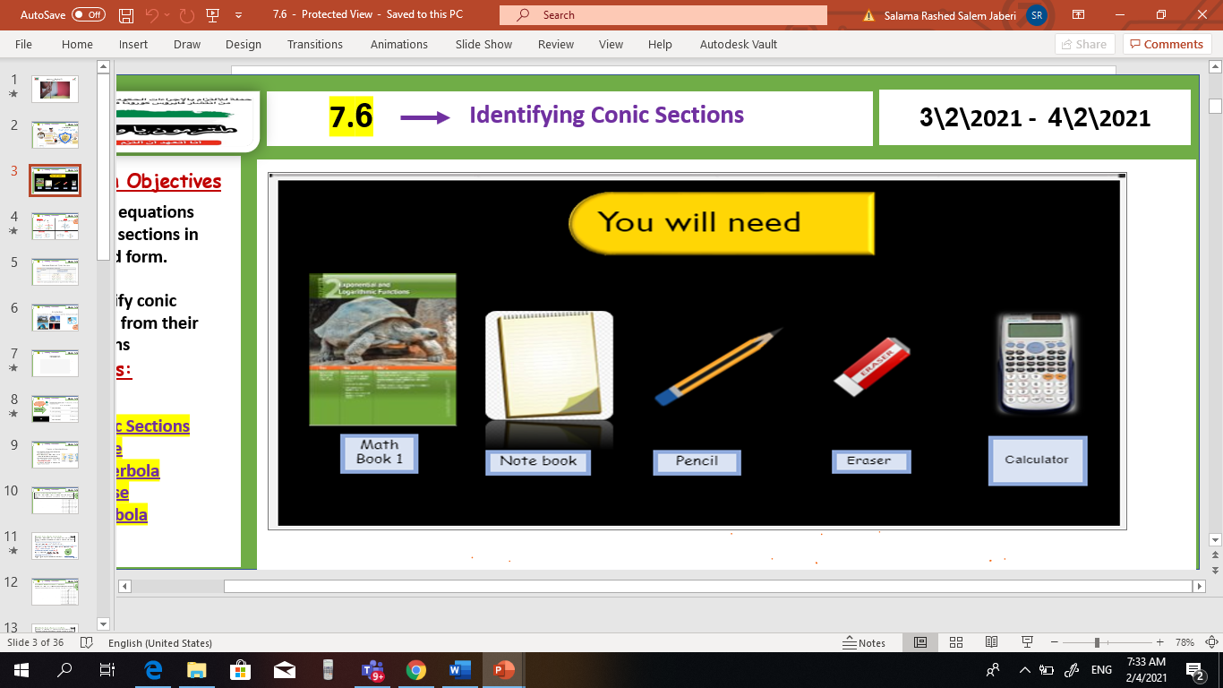

pol
V
Unit 9
9 – 5 infinite geometric Series
Mon, 8 Mar 2021
Lesson Objectives
m
1. Graph points with polar coordinates.
2. Graph simple polar equations.
Keywords
Polar coordinates
Pole
Polar axis
Polar coordinates
Polar equation
Polar graph

Slide 2
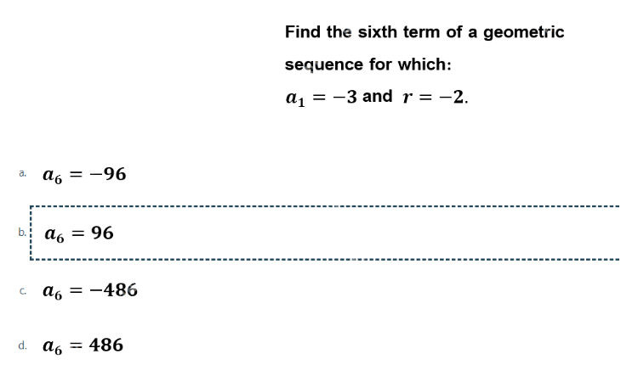

sum
Unit 9
9 – 5 infinite geometric Series
Mon, 8 Mar 2021
Analysis skill
Lesson Objectives
m
1 – Find sums of infinite geometric series. 2- write repeating decimals as fractions.
New Vocabulary
Infinite geometric series Convergent Series Divergent Series Infinity

Slide 3
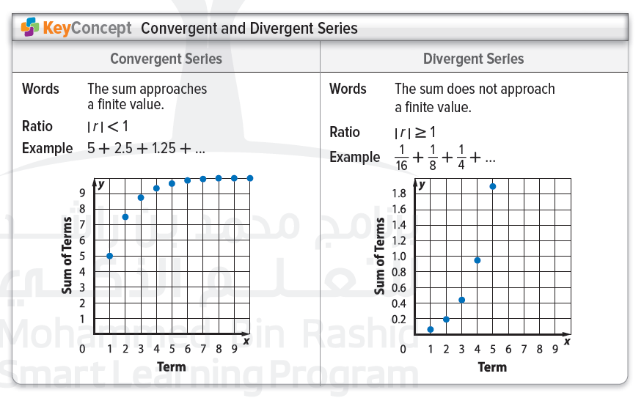
sum
Unit 9
9 – 5 infinite geometric Series
Mon, 8 Mar 2021
Lesson Objectives
m
1 – Find sums of infinite geometric series. 2- write repeating decimals as fractions.
New Vocabulary
Infinite geometric series Convergent Series Divergent Series Infinity

Slide 4
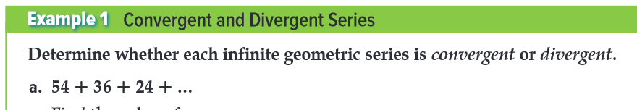
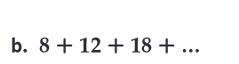
sum
Unit 9
9 – 5 infinite geometric Series
Mon, 8 Mar 2021
Lesson Objectives
m
1 – Find sums of infinite geometric series. 2- write repeating decimals as fractions.
New Vocabulary
Infinite geometric series Convergent Series Divergent Series Infinity

Slide 5

sum
Unit 9
9 – 5 infinite geometric Series
Mon, 8 Mar 2021
Lesson Objectives
m
1 – Find sums of infinite geometric series. 2- write repeating decimals as fractions.
New Vocabulary
Infinite geometric series Convergent Series Divergent Series Infinity

Slide 6
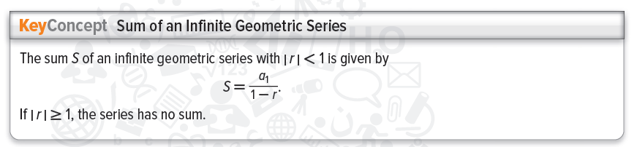
sum
Unit 9
9 – 5 infinite geometric Series
Mon, 8 Mar 2021
Lesson Objectives
m
1 – Find sums of infinite geometric series. 2- write repeating decimals as fractions.
New Vocabulary
Infinite geometric series Convergent Series Divergent Series Infinity

Slide 7
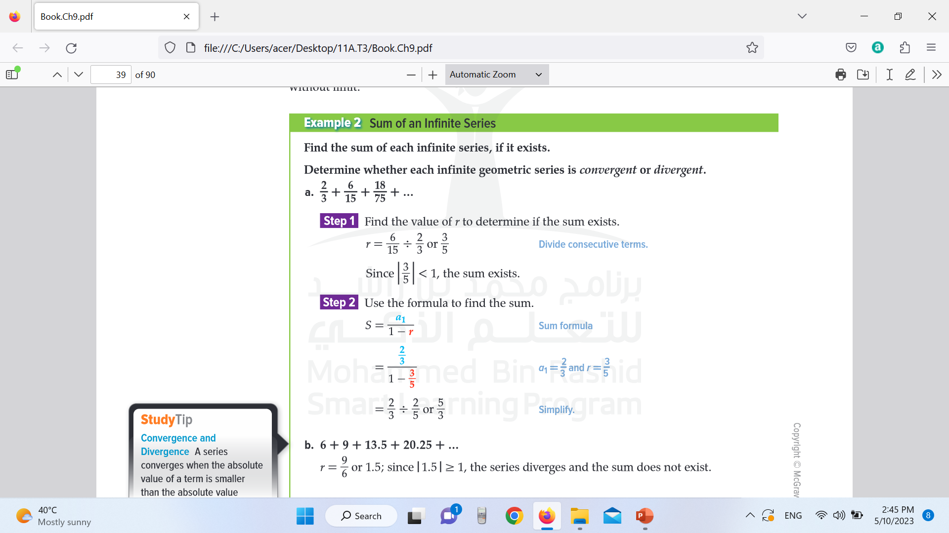
sum
Unit 9
9 – 5 infinite geometric Series
Mon, 8 Mar 2021
Lesson Objectives
m
1 – Find sums of infinite geometric series. 2- write repeating decimals as fractions.
New Vocabulary
Infinite geometric series Convergent Series Divergent Series Infinity

Slide 8

sum
Unit 9
9 – 5 infinite geometric Series
Mon, 8 Mar 2021
Lesson Objectives
m
1 – Find sums of infinite geometric series. 2- write repeating decimals as fractions.
New Vocabulary
Infinite geometric series Convergent Series Divergent Series Infinity

Slide 9
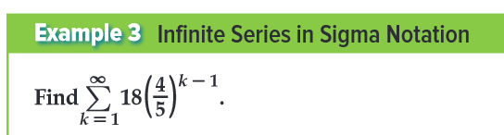
sum
Unit 9
9 – 5 infinite geometric Series
Mon, 8 Mar 2021
Lesson Objectives
m
1 – Find sums of infinite geometric series. 2- write repeating decimals as fractions.
New Vocabulary
Infinite geometric series Convergent Series Divergent Series Infinity

Slide 10

sum
Unit 9
9 – 5 infinite geometric Series
Mon, 8 Mar 2021
Lesson Objectives
m
1 – Find sums of infinite geometric series. 2- write repeating decimals as fractions.
New Vocabulary
Infinite geometric series Convergent Series Divergent Series Infinity

Slide 11
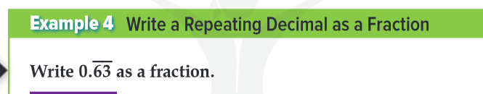
sum
Unit 9
9 – 5 infinite geometric Series
Mon, 8 Mar 2021
Lesson Objectives
m
1 – Find sums of infinite geometric series. 2- write repeating decimals as fractions.
New Vocabulary
Infinite geometric series Convergent Series Divergent Series Infinity

Slide 12

sum
Unit 9
9 – 5 infinite geometric Series
Mon, 8 Mar 2021
Lesson Objectives
m
1 – Find sums of infinite geometric series. 2- write repeating decimals as fractions.
New Vocabulary
Infinite geometric series Convergent Series Divergent Series Infinity

