Slide 1
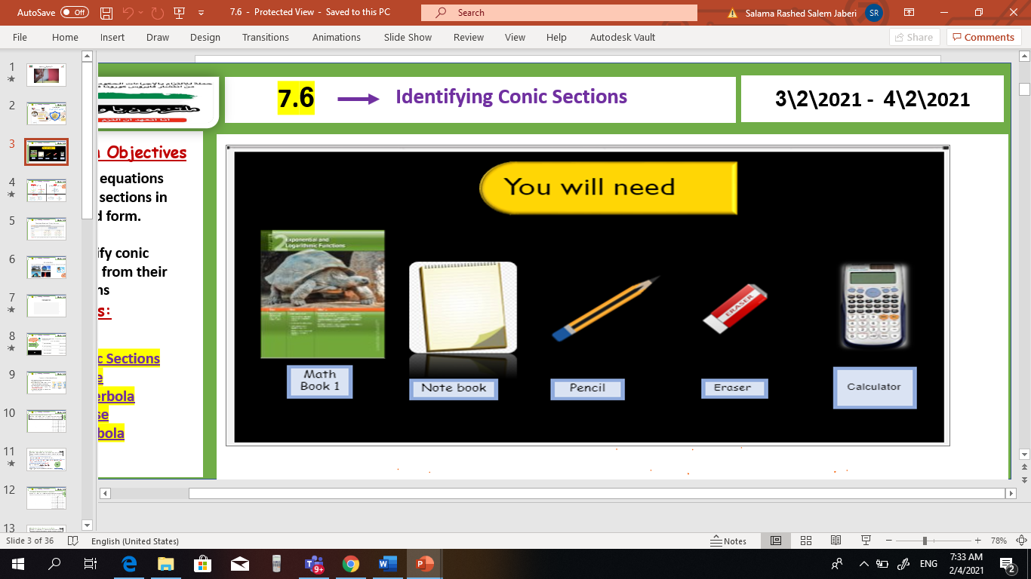
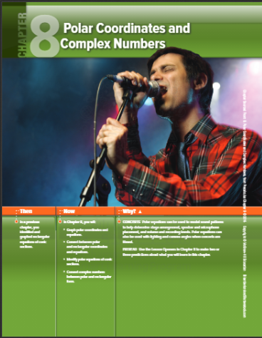

pol
8-3 Polar and rectangular
forms of equations
Vrec
Unit 8
Sun, 14 Feb 2021
Lesson Objectives
m
1. Graph points with polar coordinates.
2. Graph simple polar equations.
Keywords
Polar coordinates
Pole
Polar axis
Polar coordinates
Polar equation
Polar graph

Slide 2
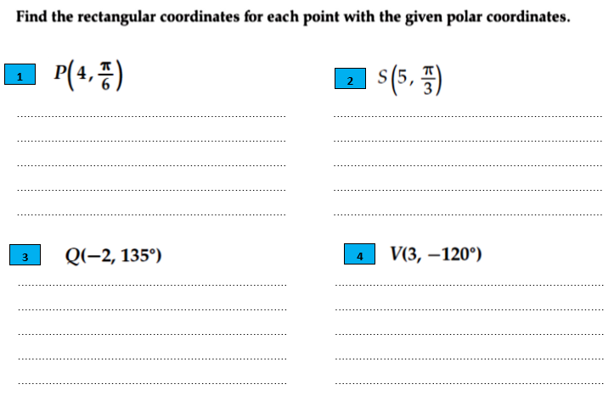
pol
8-3 Polar and rectangular
forms of equations
V
Unit 8
Sun, 14 Feb 2021
Lesson Objectives
m
1. Convert between polar and rectangular coordinates.
2. . Convert between polar and rectangular equations.

Slide 3
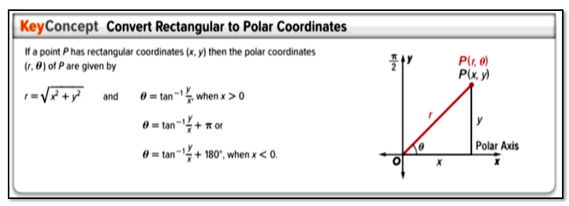
pol
8-3 Polar and rectangular
forms of equations
V
Unit 8
Sun, 14 Feb 2021
Lesson Objectives
m
1. Convert between polar and rectangular coordinates.
2. . Convert between polar and rectangular equations.

Slide 4
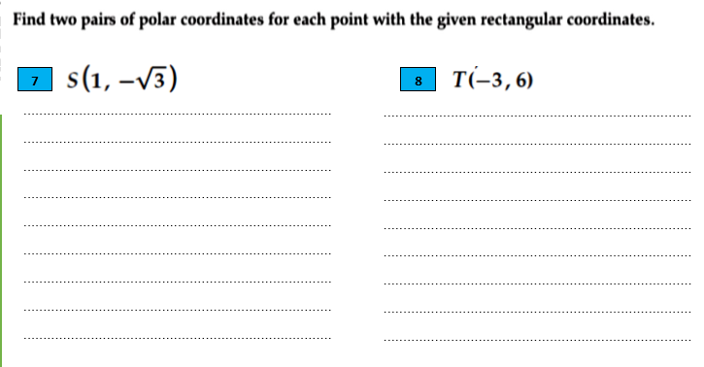
pol
8-3 Polar and rectangular
forms of equations
V
Unit 8
Sun, 14 Feb 2021
Lesson Objectives
m
1. Convert between polar and rectangular coordinates.
2. . Convert between polar and rectangular equations.

Slide 5
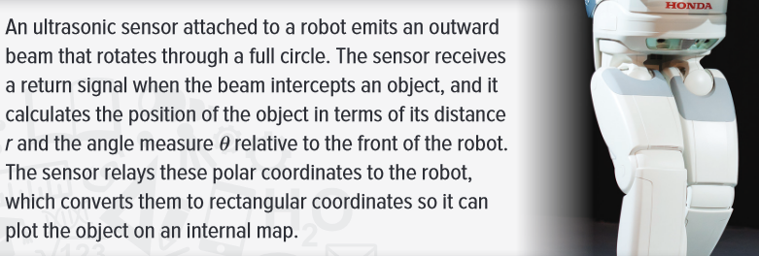
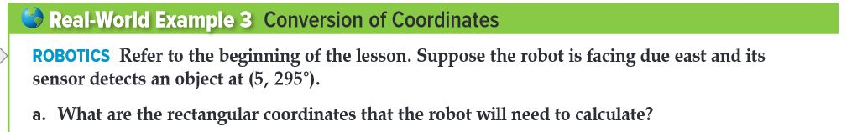
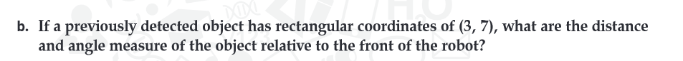
pol
8-3 Polar and rectangular
forms of equations
V
Unit 8
Sun, 14 Feb 2021
Lesson Objectives
m
1. Convert between polar and rectangular coordinates.
2. . Convert between polar and rectangular equations.

Slide 6
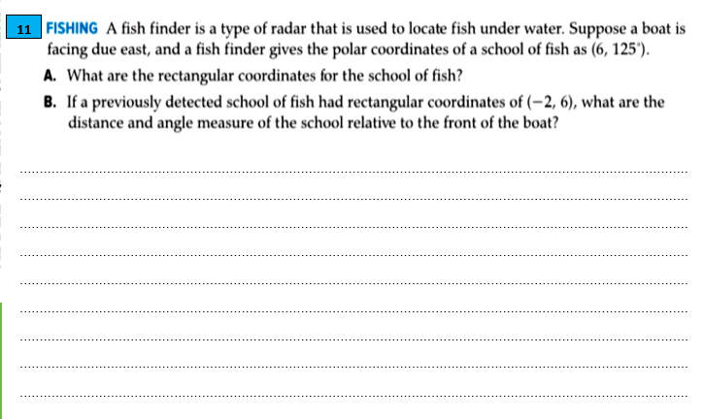
pol
8-3 Polar and rectangular
forms of equations
V
Unit 8
Sun, 14 Feb 2021
Lesson Objectives
m
1. Convert between polar and rectangular coordinates.
2. . Convert between polar and rectangular equations.

Slide 7
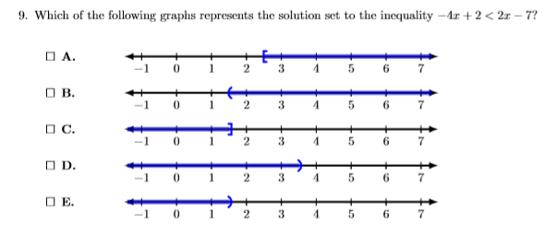
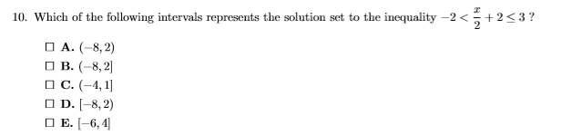
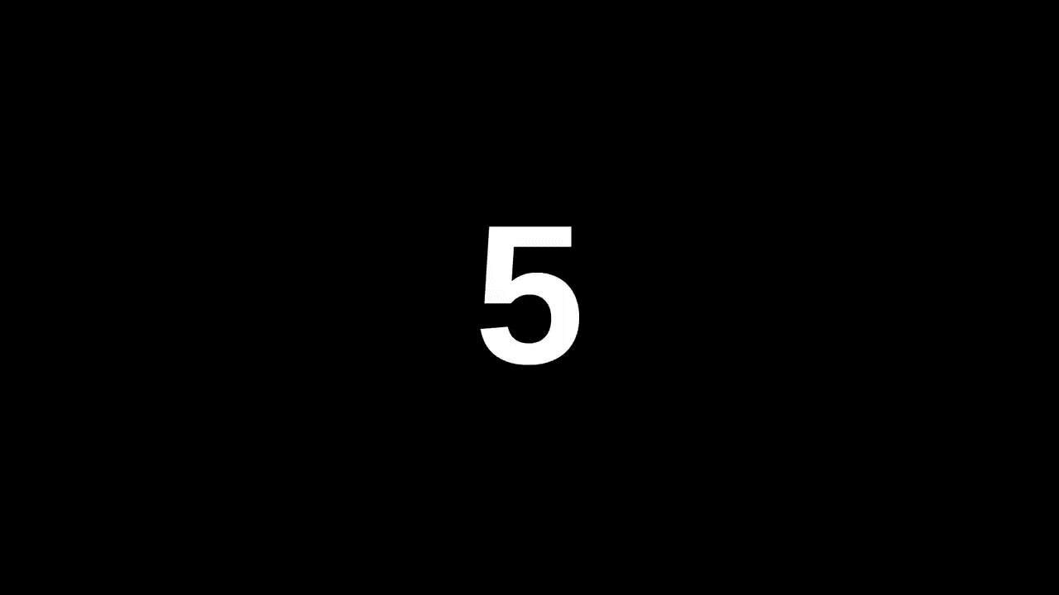
pol
8-3 Polar and rectangular
forms of equations
V
Unit 8
Mon, 15 Feb 2021
m
Lesson Objectives
Analysis skill
EMSAT
1. Convert between polar and rectangular coordinates.
2. . Convert between polar and rectangular equations.

Slide 8
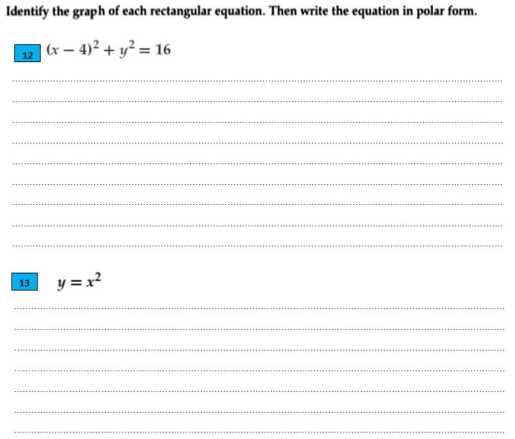
pol
8-3 Polar and rectangular
forms of equations
V
Unit 8
Sun, 14 Feb 2021
Lesson Objectives
m
1. Convert between polar and rectangular coordinates.
2. . Convert between polar and rectangular equations.

Slide 9
pol
8-3 Polar and rectangular
forms of equations
V
Unit 8
Sun, 14 Feb 2021
Lesson Objectives
m
1. Convert between polar and rectangular coordinates.
2. . Convert between polar and rectangular equations.

Slide 10
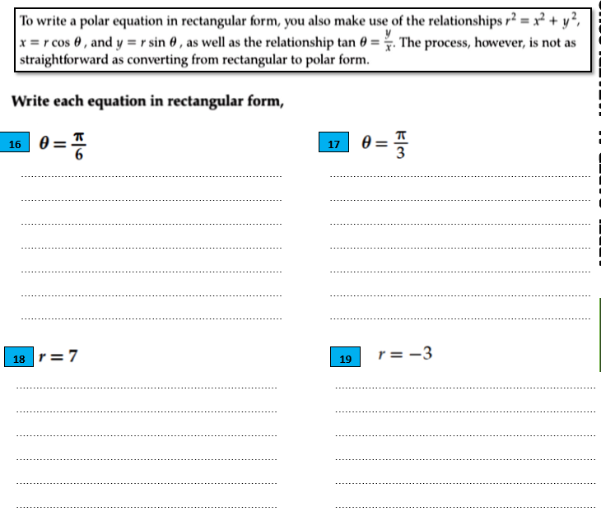
pol
8-3 Polar and rectangular
forms of equations
V
Unit 8
Sun, 14 Feb 2021
Lesson Objectives
m
1. Convert between polar and rectangular coordinates.
2. . Convert between polar and rectangular equations.

Slide 11
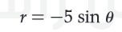
pol
8-3 Polar and rectangular
forms of equations
V
Unit 8
Sun, 14 Feb 2021
Lesson Objectives
m
1. Convert between polar and rectangular coordinates.
2. . Convert between polar and rectangular equations.

Slide 12
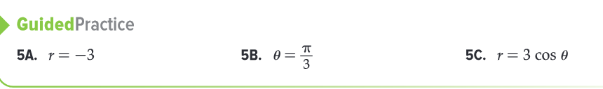
pol
8-3 Polar and rectangular
forms of equations
V
Unit 8
Sun, 14 Feb 2021
Lesson Objectives
m
1. Convert between polar and rectangular coordinates.
2. . Convert between polar and rectangular equations.

