Slide 1

Mendelian Genetics
Mr Mohammed

Slide 2
Learning objectives
Describe the significance of Mendel’s experiments to the study of genetics
Describe the law of segregation and the law of independent assortment
Identify the possible offspring's using a Punnett square

Slide 3
3 minutes
What is inheritance?
List some things we can inherit
Notes:
https://www.youtube.com/watch?v=Mehz7tCxjSE

Slide 4
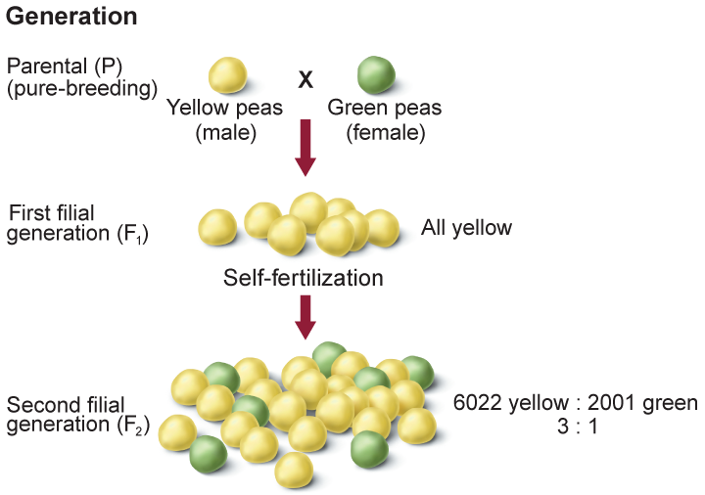

Slide 5
Mendel studied several different traits including:
Seed or pea color
Flower color
Seed pod color
Seed shape
Stem length

Slide 6
Mendel's work was not accepted by most scientists when he was alive for three main reasons:
when he presented his work to other scientists he did not communicate it well so they did not really understand it
it was published in a scientific journal that was not well known so not many people read it
he could not explain the science behind why characteristics were inherited

Slide 7
Allele
A form of a gene passed from generation to generation
Dominant
Recessive

Slide 8
Dominance
An organism with two of the same alleles for a particular trait is homozygous.
An organism with two different alleles for a particular trait is heterozygous.

Slide 9
Genotype and Phenotype
An organism’s allele pairs are called its genotype.
The observable characteristic or outward expression of an allele pair is called the phenotype.

Slide 10
An organism with two of the same alleles for a particular trait
Heterozygous
The observable characteristic of an allele pair
Genotype
An organism with two different alleles for a particular trait
Homozygous
Phenotype
An organism’s allele pairs

Slide 11
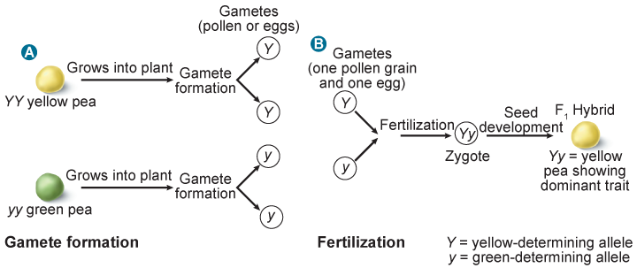
Mendel’s Law of Segregation
Two alleles for each trait separate during meiosis.
During fertilization, two alleles for that trait unite.
Heterozygous organisms are called hybrids.

Slide 12
Law of Independent Assortment
Random distribution of alleles occurs during gamete formation
Genes on separate chromosomes sort independently during meiosis.
Each allele combination is equally likely to occur.

Slide 13
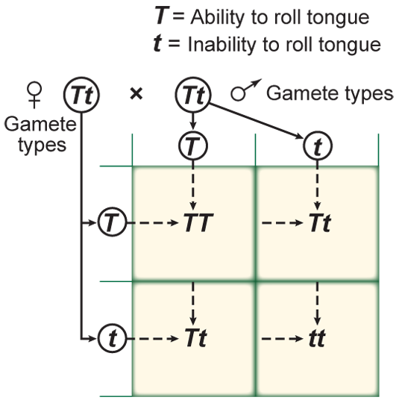
Punnett Squares
Notes:
https://www.liveworksheets.com/oq1336503xg

Slide 14
H = black hair
h = brown hair
H
h
H
h
The ratio of the different phenotypes can be shown as:
black : brown = :
The ratio of the different genotypes can be shown as:
HH : Hh : hh = : :
Notes:
https://www.liveworksheets.com/worksheets/en/Science/Science/Punnett_Square_av1695286oh

Slide 15
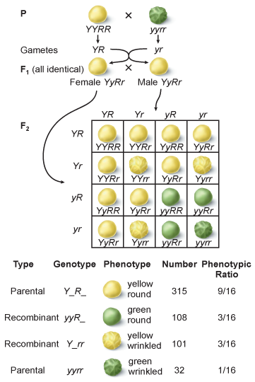
Punnett Square—Dihybrid Cross
Four types of alleles from the male gametes and four types of alleles from the female gametes can be produced.

Slide 16
Dihybrid cross punnet square: worked example
BG
Bg
bG
bg
BG
BG
bG
bg

Slide 17
An organism with two of the same alleles for a particular trait
Heterozygous
GG
An organism with two different alleles for a particular trait
Homozygous
Gg
Notes:
https://quizizz.com/admin/quiz/580eae1756bd584f78ece074

