Slide 1
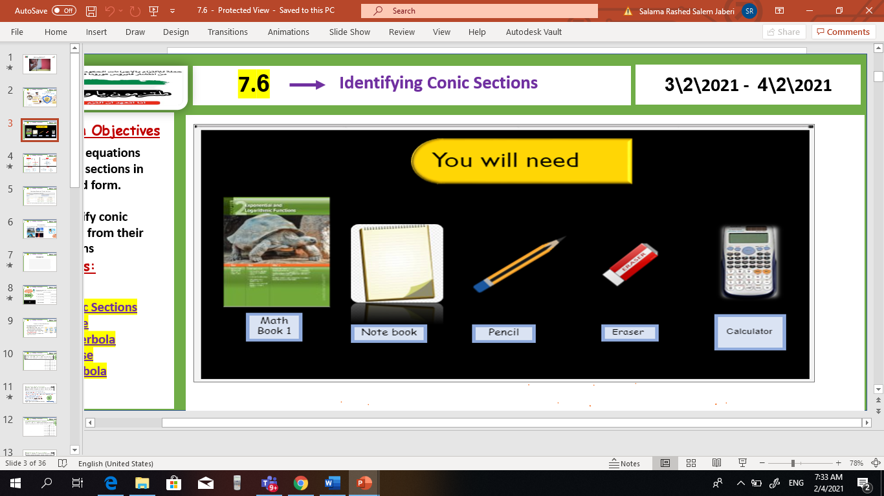
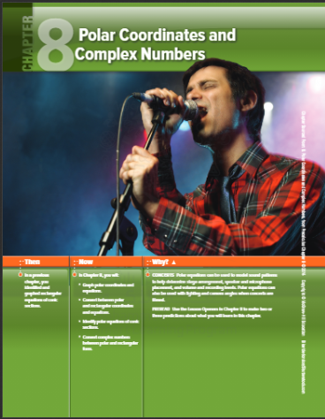

pol
V
Unit 8
8-1 Polar Coordinates
Sun, 7 Feb 2021
Lesson Objectives
m
1. Graph points with polar coordinates.
2. Graph simple polar equations.
Keywords
Polar coordinates
Pole
Polar axis
Polar coordinates
Polar equation
Polar graph

Slide 2
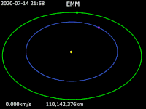
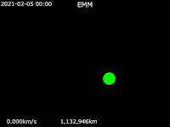
pol
V
Unit 8
8-1 Polar Coordinates
Sun, 7 Feb 2021
Lesson Objectives
m
1. Graph points with polar coordinates.
2. Graph simple polar equations.
Keywords
Polar coordinates
Pole
Polar axis
Polar coordinates
Polar equation
Polar graph

Slide 3
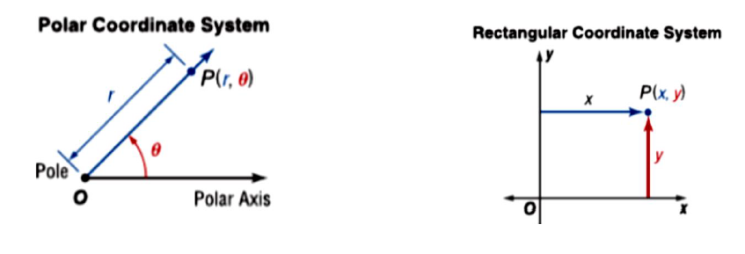
pol
V
Unit 8
8-1 Polar Coordinates
Sun, 7 Feb 2021
Lesson Objectives
m
1. Graph points with polar coordinates.
2. Graph simple polar equations.
Keywords
Polar coordinates
Pole
Polar axis
Polar coordinates
Polar equation
Polar graph

Slide 4
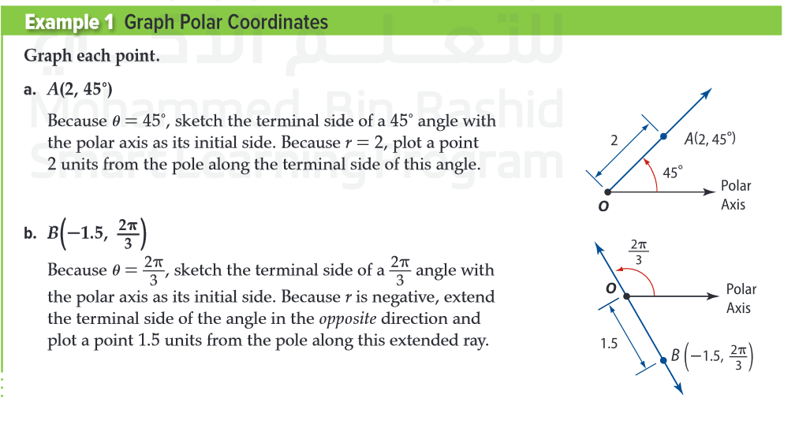
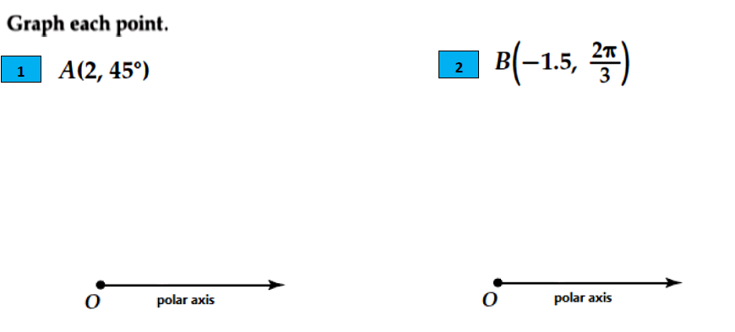
pol
V
Unit 8
8-1 Polar Coordinates
Sun, 7 Feb 2021
m
Lesson Objectives
Graphics analysis skill
1. Graph points with polar coordinates.
2. Graph simple polar equations.
Keywords
Polar coordinates
Pole
Polar axis
Polar coordinates
Polar equation
Polar graph

Slide 5
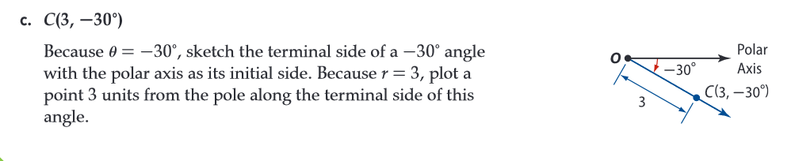
pol
V
Unit 8
8-1 Polar Coordinates
Sun, 7 Feb 2021
Lesson Objectives
m
1. Graph points with polar coordinates.
2. Graph simple polar equations.
Keywords
Polar coordinates
Pole
Polar axis
Polar coordinates
Polar equation
Polar graph

Slide 6
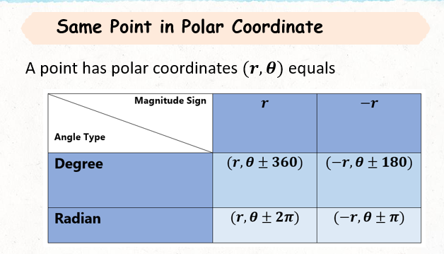
pol
V
Unit 8
8-1 Polar Coordinates
Sun, 7 Feb 2021
Lesson Objectives
m
1. Graph points with polar coordinates.
2. Graph simple polar equations.
Keywords
Polar coordinates
Pole
Polar axis
Polar coordinates
Polar equation
Polar graph

Slide 7
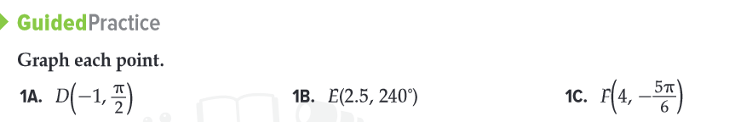
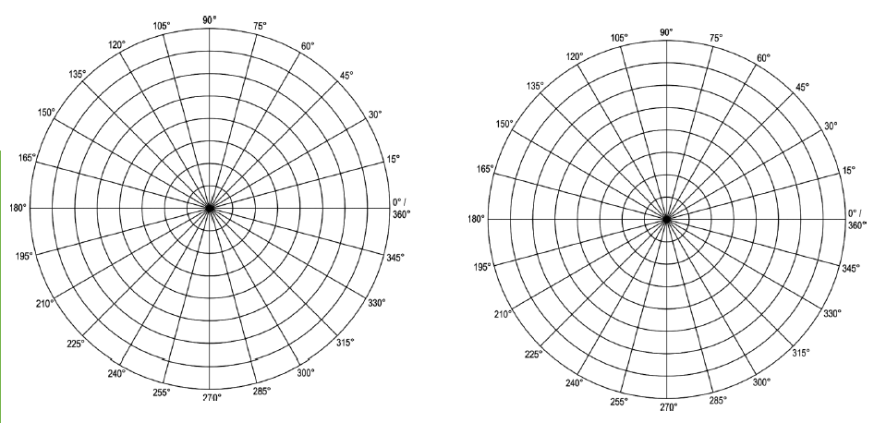
pol
V
Unit 8
8-1 Polar Coordinates
Sun, 7 Feb 2021
m
Lesson Objectives
Graphics analysis skill
1. Graph points with polar coordinates.
2. Graph simple polar equations.
Keywords
Polar coordinates
Pole
Polar axis
Polar coordinates
Polar equation
Polar graph

Slide 8
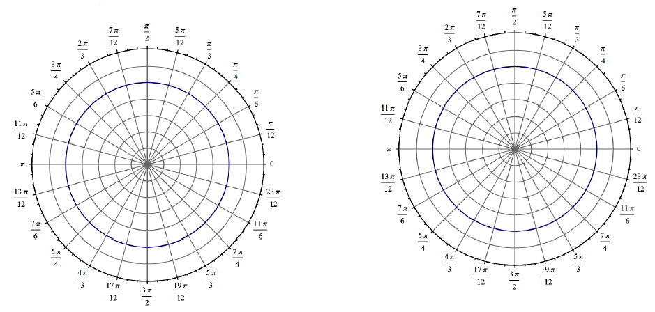
pol
V
Unit 8
8-1 Polar Coordinates
Sun, 7 Feb 2021
m
Lesson Objectives
Graphics analysis skill
1. Graph points with polar coordinates.
2. Graph simple polar equations.
Keywords
Polar coordinates
Pole
Polar axis
Polar coordinates
Polar equation
Polar graph

Slide 9
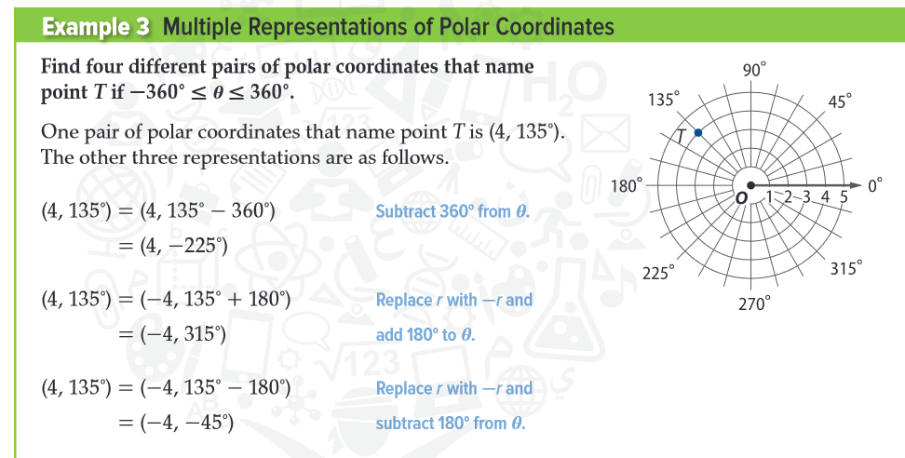
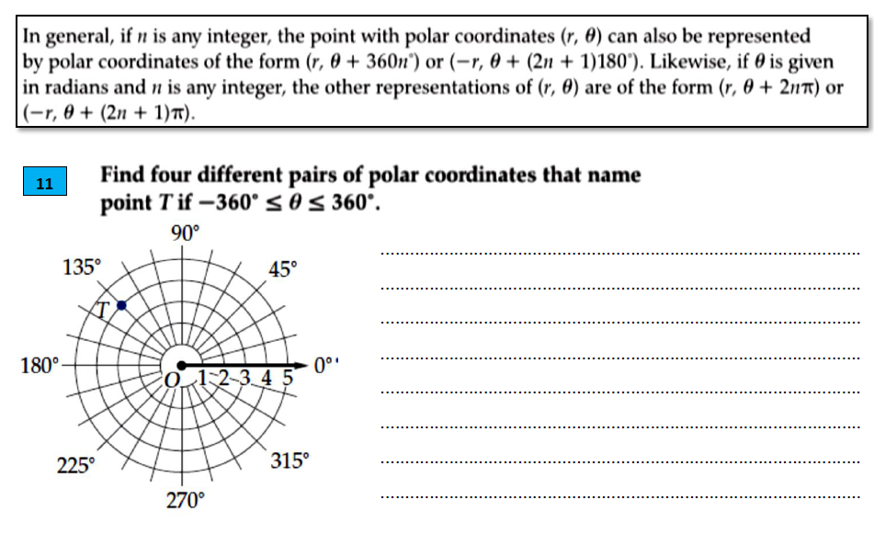
pol
V
Unit 8
8-1 Polar Coordinates
Sun, 7 Feb 2021
Lesson Objectives
m
1. Graph points with polar coordinates.
2. Graph simple polar equations.
Analysis skill
Keywords
Polar coordinates
Pole
Polar axis
Polar coordinates
Polar equation
Polar graph

Slide 10
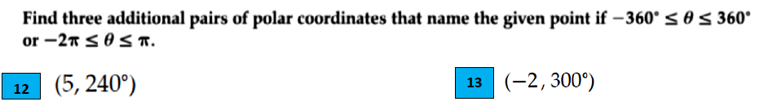
pol
V
Unit 8
8-1 Polar Coordinates
Sun, 7 Feb 2021
Lesson Objectives
m
1. Graph points with polar coordinates.
2. Graph simple polar equations.
Analysis skill
Keywords
Polar coordinates
Pole
Polar axis
Polar coordinates
Polar equation
Polar graph

Slide 11
pol
V
Unit 8
8-1 Polar Coordinates
Sun, 7 Feb 2021
Lesson Objectives
m
Analysis skill
1. Graph points with polar coordinates.
2. Graph simple polar equations.
Exit Ticket
https://www.liveworksheets.com/2-ok492404oi
Keywords
Polar coordinates
Pole
Polar axis
Polar coordinates
Polar equation
Polar graph

Slide 12

pol
V
Unit 8
8-1 Polar Coordinates
Mon, 8 Feb 2021
Lesson Objectives
m
1. Graph simple polar equations.
2. Find the distance between two polar coordinates.
Attendance and absence record
Keywords
Polar coordinates
Pole
Polar axis
Polar coordinates
Polar equation
Polar graph

Slide 13
pol
V
Unit 8
8-1 Polar Coordinates
Tues, 9 Feb 2021
Lesson Objectives
m
1. Graph simple polar equations.
2. Find the distance between two polar coordinates.
See Alef Video in lesson 100
Keywords
Polar coordinates
Pole
Polar axis
Polar coordinates
Polar equation
Polar graph

Slide 14
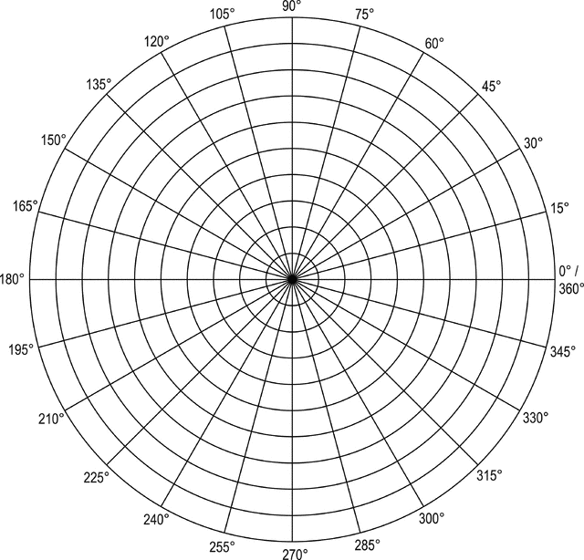
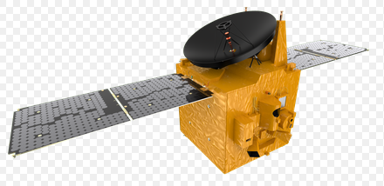
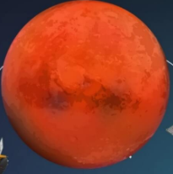
pol
V
Unit 8
8-1 Polar Coordinates
Tues, 9 Feb 2021
Graphics analysis skill
Lesson Objectives
m
1. Graph simple polar equations.
2. Find the distance between two polar coordinates.
Find the polar coordinates of :
1) Mars
20 Hope probe:
3) Distance between hope probe
and mars ………………….……
Keywords
Polar coordinates
Pole
Polar axis
Polar coordinates
Polar equation
Polar graph

Slide 15
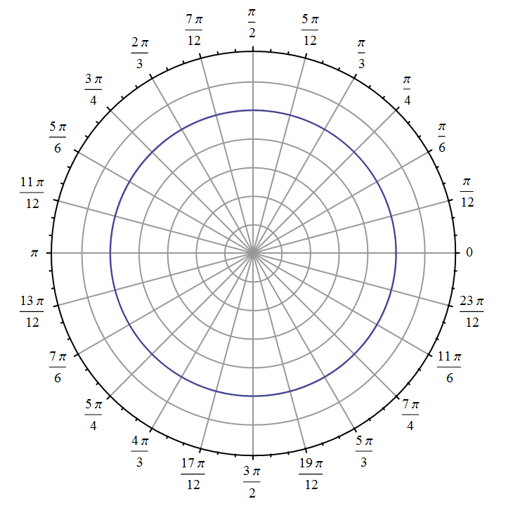
pol
V
Unit 8
8-1 Polar Coordinates
Tues, 9 Feb 2021
Graphics analysis skill
Lesson Objectives
m
Graph each polar equation
1. Graph simple polar equations.
2. Find the distance between two polar coordinates.
r = 5
$$θ={135}^{0}$$
Keywords
Polar coordinates
Pole
Polar axis
Polar coordinates
Polar equation
Polar graph

Slide 16
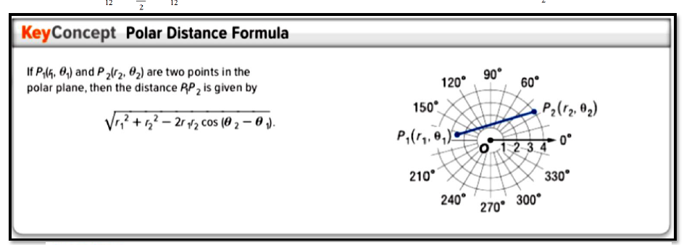
pol
V
Unit 8
8-1 Polar Coordinates
Tues, 9 Feb 2021
Lesson Objectives
m
1. Graph simple polar equations.
2. Find the distance between two polar coordinates.
Keywords
Polar coordinates
Pole
Polar axis
Polar coordinates
Polar equation
Polar graph

Slide 17



pol
V
Unit 8
8-1 Polar Coordinates
Mon, 8 Feb 2021
Graphics analysis skill
Lesson Objectives
m
1. Graph simple polar equations.
2. Find the distance between two polar coordinates.
Analysis skill
Keywords
Polar coordinates
Pole
Polar axis
Polar coordinates
Polar equation
Polar graph

Slide 18
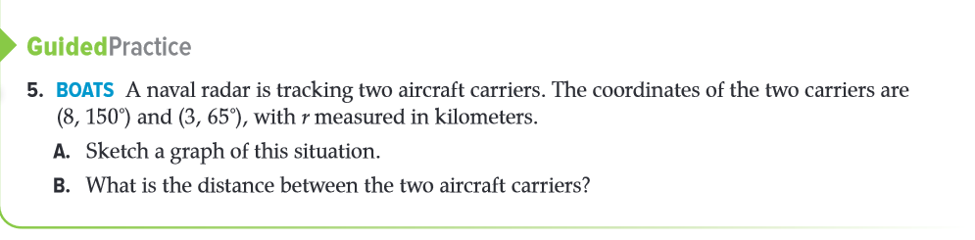
pol
V
Unit 8
8-1 Polar Coordinates
Tues, 9 Feb 2021
Lesson Objectives
m
1. Graph simple polar equations.
2. Find the distance between two polar coordinates.
Ticket Exit
https://www.liveworksheets.com/2-qi495221zo
Keywords
Polar coordinates
Pole
Polar axis
Polar coordinates
Polar equation
Polar graph

