Slide 1
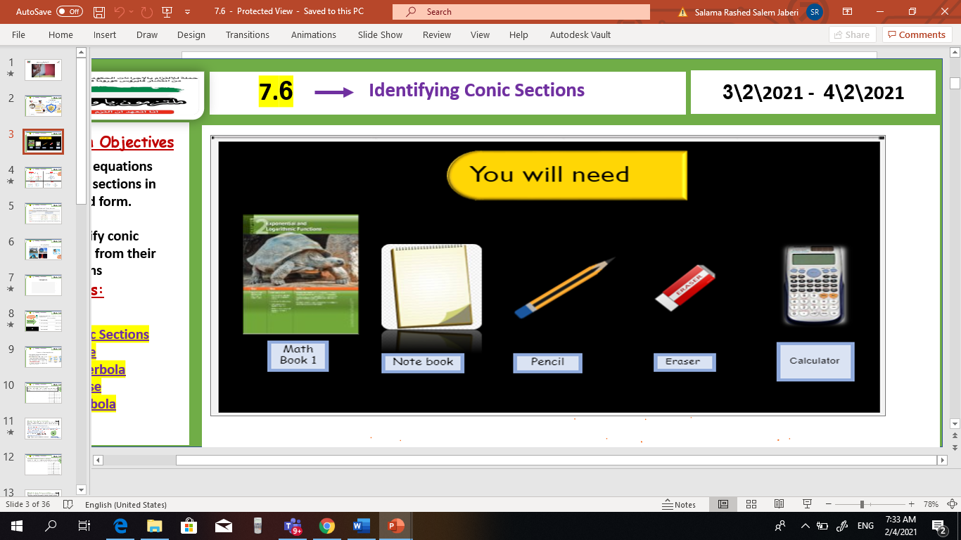

V
Unit 9
9 – 6 Recursion and Iteration
Tues, 9 Mar 2021
Lesson Objectives
m
1. Graph points with polar coordinates.
2. Graph simple polar equations.
Keywords
Polar coordinates
Pole
Polar axis
Polar coordinates
Polar equation
Polar graph

Slide 2
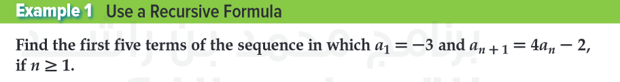
sum
Unit 9
9 – 6 Recursion and Iteration
Tues, 9 Mar 2021
Lesson Objectives
m
1 – Recognize and use special sequences. 2- Iterate functions.
New Vocabulary
Recursive sequence Explicit formula Recursive formula Iteration

Slide 3
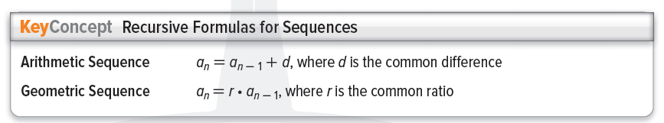
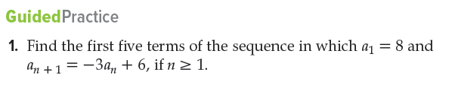
sum
Unit 9
9 – 6 Recursion and Iteration
Tues, 9 Mar 2021
Lesson Objectives
m
1 – Recognize and use special sequences. 2- Iterate functions.
New Vocabulary
Recursive sequence Explicit formula Recursive formula Iteration

Slide 4
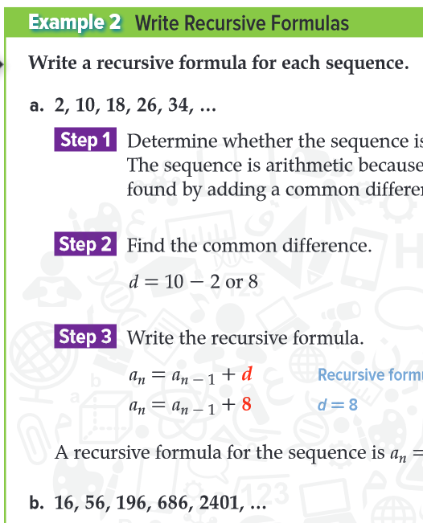
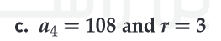
sum
Unit 9
9 – 6 Recursion and Iteration
Tues, 9 Mar 2021
Lesson Objectives
m
1 – Recognize and use special sequences. 2- Iterate functions.
New Vocabulary
Recursive sequence Explicit formula Recursive formula Iteration

Slide 5
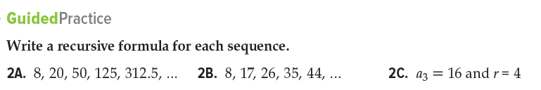
sum
Unit 9
9 – 6 Recursion and Iteration
Tues, 9 Mar 2021
Lesson Objectives
m
1 – Recognize and use special sequences. 2- Iterate functions.
New Vocabulary
Recursive sequence Explicit formula Recursive formula Iteration

Slide 6
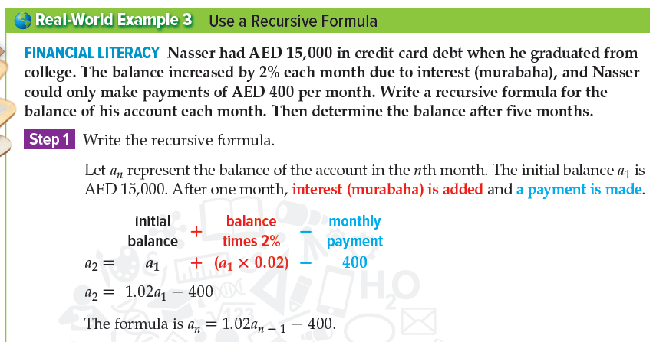
sum
Unit 9
9 – 6 Recursion and Iteration
Tues, 9 Mar 2021
Lesson Objectives
m
1 – Recognize and use special sequences. 2- Iterate functions.
New Vocabulary
Recursive sequence Explicit formula Recursive formula Iteration

Slide 7
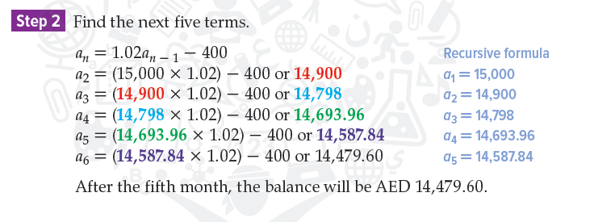
sum
Unit 9
9 – 6 Recursion and Iteration
Tues, 9 Mar 2021
Lesson Objectives
m
1 – Recognize and use special sequences. 2- Iterate functions.
New Vocabulary
Recursive sequence Explicit formula Recursive formula Iteration

Slide 8
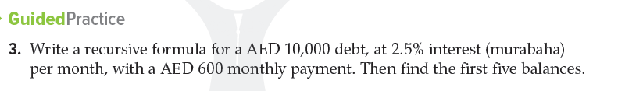
sum
Unit 9
9 – 6 Recursion and Iteration
Tues, 9 Mar 2021
Lesson Objectives
m
1 – Recognize and use special sequences. 2- Iterate functions.
New Vocabulary
Recursive sequence Explicit formula Recursive formula Iteration

Slide 9
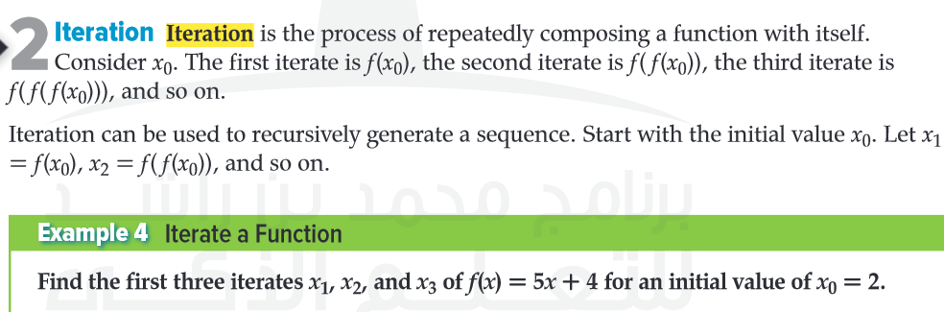
sum
Unit 9
9 – 6 Recursion and Iteration
Tues, 9 Mar 2021
Lesson Objectives
m
1 – Recognize and use special sequences. 2- Iterate functions.
New Vocabulary
Recursive sequence Explicit formula Recursive formula Iteration

Slide 10
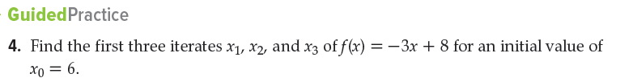
sum
Unit 9
9 – 6 Recursion and Iteration
Tues, 9 Mar 2021
Lesson Objectives
m
1 – Recognize and use special sequences. 2- Iterate functions.
New Vocabulary
Recursive sequence Explicit formula Recursive formula Iteration

