Slide 1
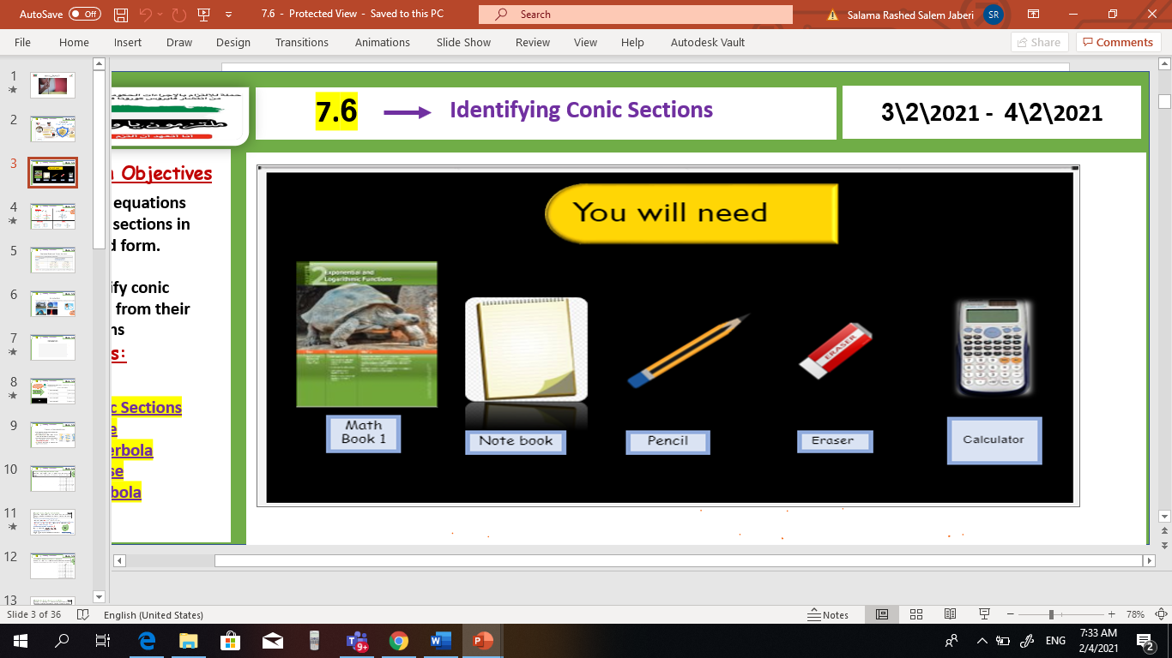

V
Unit 9
Lesson 9-2 Sequences, Series, and Sigma Notation
Thr, 25 Feb 2021
Lesson Objectives
m
1. Graph points with polar coordinates.
2. Graph simple polar equations.
Keywords
Polar coordinates
Pole
Polar axis
Polar coordinates
Polar equation
Polar graph

Slide 2
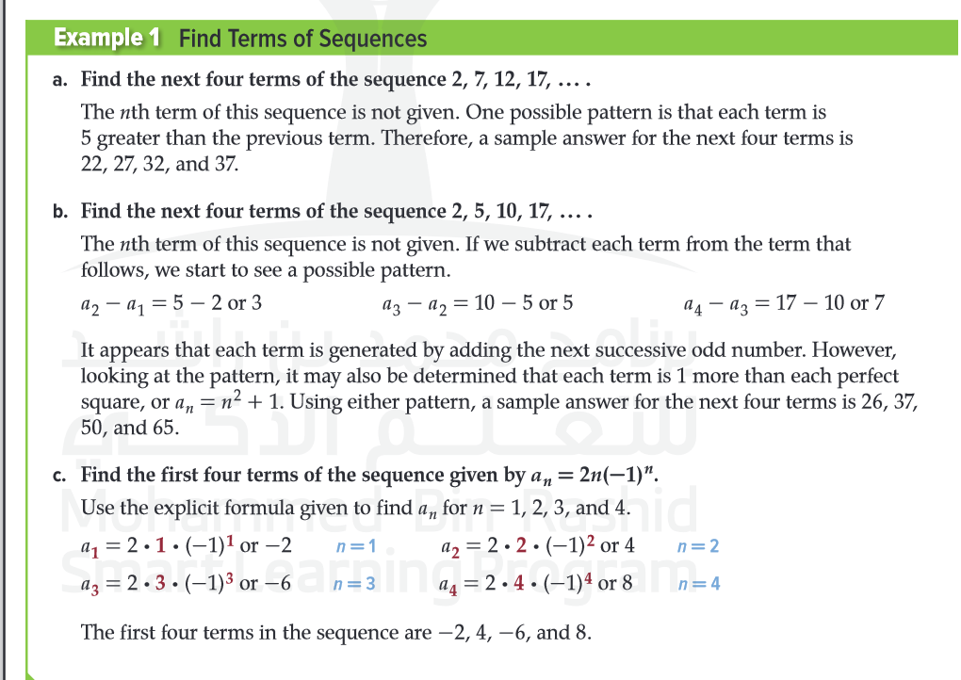
Unit 9
Lesson 9-2 Sequences, Series, and Sigma Notation
Sum, 28 Feb 2021
Lesson Objectives
m
1-Investigate several different types of sequences. 2. Use sigma notation to represent and calculate sums of series.
New Vocabulary
Sequence Term Finite sequence Infinite sequence recursive sequence explicit sequence Fibonacci sequence

Slide 3
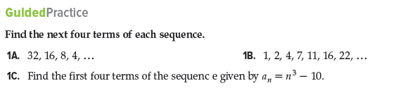
Unit 9
Lesson 9-2 Sequences, Series, and Sigma Notation
Sum, 28 Feb 2021
Lesson Objectives
m
1-Investigate several different types of sequences. 2. Use sigma notation to represent and calculate sums of series.
New Vocabulary
Sequence Term Finite sequence Infinite sequence recursive sequence explicit sequence Fibonacci sequence

Slide 4
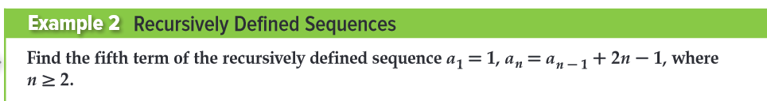
Unit 9
Lesson 9-2 Sequences, Series, and Sigma Notation
Sum, 28 Feb 2021
Lesson Objectives
m
1-Investigate several different types of sequences. 2. Use sigma notation to represent and calculate sums of series.
New Vocabulary
Sequence Term Finite sequence Infinite sequence recursive sequence explicit sequence Fibonacci sequence

Slide 5
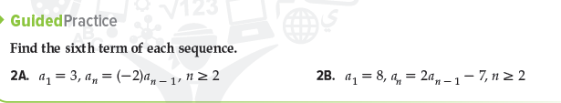
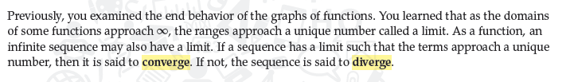
Unit 9
Lesson 9-2 Sequences, Series, and Sigma Notation
Sum, 28 Feb 2021
Lesson Objectives
m
1-Investigate several different types of sequences. 2. Use sigma notation to represent and calculate sums of series.
New Vocabulary
Sequence Term Finite sequence Infinite sequence recursive sequence explicit sequence Fibonacci sequence

Slide 6
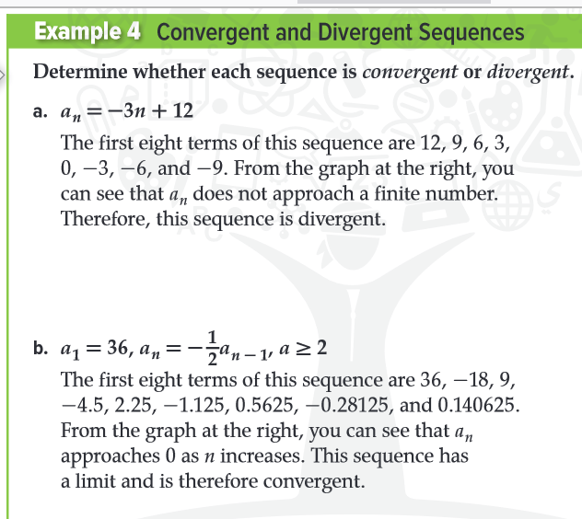
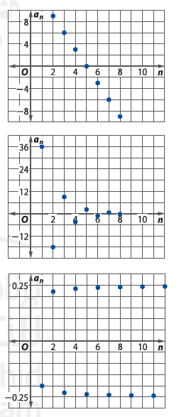
Unit 9
Lesson 9-2 Sequences, Series, and Sigma Notation
Sum, 28 Feb 2021
Lesson Objectives
m
1-Investigate several different types of sequences. 2. Use sigma notation to represent and calculate sums of series.
New Vocabulary
Sequence Term Finite sequence Infinite sequence recursive sequence explicit sequence Fibonacci sequence

Slide 7
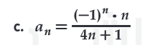
Unit 9
Lesson 9-2 Sequences, Series, and Sigma Notation
Sum, 28 Feb 2021
Lesson Objectives
m
1-Investigate several different types of sequences. 2. Use sigma notation to represent and calculate sums of series.
New Vocabulary
Sequence Term Finite sequence Infinite sequence recursive sequence explicit sequence Fibonacci sequence

Slide 8

Unit 9
Lesson 9-2 Sequences, Series, and Sigma Notation
Sum, 28 Feb 2021
Lesson Objectives
m
1-Investigate several different types of sequences. 2. Use sigma notation to represent and calculate sums of series.
New Vocabulary
Sequence Term Finite sequence Infinite sequence recursive sequence explicit sequence Fibonacci sequence

Slide 9
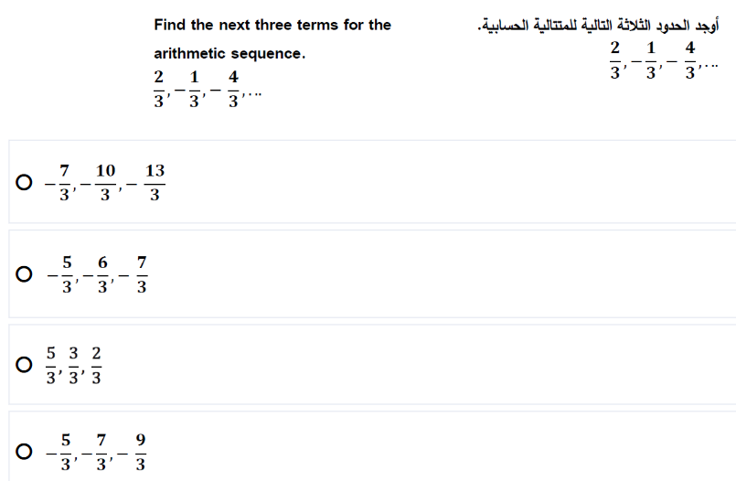
Unit 9
Lesson 9-2 Sequences, Series, and Sigma Notation
Sum, 28 Feb 2021
Lesson Objectives
m
1-Investigate several different types of sequences. 2. Use sigma notation to represent and calculate sums of series.
New Vocabulary
Sequence Term Finite sequence Infinite sequence recursive sequence explicit sequence Fibonacci sequence

Slide 10
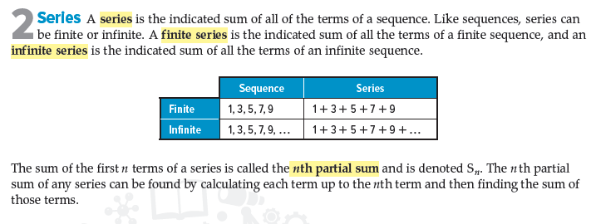
Unit 9
Lesson 9-2 Sequences, Series, and Sigma Notation
Sum, 28 Feb 2021
Lesson Objectives
m
1-Investigate several different types of sequences. 2. Use sigma notation to represent and calculate sums of series.
New Vocabulary
Sequence Term Finite sequence Infinite sequence recursive sequence explicit sequence Fibonacci sequence

Slide 11
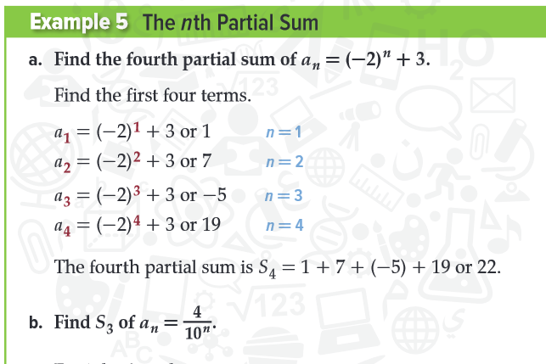
Unit 9
Lesson 9-2 Sequences, Series, and Sigma Notation
Sum, 28 Feb 2021
Lesson Objectives
m
1-Investigate several different types of sequences. 2. Use sigma notation to represent and calculate sums of series.
New Vocabulary
Sequence Term Finite sequence Infinite sequence recursive sequence explicit sequence Fibonacci sequence

Slide 12
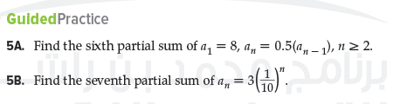
Unit 9
Lesson 9-2 Sequences, Series, and Sigma Notation
Sum, 28 Feb 2021
Lesson Objectives
m
1-Investigate several different types of sequences. 2. Use sigma notation to represent and calculate sums of series.
New Vocabulary
Sequence Term Finite sequence Infinite sequence recursive sequence explicit sequence Fibonacci sequence

Slide 13
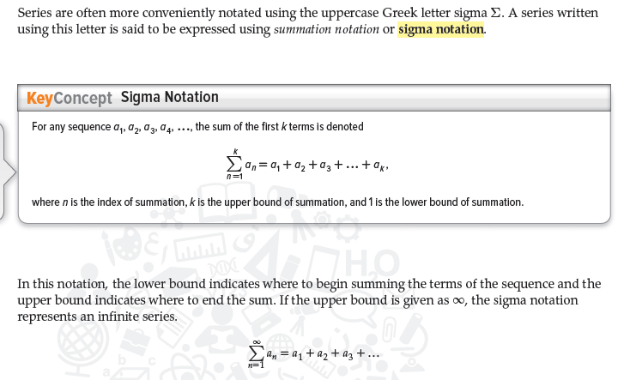
Unit 9
Lesson 9-2 Sequences, Series, and Sigma Notation
Sum, 28 Feb 2021
Lesson Objectives
m
1-Investigate several different types of sequences. 2. Use sigma notation to represent and calculate sums of series.
New Vocabulary
Sequence Term Finite sequence Infinite sequence recursive sequence explicit sequence Fibonacci sequence

Slide 14
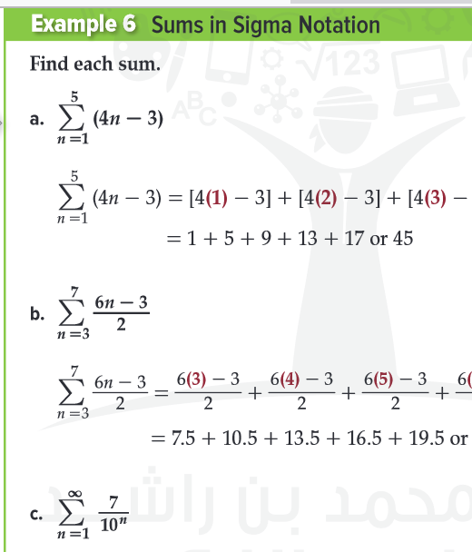
Unit 9
Lesson 9-2 Sequences, Series, and Sigma Notation
Sum, 28 Feb 2021
Lesson Objectives
m
1-Investigate several different types of sequences. 2. Use sigma notation to represent and calculate sums of series.
New Vocabulary
Sequence Term Finite sequence Infinite sequence recursive sequence explicit sequence Fibonacci sequence

Slide 15

Unit 9
Lesson 9-2 Sequences, Series, and Sigma Notation
Sum, 28 Feb 2021
Lesson Objectives
m
1-Investigate several different types of sequences. 2. Use sigma notation to represent and calculate sums of series.
New Vocabulary
Sequence Term Finite sequence Infinite sequence recursive sequence explicit sequence Fibonacci sequence

