Slide 1
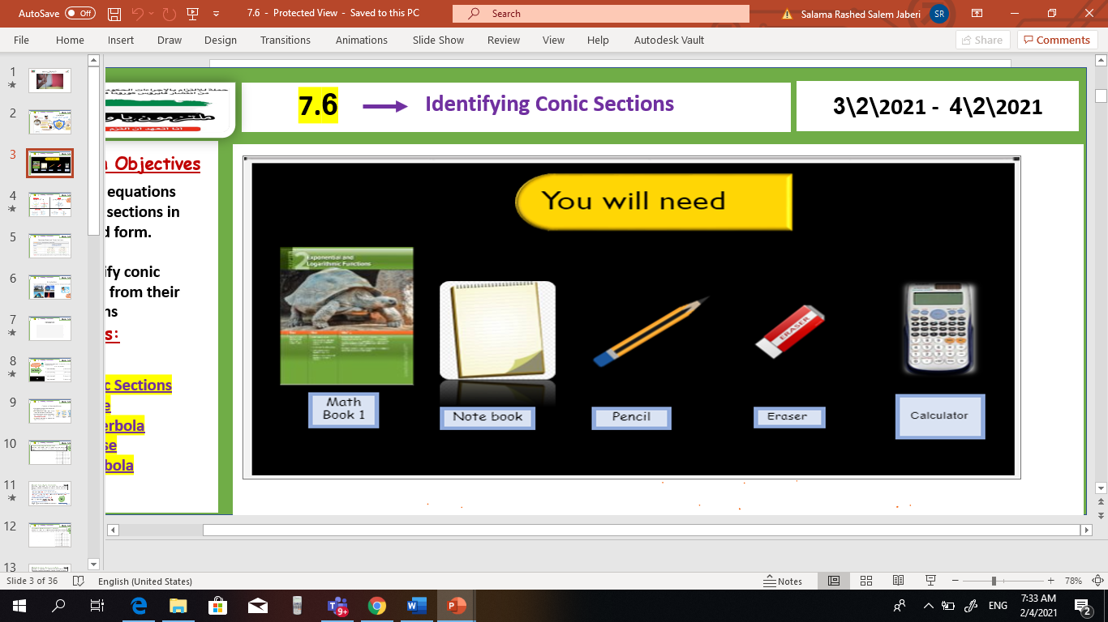

V
Unit 9
9 – 7 The binomial Theorem
Tues, 16 Mar 2021
Lesson Objectives
m
1. Graph points with polar coordinates.
2. Graph simple polar equations.
Keywords
Polar coordinates
Pole
Polar axis
Polar coordinates
Polar equation
Polar graph

Slide 2
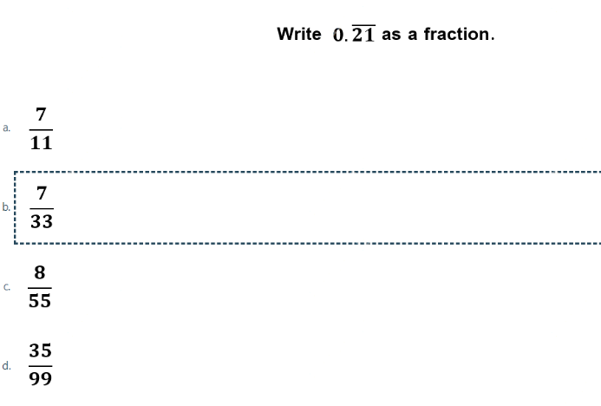
sum
Unit 9
9 – 7 The binomial Theorem
Tues, 16 Mar 2021
Lesson Objectives
m
1 – Use pascal’s triangle to expand power of binomials 2 – use the binomial theorem to expand powers of binomials .
New Vocabulary
pascal’s triangle

Slide 3
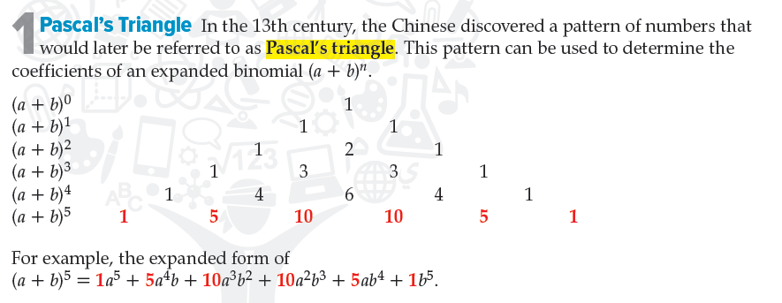
sum
Unit 9
9 – 7 The binomial Theorem
Tues, 16 Mar 2021
Lesson Objectives
m
1 – Use pascal’s triangle to expand power of binomials 2 – use the binomial theorem to expand powers of binomials .
New Vocabulary
pascal’s triangle

Slide 4
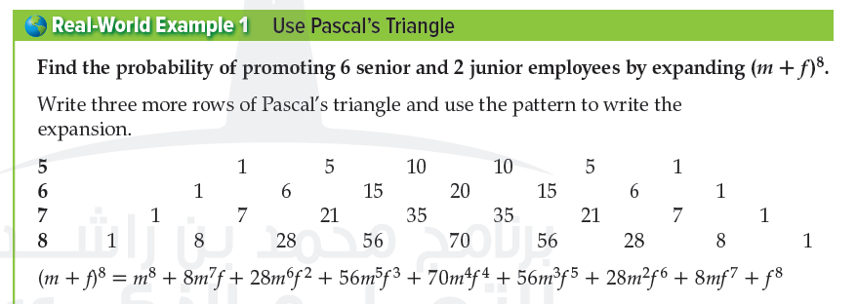
sum
Unit 9
9 – 7 The binomial Theorem
Tues, 16 Mar 2021
Lesson Objectives
m
1 – Use pascal’s triangle to expand power of binomials 2 – use the binomial theorem to expand powers of binomials .
New Vocabulary
pascal’s triangle

Slide 5

sum
Unit 9
9 – 7 The binomial Theorem
Tues, 16 Mar 2021
Lesson Objectives
m
1 – Use pascal’s triangle to expand power of binomials 2 – use the binomial theorem to expand powers of binomials .
New Vocabulary
pascal’s triangle

Slide 6
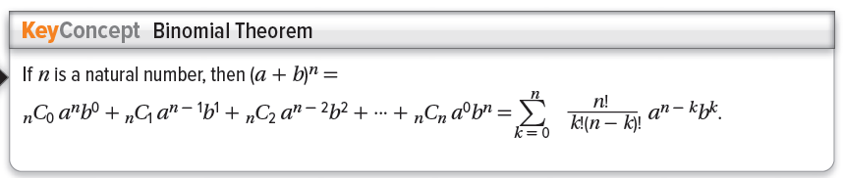
sum
Unit 9
9 – 7 The binomial Theorem
Tues, 16 Mar 2021
Lesson Objectives
m
1 – Use pascal’s triangle to expand power of binomials 2 – use the binomial theorem to expand powers of binomials .
New Vocabulary
pascal’s triangle

Slide 7
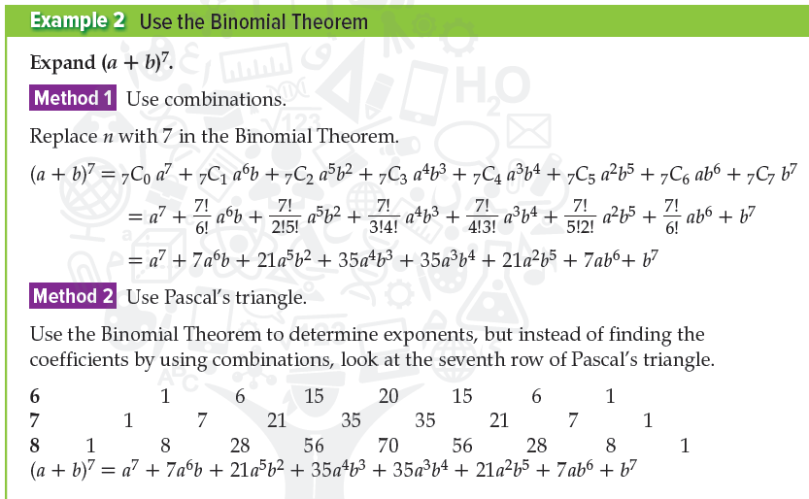
sum
Unit 9
9 – 7 The binomial Theorem
Tues, 16 Mar 2021
Lesson Objectives
m
1 – Use pascal’s triangle to expand power of binomials 2 – use the binomial theorem to expand powers of binomials .
New Vocabulary
pascal’s triangle

Slide 8

sum
Unit 9
9 – 7 The binomial Theorem
Tues, 16 Mar 2021
Lesson Objectives
m
1 – Use pascal’s triangle to expand power of binomials 2 – use the binomial theorem to expand powers of binomials .
New Vocabulary
pascal’s triangle

Slide 9
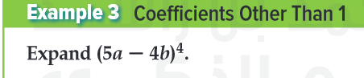
sum
Unit 9
9 – 7 The binomial Theorem
Tues, 16 Mar 2021
Lesson Objectives
m
1 – Use pascal’s triangle to expand power of binomials 2 – use the binomial theorem to expand powers of binomials .
New Vocabulary
pascal’s triangle

Slide 10

sum
Unit 9
9 – 7 The binomial Theorem
Tues, 16 Mar 2021
Lesson Objectives
m
1 – Use pascal’s triangle to expand power of binomials 2 – use the binomial theorem to expand powers of binomials .
New Vocabulary
pascal’s triangle

Slide 11
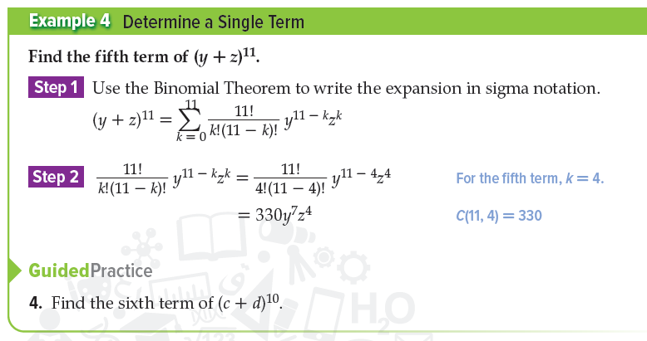

sum
Unit 9
9 – 7 The binomial Theorem
Tues, 16 Mar 2021
Lesson Objectives
m
1 – Use pascal’s triangle to expand power of binomials 2 – use the binomial theorem to expand powers of binomials .
New Vocabulary
pascal’s triangle

Slide 12
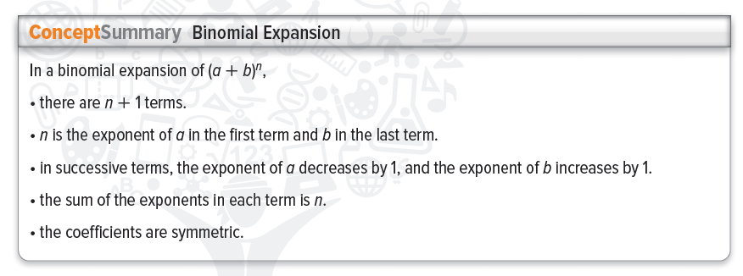
sum
Unit 9
9 – 7 The binomial Theorem
Tues, 16 Mar 2021
Lesson Objectives
m
1 – Use pascal’s triangle to expand power of binomials 2 – use the binomial theorem to expand powers of binomials .
New Vocabulary
pascal’s triangle

