Slide 1
Timed Progress Bars for Student Task
Start 10 seconds
Start 20 seconds
Start 30 seconds
Start 1 minute
Start 5 minutes
Start 10 minutes

Slide 2
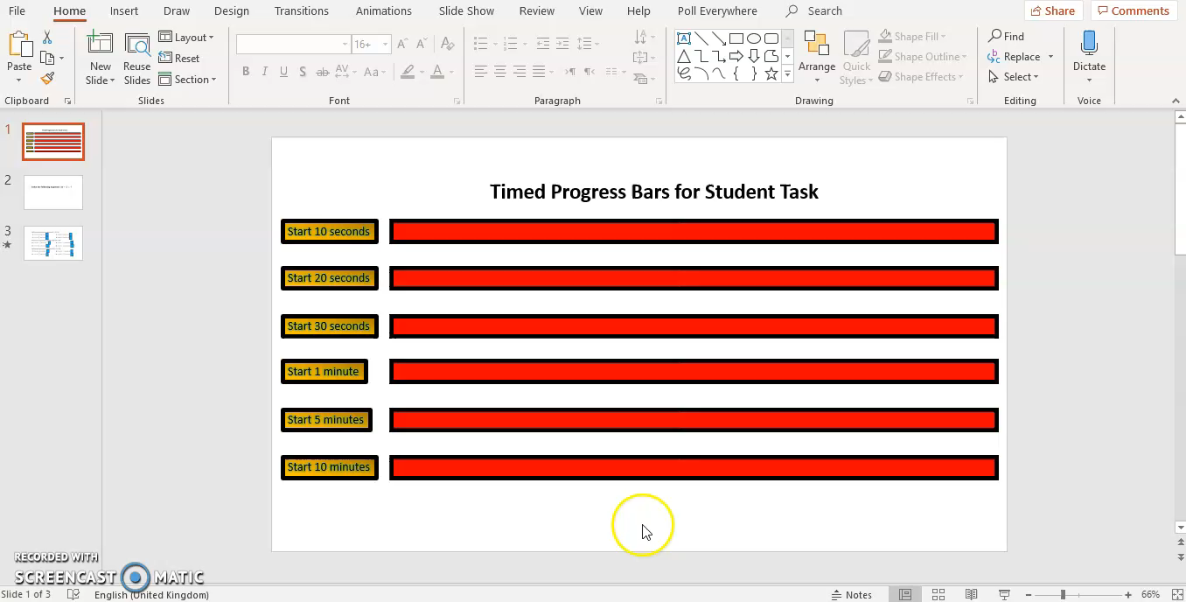
Video – How to use the timed progress bars

Slide 3
11.1 Trigonometric Identities
Trigonometric identities are equations that are true for all values of the variable for which both sides are defined.

Slide 4
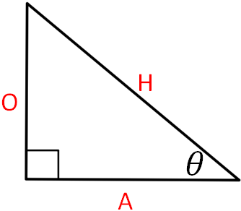
Starter
Divide any pair of sides to give you a ratio (fraction form).
Find all the different ratios. How many are there?
Can you identify which trig function each ratio represents?

Slide 5
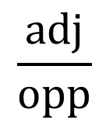

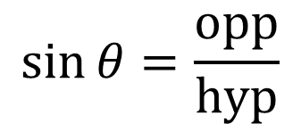
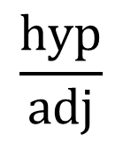



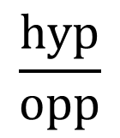

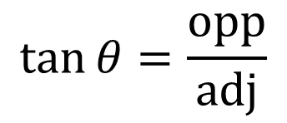


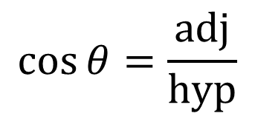


Reciprocal Identities
$$\sin{θ=\frac{opp}{hyp}}$$
$$\frac{hyp}{opp}$$
$$=csc{θ}$$
Reciprocal Trig Identities
$$\csc{θ=\frac{1}{\sin{θ}}}$$
$$\sin{θ=\frac{1}{\csc{θ}}}$$
Reciprocal Trig Functions
$$\cos{θ=\frac{adj}{hyp}}$$
Take the reciprocal
$$\sec{θ=\frac{1}{\cos{θ}}}$$
$$\cos{θ=\frac{1}{\sec{θ}}}$$
$$\frac{hyp}{adj}$$
$$=\sec{θ}$$
$$\cot{θ=\frac{1}{\tan{θ}}}$$
$$\tan{θ=\frac{1}{\cot{θ}}}$$
$$\tan{θ=\frac{opp}{adj}}$$
$$\frac{adj}{opp}$$
These are defined for when the denominators are not equal to zero.
$$=\cot{θ}$$

Slide 6
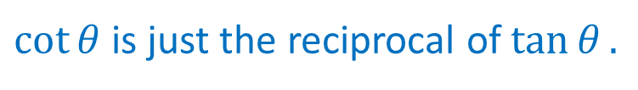
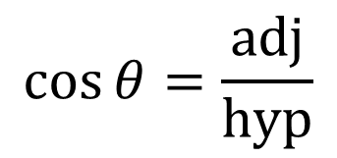

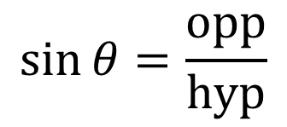

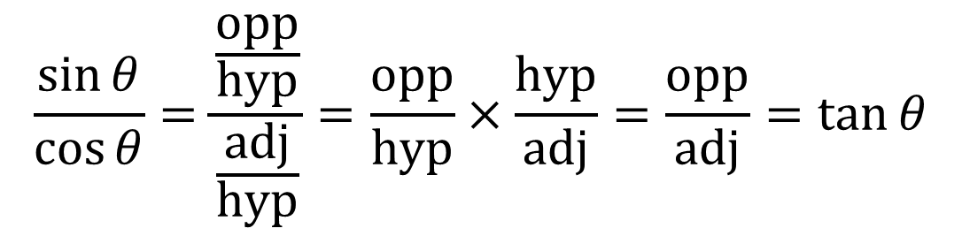
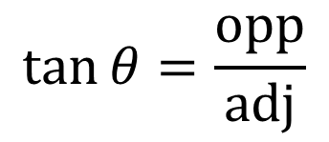
Quotient Identities
$$\sin{θ=\frac{opp}{hyp}}$$
$$\cos{θ=\frac{adj}{hyp}}$$
$$\tan{θ=\frac{opp}{adj}}$$
$$\frac{\sin{θ}}{\cos{θ}}=\frac{\frac{opp}{hyp}}{\frac{adj}{hyp}}=\frac{opp}{hyp}×\frac{hyp}{adj}=\frac{opp}{adj}=\tan{θ}$$
$$\tan{θ=\frac{sin θ}{cos θ}}$$
$$\cot{θ=\frac{cos θ}{sin θ}}$$
These are defined for when the denominators are not equal to zero.
$\cot{θ}$ is just the reciprocal of $\tan{θ}.$

Slide 7









Pythagorean Identities
Start with a unit circle.
A general point $P(x,y)$ lies on the unit circle.
$$y$$
$$P(x, y)$$
$$1$$
The radius is 1 with an angle $θ$ in the standard position.
$$θ$$
$$x$$
Pythagoras Theorem tells us that $x^{2}+y^{2}=1$.
1
$$y$$
$$θ$$
$$x$$

Slide 8
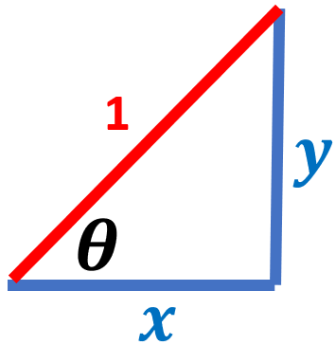
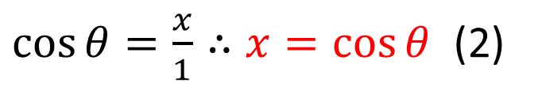
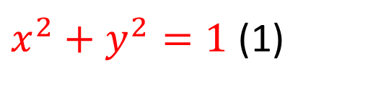

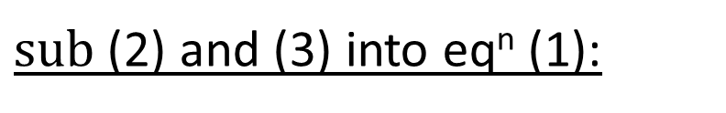
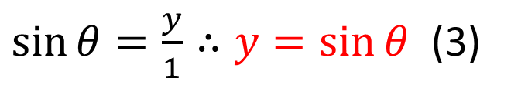
Pythagorean Identities
$x^{2}+y^{2}=1$ (1)
$\cos{θ=\frac{x}{1}∴x=\cos{θ}}$ (2)
$\sin{θ=\frac{y}{1}∴y=\sin{θ}}$ (3)
$sub$ (2) and (3) into eq^{n} (1):
$$\cos^{2}{θ}+\sin^{2}{θ}=1$$

Slide 9
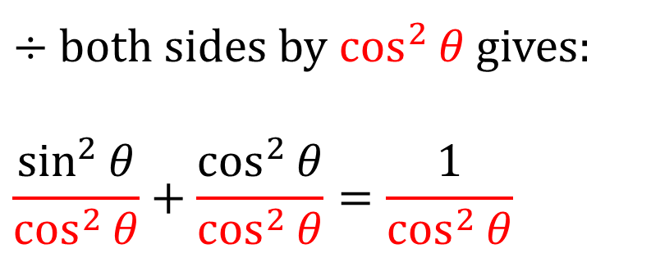


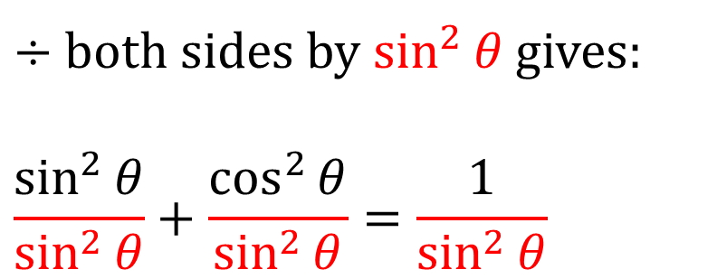


Pythagorean Identities
similarly
$$\sin^{2}{θ}+ \cos^{2}{θ}=1$$
$$\sin^{2}{θ}+ \cos^{2}{θ}=1$$
$÷$ both sides by $\cos^{2}{θ}$ gives:
$$\frac{\sin^{2}{θ}}{\cos^{2}{θ}}+\frac{\cos^{2}{θ}}{\cos^{2}{θ}}=\frac{1}{\cos^{2}{θ}}$$
$÷$ both sides by $\sin^{2}{θ}$ gives:
$$\frac{\sin^{2}{θ}}{\sin^{2}{θ}}+\frac{\cos^{2}{θ}}{\sin^{2}{θ}}=\frac{1}{\sin^{2}{θ}}$$
$$\tan^{2}{θ}+1=\sec^{2}{θ}$$
$$1+\cot^{2}{θ}=\csc^{2}{θ}$$

Slide 10
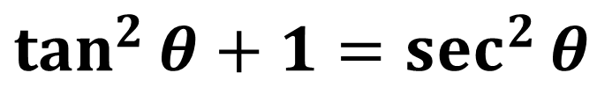

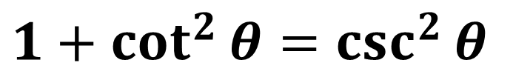
Pythagorean Identities
$$\sin^{2}{θ}+\cos^{2}{θ}=1$$
$$\tan^{2}{θ}+1=\sec^{2}{θ}$$
$$1+\cot^{2}{θ}=\csc^{2}{θ}$$

Slide 11
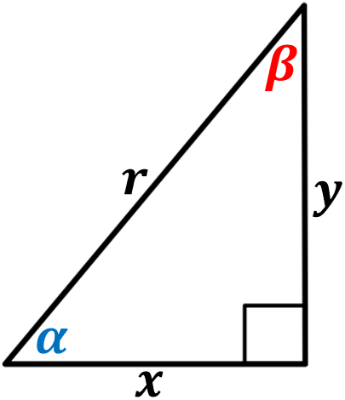

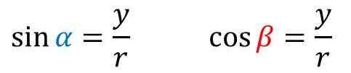


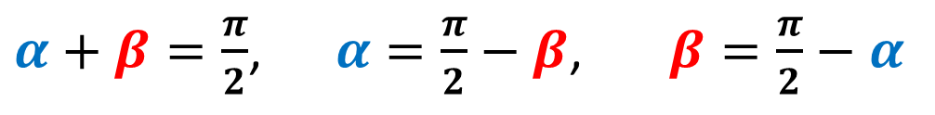
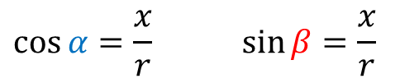


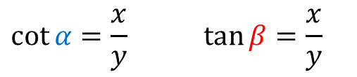

Cofunction Identities
Relationship between trig functions based on complementary angles.
$α+β=\frac{π}{2}$, $α=\frac{π}{2}−β$, $β=\frac{π}{2}−α$
$$\sin{α=\frac{y}{r}}\cos{β=\frac{y}{r}}$$
$$\cos{α=\frac{x}{r}}\sin{β=\frac{x}{r}}$$
$$\cot{α=\frac{x}{y}}\tan{β=\frac{x}{y}}$$
$\sin{α=}\cos{β=}cos \left(\frac{π}{2}−α\right)$
$\cos{α=}\sin{β=}sin \left(\frac{π}{2}−α\right)$
$\cot{α=}\tan{β=}tan \left(\frac{π}{2}−α\right)$
$\sin{α=}cos \left(\frac{π}{2}−α\right)$
$\cos{α=}sin \left(\frac{π}{2}−α\right)$
$\cot{α=}tan \left(\frac{π}{2}−α\right)$

Slide 12
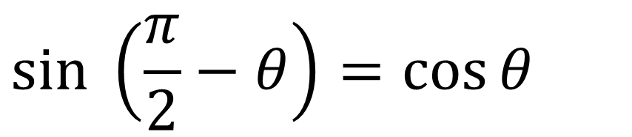
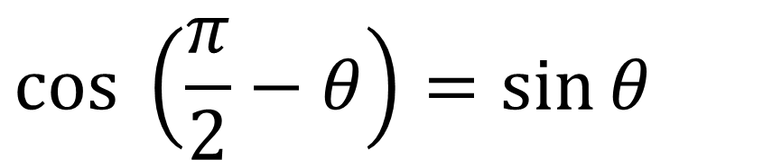
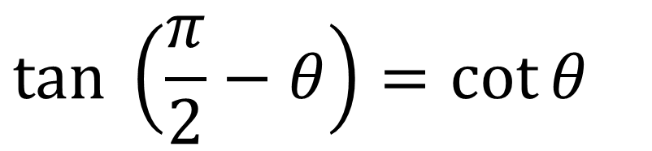
Cofunction Identities
$$cos \left(\frac{π}{2}−θ\right)=\sin{θ}$$
$$sin \left(\frac{π}{2}−θ\right)=\cos{θ}$$
$$tan \left(\frac{π}{2}−θ\right)=\cot{θ}$$

Slide 13
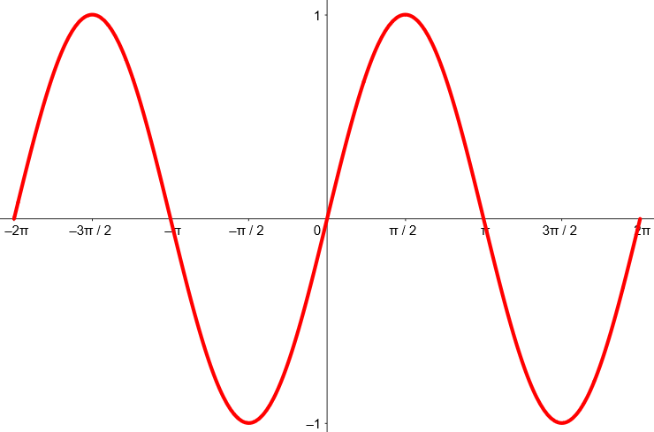
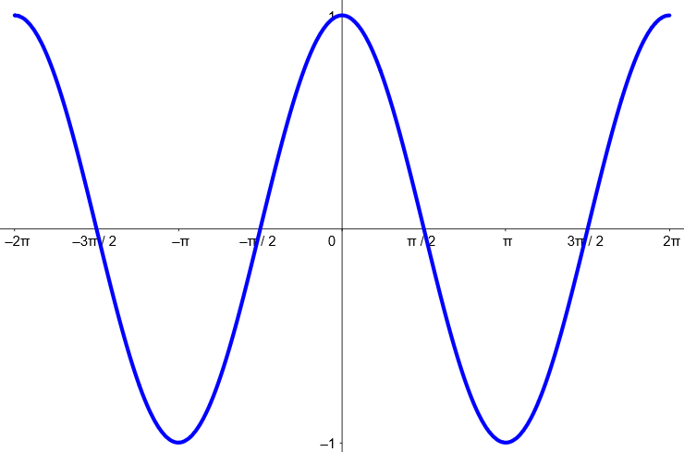
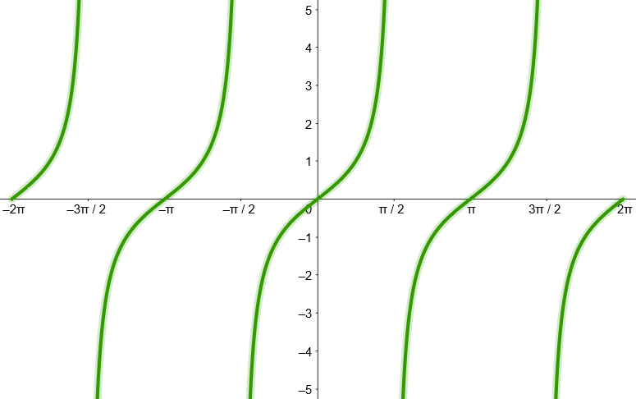






Negative Angle Identities (Odd-Even Identities)
$$y=sin{θ}$$
$$y=cos{θ}$$
$$y=tan{θ}$$
Not symmetrical.
Symmetrical.
Not symmetrical.
Odd function.
Even Function
Odd Function
$\sin{(−θ)}=−\sin{θ}$
$\cos{(−θ)}=\cos{θ}$
$\tan{(−θ)}=−tan{θ}$
Algebraically, look at the points on the graph.
Graphically speaking, look at the symmetry of these graphs about the $y−axis$.

Slide 14
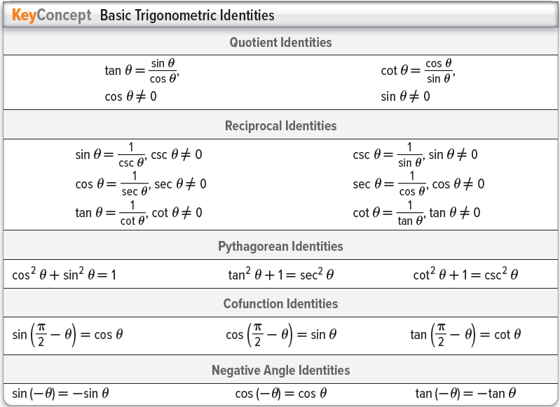
Summary of Basic Trig Identities

Slide 15




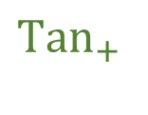




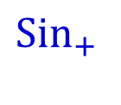






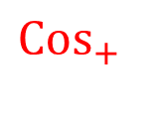

Memory Aid
$$(−270°)$$
Sometimes referred to as the CAST diagram
$$90°$$
$$+$$
$${Sin}_{+}$$
$$All_{+}$$
$$S$$
$$A$$
$$(−180°)$$
$$180°$$
$$0°$$
, $360°$
$$(−360°)$$
$${Tan}_{+}$$
$${Cos}_{+}$$
$$T$$
$$C$$
_
$$270°$$
$$(−90°)$$
Quadrant 1 – All the trig functions are positive
Quadrant 2 – Only the sine function is positive
Quadrant 3 – Only the tangent function is positive
Quadrant 4 – Only the cosine function is positive

Slide 16
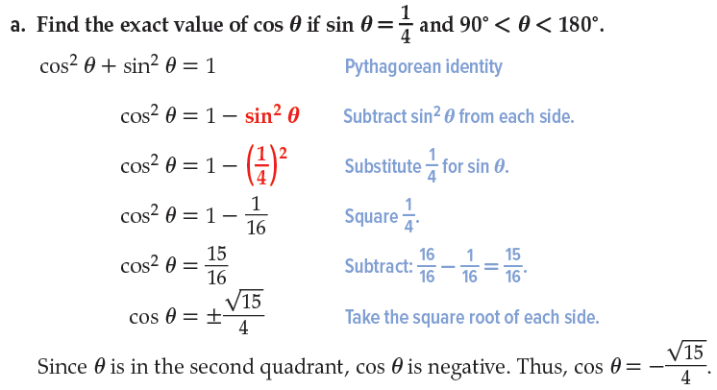
Example 1 – Trig Identities

Slide 17
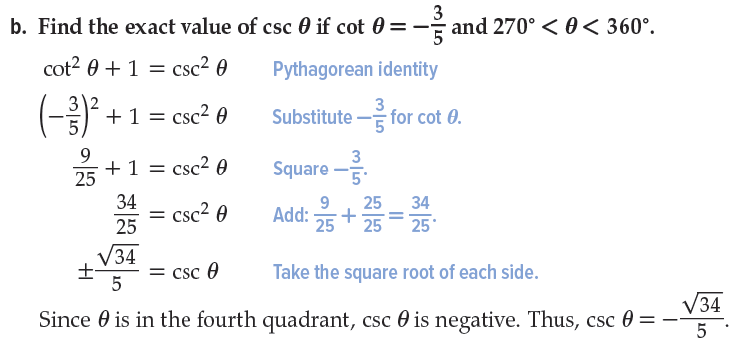
Example 1 – Trig Identities

Slide 18
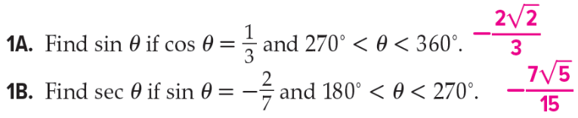
Guided Practice 1 – Trig Identities

Slide 19
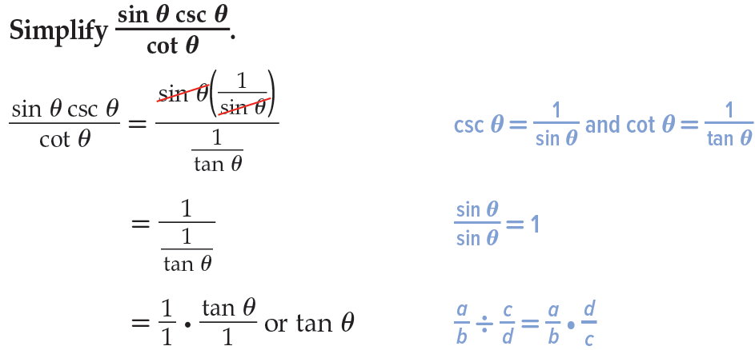
Example 2 – Simplifying an Expression

Slide 20

Guided Practice 2 – Simplifying an Expression

Slide 21


Example 3 – Simplify and Use an Expression

Slide 22

Example 3 – Simplify and Use an Expression

Slide 23

Guided Practice 3 – Simplify and Use Expression

Slide 24

Practice Questions 1

Slide 25

Practice Questions 2

Slide 26


Practice Questions 3

