Slide 1
5.2 – Solving Exponential Equations and Inequalities
Chapter 5 – Exponential Functions

Slide 2
Learning Objectives
1
Solve exponential equations in one variable
2
Solve exponential inequalities in one variable

Slide 3
1
Review of Exponent Rules

Slide 4
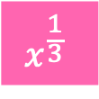





Review of Rules
Simplify the following using exponent rules:
$$x^{2}∙x^{7}$$
$$\frac{x^{14}}{x^{8}}$$
$${\left(x^{5}\right)}^{3}$$
$$x^{−4}$$
$$x^{\frac{1}{3}}$$
$$x^{0}$$

Slide 5
2
Exponential equations

Slide 6



Same base equations
Page 229, q 1
$${25}^{2x+3}={25}^{5x−9}$$

Slide 7



Changing one base
Page 230, q 33
$${81}^{a+2}=3^{3a+1}$$

Slide 8




Changing two bases
Page 230, q 36
$$8^{2y+4}={16}^{y+1}$$

Slide 9
Try it out for yourself
Answer the first 10 questions on the worksheet!

Slide 10
3
Exponential inequalities

Slide 11
Solving inequalities
You can use the exact same method as solving equations, just pay attention when multiplying or dividing by a negative number as we have to flip the inequality sign!

Slide 12




Example
Page 230, q 26
$${\left(\frac{1}{27}\right)}^{2d−2}≤{81}^{d+4}$$

Slide 13
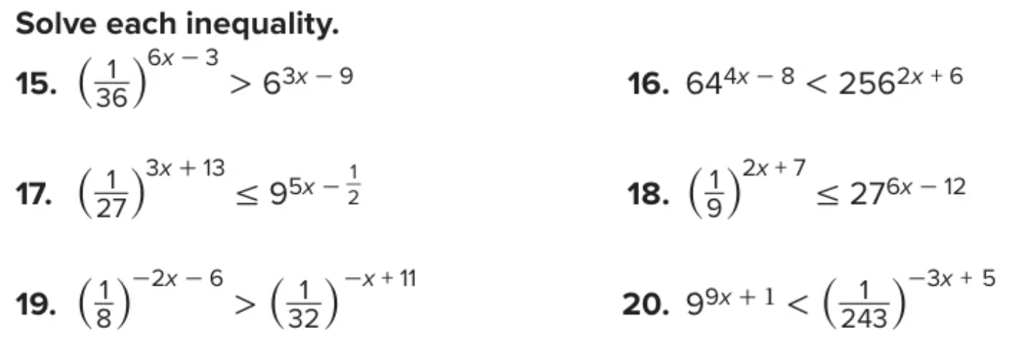
Try it out for yourself
Page 230, q 15 - 20

Slide 14

ANSWERS
Page 230, q 15 - 20
15) $x<1$ | 16) $x<12$
17) $x≥−2$ | 18) $x≥1$
19) $x>−73$ | 20) $x<−9$

Slide 15
4
Compound interest

Slide 16


Compound Interest
$$A=P{\left(1+\frac{r}{n}\right)}^{nt}$$
$A:$ the final amount
$P:$ the initial amount
$r:$ the annual interest rate
$n:$ the number of compounding periods each year
$t:$ number of years

Slide 17


Example
Page 229, q 11
Nancy deposits $2500 into an investing account that pays 6.1% annual interest compounded quarterly. What will be the balance after 10 years? Round to the nearest cent.
$$A=P{\left(1+\frac{r}{n}\right)}^{nt}$$

Slide 18
Try it out for yourself
Try the word problems to find the missing variable.

