Slide 1
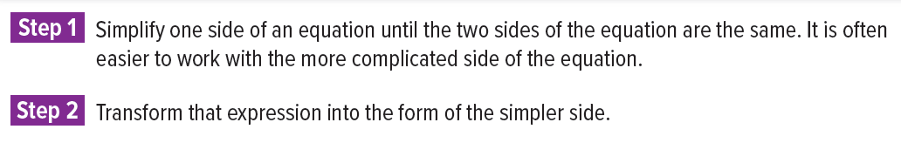
11.2 Verifying Trigonometric Identities
Trigonometric identities are equations that are true for all values of the variable for which both sides are defined.

Slide 2
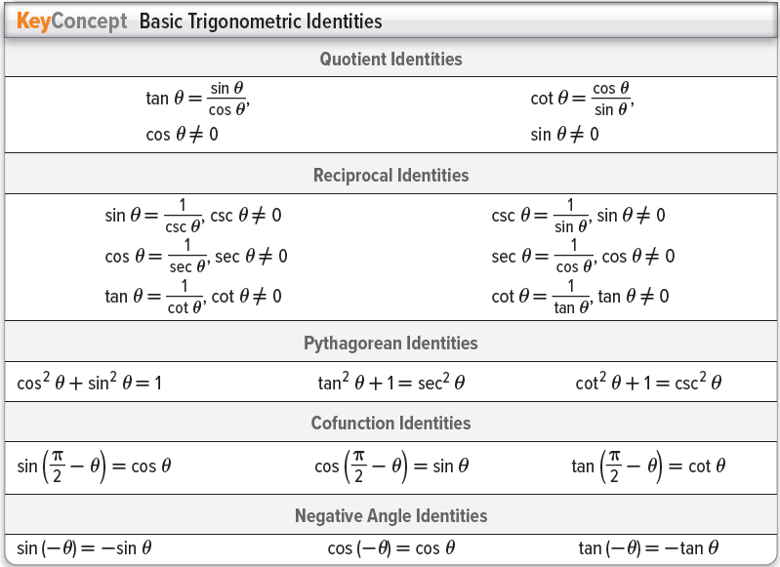
Starter
Pen and Paper needed
Write down all the trigonometric identities you can recall.
Have you discovered a way to memorize these easier that can be shared with the class?

Slide 3
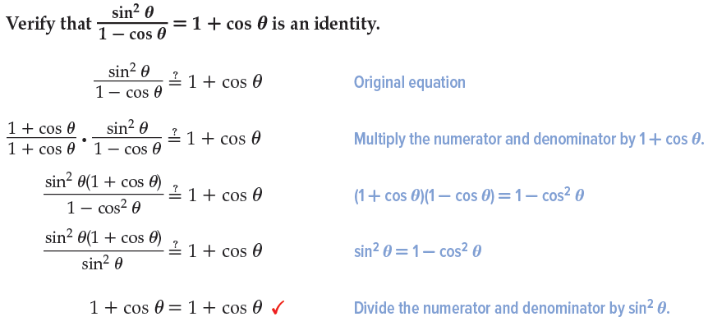
Example 1 – Transform One Side of An Equation

Slide 4
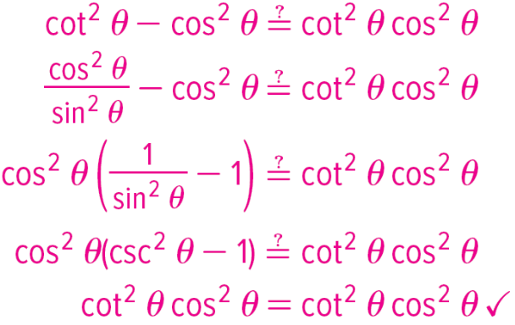
Guided Practice 1 – Transform One-Side of an Equation

Slide 5
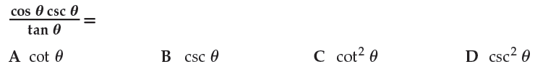
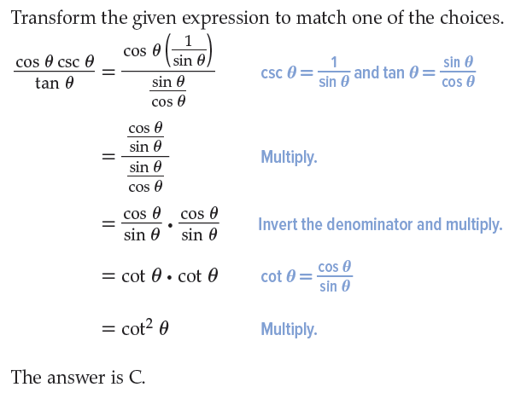
Example 2 – Simplify an Expression

Slide 6
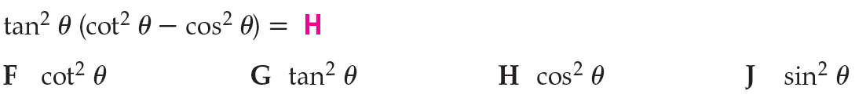
Guided Practice 2 – Simplify an Expression

Slide 7
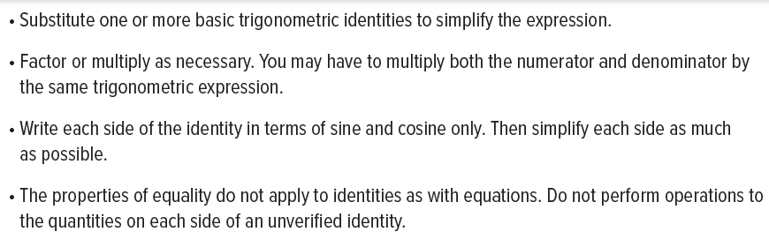
Suggestions for Verifying Identities

Slide 8
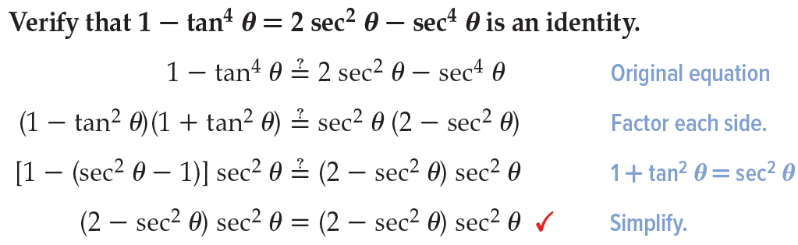
Example 3 – Verify by Transforming Each Side

Slide 9
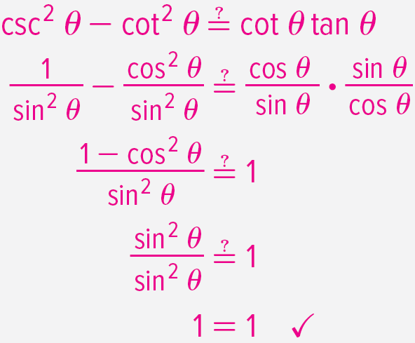
Guided Practice 3 – Verify by Transforming Each Side

Slide 10
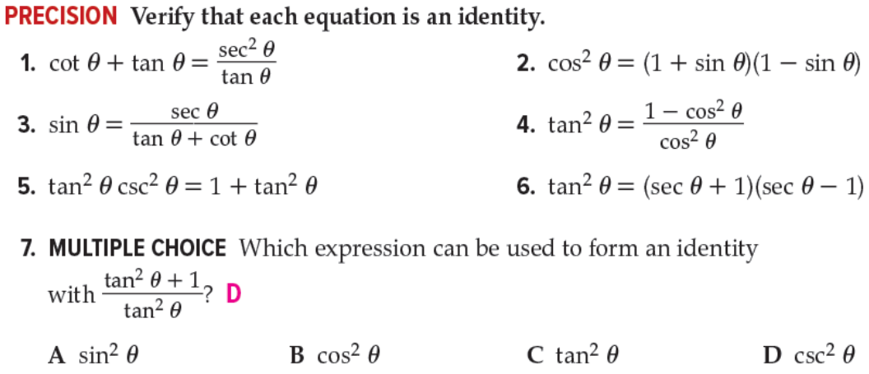
Practice Questions

Slide 11
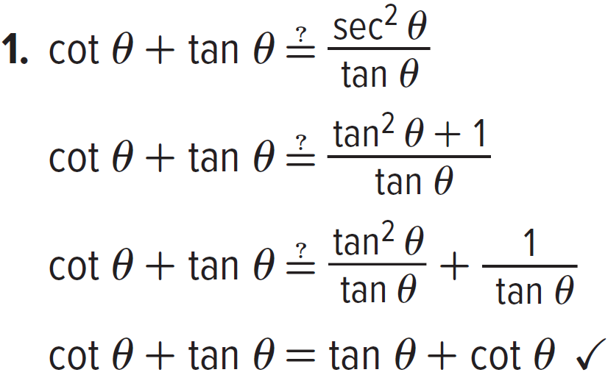
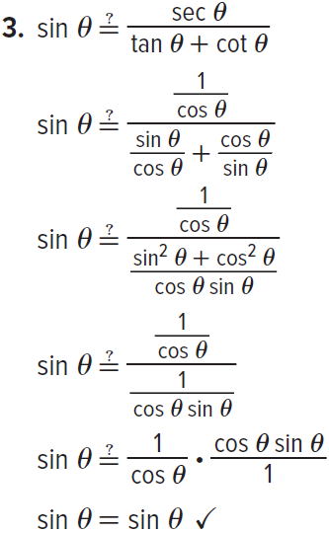
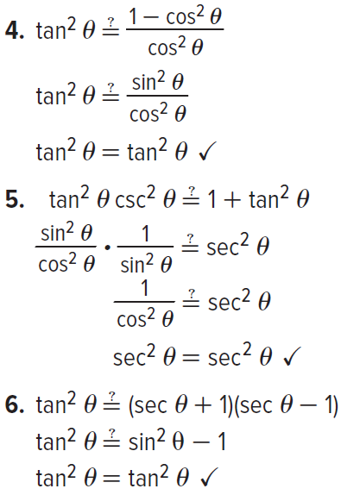
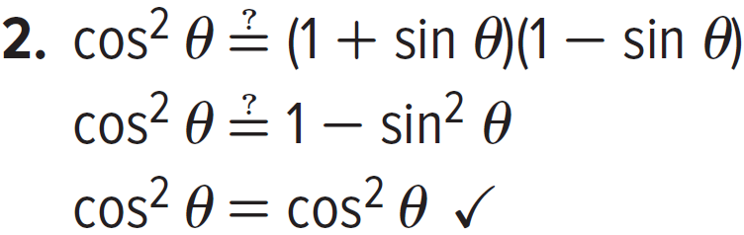
Solutions Questions 1 to 6

Slide 12
Timed Progress Bars for Student Task
Start 10 seconds
Start 20 seconds
Start 30 seconds
Start 1 minute
Start 5 minutes
Start 10 minutes

