Slide 1
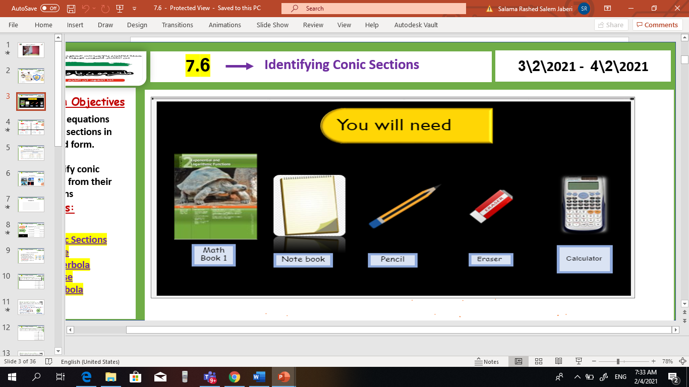

V
Unit 9
9 – 7 The binomial Theorem
Tues, 16 Mar 2021
Lesson Objectives
m
1. Graph points with polar coordinates.
2. Graph simple polar equations.
Keywords
Polar coordinates
Pole
Polar axis
Polar coordinates
Polar equation
Polar graph

Slide 2

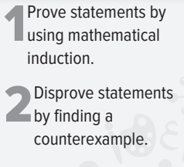
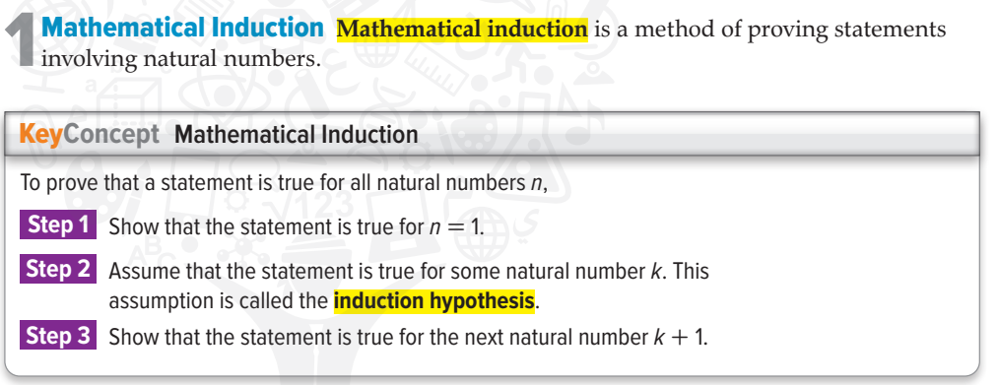


sum
Unit 9
9 – 7 The binomial Theorem
Tues, 16 Mar 2021
Lesson Objectives
m
New Vocabulary

Slide 3
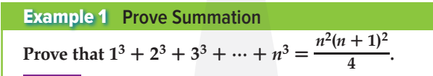
sum
Unit 9
9 – 7 The binomial Theorem
Tues, 16 Mar 2021
Lesson Objectives
m
New Vocabulary

Slide 4

sum
Unit 9
9 – 7 The binomial Theorem
Tues, 16 Mar 2021
Lesson Objectives
m
New Vocabulary

Slide 5

sum
Unit 9
9 – 7 The binomial Theorem
Tues, 16 Mar 2021
Lesson Objectives
m
New Vocabulary

Slide 6

sum
Unit 9
9 – 7 The binomial Theorem
Tues, 16 Mar 2021
Lesson Objectives
m
New Vocabulary

Slide 7
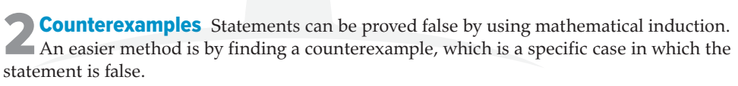
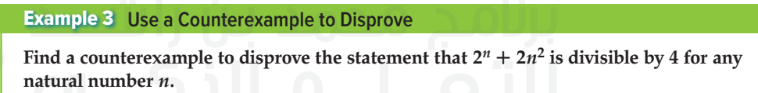
sum
Unit 9
9 – 7 The binomial Theorem
Tues, 16 Mar 2021
Lesson Objectives
m
New Vocabulary

Slide 8

sum
Unit 9
9 – 7 The binomial Theorem
Tues, 16 Mar 2021
Lesson Objectives
m
New Vocabulary

