Slide 1
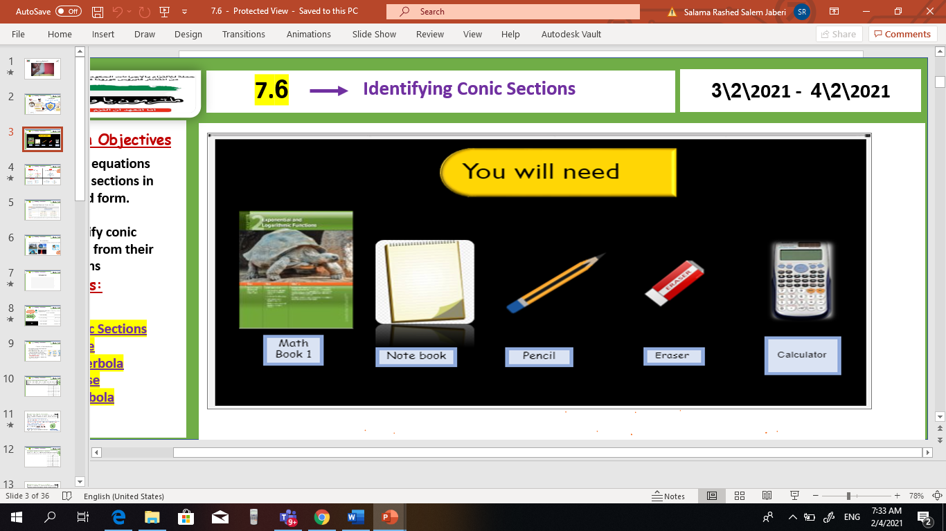

V
Unit 9
9-3 Arithmetic Sequences and series
Tues, 2 Mar 2021
Lesson Objectives
m
1. Graph points with polar coordinates.
2. Graph simple polar equations.
Keywords
Polar coordinates
Pole
Polar axis
Polar coordinates
Polar equation
Polar graph

Slide 2
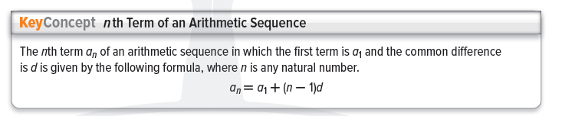
Unit 9
9-3 Arithmetic Sequences and series
Tues, 2 Mar 2021
Lesson Objectives
m
1- Use arithmetic sequences. 2 - Find sums of arithmetic series.
New Vocabulary
Arithmetic means Series Arithmetic series Partial sum sigma notation

Slide 3
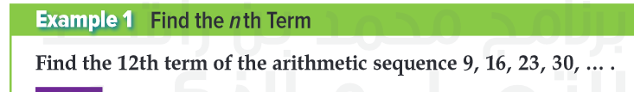
Unit 9
9-3 Arithmetic Sequences and series
Tues, 2 Mar 2021
Lesson Objectives
m
1- Use arithmetic sequences. 2 - Find sums of arithmetic series.
New Vocabulary
Arithmetic means Series Arithmetic series Partial sum sigma notation

Slide 4
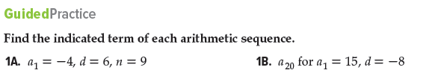
Unit 9
9-3 Arithmetic Sequences and series
Tues, 2 Mar 2021
Lesson Objectives
m
1- Use arithmetic sequences. 2 - Find sums of arithmetic series.
New Vocabulary
Arithmetic means Series Arithmetic series Partial sum sigma notation

Slide 5
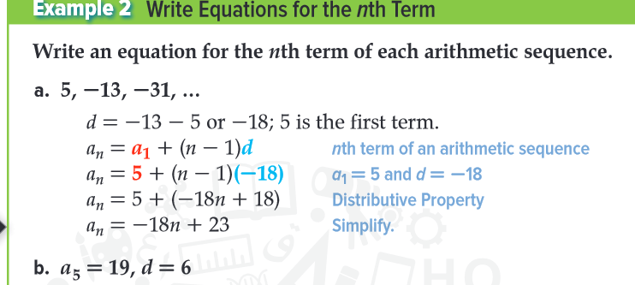
Unit 9
9-3 Arithmetic Sequences and series
Tues, 2 Mar 2021
Lesson Objectives
m
1- Use arithmetic sequences. 2 - Find sums of arithmetic series.
New Vocabulary
Arithmetic means Series Arithmetic series Partial sum sigma notation

Slide 6

Unit 9
9-3 Arithmetic Sequences and series
Tues, 2 Mar 2021
Lesson Objectives
m
1- Use arithmetic sequences. 2 - Find sums of arithmetic series.
New Vocabulary
Arithmetic means Series Arithmetic series Partial sum sigma notation

Slide 7
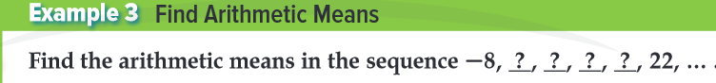
Unit 9
9-3 Arithmetic Sequences and series
Tues, 2 Mar 2021
Lesson Objectives
m
1- Use arithmetic sequences. 2 - Find sums of arithmetic series.
New Vocabulary
Arithmetic means Series Arithmetic series Partial sum sigma notation

Slide 8

Unit 9
9-3 Arithmetic Sequences and series
Tues, 2 Mar 2021
Lesson Objectives
m
1- Use arithmetic sequences. 2 - Find sums of arithmetic series.
New Vocabulary
Arithmetic means Series Arithmetic series Partial sum sigma notation

Slide 9
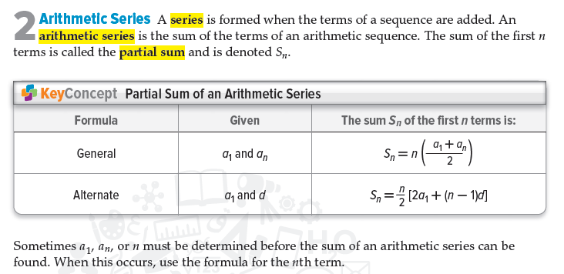
Unit 9
9-3 Arithmetic Sequences and series
Tues, 2 Mar 2021
Lesson Objectives
m
1- Use arithmetic sequences. 2 - Find sums of arithmetic series.
New Vocabulary
Arithmetic means Series Arithmetic series Partial sum sigma notation

Slide 10
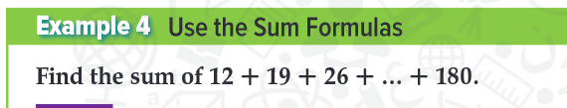
Unit 9
9-3 Arithmetic Sequences and series
Tues, 2 Mar 2021
Lesson Objectives
m
1- Use arithmetic sequences. 2 - Find sums of arithmetic series.
New Vocabulary
Arithmetic means Series Arithmetic series Partial sum sigma notation

Slide 11

Unit 9
9-3 Arithmetic Sequences and series
Tues, 2 Mar 2021
Lesson Objectives
m
1- Use arithmetic sequences. 2 - Find sums of arithmetic series.
New Vocabulary
Arithmetic means Series Arithmetic series Partial sum sigma notation

Slide 12
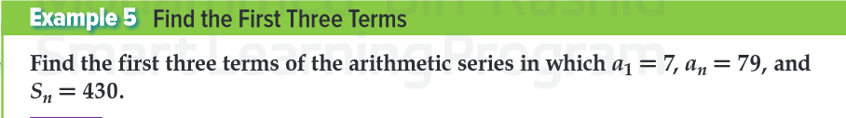
Unit 9
9-3 Arithmetic Sequences and series
Tues, 2 Mar 2021
Lesson Objectives
m
1- Use arithmetic sequences. 2 - Find sums of arithmetic series.
New Vocabulary
Arithmetic means Series Arithmetic series Partial sum sigma notation

Slide 13

Unit 9
9-3 Arithmetic Sequences and series
Tues, 2 Mar 2021
Lesson Objectives
m
1- Use arithmetic sequences. 2 - Find sums of arithmetic series.
New Vocabulary
Arithmetic means Series Arithmetic series Partial sum sigma notation

Slide 14
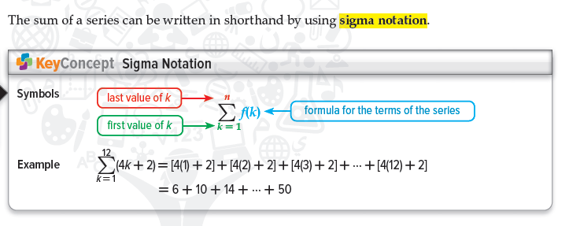
Unit 9
9-3 Arithmetic Sequences and series
Tues, 2 Mar 2021
Lesson Objectives
m
1- Use arithmetic sequences. 2 - Find sums of arithmetic series.
New Vocabulary
Arithmetic means Series Arithmetic series Partial sum sigma notation

Slide 15
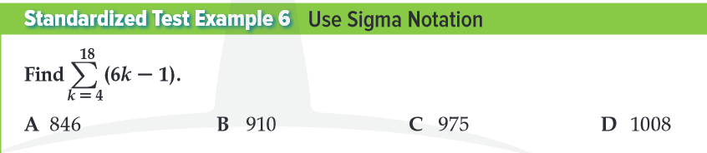
Unit 9
9-3 Arithmetic Sequences and series
Tues, 2 Mar 2021
Lesson Objectives
m
1- Use arithmetic sequences. 2 - Find sums of arithmetic series.
New Vocabulary
Arithmetic means Series Arithmetic series Partial sum sigma notation

Slide 16
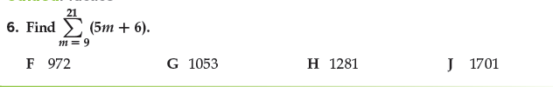
Unit 9
9-3 Arithmetic Sequences and series
Tues, 2 Mar 2021
Lesson Objectives
m
1- Use arithmetic sequences. 2 - Find sums of arithmetic series.
New Vocabulary
Arithmetic means Series Arithmetic series Partial sum sigma notation

