Slide 1
5.3 – Special Exponential Functions
Chapter 5 – Exponential Functions

Slide 2

Learning Objective
1
Analyse expressions and functions involving the natural base $e$

Slide 3

1
The letter“$e”$

Slide 4
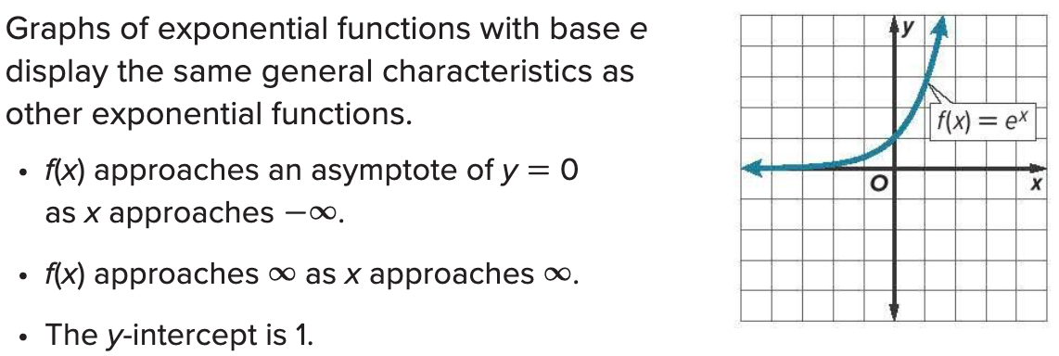

General information
$e$ is a constant (i.e. a special number) that is used to describe exponential functions. It can be used to calculate continuously compounding interest

Slide 5
2
Exponent rules

Slide 6




Simplifying exponents
Page 234, Check
$$e^{4}∙e^{3}∙e$$ | $${\left(6e^{2}\right)}^{4}$$ | $$\frac{60e^{6}}{12e^{2}}$$

Slide 7
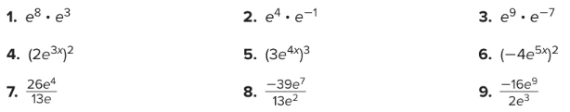
Try it out for yourself
Page 237, q 1 - 9

Slide 8
3
Average rate of change

Slide 9

Rate of change
The rate of change/average rate of change can be calculated using the same method for the slope.
$$\frac{y_{2}−y_{1}}{x_{2}−x_{1}}$$

Slide 10


Example
Page 235, Check
Find the average rate of change of $g\left(x\right)=−e^{x+1}+2$ over each interval.
$[−6, −3]$
$\left[−1, 1\right]$
$[1, 4]$

Slide 11
4
Continuously Compounding interest

Slide 12


Continously Compound Interest
$$A=Pe^{rt}$$
$A:$ the final amount
$P:$ the initial amount
$r:$ the annual interest rate (decimal)
$t:$ number of years

Slide 13

Example
Page 237, q 14
Jariah invested $6500 in a savings account that grows continuously at an annual rate of 3.25%.
Write the function that represents the situation, where A is the value of Jariah’s investment after t years.
What will Jariah’s investment be worth after 18 years?

Slide 14
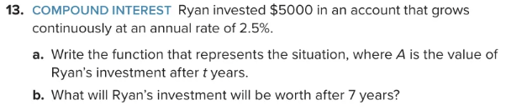
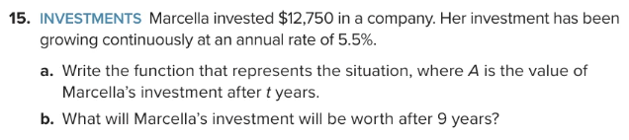
Try it out for yourself

