Slide 1
English Language
Coverage, Grammar and Functional Language Teaching Resource
Grade 11 Advanced and Elite
Term 1
2024 - 2025

Slide 2
INDEX
03
06
08
15
How to use this resource
Assessment Coverage
Preparation - Grammar
Preparation – Functional language

Slide 3
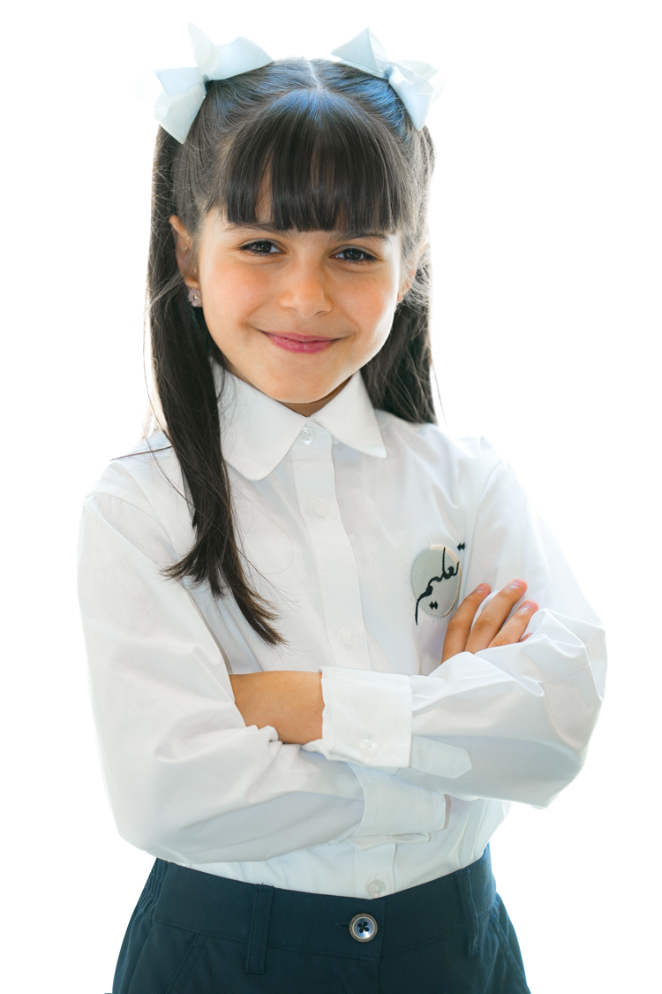
How to use this resource

Slide 4

The Coverage, Grammar and Functional Language Teaching Resource
The slides within this resource, although detailed, are designed as a starting point for teachers. You can:
construct lessons around the language points explored in them.
use the slides individually as a resource within a lesson.
incorporate them gradually in lessons throughout the term (rather than the whole PowerPoint at once).
combine functional language and grammar slides which overlap.
Ensure that students have been exposed to all the language points in the coverage ahead of their end of term exam.

Slide 5

Within this document, you will find information about:
the coverage for this term.
the lexis families that assessments will contain.
particular grammatical and functional language points that will be tested in the exams.
In the preparation sections, you will find examples and explanations for the grammatical and functional language points that will be assessed this term.
The grammar preparation sections contain:
an example sentence.
an explanation of the meaning of the example sentence.
the specific grammatical structure used within the example sentence.
links to further resources.
an explanation of the circumstances under which the structure is used.
more example sentences.
In the functional language preparation section, there are examples and explanation of how the functional language is used, as well as relevant associated grammar points.

Slide 6

Term 1 Assessment Coverage

Slide 7
Topic(s): Culture and customs, people, technology.
ECFE Grammar | Prerequisite | GSE Grammar | Functional Language
Passives: with reporting verbs | Can report current and future plans and intentions. (42) | Can use 'it is/was believed/reported that' + VP to report beliefs, reports, rumours, etc. (67) | Expressing opinion Describing past experiences and events Comparing and contrasting
Passives: present continuous passive | Can use the present simple passive. (48) | Can use present continuous passive in complex sentences. (see English Grammar Profiler)
Conditionals: second conditional | Can describe hypothetical (counterfactual) results of a current action or situation using the second conditional. (48) | Can use 'as if/as though' with the past simple to refer to hypothetical or counterfactual circumstances. (70)
Modals: deduction | Can use 'must' and 'can't' for inferences and assumptions in the present. (49) | Can use a wide range of modals of deduction in complex sentences. (see English Grammar Profile)
Adjectives: comparatives | Can make comparisons with 'more' + longer adjectives. (36) | Can use 'than' + an increasing range of non-finite clauses (to-infinitive, reduced clause) forming the second part of a comparison after a comparative adjective. (see English Grammar Profile)
Adjectives: superlatives | Can form the superlative of longer regular adjectives with 'most'. (36) | Can use a superlative adjective (+ noun) (+ 'that') followed by a clause to talk about something unique. (see English Grammar Profile)

Slide 8

Term 1 preparation: Grammar

Slide 9
It is thought that the new owner of the company is a highly-skilled programmer.
Checking questions | Is the person a skilled programmer? Are we sure? Who says that she is?
Grammatical structure | Passive reporting statements it + be + ‘believed / reported / thought’ + that + verb phrase G.10.7 Passives (past perfect simple passive)
Usage | We use passives with reporting verbs 'thought / considered / believed’ to report beliefs, reports, rumours, etc. when we want to obscure the source of the information, or where the source of the information is not important. The emphasis is on the information that is being reported, not the people who are reporting it.
Other examples | It is reported that they are the most talented chefs in town. It was believed that everyone had passed the exam. It is now thought that the game will be postponed until next week.

Slide 10
Why haven’t the IT students completed the online project? The students’ laptops are being replaced so they don’t have access.
Checking questions | Can the students work now? What has happened to their laptops? When will they get new ones? Who is replacing them?
Grammatical structure | Present continuous passive subject + is / are + being + past participle G.10.3 Passives (present continuous passive)
Usage | We use the present continuous passive to talk about actions ongoing at the moment of speaking. The passive voice is used to focus on the receiver of the action, not on who is carrying out the action.
Other examples | The new exhibition which is being created will focus on the history of the country. People’s needs are not being met by the hospital’s current level of provision. Whether artificial intelligence can be used effectively in education is being considered in many schools across the country.

Slide 11
You act as if you don’t care about the rest of us.
Checking questions | Is this situation real? Who is the speaker talking to? Does the person addressed care about people? What is their behaviour like? Is this situation possible?
Grammatical structure | Conditionals (Second) 'as if/as though' + complement clause (past simple; equivalent to second conditional)
Usage | We use ‘as if’ and ‘as though’ to talk about a situation that may not be true but that is likely or possible. We use it to imagine a situation and say that it is similar to another situation. We refer to something appearing to be the case, but where it actually is not. The verb after the phrase can be in the present tense, the past, the past perfect etc. Examples: He looks as if he were angry. (present tense) He looked as if he were angry. (past tense) He looked as if he had been angry. (past perfect tense)
Other examples | Many old people feel as though technology is too difficult for them to understand. The children behaved as though the teacher wasn’t there. My mother talked as if I had already been accepted by the university.

Slide 12
She always works late at the office. She must really like her job.
Checking questions | Does the woman like her job? How can we tell?
Grammatical structure | Modals: present modals (deduction) Present - subject + ‘must / can’t / might / could’ + base form of verb Present negative – can’t / couldn’t + base form of verb Past - subject + ‘must / might / could’ + have + past participle Past negative – can’t / couldn’t + have + past participle G.8.2 Modals (past)
Usage | We use modals of deduction to express our level of certainty about something, based on the information that we have. When we are sure of something, we use ‘must,’ ‘must have’ or ‘can’t.’ When we are less sure, we use ‘might’ or ‘could.’
Other examples | You are surrounded by family and friends so you can't be sad. She might have forgotten about the meeting yesterday because she wasn’t there. He can’t have left the country because his passport is still here.

Slide 13
Sarah performed better in the final exams than she had ever expected.
Checking questions | Did Sarah get a high mark in the exams? Did she expect to get a high mark?
Grammatical structure | Adjectives (comparatives) Can use 'than' + an increasing range of non-finite clauses (to-infinitive, reduced clause) forming the second part of a comparison after a comparative adjective. comparative phrase + ‘than’ + to infinitive comparative phrase + ‘than’ + past participle
Usage | We use comparative adjectives and phrases followed by ‘than’ when comparing two noun or verb phrases or clauses.
Other examples | In the past, it was more difficult to book hotels on the internet than to find one when you arrived at your destination. She always worked many more hours than required to make sure her work was perfect. It is much easier to consider eating healthy food, Ahmed thought, than to actually eat a healthy diet.

Slide 14
This is by far the best wedding that I have ever been to.
Checking questions | Is this a good wedding? Has the speaker been to a wedding better than this in their whole life?
Grammatical structure | Adjectives (superlatives) superlative adjective + noun + ‘that’ clause ‘by far’ / ‘among’ / ‘one of’ + the + superlative adjective
Usage | We use superlative adjectives with a ‘that’ clause to express uniqueness and that something or someone is either the top or bottom of a specified group. We use adverbial phrases such as ‘by far’ to intensify the superlative. ‘Among’ or ‘one of’ with a superlative is used to say there are several ‘bests’, for example, but only a small number.
Other examples | She is by far the most enthusiastic colleague that I’ve met in our company. This is one of the most boring meetings that I have ever sat through. It’s among the most useful designs that I have ever seen because it meets all the requirements.

Slide 15
Term 1 preparation:
Functional language

Slide 16
The way I see it, artificial intelligence will permanently replace many jobs, such as artists and authors. I can’t help thinking that people had a much higher quality of life in the past than they do today. You can’t have finished the exam. You’ve only been here twenty minutes.
Functional language point | Expressing opinion
Associated grammar | Modals of deduction, present perfect, verb phrases

Slide 17
What happened to you when you were young, to make you the way you are now? Until a few years ago, I had wanted to be an engineer, but now I am interested in studying healthcare instead. My grandfather would always say confidence and creativity were his best qualities.
Functional language point | Describing past experiences and events​
Associated grammar | Adverbial phrases of time, past simple and past continuous​, relative clauses, past perfect, adjectives

Slide 18
The race went ahead, despite several of the camels not having riders. What’s the difference between leaving now and in ten minutes, after the film has finished? In contrast to traditional crafts, modern products are made quickly and in large quantities.
Functional language point | Comparing and contrasting
Associated grammar | Adjectives, nouns, comparatives, superlatives

Slide 19
Thank you

