Slide 1
1.4 Enthalpy of a chemical reaction
LO: 1. Discuss enthalpy and enthalpy change
2. Calculate the enthalpy change of a reaction and illustrate how it depends on the stoichiometry of the reactants and products

Slide 2
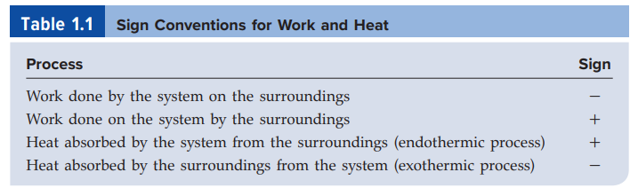

Slide 3

Enthalpy
where U is the internal energy of the system and P and V are the pressure and volume of the system, respectively.
U, P, and V are all state functions, that is, the changes in (U + PV) depend only on the initial and final states.
It follows, therefore, that the change in H, or ∆H, also depends only on the initial and final states. Thus, H is a state function.

Slide 4
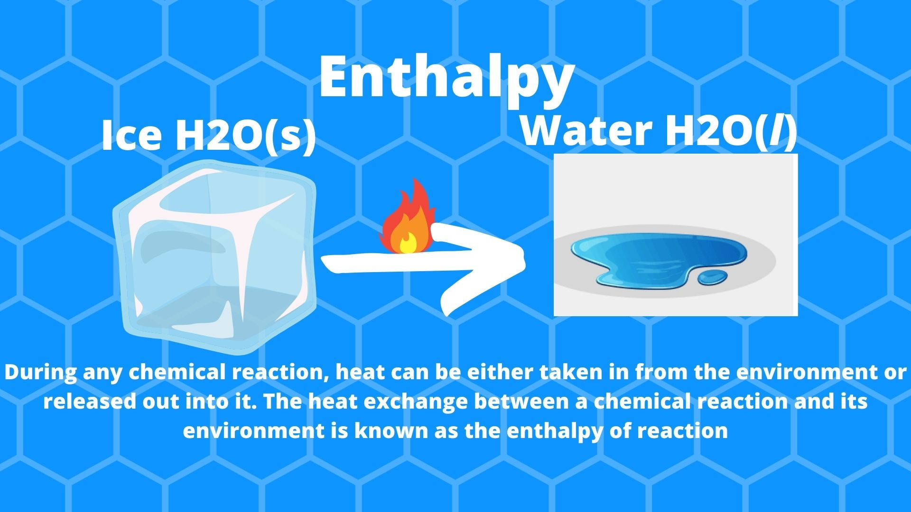

Slide 5

Enthalpy of a reaction
Enthalpy of reaction, ∆Hrxn, as the difference between the enthalpies of the products and the enthalpies of the reactants.
The enthalpy of reaction can be positive or negative, depending on the process.
For an endothermic process (heat absorbed by the system from the surroundings), ∆H is positive (that is, ∆H > 0).
For an exothermic process (heat released by the system to the surroundings), ∆H is negative (that is, ∆H < 0).

Slide 6

For an endothermic process, ∆H is positive (that is, ∆H > 0), here 88 kJ is required for the process .
For an exothermic process, ∆H is negative (that is, ∆H < 0), here 802.4 kJ is released from the process.

Slide 7
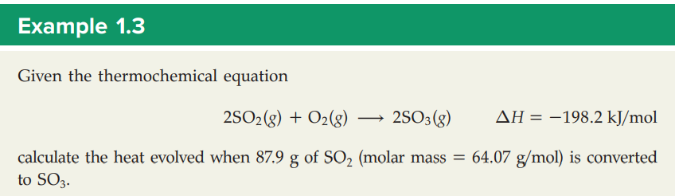
q=n ∆H
Where q=heat evolved
n= number of moles
∆H = change in enthalpy
n, number of moles = mass/molar mass =87.9/64.07 = 1.37 moles of SO2
Here we have 2 moles of SO2, so n = 1.37/2 = 0.69
q= n ∆H = 0.69 x 198.2 = 136.758 =137 kJ
Heat evolved = 137 kJ

Slide 8
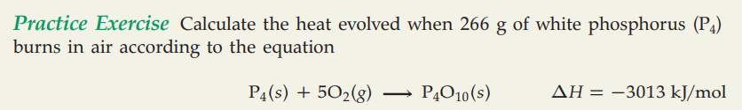

Slide 9
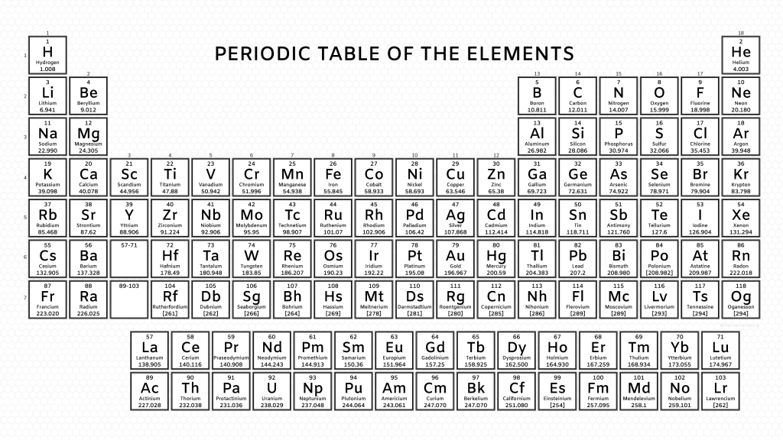

Slide 10
Guidelines for interpreting thermochemical equations
When writing thermochemical equations, we must always specify the physical states of all reactants and products, because they help determine the actual enthalpy changes. For example, in the equation for the combustion of methane, if we show water vapor rather than liquid water as a product.

Slide 11
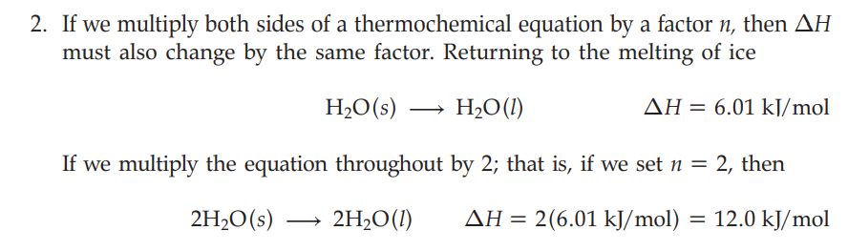

Slide 12
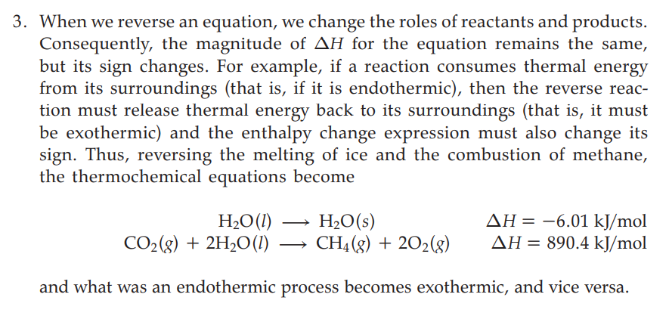

Slide 13
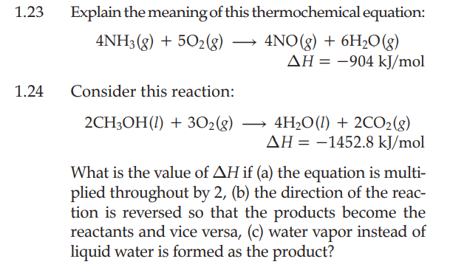


Slide 14
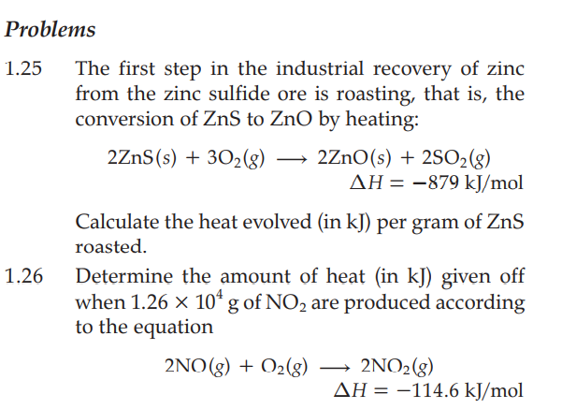

Slide 15
