Slide 1
Thermodynamics

Slide 2
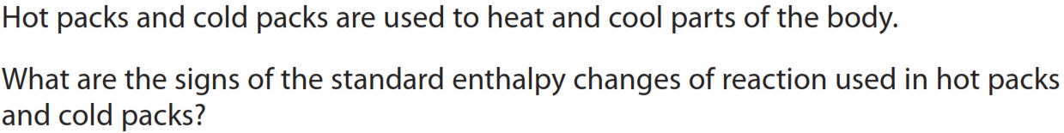
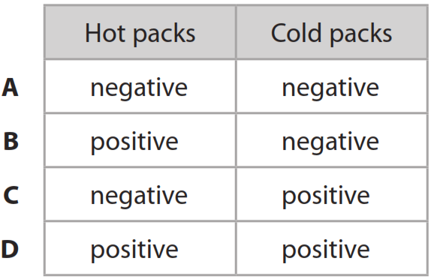
What you need to do:
Write the title, the date and L.Os in your book
Sunday, 15 September 2024
Enthalpy
Learning objectives
I can calculate enthalpy changes and apply Hess’s Law
Key words: Enthalpy • State function • System • Surrounding
Do it Now
Notes:
2
2

Slide 3
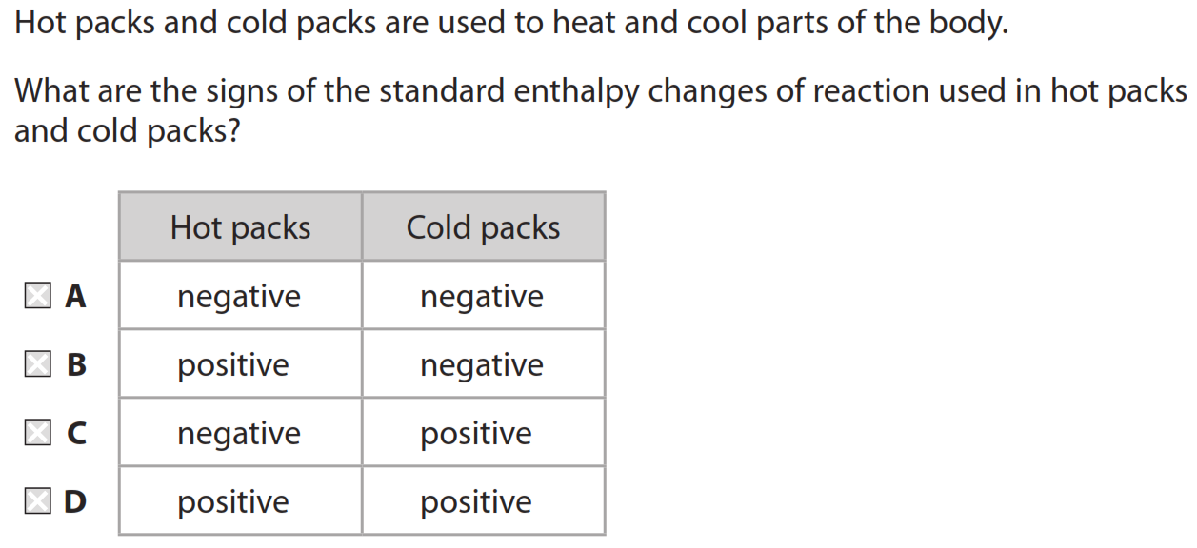
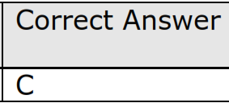
Do it Now

Slide 4
Enthalpy Change, ΔH
Enthalpy is defined as potential energy that may be evolved or absorbed as heat.
Most enthalpy changes are quoted as standard enthalpy changes.
This means that heat produced is measured under standard conditions, (SATP),
which are:
a pressure of 1 atm
a stated temperature (usually 25 ºC)
all solutions at a concentration of 1 mol/L
The symbol for standard conditions is a superscript 0 or θ, as in ΔH⁰
SATP stands for Standard Ambient Temperature and Pressure

Slide 5
Standard enthalpy of formation, ΔH_{f} ⁰
The standard enthalpy of formation is the enthalpy change when 1 mol of a substance is formed from its elements in their standard states at 1 atm pressure and 298 K (25 ºC). The units are kJ/mol
C (s) + ½O₂ (g) → CO (g)
e.g.
2C (s) + 3H₂ (g) + ½O₂ (g) → C₂H₅OH (l)

Slide 6
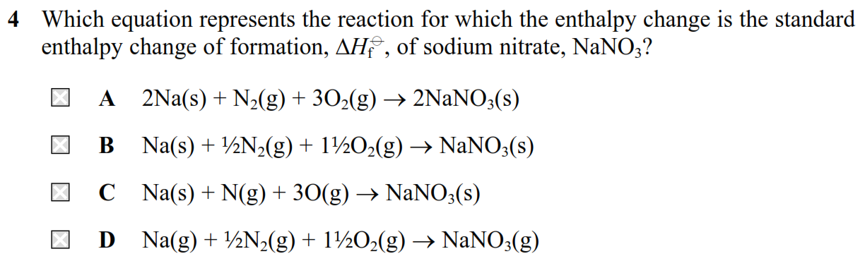
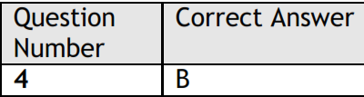

Slide 7
Standard enthalpy of reaction, ΔH_{r}⁰
Standard enthalpy of reaction is the enthalpy change when the number of moles of a substances in the equation as written react under standard condition of 1 atm pressure and a stated temperature, usually 298 K (25 ºC). The units are kJ/mol
ΔH_{r}
C₄H_{6(g)} + 2HBr (g)
CH₃CHBrCHBrCH₃

Slide 8
Standard enthalpy of combustion, ΔH_{c}⁰
The standard enthalpy of combustion is the enthalpy change when 1 mol of substance is completely burned in excess oxygen under standard conditions of 1 atm pressure and 298 K (25ºC).
C₂H₆ (g) + 3½O₂ (g) → 2CO₂ (g) + 3H₂O (l)
The enthalpy change is for 1 mol of substance. This is why the moles of oxygen gas can be given as a fraction.

Slide 9
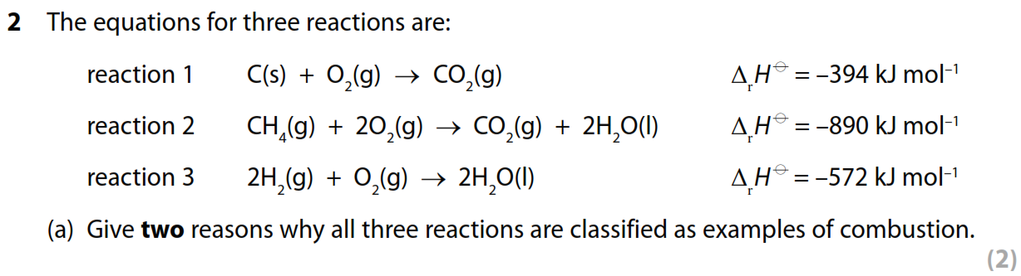

Slide 10
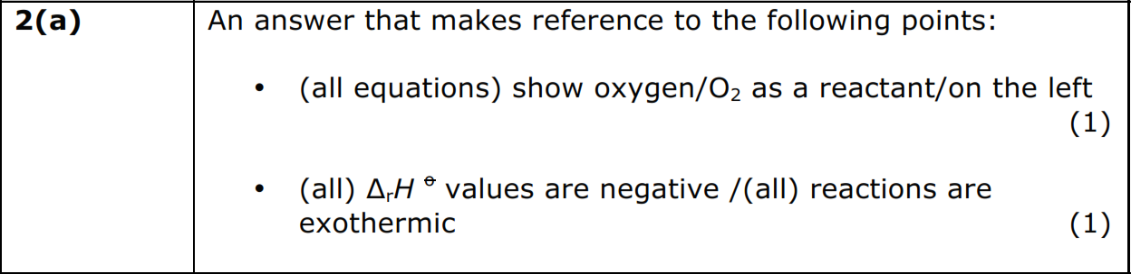

Slide 11
Stretch and challenge

Slide 12
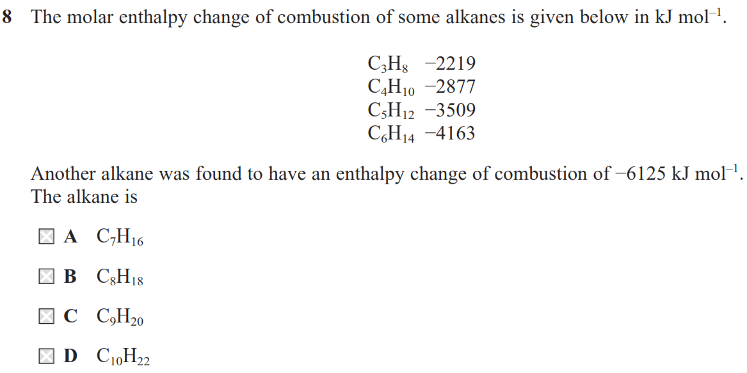

Slide 13
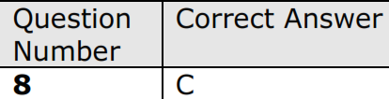

Slide 14
Standard enthalpy of neutralisation, ΔH_{neut} ⁰
Standard enthalpy of neutralisation is the enthalpy change when 1 mol of water is produced by the neutralisation of a solution of an acid by excess base under standard conditions, with all solutions of concentration 1 moldm⁻³. The units are kJmol⁻¹
The standard enthalpy change of neutralisation of HCl can be represented:
HCl + NaOH + → NaCl + H₂O
Strong acids are completely ionised in solution. Therefore, the ionic equation representing the enthalpy of the neutralisation of any strong acid by a strong base is:
H⁺ + OH⁻ → H₂O

Slide 15
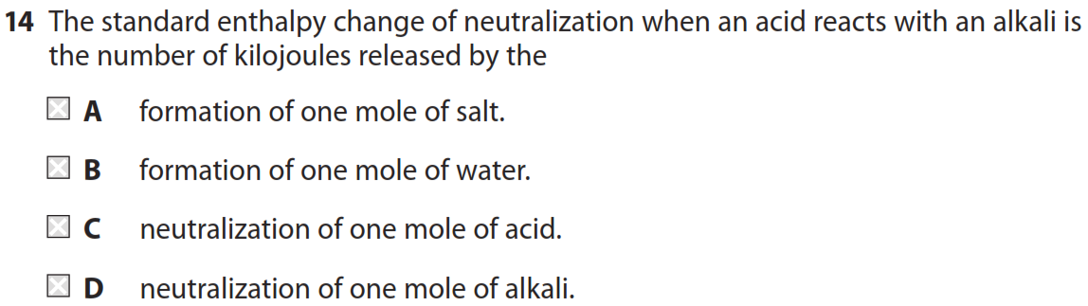

Slide 16
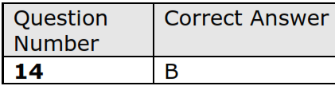

Slide 17
Plenary

Slide 18
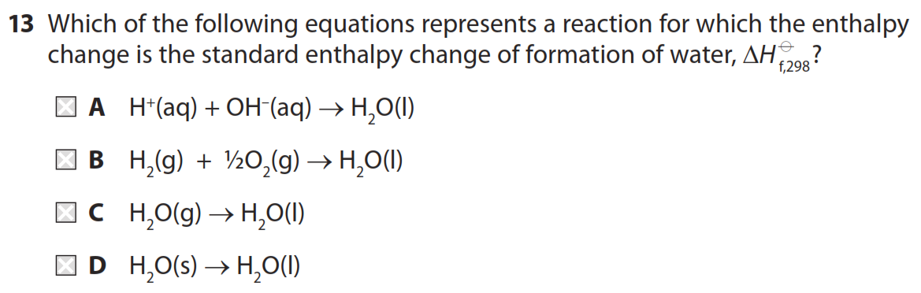

Slide 19
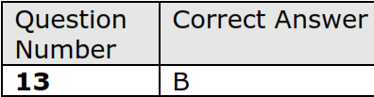

Slide 20
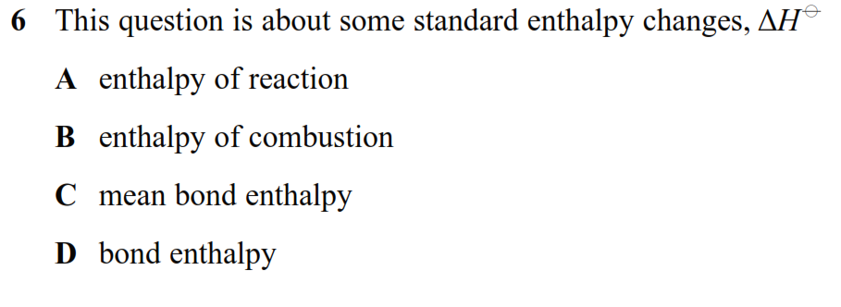
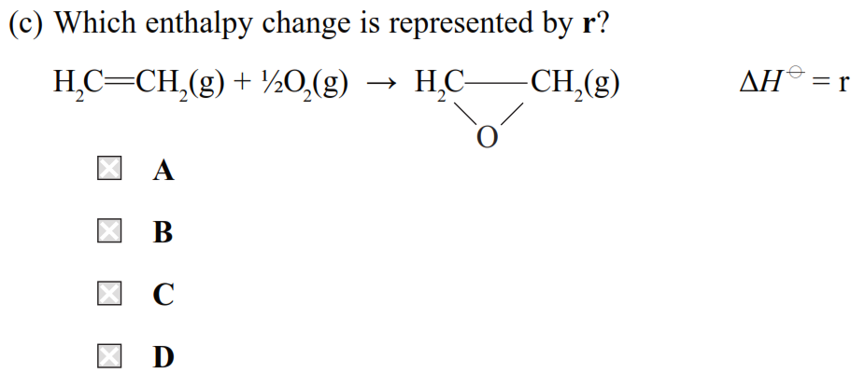

Slide 21
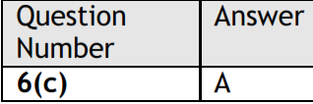

Slide 22

END

