Slide 1
مراجعة على المصفوفات

Slide 2
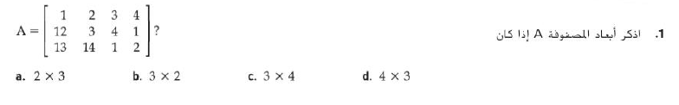
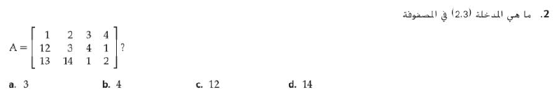



Slide 3
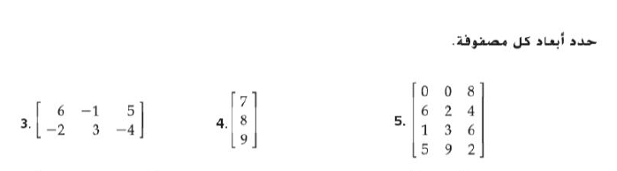
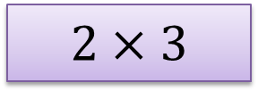
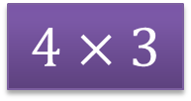
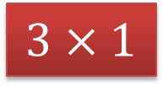
$$2×3$$
$$3×1$$
$$4×3$$

Slide 4

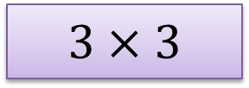
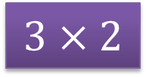
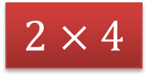
$$3×3$$
$$2×4$$
$$3×2$$

Slide 5





Slide 6
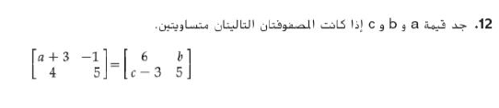

Slide 7



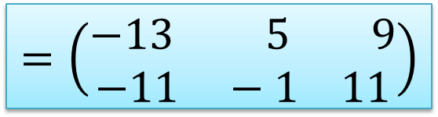
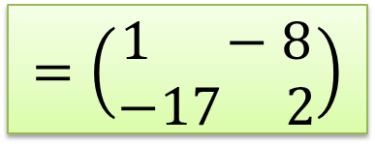
$$=\left(\begin{aligned}1 −8 \\ −17 2\end{aligned}\right)$$
$$=\left(\begin{aligned}−13 5 9 \\ −11 −1 11\end{aligned}\right)$$
غير ممكنه

Slide 8


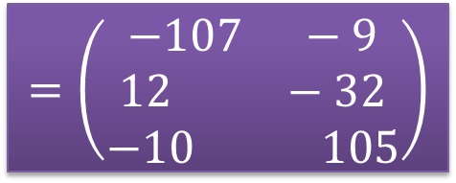
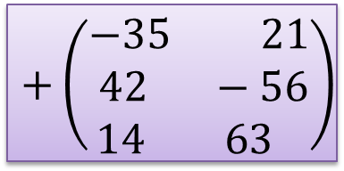
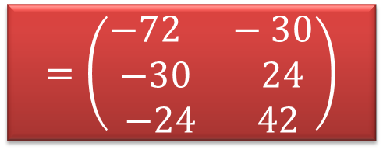
$$=\left(\begin{aligned}−72 −30 \\ −30 24 \\ −24 42\end{aligned}\right)$$
$$+\left(\begin{aligned}−35 21 \\ 42 −56 \\ 14 63 \end{aligned}\right)$$
$$=\left(\begin{aligned}−107 −9 \\ 12 −32 \\ −10 105\end{aligned}\right)$$

Slide 9
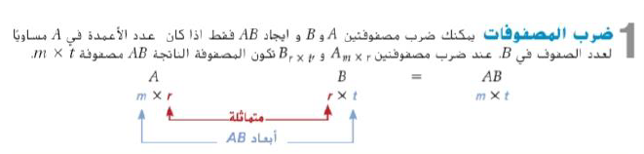
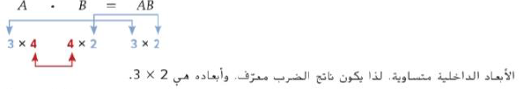
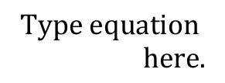

Slide 10





$$A_{4×6} . B_{6×2=}$$
$${AB}_{4 × 2}$$

Slide 11


$$A_{3×2} . B_{3×2}$$

Slide 12


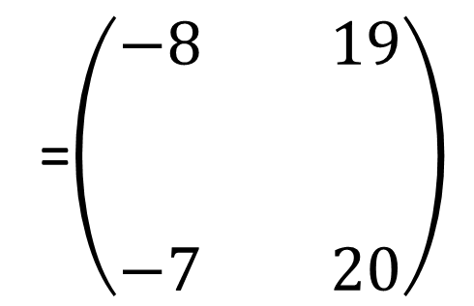
$$AB=$$
=$\left(\begin{aligned}−8 19 \\ \\ \\ −7 20\end{aligned}\right)$
-8
19
$$\left(\begin{aligned}4 −1 \\ \\ \\ 5 −2\end{aligned}\right)$$
$$\left(\begin{aligned}−3 6 \\ \\ \\ −4 5\end{aligned}\right)$$
-7
20

Slide 13

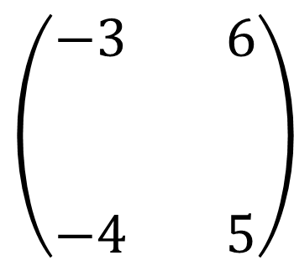
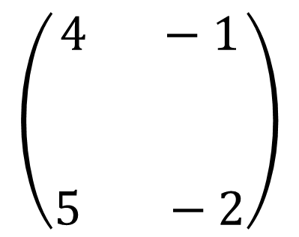
$$BA=$$
$$\left(\begin{aligned}−3 6 \\ \\ \\ −4 5\end{aligned}\right)$$
$$\left(\begin{aligned}4 −1 \\ \\ \\ 5 −2\end{aligned}\right)$$
18
-9
=
9
-6
نجد ان
$$AB≠BA$$

Slide 14




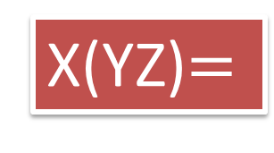
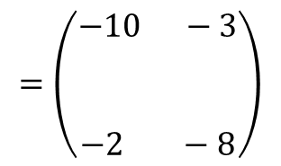
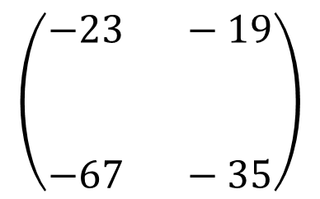
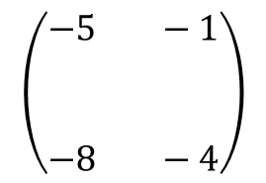
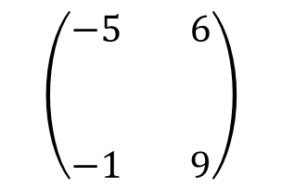
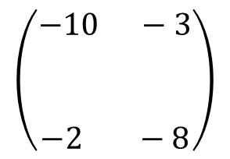
X(YZ)$=$
$$\left(\begin{aligned}−23 −19 \\ \\ \\ −67 −35\end{aligned}\right)$$
-23
-19
$$\left(\begin{aligned}−10 −3 \\ \\ \\ −2 −8\end{aligned}\right)$$
$$\left(\begin{aligned}−5 6 \\ \\ \\ −1 9\end{aligned}\right)$$
$$\left(\begin{aligned}−5 −1 \\ \\ \\ −8 −4\end{aligned}\right)$$
$$=\left(\begin{aligned}−10 −3 \\ \\ \\ −2 −8\end{aligned}\right)$$
-67
-35

Slide 15


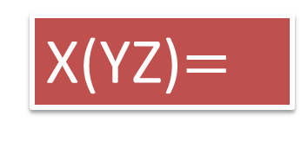
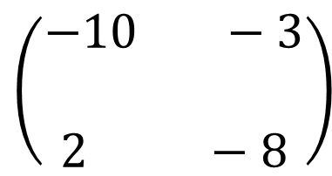
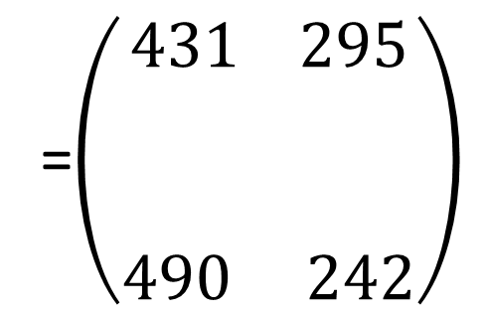
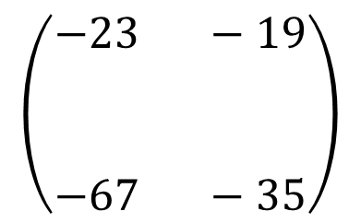
$$\left(\begin{aligned}−10 −3 \\ \\ 2 −8\end{aligned}\right)$$
$$\left(\begin{aligned}−23 −19 \\ \\ \\ −67 −35\end{aligned}\right)$$
X(YZ)$=$
=$\left(\begin{aligned}431 295 \\ \\ \\ 490 242\end{aligned}\right)$
431
295
490
242

Slide 16


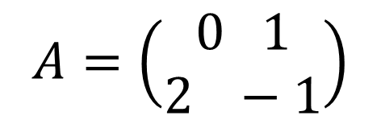
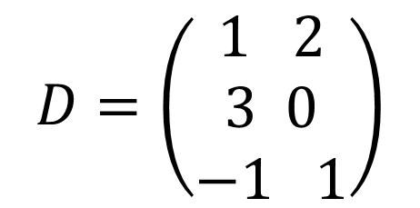
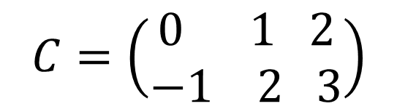
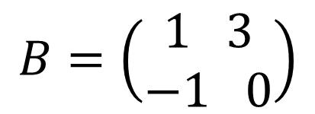
$$A=\left(\begin{aligned}0 1 \\ 2 −1\end{aligned}\right)$$
$$B=\left(\begin{aligned}1 3 \\ −1 0\end{aligned}\right)$$
$$D=\left(\begin{aligned}1 2 \\ 3 0 \\ −1 1\end{aligned}\right)$$
$$C=\left(\begin{aligned}0 1 2 \\ −1 2 3\end{aligned}\right)$$

Slide 17

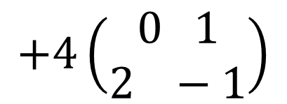
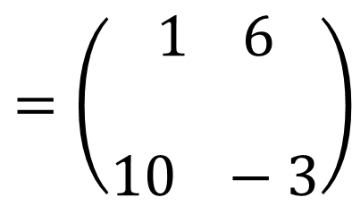
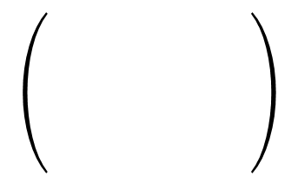
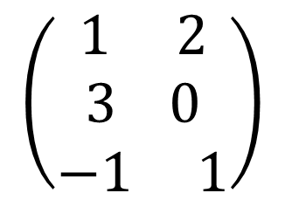

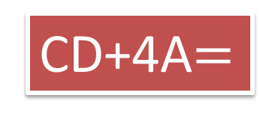
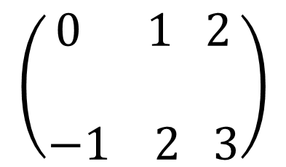


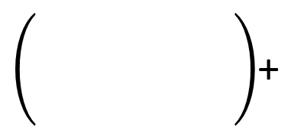

$$\left(\begin{aligned}0 1 2 \\ \\ −1 2 3\end{aligned}\right)$$
$$\left(\begin{aligned}1 2 \\ 3 0 \\ −1 1\end{aligned}\right)$$
CD+4A$=$
$$+4\left(\begin{aligned}0 1 \\ 2 −1\end{aligned}\right)$$
1
2
$$0$$
$$4$$
+
$$=\left(\begin{aligned}1 6 \\ \\ 10 −3\end{aligned}\right)$$
2
1
$$8$$
$$−4$$

Slide 18

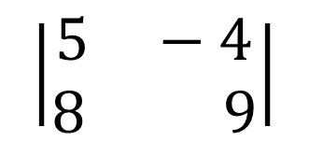




Slide 19


1A)
1B)
=(-6)(8) – (-7)(10)
=(7)(- 4) – (5)(9 )
=22
=-73

Slide 20
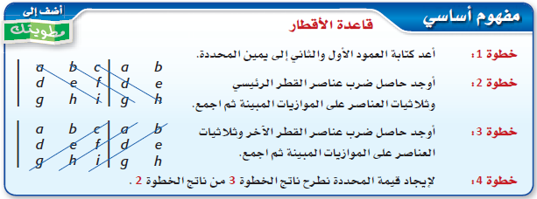
(2)

Slide 21

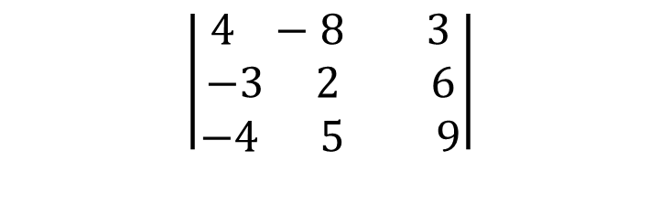
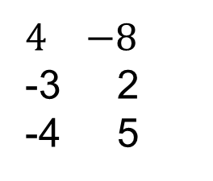
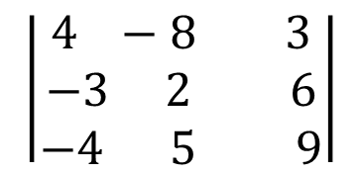
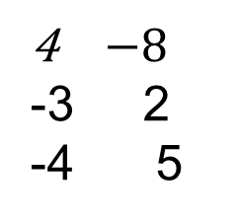
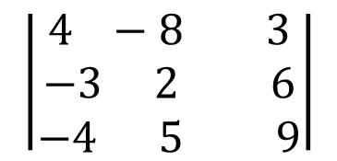
تمرين
الثاني
الأول
-8
-3 2
-4 9

Slide 22
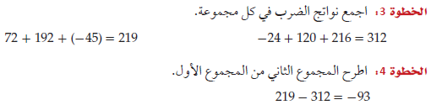


Slide 23


- 5 9
- 2 -1
- 4 6
2A)
=
-
(-5)(-1)(2) + (9)(5)(-4) + (4)(-2)(6)
(9)(-2)(2) + (-5)(5)(6) + (4)(-1)(-4)
= -218 - -170
= -48
2B)
- 8 -4
-0 -5
3 4
=
-
(-8)(-5)(1) + (-4)(-8)(3) + (4)(0)(4)
(-4)(0)(1) + (-8)(-8)(4) + (4)(-5)(3)
= 136 - 196
= - 60

Slide 24


Slide 25





9
6 4
3 15
= 0.5(11x4x1+9x1x3+1x6x15 – 9x6x1+11x1x15+1x4x3)
= -35

Slide 26














1B)
1A)
حل النظام ( 5 , -6 )
حل النظام ( 4 , 3 )

Slide 27





$$3x+y=5$$
$$2x−y=0$$
$$c=\left|\begin{aligned}3 1 \\ 2 −1\end{aligned}\right|$$
$$=−5$$
$$∆x=\left|\begin{aligned}5 1 \\ 0 −1\end{aligned}\right|$$
$$=−5$$
$$x=\frac{∆x}{c}=1$$
$$∆y=\left|\begin{aligned}3 5 \\ 2 0\end{aligned}\right|$$
$$=−10$$
$$y=\frac{∆y}{c}=2$$
حل النظام (1 ,2 )

Slide 28










حل النظام ( 4 , -2 , 5 )

Slide 29







X$.Y=$
$$\left(\begin{aligned}4 −1 \\ 2 −2\end{aligned}\right)$$
$$=\left(\begin{aligned}1 0 \\ 0 1\end{aligned}\right)$$
$$Y . X=$$
$$\left(\begin{aligned}4 −1 \\ 2 −2\end{aligned}\right)$$
$$=\left(\begin{aligned}1 0 \\ 0 1\end{aligned}\right)$$
المصفوفتان متعاكستان

Slide 30



$$A.B=$$
$$\left(\begin{aligned}2 1 \\ −1 0\end{aligned}\right) \left(\begin{aligned}1 2 \\ 2 1\end{aligned}\right)$$
$$=\left(\begin{aligned}4 5 \\ −1 −2\end{aligned}\right)$$
المصفوفات غير متعاكستان

Slide 31

متى يوجد للمصفوفة A معكوس؟
0= |A |
0$≠$|A |
في هذه الحالة لا يوجد معكوس ضربي للمصفوفة A
في هذه الحالة يوجد معكوس ضربي للمصفوفة A
معوس

Slide 32

$$A=\left(\begin{aligned}−2 1 \\ 1 1\end{aligned}\right)$$
مصفوفة المعاملات
$$A^{−1}=\frac{−1}{3}\left(\begin{aligned}1 −1 \\ −1 −2\end{aligned}\right)$$
$$\left(\begin{aligned}x \\ \\ y\end{aligned}\right)=$$
$$\left(\begin{aligned}\frac{−1}{3} \begin{aligned}\frac{1}{3} \\ \end{aligned} \\ \frac{1}{3} \frac{2}{3}\end{aligned}\right)\left(\begin{aligned}9 \\ \\ 3\end{aligned}\right)$$
$$=\left(\begin{aligned}−2 \\ \\ 5\end{aligned}\right)$$

