Slide 1
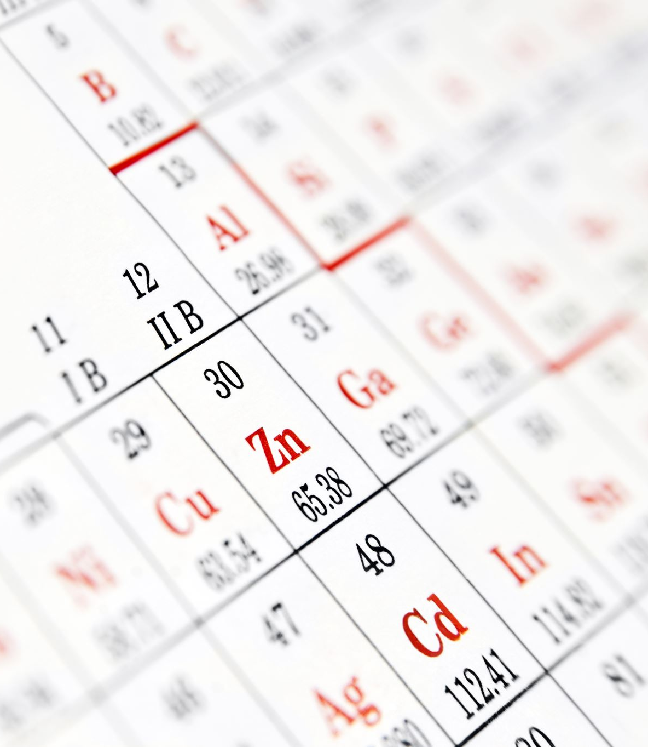
Module 5 – Lesson 1: Development of the modern periodic table

Slide 2
Learning Outcomes
Illustrate the development of the periodic table of Mendeleev to the modern periodic table. Define the main features and characteristics of the modern periodic table .State the periodic law.
Identify the information that can be displayed in the periodic table. Distinguish between a group and a period in the periodic table. Explain why the properties of the elements in the same group are similar.
List the different families in the periodic table with the identification of the group number and the elements present.
Differentiate between representative elements and transition elements.
Describe the general properties of metals, non-metals and metalloids and their uses.
Describe the general properties of alkali metals, alkaline earth metals, halogens, noble gases, tramsition and inner transition elements and their uses.

Slide 3

Starter Activity

Slide 4
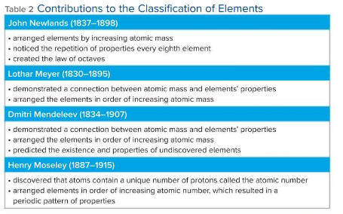
L.O.1.Illustrate the development of the periodic table of Mendeleev to the modern periodic table.

Slide 5




Quick Check

Slide 6
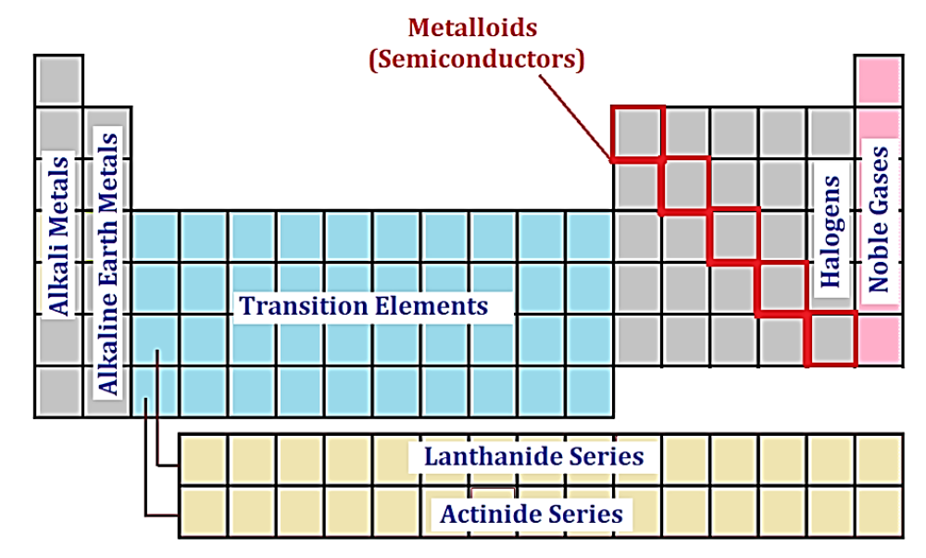
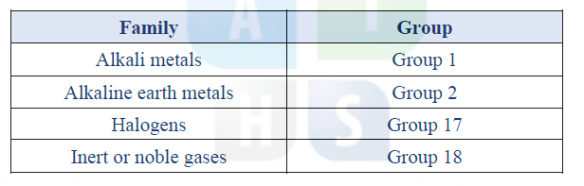
L.O.2. List the different families in the periodic table with the identification of the group number and the elements present.
Groups: Columns in the periodic table
Periods: Rows in the periodic table

Slide 7
L.O.3 Differentiate between representative elements and transition elements.
Representative elements
They are elements in Groups 1, 2 and 13 to 18 that possess a wide range of chemical and physical properties.
Transition elements
They are elements in Groups 3 to 12, they are mostly brittle solids with electrical conductivity between those of metal (good conductors) and nonmetals (nonconductors).
Periodic Law: It is the periodic repetition of chemical and physical properties of the elements when they are arranged by increasing atomic number.

Slide 8
L.O.4 Describe the general properties of metals, non-metals and metalloids and their uses
Metals:
1) Shiny when smooth and clean (caused by the ability of metal to reflect light)
2) Solid at room temperature (except Mercury, Hg, it is a liquid)
3) Good conductor of heat and electricity
4) Malleable (they can be hammered into thin sheets)
5) Ductile (they can be pulled into wires)
Non-metals:
1) Most non-metals are gases at room temperature, a few are solids as sulfur and phosphorus, one
non-metal bromine, is a dark red-liquid
2) Solid non-metals tend to be brittle (they will shatter if hit with a hammer) and dull
3) Poor conductor of heat and electricity (Except carbon in the form of graphite is a good conductor)
Metalloids:
They have physical and chemical properties of both metals and non-metals.
Silicon, Si, and Germanium, Ge, are two important metalloids used extensively in computer chips and solar cells.

Slide 9
L.O.5: Properties and Uses of group in Periodic Table
Family | Group | Properties | Uses
Alkali metals | 1 | 1) Extremely reactive (react vigorously with water) so they exist as compounds with other element 2) Silvery in appearance 3) Soft enough to be cut with a knife | Sodium, Na, is one of the components of salt Lithium, Li, used in batteries
Alkaline earth metals | 2 | Harder, denser, stronger and have higher melting points than alkali metals but less reactive than alkali metals (they exist as compounds with other element) | Magnesium is light and used in fabrication of electronic devices as laptops Calcium is a mineral important for the health
Halogens | 17 | The most reactive group of non-metals, and react with most metals to form salts. Like group 1 and 2 elements, the halogens are often part of compounds. | Fluorine is added to toothpaste and drinking water to prevent tooth decay Chlorine is used for the sterilization of water
Noble gas | 18 | extremely unreactive | They are used in application where their un-reactivity is an advantage They are used in lasers, a variety of light bulbs and neon signs

Slide 10
L.O.6: compare and contrast transition metals (Group 3 to 12 elements) and inner transition metals
Transition metals: Group 3 to 12 elements
Inner transition metals: Lanthanides and actinides located along the bottom of the periodic table
The lanthanides are the elements with atomic numbers from 57 to 71. These 15 metals (along with scandium and yttrium) are often called the rare earth elements.
They are all silvery-white metals which are often found in the same ores.
They are called the lanthanides because they exhibit similar chemical properties to lanthanum, the first element in the group.
They are used in products such as hybrid cars, superconductors, and permanent magnets.
Actinides are the 15 elements with atomic numbers from 89 to 103. They are named after the first element in the series, actinium.
The actinides group includes mostly man-made elements with only a few exceptions such as uranium and thorium.
The actinides are most known for the elements uranium and plutonium which are used in nuclear reactors and nuclear bombs.
The actinide americium is used in smoke detectors

Slide 11
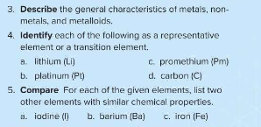
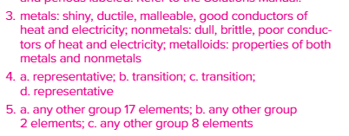
Plenary

