Slide 1
Unit 6
Thermodynamics

Slide 2
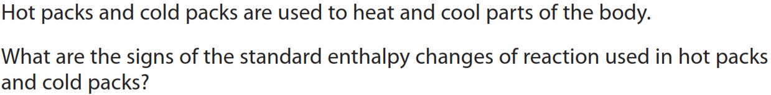
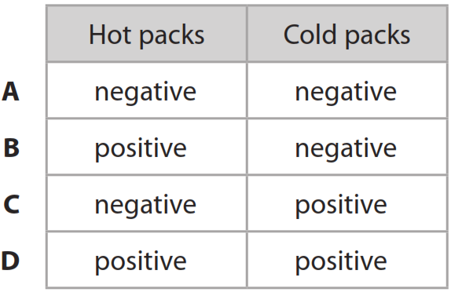
What you need to do:
Write the title, the date and L.Os in your book
Sunday, 15 September 2024
The Nature of Energy
Learning objectives
I can calculate enthalpy changes and apply Hess’s Law
Key words: Enthalpy • State function • System • Surrounding
Starter
Notes:
2
2

Slide 3
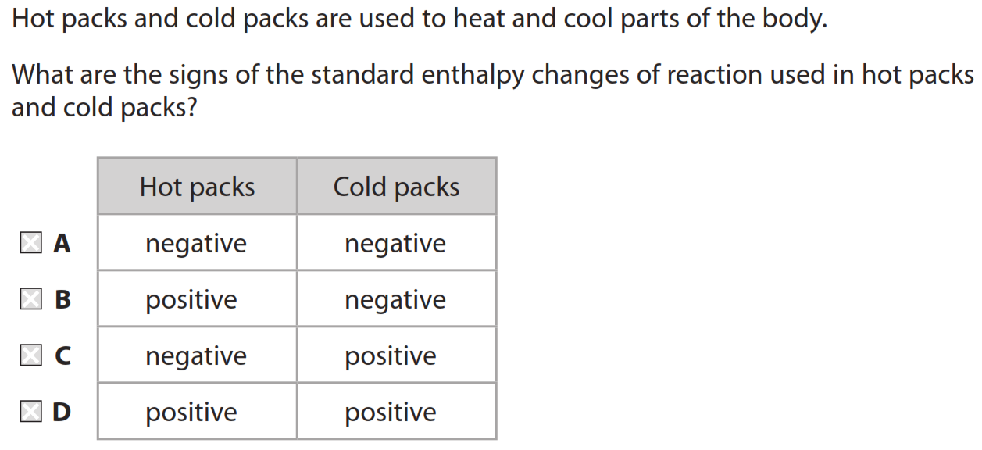
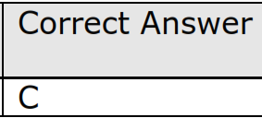
Starter

Slide 4
Energy
The first law of thermodynamics states that energy can neither be created nor destroyed. However, one form of energy can be converted into another.
There are various forms of energy:
work – when a force moves an object.
kinetic energy - the energy due to motion of a body.
gravitational potential energy – the energy due to position of the object due to the centre of the earth.
chemical potential energy – the energy stored in a molecule.
radiant energy – the energy in light and sound
electrical energy– this can be in the form of electrical potential energy or the energy due to an electric current.

Slide 5
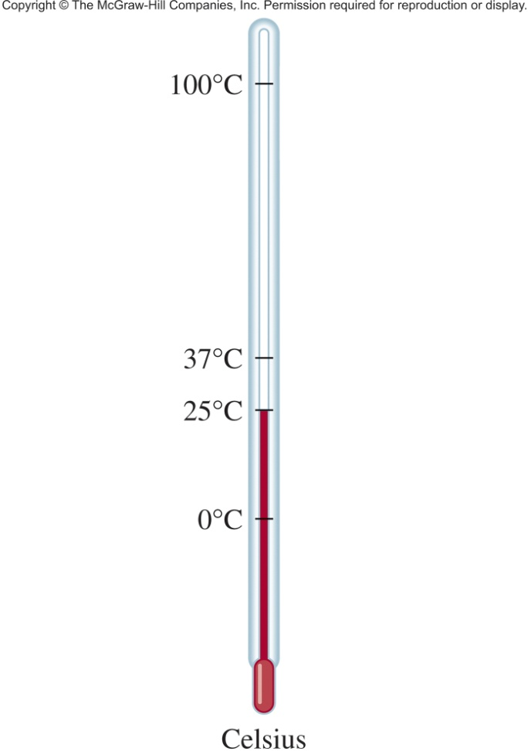
Energy Changes in Chemical Reactions
Heat is the transfer of thermal energy between two bodies that are at different temperatures.
Temperature is a measure of the thermal energy.
Temperature = Thermal Energy

Slide 6
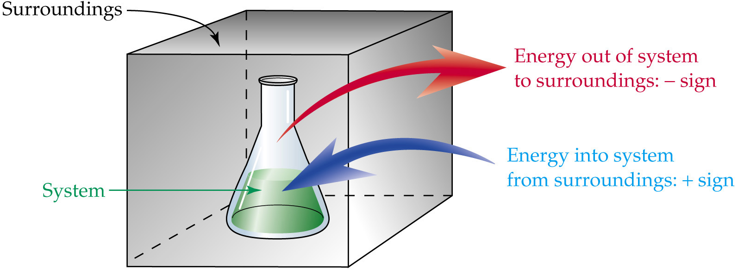
‘System’ and ‘Surroundings’
Thermochemistry is the study of heat change in chemical reactions.
The system is the specific part of the universe that is of interest in the study.
EXOTHERMIC
ENDOTHERMIC

Slide 7
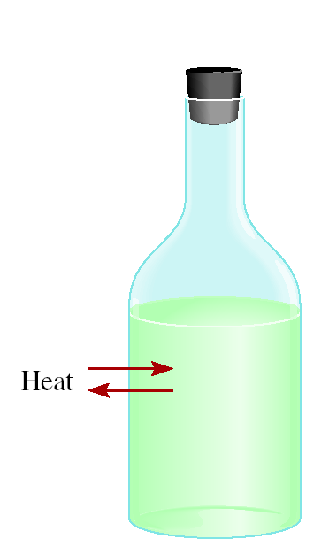
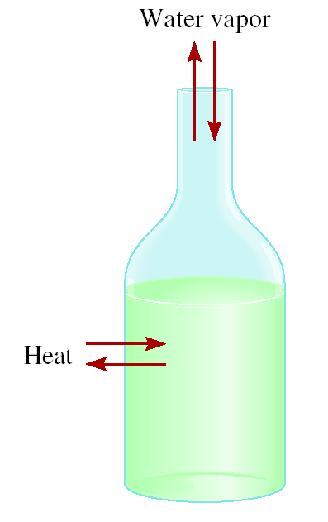
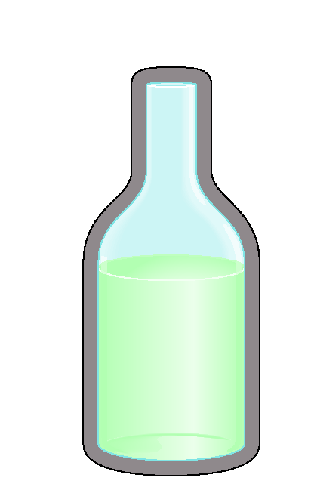
‘System’ and ‘Surroundings’
Thermochemistry is the study of heat change in chemical reactions.
The system is the specific part of the universe that is of interest in the study.
open
closed
isolated
Exchange:
mass & energy
energy
nothing

Slide 8
State Function
A state function or state variable is a property that depends on the current “state” of a system.
These are conditions such as its volume, temperature, pressure and composition.
State functions are independent of the pathway taken to reach the state.
Common state functions include internal energy, enthalpy changes, entropy and free energy

Slide 9
The System and Its Surroundings
A meaningful study of any transfer of energy requires that we first clearly define both the system and its surroundings.
System + Surroundings = Universe
The internal energy, E, of a system is the sum of the potential and kinetic energies of all the particles present.
The total energy of the universe remains constant.
A change in the energy of the system must be accompanied by an equal and opposite change in the energy of the surroundings.

Slide 10
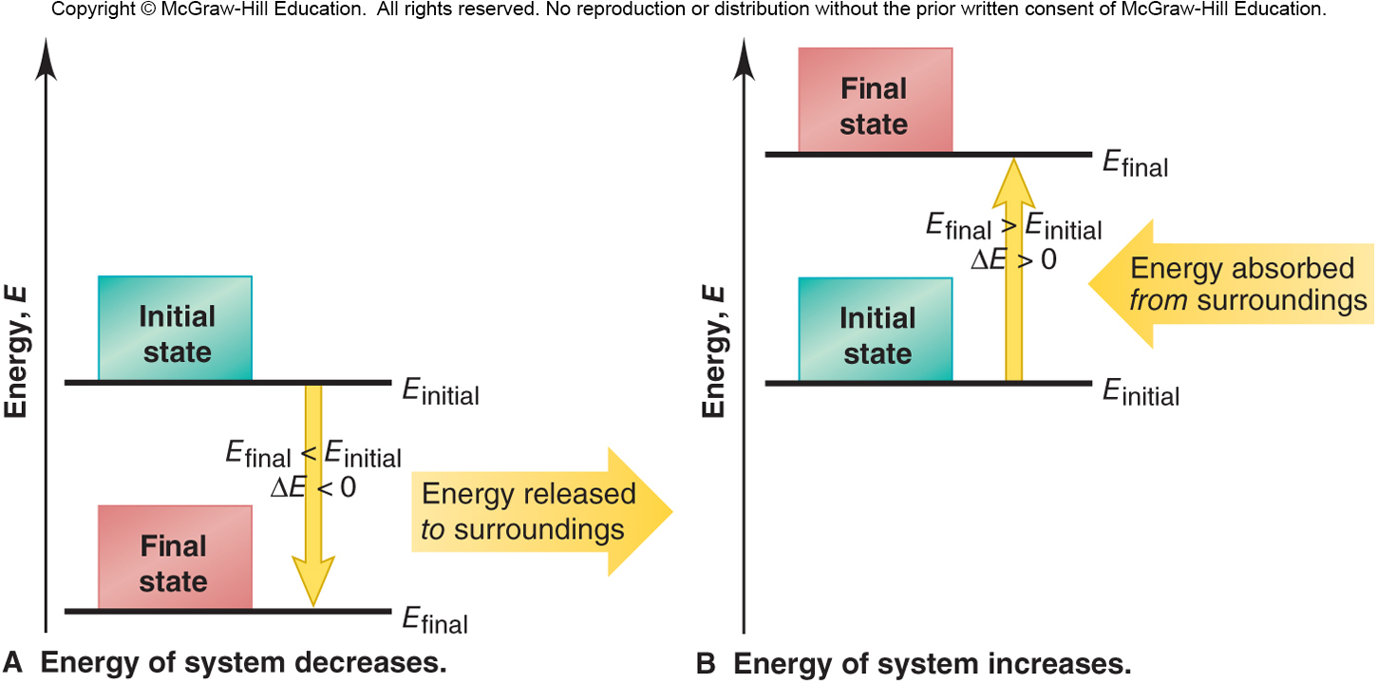
Energy diagrams for the transfer of internal energy (E) between a system and its surroundings.
ΔE = E_{final} - E_{initial} = E_{products} - E_{reactants}

Slide 11
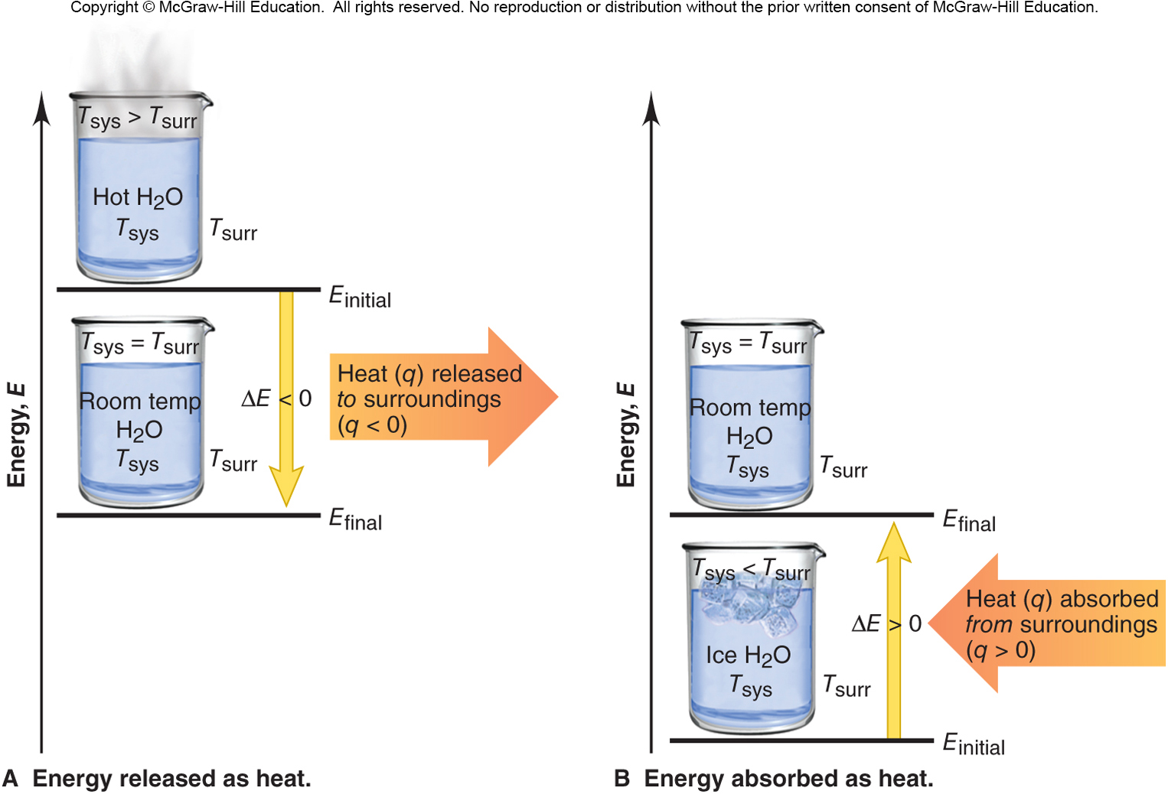
The two cases where energy is transferred as heat only.

Slide 12
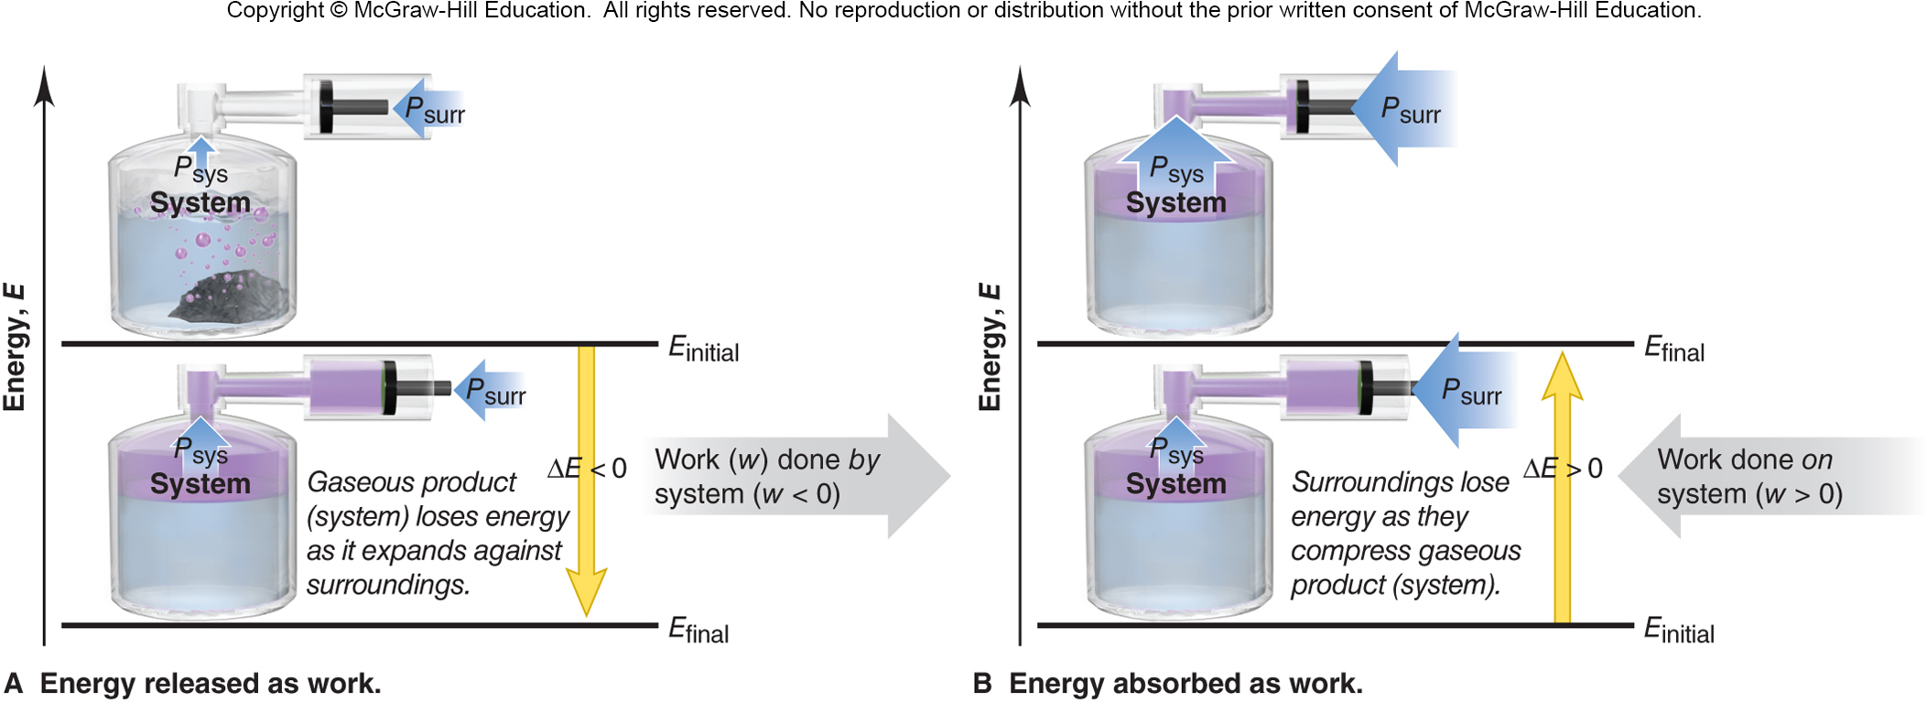
The two cases where energy is transferred as work only.

Slide 13
Table 6.1 The Sign Conventions* for q, w, and ΔE
q
+
w
=
ΔE
+
+
+
+
–
depends on sizes of q and w
–
+
depends on sizes of q and w
–
–
–
* For q: + means system gains heat; – means system releases heat.
* For w: + means work done on system; – means work done by system.

Slide 14
The Law of Energy Conservation
The first law of Thermodynamics states that the total energy of the universe is constant.
Energy is conserved, and is neither created nor destroyed. Energy is transferred in the form of heat and/or work.
ΔE_{universe} = ΔE_{system} + ΔE_{surroundings} = 0

Slide 15
Units of Energy
The SI unit of energy is the joule (J).
1 J = 1 kg∙m²/s²
The calorie was once defined as the quantity of energy needed to raise the temperature of 1 g of water by 1ºC.
1 cal = 4.184 J
The British Thermal Unit (Btu) is often used to rate appliances.
1 Btu is equivalent to 1055 J.

Slide 16
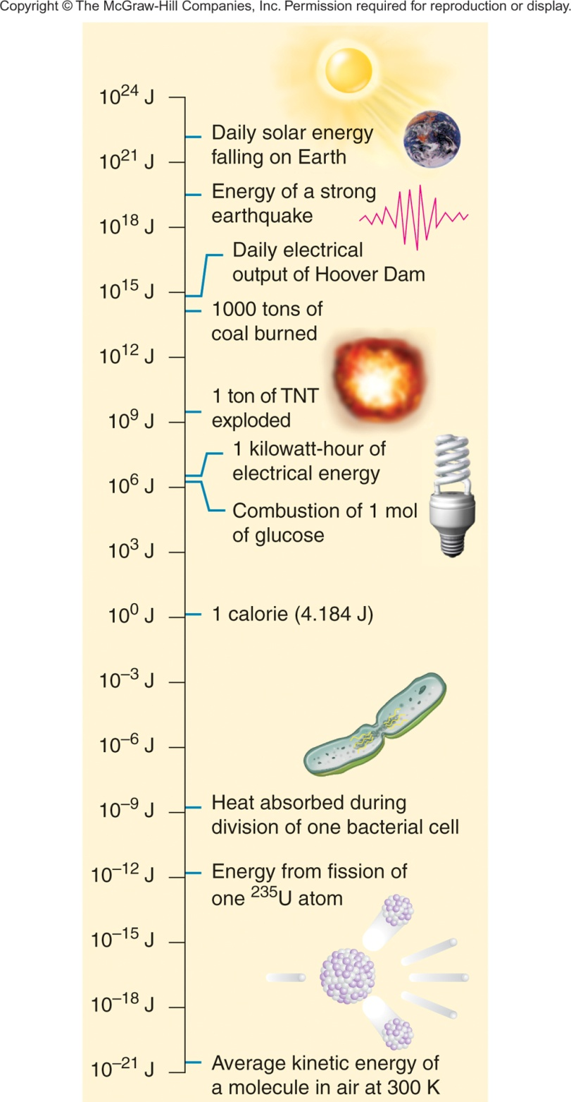
Figure 6.5
Some quantities of energy.

Slide 17
Sample Problem 6.1
Determining the Change in Internal Energy of a System
PROBLEM:
When gasoline burns in a car engine, the heat released causes the products CO₂ and H₂O to expand, which pushes the pistons outward. Excess heat is removed by the car’s radiator. If the expanding gases do 451 J of work on the pistons and the system releases 325 J to the surroundings as heat, calculate the change in energy (ΔE) in J, kJ, and kcal.
PLAN:
Define the system and surroundings and assign signs to q and w correctly. Then ΔE = q + w. The answer can be converted from J to kJ and to kcal.

Slide 18
Sample Problem 6.1
SOLUTION:
Heat is given out by a chemical reaction, so it makes sense to define the system as the reactants and products involved. The pistons, the radiator and the rest of the car then comprise the surroundings.
Heat is given out by the system, so q = –325 J
The gases expand to push the pistons, so the system does work on the surroundings and w = –451 J
ΔE = q + w =
-325 J + (-451 J) =
–776 J
1 kJ
1 kcal
–776 J x
= –0.776 kJ
–0.776 kJ x
= –0.185 kcal
10³J
4.184 kJ
Notes:
18

Slide 19
Enthalpy:
Chemical Change at Constant Pressure
ΔE = q + w
  To determine ΔE, both heat and work must be measured.
The most common chemical work is PV work
  the work done when the volume of a system changes in the presence of an external pressure.
Enthalpy (H) is defined as E + PV so
  ΔH = ΔE + ΔPV
If a system remains at constant pressure and its volume does not change much, then
ΔH ≈ ΔE

Slide 20
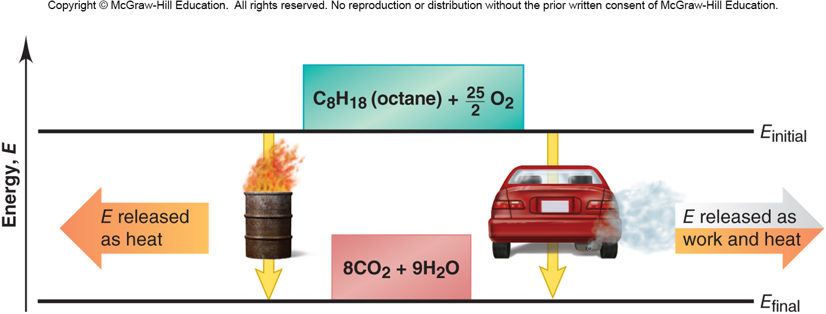
Figure 6.6
Two different paths for the energy change of a system.
Even though q and w for the two paths are different, the total ΔE is the same for both.

Slide 21
First Law of Thermodynamics
Energy cannot be created or destroyed. It can be converted from one form to another.
ΔE_{universe} = ΔE_{system} + ΔE_{surroundings} = 0
Two common methods for transferring energy between a system and its surroundings are heat, q, and work, w. The first law is sometimes expressed by defining internal energy as the sum of heat and work.
ΔE = q + w and w = –PΔV
ΔE = q – PΔV and since PV = nRT then ΔE = q – ΔnRT
When heat is absorbed or released from a chemical system and the external pressure is constant, the heat released or absorbed is equal to the enthalpy change of the process.
For reactions that do not involve gases or a change in the number of moles of gas, the pressure-volume work done is zero, the PΔV term becomes zero and ΔH = ΔE.

Slide 22
Plenary

Slide 23
Which of the following is an example of chemical potential energy?
A. the moon orbiting Earth
B. a car battery
C. a compressed spring
D. a roller coaster at the top of a hill

Slide 24
In thermochemistry, the specific part of the universe you are studying is called ____.
A. system
B. area
C. enthalpy
D. surroundings

Slide 25
What is the heat content of a system at constant pressure called?
A. heat of reaction
B. heat of the system
C. enthalpy
D. entropy

Slide 26
Energy stored in chemical bonds is ____.
A. free energy
B. kinetic energy
C. specific heat
D. chemical potential energy

Slide 27
The first law of thermodynamics states:
A. matter is neither created nor destroyed in chemical reactions
B. energy is neither created nor destroyed in chemical reactions
C. spontaneous processes always proceed in such a way that the entropy of the universe increases
D. free energy is random motion of particles

Slide 28
____ energy is energy of motion.
A. Free
B. Kinetic
C. Enthalpy
D. Chemical potential
Standardized Test Practice

Slide 29

END

