Slide 1




Notes:
2021 - 2022

Slide 2

Application of Differentiation
Chapter 4
7. Optimization
8. Related Rates
9. Rates of Change in Economics and the Sciences

Slide 3


Slide 4
Lesson 7
Solve Mathematical and real life Optimization problems

Slide 5


Strategies for Solving Optimization Problems
Draw a picture (if applicable)
Determine the variables (known and unknown) and how they are related.
Determine the quantity that needs to be maximized or minimized.
Write an expression of the amount to be maximized or minimized in term of one variable, by solving for any other variables in term of this one variable.
Determine the maximum/ minimum allowed values.
Solve the problem and check your answer.
In optimization problems, we are generally tasked with finding the maximum or minimum value of specific variables depending on the context of the problem and the nature of the optimization.
Notes:
Whenever there are two variables, one of the variables should be written in terms of the other.

Slide 6
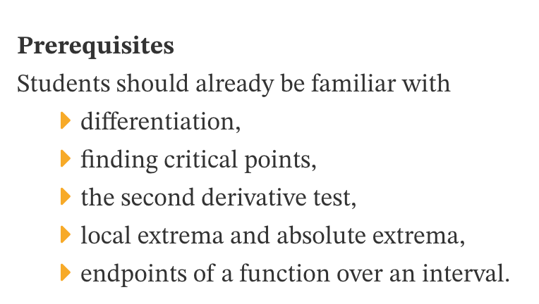

Slide 7

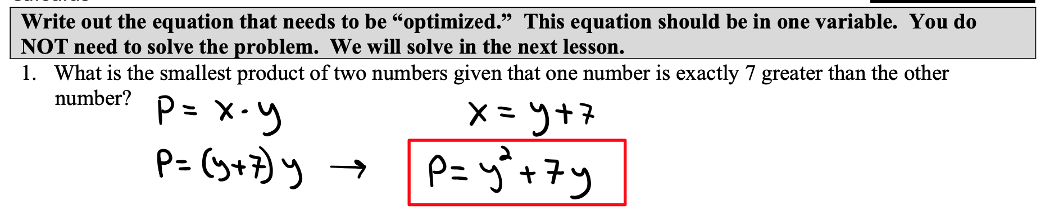
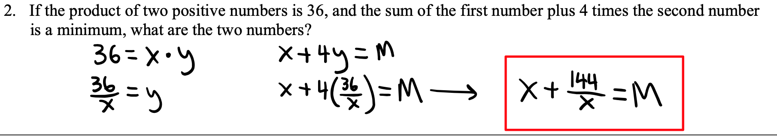
Basic Examples
5 mins

Slide 8
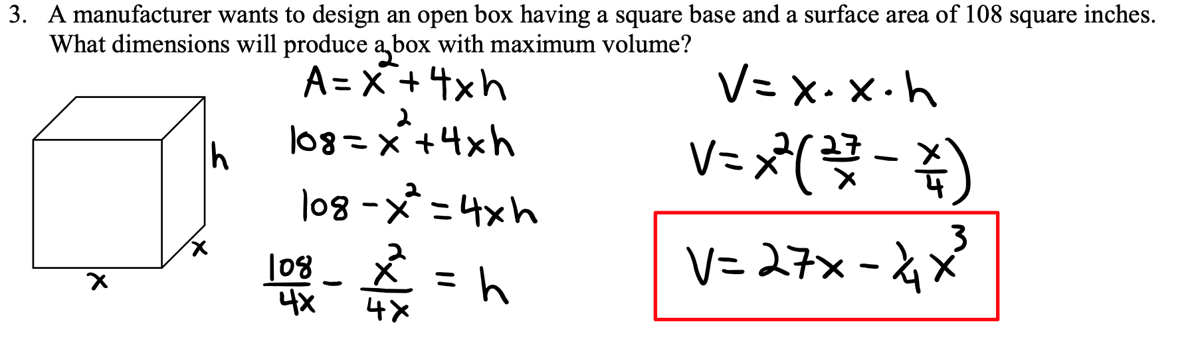

Slide 9
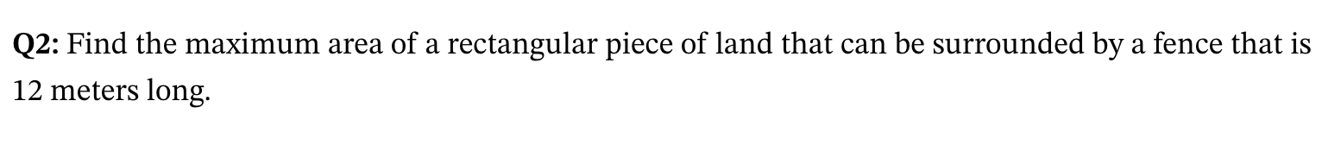
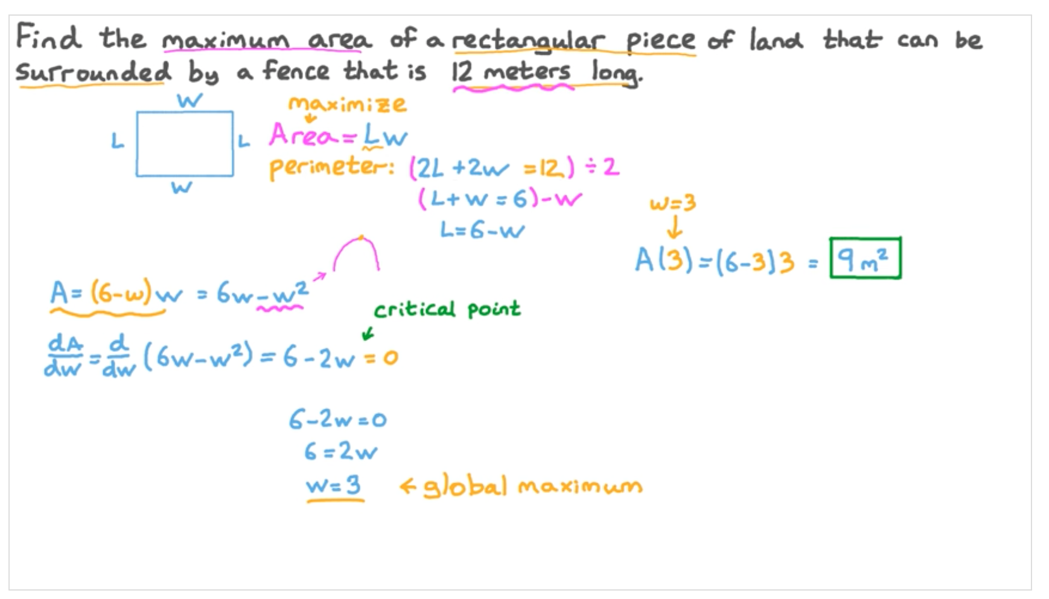
4

Slide 10
Practice Questions
Lesson 7

Slide 11
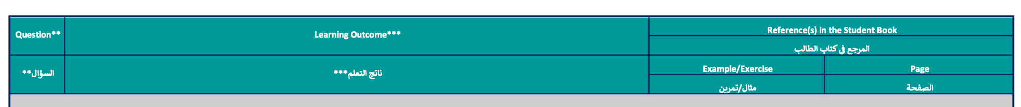
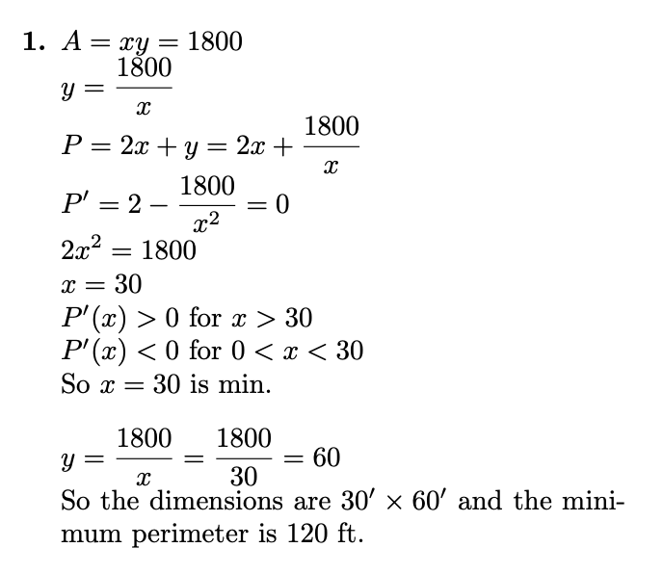
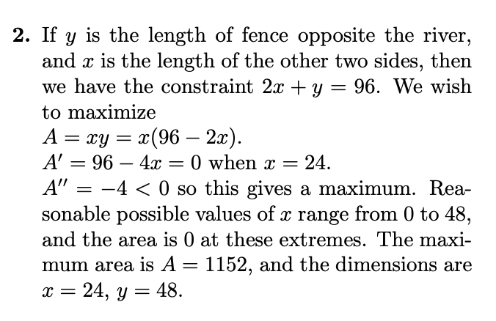

Slide 12
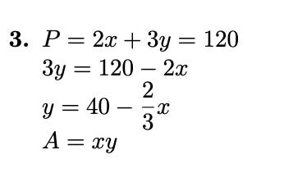
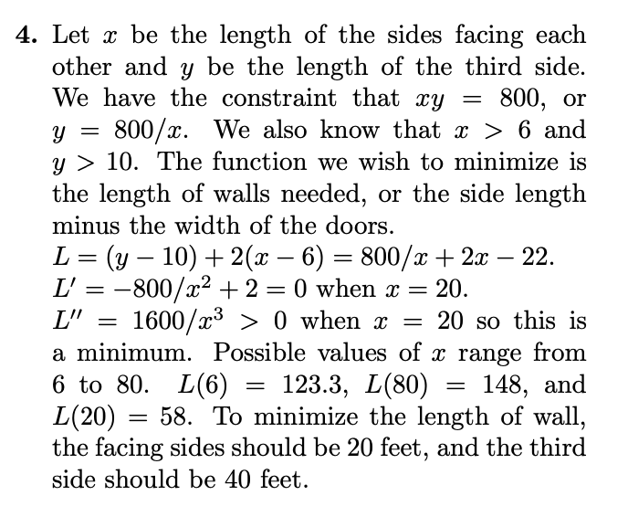
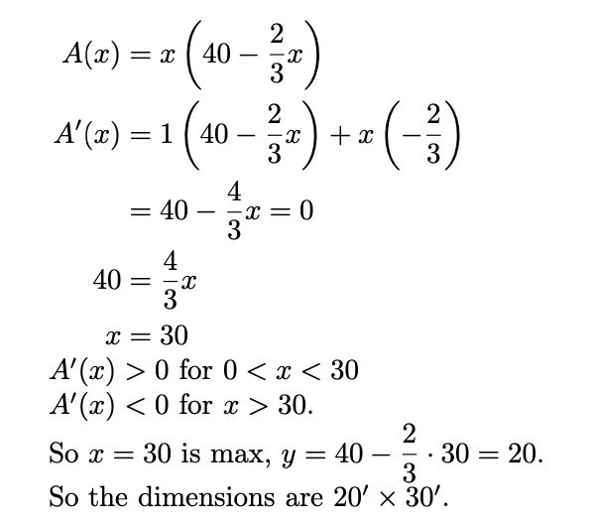

Slide 13
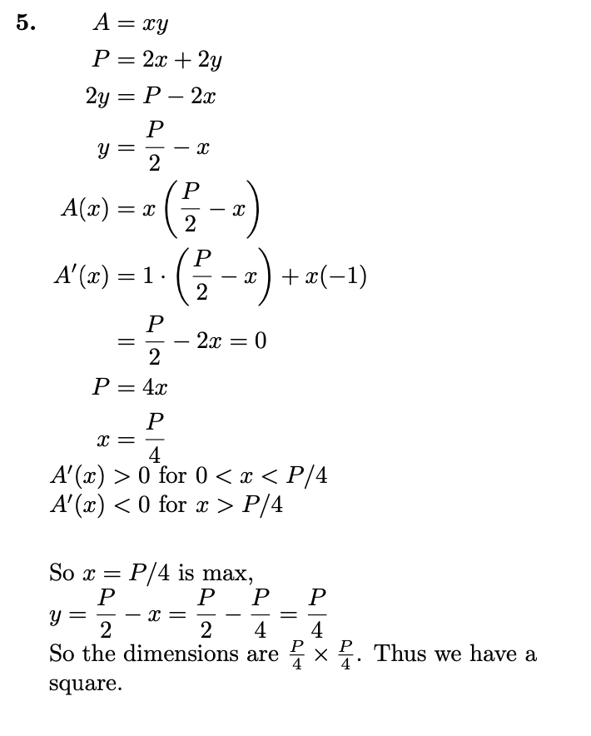
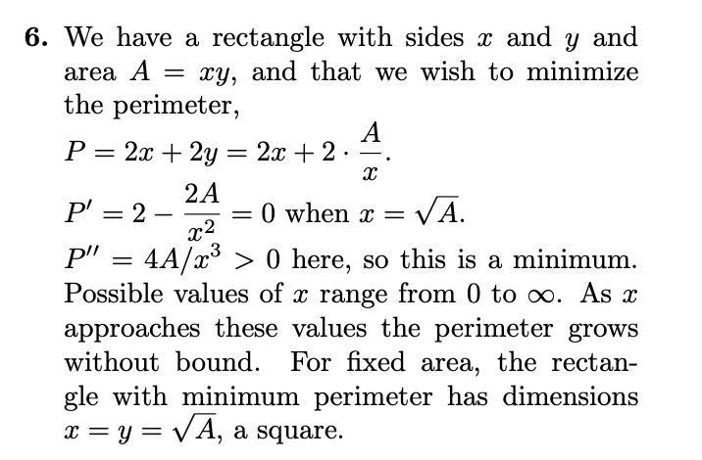

Slide 14
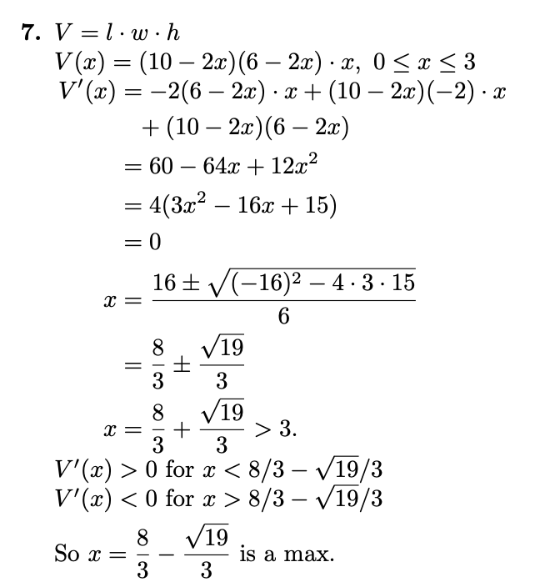

Slide 15
Lesson 8
Solve Mathematical and real life Related Rates problems

Slide 16
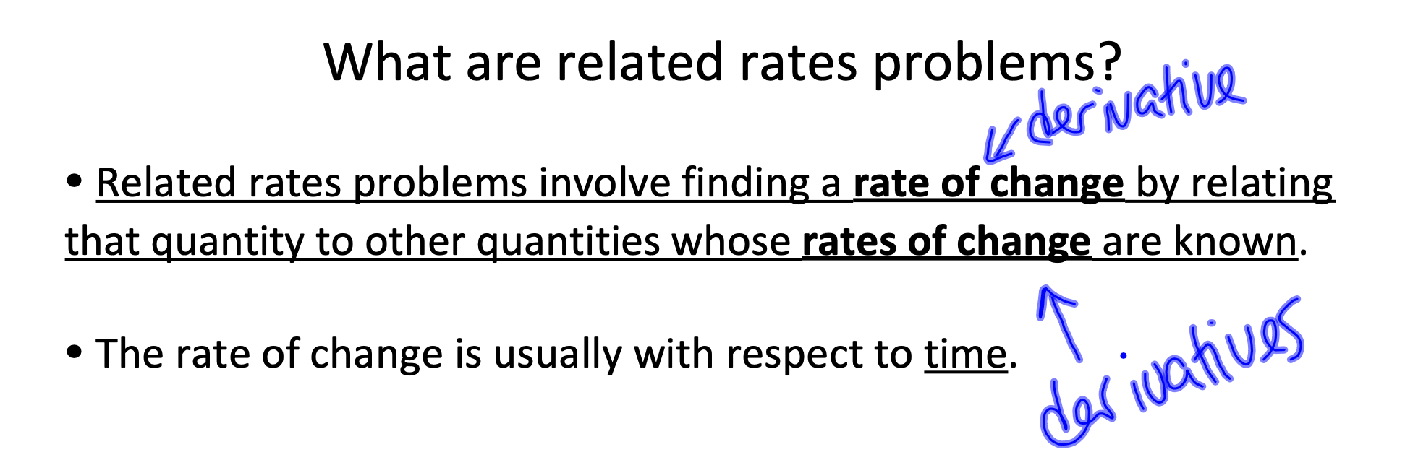

Slide 17






Introduction
Related Rates Problems
Equation relating two or more quantities that are all changing with time.
Use chain rule (with implicit differentiation with respect to time) to determine how different rates (derivatives with respect to time) are related.
01 - Sketch
Make a simple sketch, if appropriate.
02 - Equation
Set up an equation relating all relevant quantities.
Steps to Solve Related Rates Problem
$$d/dt$$
03 - Differentiate
Differentiate implicitly both sides of the equation with respect to time $t$.
04 - Substitute
Substitute in values for all known quantities and derivatives.
05 - solve
Solve for the remaining rate.

Slide 18

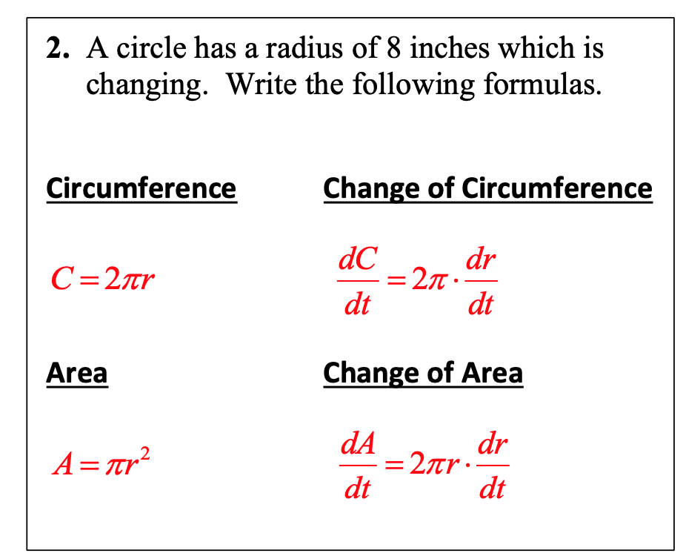
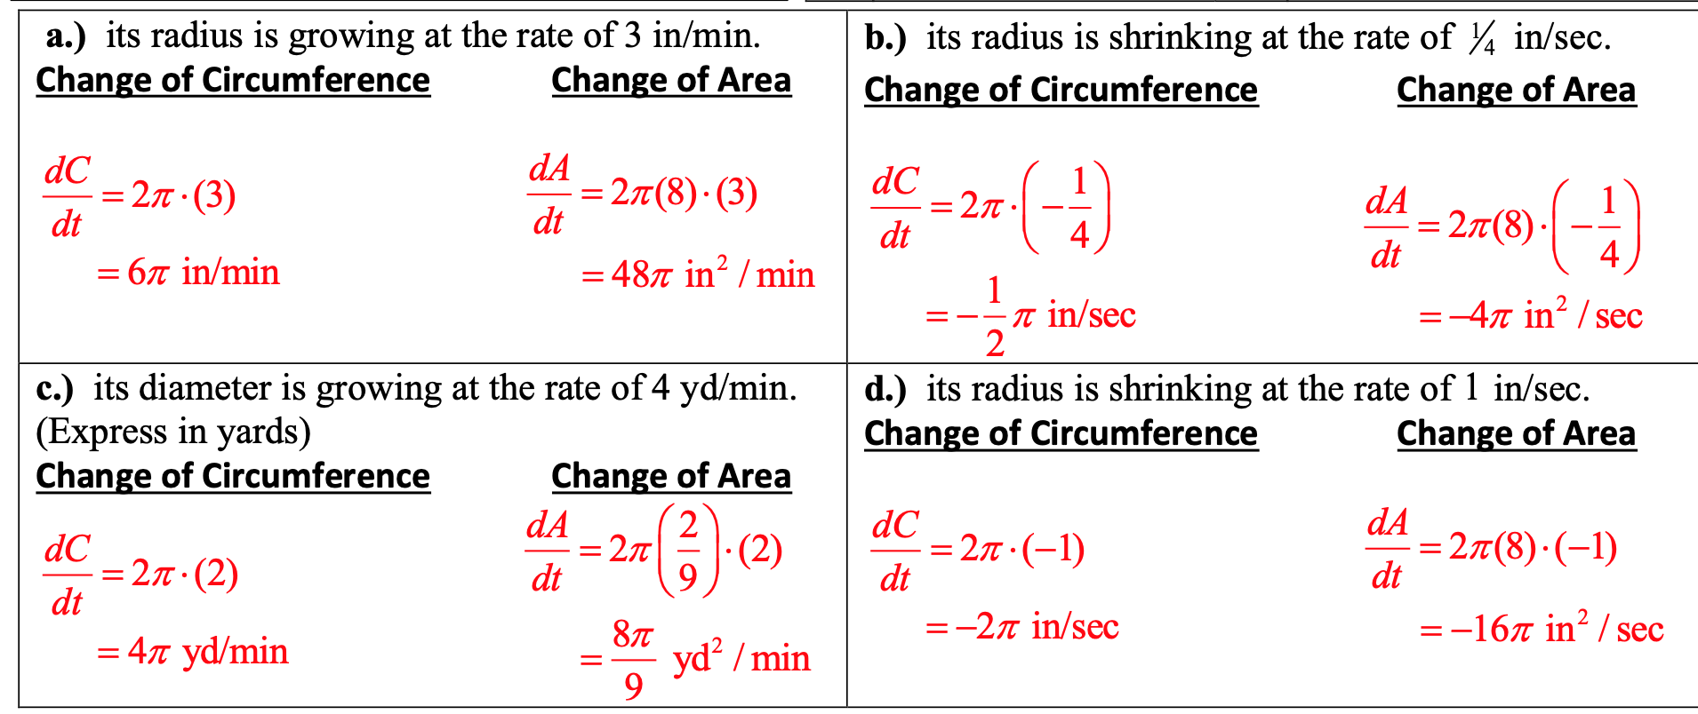
Builder

Slide 19
Practice Questions
Lesson 8

Slide 20
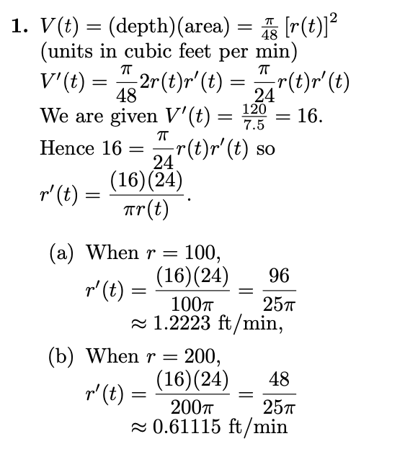
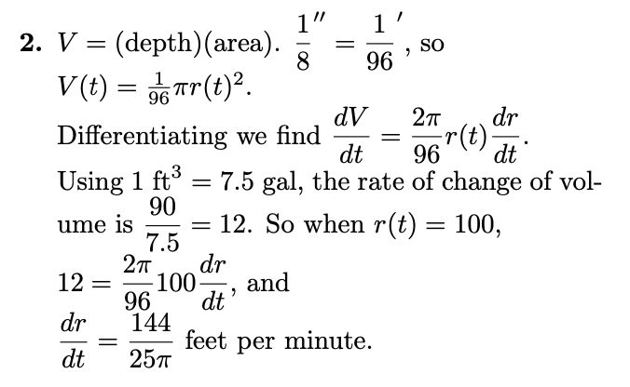

Slide 21
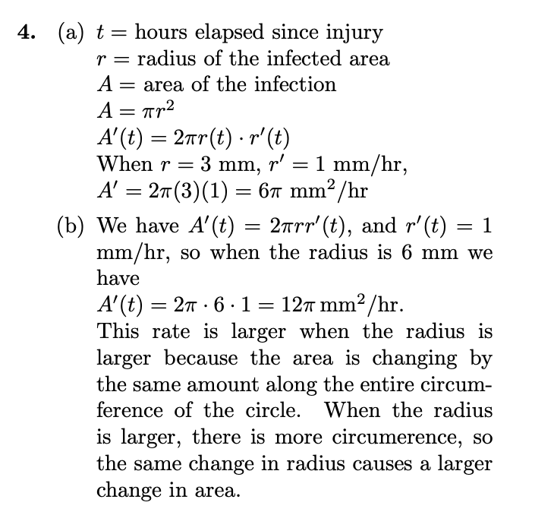
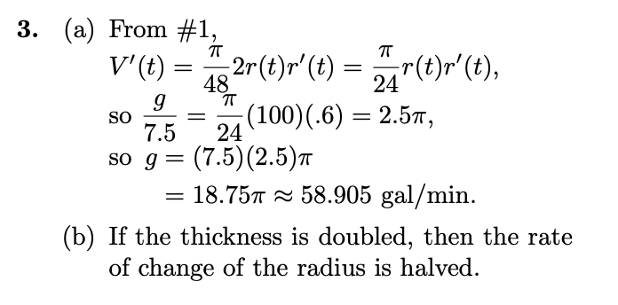

Slide 22
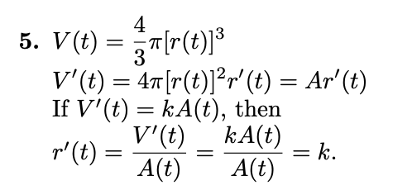
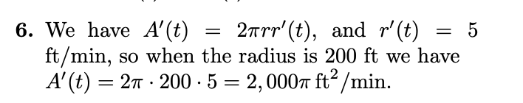

Slide 23
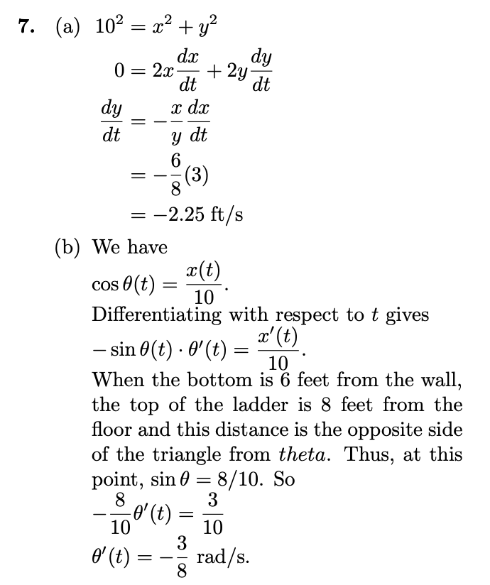

Slide 24
Lesson 9
Solve Economical and Scientist problems on Extrema

Slide 25
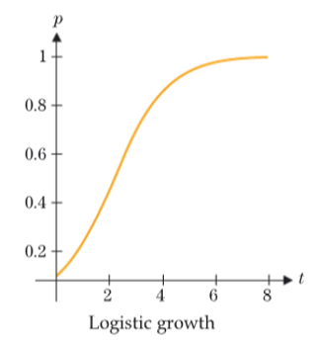
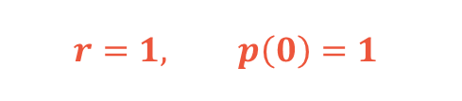


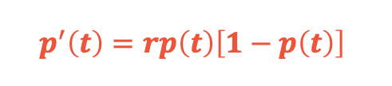

#1 - Rate of Population Growth
Logistic Growth is a basic model for population growth.
Populations modeled by logistic growth are constrained by limitations
Growth of a colony of bacteria
Ex:
Population:
$$p(t)$$
is given as a fraction of maximum sustainable population
$$p^{′}\left(t\right)=rp\left(t\right)\left[1−p\left(t\right)\right]$$
Rate of Change of Population :
$$r=1, p\left(0\right)=1$$
$r:$Constant

Slide 26

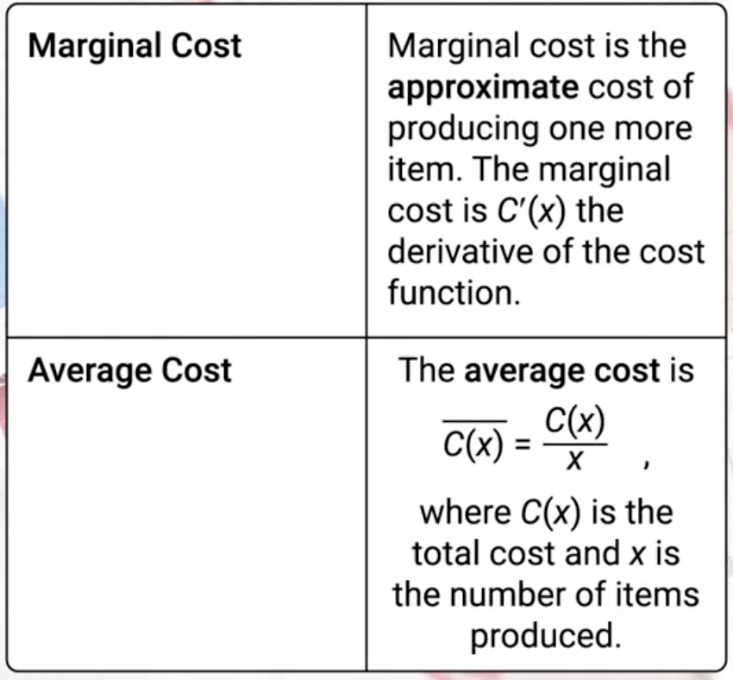


#2
Total Cost Function of producing $x$ items:
$$C\left(x\right)$$
Notes:
Marginal indicates rate which is the derivative
Many production factors affect the cost that’s why the cost per item is not constant

Slide 27
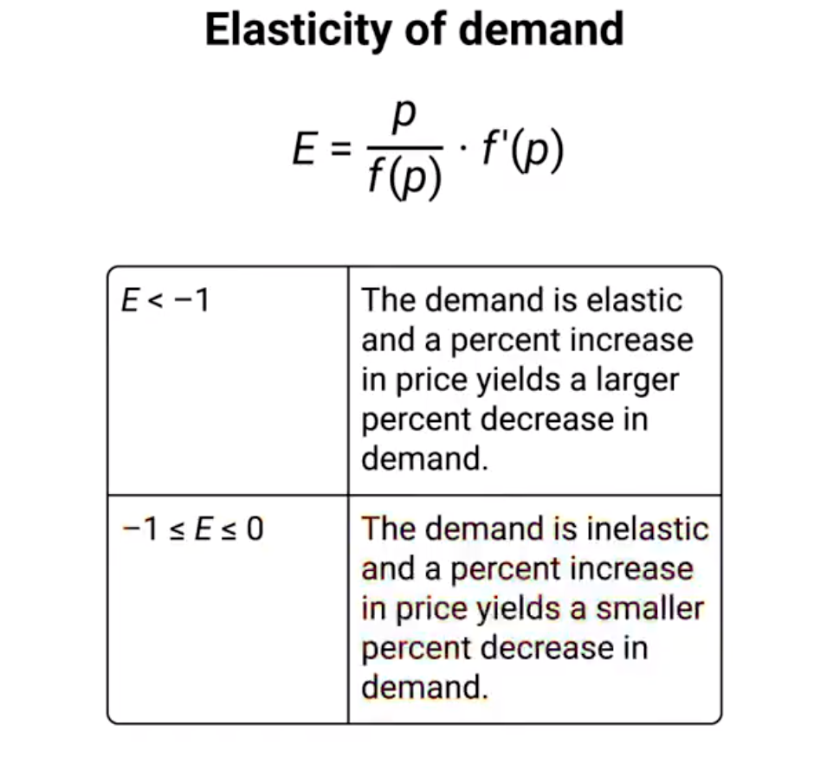

#3
Revenue is equal to the number of units sold times the price per unit.
$$Revenue=R(p)=pf(p)$$

Slide 28

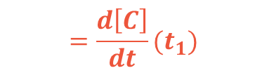
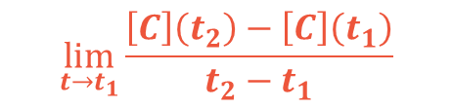
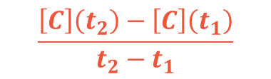
#4
Rate of Chemical Reactions
In Chemistry we study Rates of Chemical Reactions.
This gives chemists information about chemical bonds and quantities of reactants and products.
In the chemical reaction:
A + B
C
Reactants
Product
Concentration of product C is:
$$\left[C(t)\right]$$
Moles per liter
Average Reaction rate:
$$\frac{\left[C\right]\left(t_{2}\right)−\left[C\right]\left(t_{1}\right)}{t_{2}−t_{1}}$$
(Average Change in Concentration of product C in the interval $\left[t_{1},t_{2}\right]$)
$$\lim_{t→t_{1}}{\frac{\left[C\right]\left(t_{2}\right)−\left[C\right]\left(t_{1}\right)}{t_{2}−t_{1}}}$$
$$=\frac{d\left[C\right]}{dt}(t_{1})$$
(The derivative with respect to time)
Instantaneous Reaction rate:

Slide 29
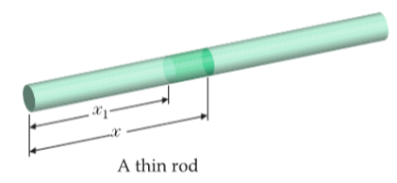
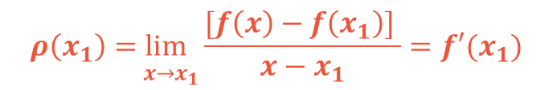

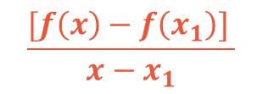




#5
Mass Density
Mass Density is a representation of the amount of mass (or the number of particles) of a substance, material or object in relation to the space it occupies.
Mass Density
$$=\frac{mass}{volume}$$
For homogeneous materials
(mass in any prtion of the material of a given volume is the same)
The mass density is constant
Mass Density for Nonhomogeneous materials
Mass of the first $x$ meter of a thin rod:
$$f(x)$$
Measured in (kilograms)
Total Mass between $x and x_{1}$:
$$[f\left(x\right)−f\left(x_{1}\right)]$$
Average Linear Density:
$$\frac{[f\left(x\right)−f\left(x_{1}\right)] }{x−x_{1}}$$
(mass per unit length)
$$\underset{ x→x_{1}}{ρ\left(x_{1}\right)=lim}{\frac{[f\left(x\right)−f\left(x_{1}\right)] }{x−x_{1}}=f′(x_{1})}$$
Linear Density:
(Derivative)

Slide 30
Practice Questions
Lesson 9

Slide 31
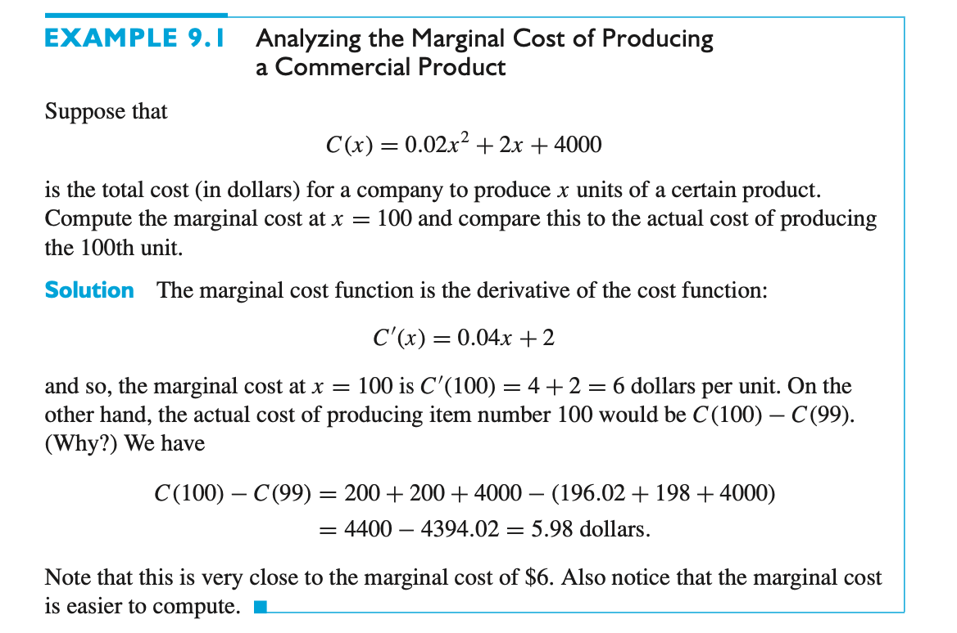

Slide 32


