Slide 1
Grade 12 Gen Lesson 3
The Internet
CB pg. 37-38
WB pg. 31-32

Slide 2
Learning Outcomes
To be able to recognize and use new vocabulary words related to the Internet correctly.
To be able to read for gist- Skimming
To be able to read a text to find specific information – Scanning.

Slide 3
Do Now-Answer question 1 and choose between question 2 and 3
2. Choice
Do you think that there is a way to protect ourselves against cyber crime?
3. Choice
Who can become a victim of cyber crime?
1. Must answer
What do you understand by cyber crime?

Slide 4
Key words
antivirus
server
domain,
download
gigabyte
network
firewall
browse
malware
wall

Slide 5
Learning Outcomes
To be able to recognize and use new vocabulary words related to the Internet correctly.
To be able to read for gist- Skimming
To be able to read a text to find specific information – Scanning.

Slide 6
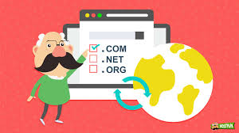
Domain
It is used to identify one or more IP addresses
it is the address where internet users can access your website.

Slide 7
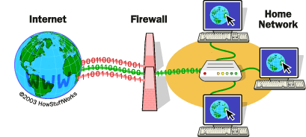
firewall
a device or program that stops people from seeing or using information on a computer without permission while it is connected to the internet

Slide 8
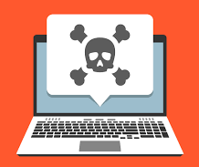
malware
computer software that is designed to damage the way a computer works

Slide 9
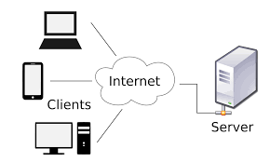
server
a central computer from which other computers get information

Slide 10
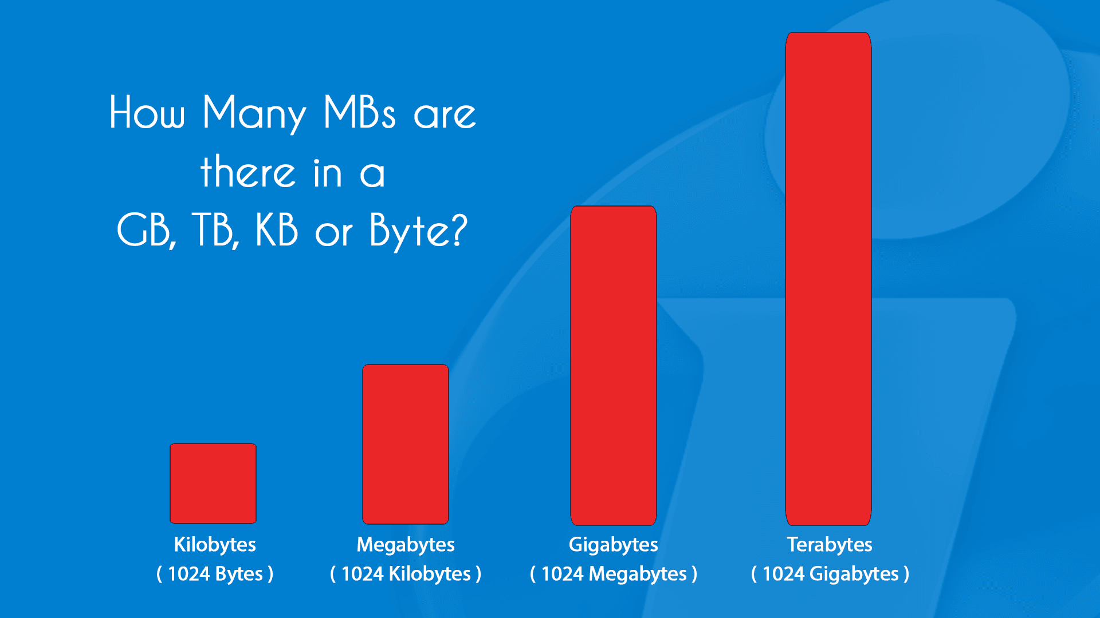
gigabyte
a unit of computer information consisting of 1,024 megabytes

Slide 11
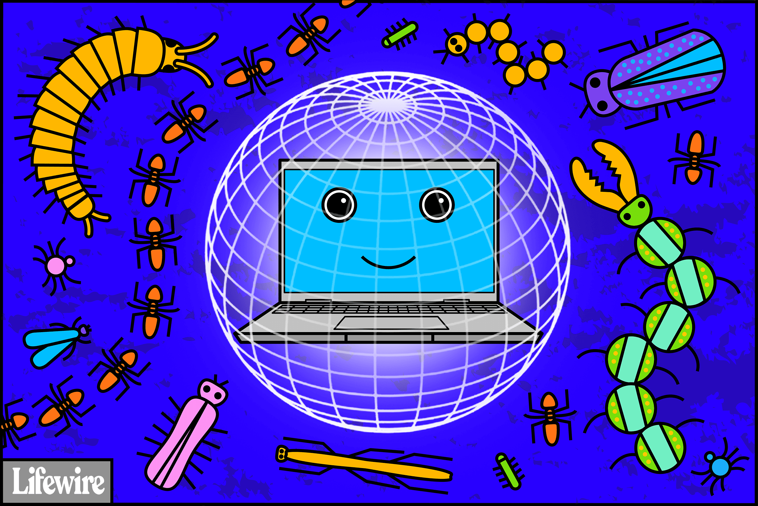
antivirus
To protect your computer against viruses

Slide 12
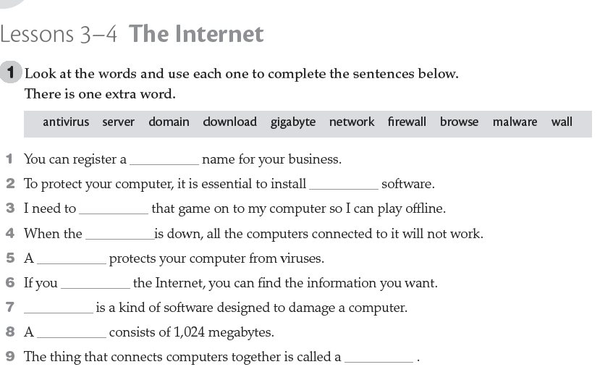
domain
antivirus
download
server
firewall
browse
Malware
gigabyte
network

Slide 13
Learning Outcomes
To be able to recognize and use new vocabulary words related to the Internet correctly.
To be able to read for gist- Skimming
To be able to read a text to find specific information – Scanning.

Slide 14
Read the following text and decide which best describes its purpose
It give information about removing viruses
Highlights the advantages of having computers connected together.
To persuade the reader that a kind of protection software is available.

Slide 15
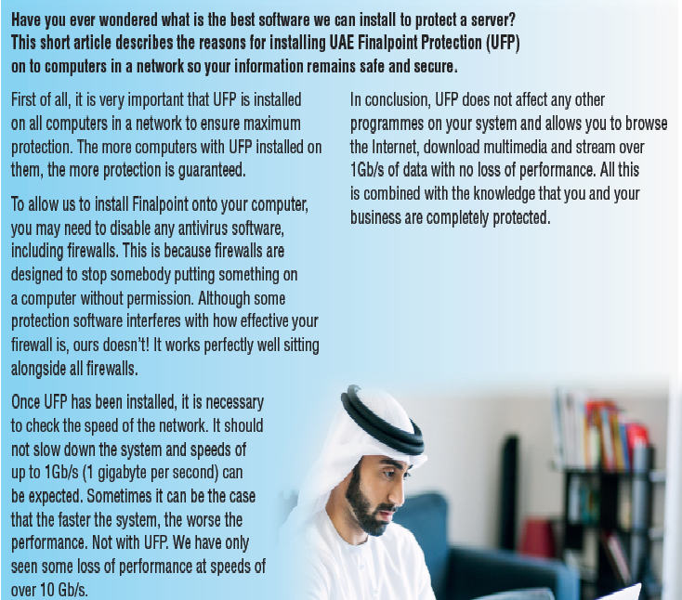
CB pg.

Slide 16
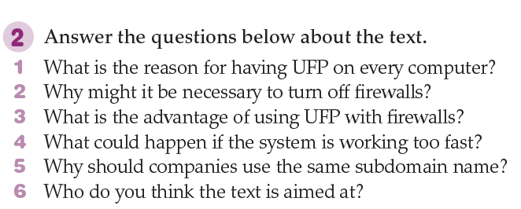
Answer the questions below about the text.

Slide 17

How can you convince your friends to be more careful when using the internet?
Write one point if you want to be good
Write two points if you want to be very good
Write three points if you want to be excellent

Slide 18



Exit Ticket
One thing I learnt this class…
One thing I want to learn more about…
I really liked the part about…

Slide 19
Grade 12 Gen Lesson 4
The Internet
CB pg

Slide 20
Learning Outcomes
To recognize and the structure the…the…
To recognize and outline argument structure within a paragraph.
Write a paragraph using correct paragraph structure.

Slide 21
Read the following examples, what do you notice about them?
The less I see him, the more I like him.
The more he reads, the less he understands.
The older we grow, the wiser we become.

Slide 22
Comparison and contrast are expressed by the use of the…the… with comparative adjectives in parallel clauses.
The less I see him the more I like him.
The more he reads, the less he understands.
The older we grow, the wiser we become.

Slide 23
Structure
the + comparative adjective + clause + the + comparative adjective + clause
Example:
The older we grow, the wiser we become.

Slide 24
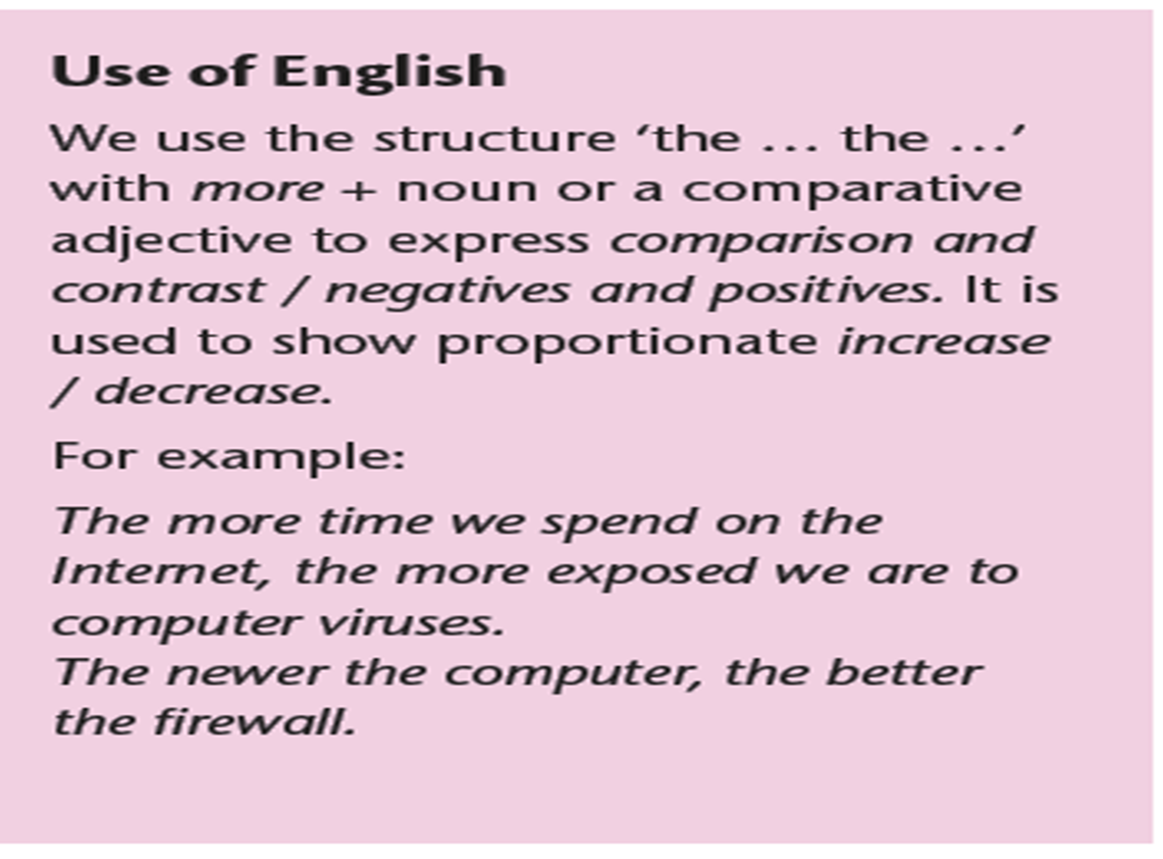
RULE

Slide 25
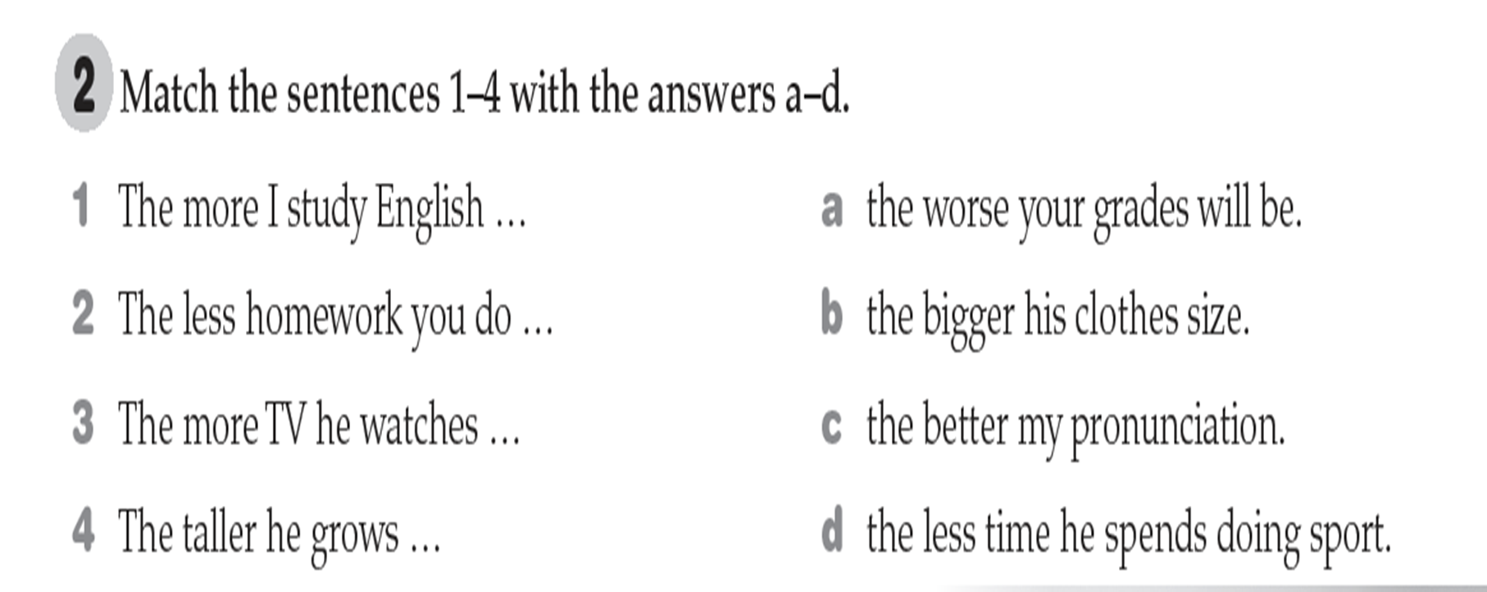
Let's try

Slide 26
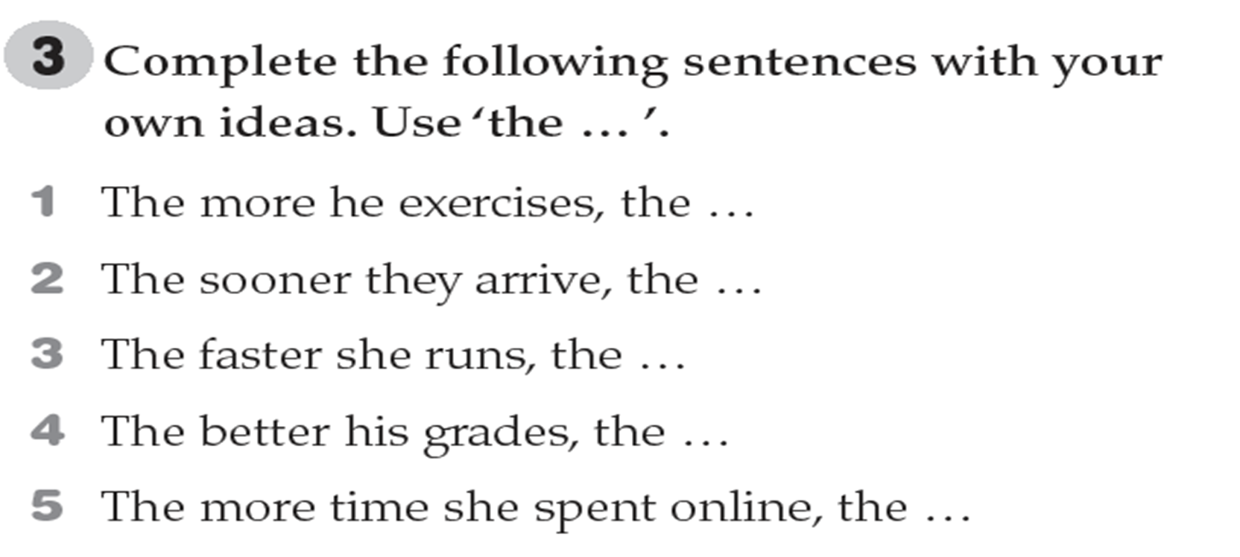
Try to write your own sentences

Slide 27
Learning Outcomes
To recognize and use the structure the…the…
To recognize and outline argument structure within a paragraph.
Write a paragraph using correct paragraph structure.

Slide 28
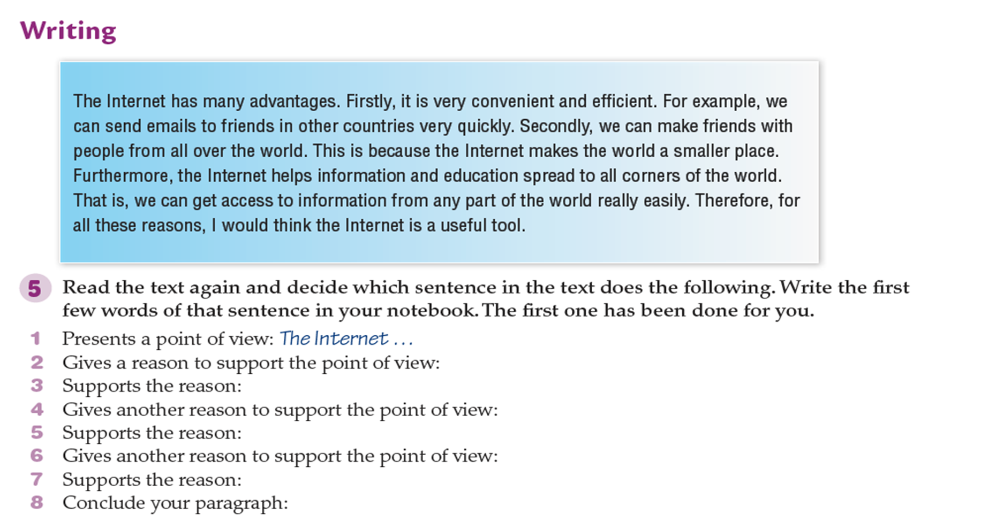
Writing
Firstly, its is very…
For example we can send
Secondly, we can make…
This because the internet makes the world..
Furthermore…
That is we can get access
Therefore, for all these reasons

Slide 29
Learning Outcomes
To recognize and use the structure The…the
To recognize and outline argument structure within a paragraph.
Write a paragraph using correct paragraph structure.

Slide 30
Nearpod collaboration/Padlet
Write a paragraph using the structure we learnt about the disadvantages of the internet.

Slide 31
Exit Ticket
One thing I learnt this class…
One thing I want to learn more about…
I really liked the part about…

