Slide 1

English Writing Exam
Mr. Ali Hassan
12 ADV - Term1 – 2025/2026
Ahmed Khalifa Al Suwaidi School C2&3

Slide 2
Task 1
Writing About Two Points of View

Slide 3
Overview
Test Date | Tuesday 25 Nov. 2025 | Platform | Swift Assess
Themes | Pushing Boundaries Rise to the Challenge | Tasks | Task 1 (15 marks) Task 2 (25 marks)
Timing | Writing : 12:00 – 01:30 pm Reading : 01:30 – 02:30

Slide 4
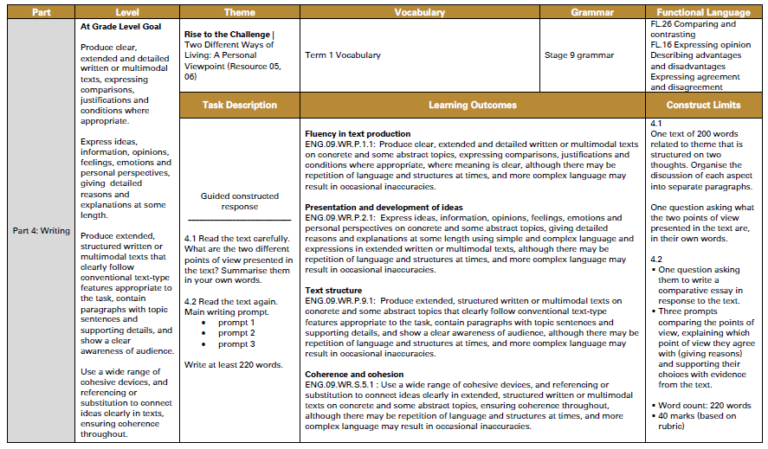

Slide 5
Overview
One text of 200 words related to theme that is structured on two thoughts organise a discussion of each aspect into separate paragraphs. One question asks what the two points of view presented in the text are in 4-5 sentences in your own words. (15 marks)
Question
1.1 Read the text. What are the two points of view presented in the text? Write them in your own words. Write at least 4-5 sentences.

Slide 6
How to answer this question

Slide 7
1. Understand the question
The task asks for two points of view from the text — that means you need to explain what’s positive or challenging about living in Tokyo and Dubai, but in your own words, not copied.

Slide 8
Living in Tokyo, Japan offers a fascinating mix of ancient tradition and modern innovation. Many people admire the country’s strong sense of harmony, politeness, and community spirit. Public transport is reliable, streets are clean, and crime rates are low, which makes everyday life feel safe and organised. Residents often say that teamwork, discipline, and attention to detail are highly valued, helping everything run smoothly.
However, daily life can also be demanding. The culture expects people to work long hours, show respect in every situation, and follow social rules closely, which can sometimes limit personal freedom. The high cost of living and limited space in large cities may also challenge those who prefer a slower lifestyle or more privacy.
Dubai, in contrast, attracts people who value ambition, opportunity, and diversity. The city offers tax-free salaries, a strong economy, and a modern lifestyle supported by world-class facilities. Its warm climate and safe environment make it an appealing place for families and professionals alike. Dubai’s multicultural society promotes respect and coexistence, allowing residents to experience different cultures, traditions, and cuisines every day. While the pace of life can be fast and the cost of living high, many appreciate how Dubai encourages innovation, progress, and success while preserving its cultural values and sense of community.
Both Tokyo and Dubai combine tradition with modern life in unique ways, offering rewarding experiences for people with different goals and lifestyles.

Slide 9
2. Identify key points in the text
Tokyo: traditional and organized life, safety, respect, teamwork — but also strict rules, long work hours, and limited space.
Dubai: modern, ambitious, diverse, offers opportunities — but fast-paced and expensive.

Slide 10
3. Write your answer in your own words
You have to paraphrase your answer and write 4-5 sentences
Don’t repeat sentences exactly as in the text. Use synonyms or paraphrasing.
For example :
Instead of “public transport is reliable,” say “people can depend on public transportation ”

Slide 11
4. Structure your answer
Write two short paragraphs, one about each city. Each paragraph should include both positive and challenging aspects.
Example structure
Paragraph 1: Viewpoint about living in Tokyo
Paragraph 2: Viewpoint about living in Dubai

Slide 12
Some helpful phrases to use
💬 Starting your answer The text is mainly about… This text discusses… The main idea of the text is that… In this passage, the writer explains… The passage focuses on… The writer talks about… | 🧩 Adding supporting ideas It explains that… It also mentions that… The text gives examples of… The writer describes how… Another important point is that… In addition, the text shows that…

Slide 13
✍️ Concluding or summarizing
Overall, the text suggests that…
In conclusion, it highlights the importance of…
The main message is that…
To sum up, the passage shows that…
The writer wants readers to understand that…

Slide 14
Model answer
Living in Tokyo offers a well-organized and respectful lifestyle where people value harmony, teamwork, and discipline. Daily life is safe and efficient, but the pressure to work long hours and follow strict social rules can make it tiring and limit personal freedom.
In contrast, Dubai provides a modern and dynamic environment with many opportunities for success. It values cultural diversity and offers comfort and safety, although the fast pace and high expenses can be challenging.
Both cities show how tradition and progress can exist together in different ways.

Slide 15
Practice
1.1 Read the text. What are the two points of view presented in the text? Write them in your own words. Write at least 4-5 sentences.

Slide 16
Living in a city and living in the countryside offer very different lifestyles, each with its own advantages and challenges. City life is often exciting and full of opportunities. People can find better jobs, schools, hospitals, and entertainment, which makes cities attractive for those seeking personal or professional growth. Public transport makes it easy to get around without needing a car, and there is always something happening — from concerts and festivals to new restaurants and shopping centres. However, city life can also be stressful. Traffic jams, noise, pollution, and the fast pace of daily routines sometimes make people feel tired, overwhelmed, or disconnected from nature. The countryside, on the other hand, provides peace, fresh air, and beautiful landscapes. People living in rural areas often enjoy a slower rhythm and develop closer relationships with their neighbours and community. It’s a great place for those who value quiet, space, and a healthy environment. Yet, it can be difficult to find good job opportunities, modern facilities, or quick access to services such as hospitals or large shops. Some people may also feel isolated if they prefer more activities or social events. Both city and countryside life have their strengths. The best choice depends on what someone values most — excitement and convenience, or calmness and simplicity.

Slide 17
Task 2
Essay Writing

Slide 18
Overview
One question asking them to write a comparative essay in response to the text. Three prompts comparing the points of view, explaining which point of view you agree with (giving reasons) and supporting their choices with evidence from the text in 220 words. (25 marks)

Slide 19
Question
1.2 Read the text again. Now write a comparative essay in which you:
• Compare life in Tokyo and Dubai based on the ideas in the text
• Explain which lifestyle you would prefer and why
• Support your opinion with examples or details from the text
Write at least 220 words.

Slide 20
Living in Tokyo, Japan offers a fascinating mix of ancient tradition and modern innovation. Many people admire the country’s strong sense of harmony, politeness, and community spirit. Public transport is reliable, streets are clean, and crime rates are low, which makes everyday life feel safe and organised. Residents often say that teamwork, discipline, and attention to detail are highly valued, helping everything run smoothly.
However, daily life can also be demanding. The culture expects people to work long hours, show respect in every situation, and follow social rules closely, which can sometimes limit personal freedom. The high cost of living and limited space in large cities may also challenge those who prefer a slower lifestyle or more privacy.
Dubai, in contrast, attracts people who value ambition, opportunity, and diversity. The city offers tax-free salaries, a strong economy, and a modern lifestyle supported by world-class facilities. Its warm climate and safe environment make it an appealing place for families and professionals alike. Dubai’s multicultural society promotes respect and coexistence, allowing residents to experience different cultures, traditions, and cuisines every day. While the pace of life can be fast and the cost of living high, many appreciate how Dubai encourages innovation, progress, and success while preserving its cultural values and sense of community.
Both Tokyo and Dubai combine tradition with modern life in unique ways, offering rewarding experiences for people with different goals and lifestyles.

Slide 21
How to answer this question

Slide 22
✏️ Step 1 – Understand the task
Compare life in Tokyo and Dubai (based on the text)
Give your opinion – which city’s lifestyle you prefer
Support your opinion with examples or details from the text

Slide 23
💡 Step 2 – Plan your essay
Write in four clear paragraphs:
Introduction – Mention both cities and what the essay will compare.
Paragraph 1 – Describe life in Tokyo (main features, pros and cons).
Paragraph 2 – Describe life in Dubai (main features, pros and cons).
Conclusion – State which lifestyle you prefer and explain why, using examples or ideas from the text.

Slide 24
🧩 Step 3 – Use linking words
To compare and contrast :
Similarly, both, in contrast, on the other hand, whereas, while, however, compared to
To express opinion:
I believe that_____, In my opinion _________, I would prefer ______, The main reason why I would like to live in ______ is_______

Slide 25
✏️ Useful Phrases for this question
🟢 Starting your answer
The text presents two different points of view about…
There are contrasting opinions on…
The passage discusses both the advantages and disadvantages of…
The writer explains two sides of the issue.
According to the text, people have different perspectives on…

Slide 26
🟡 Introducing the first point of view
One point of view is that…
Some people believe that…
The first perspective suggests that…
It is argued that…
Supporters of this view think that…
This point of view focuses on…

Slide 27
🔵 Introducing the second point of view
On the other hand, others think that…
The second opinion is that…
In contrast, some people believe…
Another perspective suggests that…
However, not everyone agrees with this idea.
The opposite view highlights that…

Slide 28
🔵 Explaining or giving examples
For example,…
This can be seen in…
One clear example of this is…
This shows that…
This means that…

Slide 29
🔵 Comparing and contrasting
While some people prefer…, others think…
In comparison,…
Although both sides agree that…, they differ in…
Both views have strong points, but they focus on different aspects.
Whereas one side emphasizes…, the other highlights…

Slide 30
⚪ Summarizing or concluding
Overall, both points of view have valid reasons.
In conclusion, each side offers a different way of looking at the topic.
The text shows that there are both positive and negative sides to this issue.
Ultimately, it depends on personal opinion or situation.
To sum up, both perspectives help us understand the topic more completely.

Slide 31
💡 3. Writing tips
✅ Use linking words: however, also, for example, in addition, therefore.
✅ Keep your ideas clear and connected.
✅ Don’t just list — explain each point briefly.
✅ Write in complete sentences and use your own words and way of writing
✅ Check grammar, punctuation, and spelling before submitting your answer

Slide 32
💡 Model answer
Living in both Tokyo and Dubai offers a balance between tradition and modern life, but each city provides a very different lifestyle. The text highlights how both cities integrate strong cultural values with modern comforts, despite their diverse daily experiences and expectations.
Life in Tokyo is described as organized, respectful, and efficient. People in Japan value harmony, teamwork, and discipline, which makes society run smoothly. Public transport is reliable, streets are clean, and the environment feels safe. However, this lifestyle can also be demanding. The culture expects people to work long hours, follow many social rules, and live in limited space, which may feel stressful for some.
In Dubai, life is more dynamic and focused on ambition and opportunity. The city attracts people from many countries who appreciate its safety, diversity, and modern lifestyle. Residents enjoy tax-free income, advanced facilities, and a strong economy. Yet, the fast pace and high cost of living can be challenging for some individuals.
Personally, I would prefer living in Dubai because it offers more freedom and multicultural experiences. I like how it encourages innovation and brings people from different backgrounds together. While Tokyo’s discipline is admirable, I find Dubai’s openness and energy more appealing for a balanced, exciting lifestyle.

Slide 33
Practice
1.2 Read the text again. Now write a response to the text in which you: Compare living in a large city to living in the countryside based on ideas in the text Explain which way of life you would prefer and why Support your opinion with examples or details from the text. Write at least 220 words.

Slide 34
Living in a city and living in the countryside offer very different lifestyles, each with its own advantages and challenges. City life is often exciting and full of opportunities. People can find better jobs, schools, hospitals, and entertainment, which makes cities attractive for those seeking personal or professional growth. Public transport makes it easy to get around without needing a car, and there is always something happening — from concerts and festivals to new restaurants and shopping centres. However, city life can also be stressful. Traffic jams, noise, pollution, and the fast pace of daily routines sometimes make people feel tired, overwhelmed, or disconnected from nature. The countryside, on the other hand, provides peace, fresh air, and beautiful landscapes. People living in rural areas often enjoy a slower rhythm and develop closer relationships with their neighbours and community. It’s a great place for those who value quiet, space, and a healthy environment. Yet, it can be difficult to find good job opportunities, modern facilities, or quick access to services such as hospitals or large shops. Some people may also feel isolated if they prefer more activities or social events. Both city and countryside life have their strengths. The best choice depends on what someone values most — excitement and convenience, or calmness and simplicity.

Slide 35
Thank You
English With Ali Hassan

