Slide 1


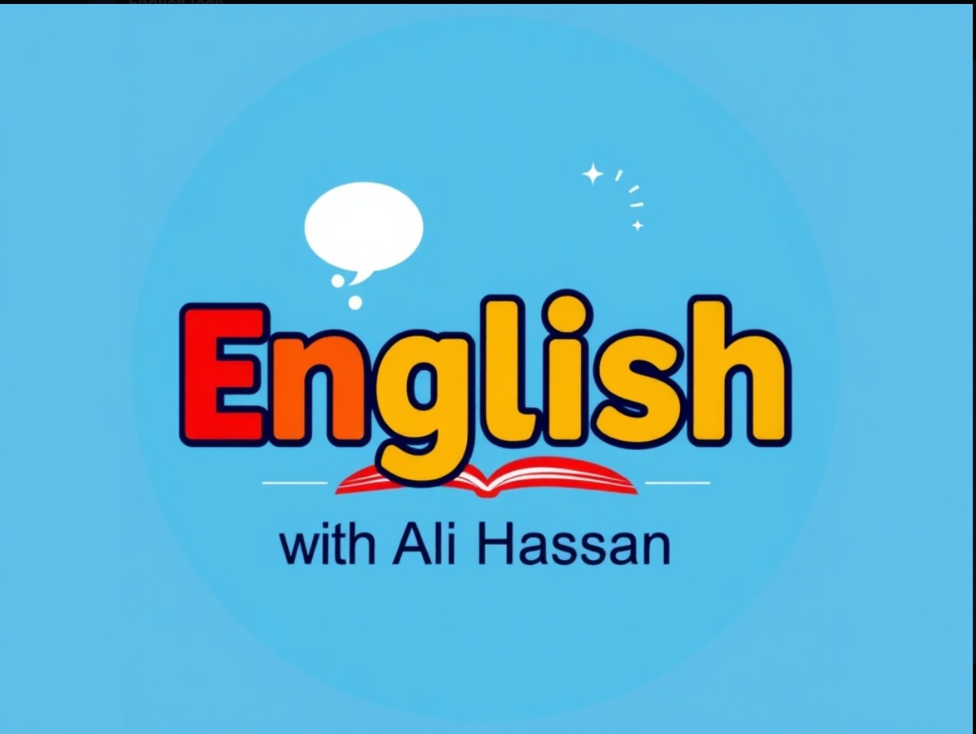


EOT 1 Exam Revision
12 ADVANCED
English With Ali Hassan
https://t.me/English_WithAliHassan
https://shorturl.at/NshZg

Slide 2

Vocabulary

Slide 3

Word / Phrase (PoS) | Arabic Meaning
roots (n) | جذور
identical (adj) | مطابق - متطابق
be reunited (v) | إعادة الاجتماع
significant (adj) | مهم - كبير
due to (prep) | بسبب
heritable (adj) | وراثي
thrill (n) | إثارة - تشويق
powerful (adj) | قوي - ذو قوة
brain (n) | دماغ
mind (n) | عقل - ذهن
memory (n) | ذاكرة
identity (n) | هوية
personality (n) | شخصية
behaviour (n) | سلوك
colleague (n) | زميل عمل
roots (n) | جذور
Word / Phrase (PoS) | Arabic Meaning
peer (n) | زميل - نظير
attitude (n) | موقف - سلوك
chemicals (n) | مواد كيميائية
natural trait (n) | صفة طبيعية
personality trait (n) | صفة شخصية
genetics (n) | علم الوراثة
knowledge (n) | معرفة - علم
insight (n) | بصيرة - فهم عميق
peer (n) | زميل - نظير
attitude (n) | موقف - سلوك
chemicals (n) | مواد كيميائية
natural trait (n) | صفة طبيعية
personality trait (n) | صفة شخصية
genetics (n) | علم الوراثة
knowledge (n) | معرفة - علم
insight (n) | بصيرة - فهم عميق
1

Slide 4
Word / Phrase (PoS) | Arabic Meaning
insulation (n) | عزل
conservation (n) | الحفاظ على البيئة / صون
original (adj) | أصلي
creation (n) | خلق / ابتكار
structural (adj) | هيكلي / إنشائي
layer (n) | طبقة
reduction (n) | تقليل
overflow (n) | فيضان / فائض
additions (n) | إضافات
historical (adj) | تاريخي
drawbacks (n) | عيوب / سلبيات
lightweight (adj) | خفيف الوزن
wildlife (n) | الحياة البرية
rainwater (n) | مياه الأمطار
Word / Phrase (PoS) | Arabic Meaning
outweigh (v) | يفوق / يغلب
overconfident (adj) | واثق بنفسه بشكل مبالغ
cost-cutting (adj) | تقليص التكاليف
fastest-growing (adj) | الأسرع نمواً
low-priced (adj) | منخفض السعر
planet friendly (adj) | صديق للبيئة
long-term (adj) | طويل الأجل
2

Slide 5
Grammar

Slide 6
Zero Conditional
If we care about each others, the community gets more connected.
Checking questions | Is the speaker sure that caring leads to a more connected community? (The speaker is confirming a belief here.)
Grammatical structure | If present simple (condition) , present simple (result ) If he gets tired , he takes a break
Usage | We use the zero conditional to talk about situations that are always true, general facts, or cause-and-effect rules.
Other examples | If it rains, the ground gets wet. If the traffic light is red, you stop. If people eat too much sugar, they gain weight. We wear light clothes if it gets hot. If I get a gift , I feel so happy. They certainly suffer some health issues if they do not adopt a healthy lifestyle,

Slide 7

Practice (Zero Conditional )
If people do not get enough sleep, they ________ more relaxed. a) do not feel b) feel c) won’t feel | If friends support each other, the relationship __________ stronger. a) become b) will become c) becomes
If you recycle plastic bottles, less waste __________ in landfills. a) ended up b) ends up c) ending up | The environment __________ cooler and cleaner if a city plants more trees. a) will get b) gets c) get

Slide 8
Modal Verbs “ Can”
My brother can speak three foreign languages fluently. It can be so cold in winter.
Checking questions | Is my brother able to speak foreign languages fluently? Is it likely to be cold in winter?
Grammatical structure | Affirmative | Subject + can + base verb
 | Negative | Subject + cannot (can’t) + base verb
 | Question | Can + Subject + base verb
Usage | The modal verb “can” is used to express: 1.Ability – ( what someone is /isn’t able to do) 2.Permission – ( when someone is allowed to do something) 3.Possibility – when something is possible. 5.Requests or Offers – to ask or offer politely.
Other examples | 1. I can swim very fast. He can’t speak a foreign language. 2. You can go out after you finish your homework. 3. It can be foggy tomorrow. 4. Can you help me answer this question, please? Can I bring you something to drink?

Slide 9
Practice (Modal Verbs “Can”)
_________ you help me carry these bags, please? a) Do b) Can c) May | He’s only two years old, so he __________ read yet. a) can b) could c) can’t
__________ I use your phone for a moment? a) Could b) Can’t c) Can | Very soon, people _______use flying taxis to commute to work. a) can b) could c) won’t

Slide 10
Modal Verbs “ Should”
You shouldn’t eat too much sugar, otherwise you will gain weight. The plane should land very soon.
Checking questions | Is it a good thing to eat too much sugar? Is it expected for the plane to land soon?
Grammatical structure | Affirmative | Subject + should + base verb
 | Negative | Subject + should not (shouldn’t) + base verb
 | Question | Should + Subject + base verb
Usage | The modal verb “should” is used to give advice, suggestions, opinions , expectations or to express what is the right or best thing to do. We use “should” to say that something is a good idea or the right thing to do.
Other examples | You should drink more water to stay healthy. ( Advice) We should take a taxi. It is a little bit late. ( Suggestion) People should lower their energy consumption. ( Opinion) The meeting should start at 8:00 pm. ( Expectation)

Slide 11
Practice (Modal Verbs “Should” )
When you feel stressed, you ___ talk to someone you trust. a) must b) should c) might | To reduce plastic waste, communities ___ recycle more. a) should b) shouldn’t c) can
You ___ control your emotions calmly when you feel angry. a) can b) may c) should | We ________ waste clean water because it is a valuable resource. a) shouldn’t b) should c) may

Slide 12
Compound Nouns
I need a new notebook for school. There’s a swimming pool in our hotel. My mother-in-law is visiting us.
Checking questions | Is “notebook “ originally one or two words? How is “ swimming pool “ written? What is written between each word in “mother-in-low”?
Grammatical structure | Type | Explanation | Example
 | Closed form | words are joined together | toothpaste, bedroom
 | Hyphenated form | words are joined with a hyphen (-) | check-in, mother-in-law
 | Open form | words are written separately but used together | post office, swimming pool
Usage | A compound noun is made up of two or more words that function as one noun. Compound nouns create specific meanings and make sentences more concise.
Other examples | He bought a toothbrush yesterday. She works in a post office. He is my brother-in-law.

Slide 13
Practice (Modal Verbs : Should )
The city is planning to build a new __________ station to produce clean power. a) solar-panel b) solarpanel c) solar panel | She works in a __________ that cares for animals in danger. a) wildlife-center b) wildlife center c) wildlifecenter
My __________ is coming to visit next month. a. sister in law b. sister-in-law c. sisterinlaw | She went shopping at the ____. a) supermarket b) super market c) super-market

Slide 14
Writing

Slide 15
TASK 1
Instructions :
A 200-word text including two viewpoints about different ways of living
In 4-5 sentences , you write about the two points of view ,supporting your answer from the text in your OWN words.
Steps to answer this question :
Read and understand the question well
Identify key words and themes in the text
Structure your answer in 2 short paragraphs ( One for each view)
Write your own writing style and do not copy the exact words from text

Slide 16
Example
1st Part of the Text
Living in Tokyo, Japan offers a fascinating mix of ancient tradition and modern innovation. Many people admire the country’s strong sense of harmony, politeness, and community spirit. Public transport is reliable, streets are clean, and crime rates are low, which makes everyday life feel safe and organised. Residents often say that teamwork, discipline, and attention to detail are highly valued, helping everything run smoothly.
However, daily life can also be demanding. The culture expects people to work long hours, show respect in every situation, and follow social rules closely, which can sometimes limit personal freedom. The high cost of living and limited space in large cities may also challenge those who
prefer a slower lifestyle or more privacy.
1st Part of the Answer:
Living in Tokyo offers a well-organized and respectful lifestyle where people value harmony, teamwork, and discipline. Daily life is safe and efficient, but high expenses and the pressure to work long hours and follow strict rules can make it tiring and lead to less private life.

Slide 17
Example
2nd Part of the Text
Dubai, in contrast, attracts people who value ambition, opportunity, and diversity. The city offers tax-free salaries, a strong economy, and a modern lifestyle supported by world-class facilities. Its warm climate and safe environment make it an appealing place for families and professionals alike. Dubai’s multicultural society promotes respect and coexistence, allowing residents to experience different cultures, traditions, and cuisines every day. While the pace of life can be fast and the cost of living high, many appreciate how Dubai encourages innovation, progress, and success while preserving its cultural values and sense of community.
Both Japan and Dubai combine tradition with modern life in unique ways, offering rewarding experiences for people with different goals and lifestyles.
2nd Part of the Answer:
In contrast, Dubai provides a modern and dynamic environment with many opportunities for success. It celebrates cultural diversity and offers comfort and safety, although the fast pace and high expenses can be challenging. Both cities show how tradition and progress can exist together in different ways.

Slide 18
Final Answer
Living in Tokyo offers a well-organized and respectful lifestyle where people value harmony, teamwork, and discipline. Daily life is safe and efficient, but high expenses and the pressure to work long hours and follow strict rules can make it tiring and lead to less private life.
In contrast, Dubai provides a modern and dynamic environment with many opportunities for success. It celebrates cultural diversity and offers comfort and safety, although the fast pace and high expenses can be challenging. Both cities show how tradition and progress can exist together in different ways.

Slide 19
TASK 2
Instructions :
With the text given in Task 1, students are to write a response to the text.
Three prompts are to be covered in 220-word essay.
Steps to answer this question :
Read and understand the task:
Compare life in Tokyo and Dubai (based on the text)
Give your opinion – which city’s lifestyle you prefer
Support your opinion with examples or details from the text

Slide 20
TASK 2
2. Plan your essay :
Write in FOUR clear paragraphs:
Introduction – Mention both cities and what the essay will compare.
Paragraph 1 – Describe life in Tokyo (main features, pros and cons).
Paragraph 2 – Describe life in Dubai (main features, pros and cons).
Conclusion – State which lifestyle you prefer and explain why, using examples or ideas from the text.

Slide 21
TASK 2
💡 3. Writing tips
✅ Use linking words: however, also, for example, in addition, therefore. ✅ Keep your ideas clear and connected. ✅ Don’t just list points — explain each point briefly. ✅ Write in complete sentences and use your own words and way of writing ✅ Check grammar, punctuation, and spelling before submitting your answer

Slide 22
💡 Model answer
Living in both Tokyo and Dubai offers a balance between tradition and modern life, but each city provides a very different lifestyle. The text highlights how both cities integrate strong cultural values with modern comforts, despite their diverse daily experiences and expectations.
Life in Tokyo is described as organized, respectful, and efficient. People in Japan value harmony, teamwork, and discipline, which makes society run smoothly. Public transport is reliable, streets are clean, and the environment feels safe. However, this lifestyle can also be demanding. The culture expects people to work long hours, follow many social rules, and live in limited space, which may feel stressful for some.
In Dubai, life is more dynamic and focused on ambition and opportunity. The city attracts people from many countries who appreciate its safety, diversity, and modern lifestyle. Residents enjoy tax-free income, advanced facilities, and a strong economy. Yet, the fast pace and high cost of living can be challenging for some individuals.
Personally, I would prefer living in Dubai because it offers more freedom and multicultural experiences. I like how it encourages innovation and brings people from different backgrounds together. While Tokyo’s discipline is admirable, I find Dubai’s openness and energy more appealing for a balanced, exciting lifestyle.

Slide 23
Thank You
English With Ali Hassan

