Slide 1
Speaking 2
12 Advanced
New Interactions
3

Slide 2

Learning Objectives
Listening: Listening for persuasive language
Speaking: Talking about persuasion; giving a short speech
Vocabulary: Words associated with persuading others to take action
Language Focus: Persuasive language; conditional sentences – if and unless
Critical Thinking: Presenting convincing arguments and persuading others to take action
Research and Document: Researching a topic for a persuasive speech

Slide 3
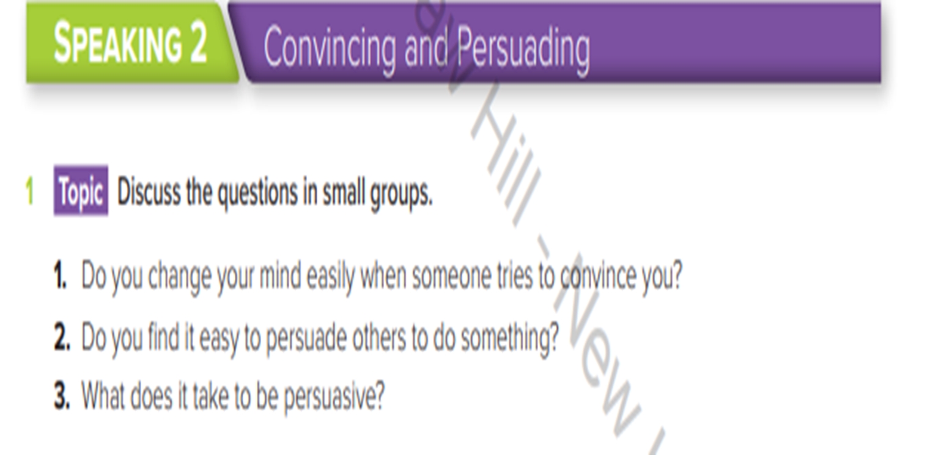



Slide 4

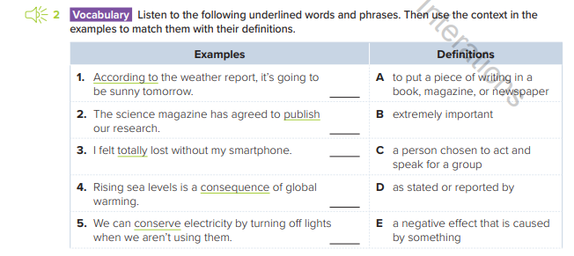
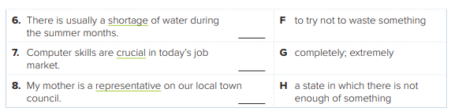
D
A
G
E
F
H
B
C

Slide 5
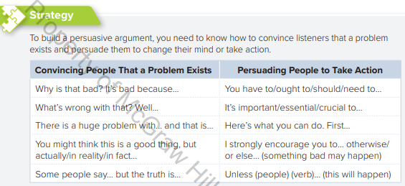
Persuasive Language
Skills Focus

Slide 6
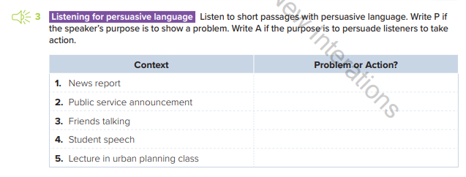
P
A
A
A
P

Slide 7
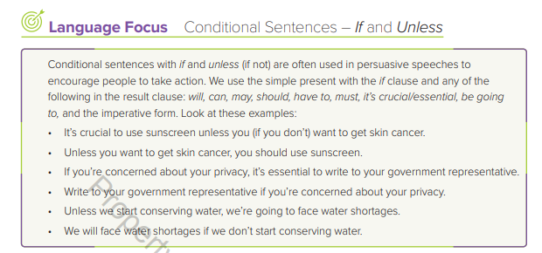

Slide 8
If not = unless
Complete the following sentences.
1. I will take the job ………………… the pay is too low.
if
unless
2. I will be back tomorrow ………………….. there is a plane strike.
if
unless
3. Let’s go for a walk – ………………… you are too tired.
unless
if

Slide 9
4. I am going to work in the garden this afternoon, …………………. it rains.
if
Unless
5. I will be surprised ………………….. he doesn’t have an accident soon.
if
Unless
6. I think she would look prettier …………………. she didn’t wear so much make-up.
if
Unless
7. …………………. you don’t stop smoking, you will fall seriously ill.
If
Unless
8. …………………. you start now, you will not reach there in time.
If
Unless
4. I am going to work in the garden this afternoon,
…………………. it rains.
if
unless

Slide 10


Use the following patterns to form If / Unless sentences
It’s crucial /essential +unless/if + present smple
Unless/If + present simple , will /can / may…..+inf
Imperative form Unless/If + present simple
Unless/If + present simple , be going to + inf
https://www.myenglishpages.com/english/grammar-exercise-if-or-unless.php

