Slide 1

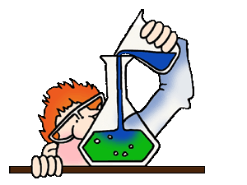

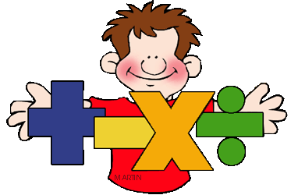
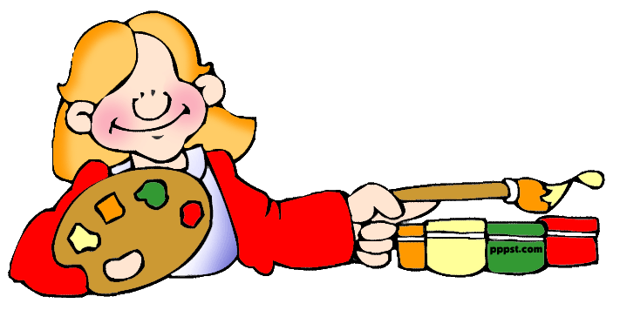
U: Looking back
L: 9-10 Fables
WEEK 2
Date: 8/9/2021
By: Mrs. Riffat Noreen
Grade: 11 GEN
ENGLISH
MATH
SCIENCE
ART

Slide 2
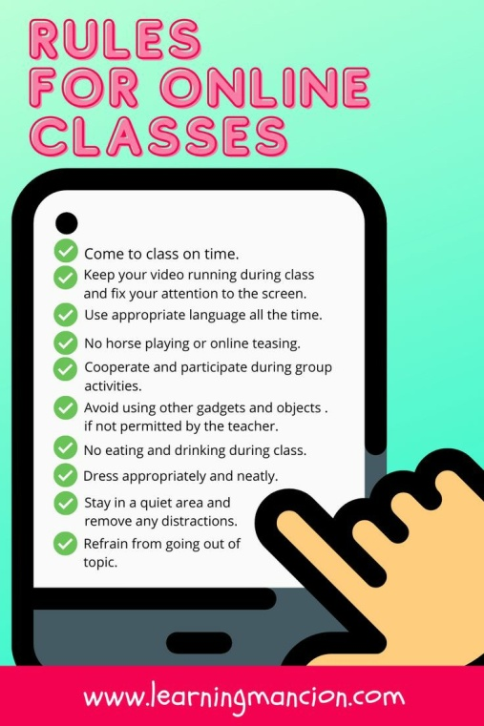

Slide 3

Learning Objectives
By the end of the lesson students will be able to
Learn new vocabulary about fables and morals.
Read a fable and identify the story elements.

Slide 4
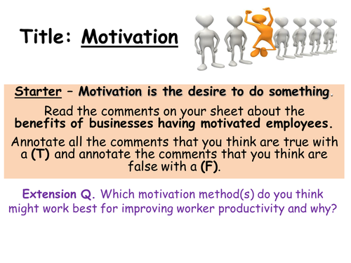
Starter
What stories do you remember from your childhood?
Do you like to read stories / Fables?
What was the last story you read?
Did it have any message / moral?

Slide 5


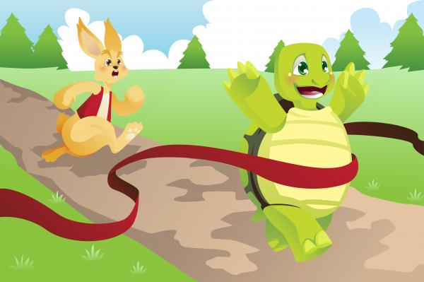
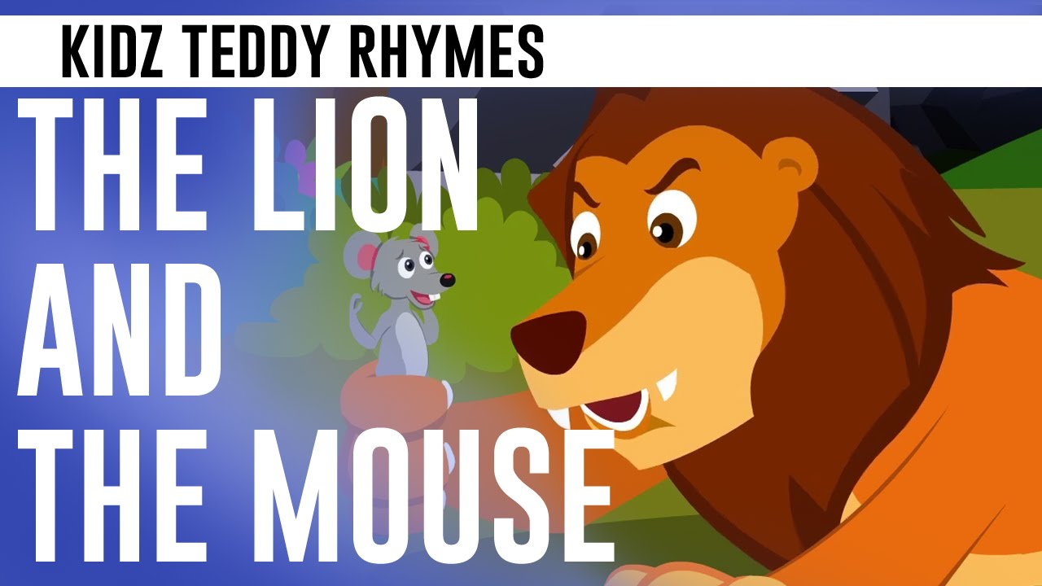

Activity
Do you know any of these fables?

Slide 6


OBJECTIVES
By the end of the lesson
all students
most
some
Key Concept
To learn what fables are

Slide 7
Vocabulary
Fable: a short tale / story, typically with animals as characters, conveying a moral.

Slide 8
Vocabulary
Moral: is the lesson that is derived from a story and that teaches us
how to behave in life

Slide 9
Vocabulary
Character: a person in a novel, play, or film.

Slide 10
Vocabulary
Once upon a time: at some time in the past (used as a conventional opening of a story).

Slide 11
Vocabulary
Narrator: a person who narrates a story

Slide 12
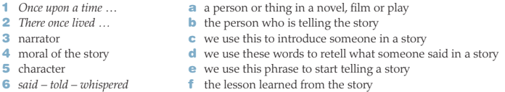
Activity
Match the words and phrases we use in storytelling with the correct definition.
https://quizizz.com/admin/quiz/613793ad841552001e0d146f

Slide 13
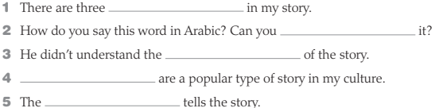
Activity
Complete the gaps with the given words
Characters – Translate – Moral – Fables - Narrator

Slide 14
Answer Key
Check the answers:
Narrator – Morals – Fables – Translate - Characters
characters
translate
morals
Fables
narrator

Slide 15
Activity
You are going to read about a book called Kalila and Dimna.

Slide 16
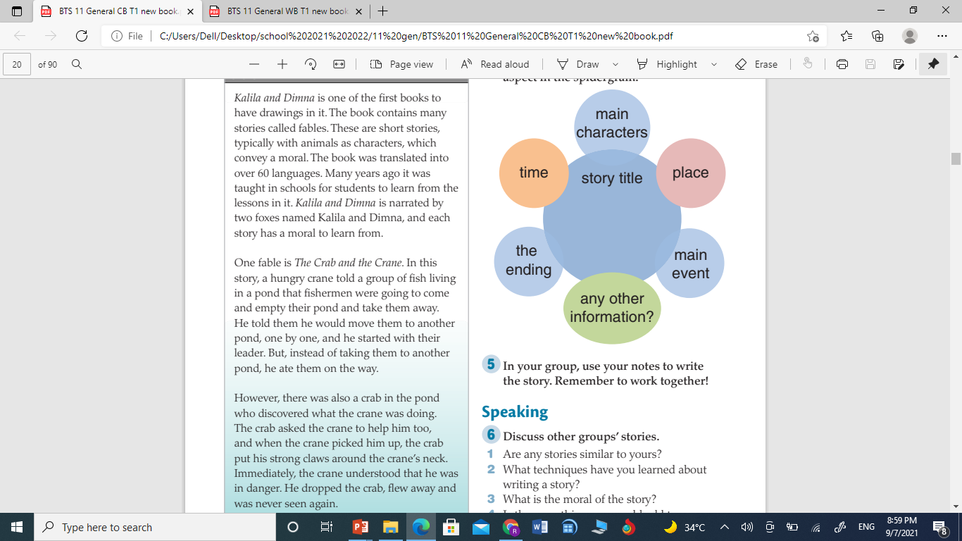
Text

Slide 17
Text

Slide 18
Text

Slide 19
OBJECTIVES
By the end of the lesson
all students
most
some
21st Century Skills
In your opinion, what is the moral of The Crab and the Crane?

Slide 20
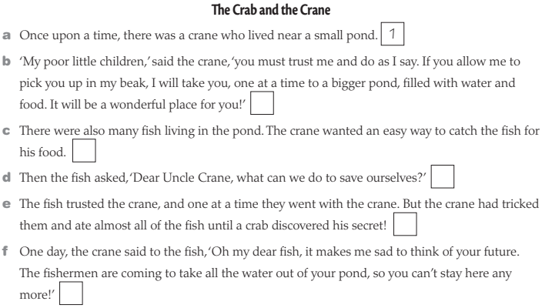
Activity
Order these lines from the beginning of the story, The Crab and the Crane. The first one has been done for you.

Slide 21
Answer Key
Order these lines from the beginning of the story, The Crab and the Crane. The first one has been done for you.
5
2
4
6
3

Slide 22
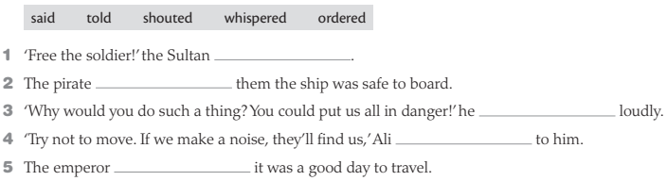
Activity
Complete the sentences with these reporting verbs

Slide 23
Answer Key
Complete the sentences with these reporting verbs
ordered
told
shouted
whispered
said

Slide 24

OBJECTIVES
By the end of the lesson
all students
most
some
Self-evaluation
Write 3 things you have learned today.

