Slide 1
English Language
Coverage, Grammar and Functional Language Teaching Resource
Level 7.1
Term 1
2024 - 2025

Slide 2
INDEX
03
06
08
15
How to use this resource
Assessment Coverage
Preparation - Grammar
Preparation – Functional language

Slide 3
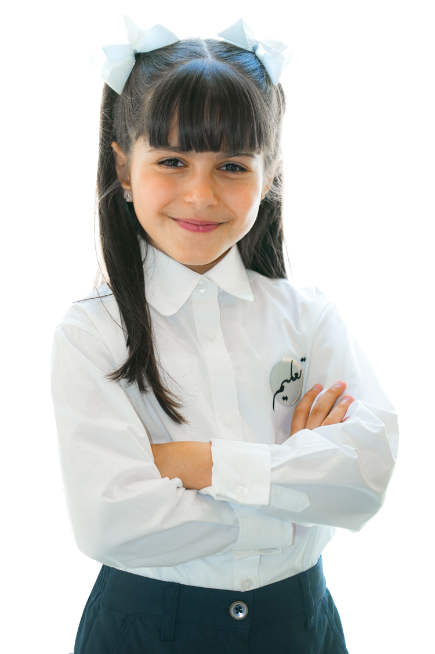
How to use this resource

Slide 4

The Coverage, Grammar and Functional Language Teaching Resource
The slides within this resource, although detailed, are designed as a starting point for teachers. You can:
construct lessons around the language points explored in them.
use the slides individually as a resource within a lesson.
incorporate them gradually in lessons throughout the term (rather than the whole PowerPoint at once).
combine functional language and grammar slides which overlap.
Ensure that students have been exposed to all the language points in the coverage ahead of their end of term exam.

Slide 5

Within this document, you will find information about:
the coverage for this term.
the lexis families that assessments will contain.
particular grammatical and functional language points that will be tested in the exams.
In the preparation sections, you will find examples and explanations for the grammatical and functional language points that will be assessed this term.
The grammar preparation sections contain:
an example sentence.
an explanation of the meaning of the example sentence.
the specific grammatical structure used within the example sentence.
links to further resources.
an explanation of the circumstances under which the structure is used.
more example sentences.
In the functional language preparation section, there are examples and explanation of how the functional language is used, as well as relevant associated grammar points.

Slide 6

Term 1 Assessment Coverage

Slide 7
Topic(s): Business, jobs, science.
ECFE Grammar | Prerequisite | GSE Grammar | Functional Language
Passive: future simple passive | Can use the present simple passive. (48) | Can use 'going' to and 'will' future forms of the passive. (50) | Describing past experiences and events Expressing opinion Comparing and contrasting
Adjectives: superlatives | Can form the superlative of regular adjectives with '-est'. (36) | Can use 'one of/some of/among' in phrases with superlative adjectives. (55)
Reported speech: reporting verbs | Can make affirmative statements using common regular past simple forms. (30) | Can make tense changes (present to past) in reported speech. (56)
Past time: past perfect | Can use the present perfect to refer to personal experiences in the past. (41) | Can use the past perfect in a range of common situations. (54)
Future time: future perfect | Can use the present perfect to refer to personal experiences in the past. (41) | Can use the future perfect with reference to actions to be completed by a specific time in the future. (66)
Modals: present modals (likelihood) | Can use 'can' to refer to ability in the present. (29) | Can use a range of modals to express likelihood (may, might, could, should).

Slide 8

Term 1 preparation: Grammar

Slide 9
The email will be sent tomorrow morning.
Checking questions | Has the email already been sent? When will it be sent? Who will send it?
Grammatical structure | Passive: future simple passive NP + 'going to/will' + VP passive object + ‘will be’ + past participle (+ ‘by’ doer) object + ‘is/am/are’ + ‘going to be’ + past participle (+ ‘by’ doer)
Usage | We use future simple passive to talk about future events where the receiver of the action or the action itself is more interesting or important than the doer of the action. To create passive voice, the object (receiver) of the active sentence is moved to the subject position in the passive sentence and ‘be’ is added before the main verb.
Other examples | The car is going to be sold. The job is not going to be advertised in the paper. The answers will be given at the end of the class. Will the contract be signed by Mr. Ahmad tomorrow?
The teacher will send the email tomorrow morning. (active)
The email will be sent tomorrow morning. (passive)

Slide 10
The company is one of the best because it is dedicated to the welfare of its employees.
Checking questions | Is the company good at welfare? Is the company the absolute best company?
Grammatical structure | Adjectives: superlatives​ subject + verb + ‘one of / some of / among the’ + superlative phrase​
Usage | We use superlative adjectives to express that something or someone is either the top or bottom of a specified group. Superlative adjectives can use the words most or least (beautiful = most beautiful), end in –est (easy = easiest), or be irregular (good = best). We use superlatives with ‘one of / some of / among the’ to soften the superlative. We are not talking about one thing that is at the absolute top, rather it is part of a group that are all at the top.
Other examples | That was one of the most interesting lectures I have ever attended. Egypt produces some of the finest cotton in the world.​ This new product is among the best on the market right now. In fact, Emirati entrepreneurs are some of the best in the business.

Slide 11
He said (that) he was tired.
Checking questions | Is the conversation happening now? When is it happening? Is the speaker tired?
Grammatical structure | Reported speech: reporting verbs reporting verbs + 'that' + complement clause
Usage | We use reported speech to tell someone what another person said. To do this, we ‘backshift’ the tense so, for example, present simple tense becomes past simple tense, and past simple becomes past perfect simple.
Other examples | She told me (that) she had expanded her company. Maryam said (that) the movie lasted for more than three hours! We told her (that) our boss had been on a business trip.
“I am tired,” he said. He said he was tired.
“I was at school,” she said. She said that she had been at school.

Slide 12
Mona had read the paper by the time she reached home.
Checking questions | Has Mona finished reading? Did she finish reading before or after she got home? Is she at home now?
Grammatical structure | Past time: past perfect had + past participle
Usage | We can use the past perfect when we want to talk about two completed past actions. We use the past perfect when an action happens before another past action. Past simple is used for the later action. We can also use past perfect when we want to say an action was happening up to a certain time in the past. In the example below, the man was a shop salesman for ten years, then changed his job.
Other examples | He had worked in retail for ten years before he became a businessman. I remembered it after I’d already left home. By the time I got there, she’d gone. When the guests arrived, I had finished my work.
Finished reading paper
Got home
Present

Slide 13
Will you have finished writing your report by tomorrow? Yes, I will have done it all by the time the programme starts.
Checking questions | Has the speaker finished their report now? It is tomorrow – are they finished?
Grammatical structure | Future time: future perfect simple subject + will / won’t + have + past participle + complement
Usage | We use the future perfect to talk about an event that is expected to happen before a particular time in the future. We look forward to the future event from the moment of speech. The auxiliary ‘will’ is used in a clause with the past participle to describe the event that is expected to happen and it is usually combined with a time phrase in the complement to give information about when the event is expected to occur.
Other examples | I will have submitted the project by Monday afternoon. My friends are coming at 7pm. I will have finished cooking by then. By the 18th of April, the company will have launched their newest products. Ahmed will have arrived at Heathrow airport by tomorrow morning.
Finished writing report
Present

Slide 14
Fatima might finish the project today.
Checking questions | Will Fatima finish her project today?
Grammatical structure | Modals: present modals, Modals: past modals and Modals: passive modals (possibility) present/future - modal + main verb past - modal + have + past participle
Usage | We can use a range of modals to talk about the possibility or likelihood of something happening. We use ‘should’ when we think it is reasonable to expect something to happen in the future because it’s what usually happens. We use ‘might’, ‘may’ and ‘could’ when we think something is possible, but we’re not completely sure. ‘May’ is more formal than ‘might’ or ‘could’.
Other examples | The computer should work now it’s been fixed. I might see you at the weekend. Could he have seen us? The project may be completed ahead of schedule.

Slide 15
Term 1 preparation:
Functional language

Slide 16
In my opinion, online education offers more flexibility than traditional schooling. I strongly believe that climate change should be the top priority for governments worldwide. From my perspective, travelling is the best way to learn about different cultures and broaden your horizons. As far as I'm concerned, remote work can improve work-life balance for many people. It seems to me that social media has a significant influence on young people's self-esteem.
Functional language point | Expressing opinion
Associated grammar | Prepositional phrases, noun phrases, comparative degree, conjunctions, modal verbs, defining relative clauses, gerunds.

Slide 17
Last summer, I travelled to Greece and visited some of the most beautiful historical sites in the world. When I was a child, we used to go camping in the mountains every year. In 2020, I completed my degree and started my first full-time job. Back in high school, I was a member of the robotics school team. One of the best moments of my life was when I hiked to the top of a mountain and saw the sunrise. I had never tried skiing before last winter, but it turned out to be a lot of fun.
Functional language point | Describing past experiences and events
Associated grammar | Past simple, past perfect, phrasal verbs, “used to” construction, conjunctions, time expressions.

Slide 18
A doctor develops treatment plans while a nurse puts those plans into practice.​ He completed his work faster than his classmates.​ In contrast to laptops, tablets are much easier to use.
Functional language point | Comparing and contrasting​
Associated grammar | Adjectives, nouns, comparatives, superlatives​

Slide 19
Thank you

