Slide 1
MATH FINAL EXAM REVISION TERM 3
11 GENERAL
TEACHERS:
HANA ALMANSOORI
FFATIMA ALI

Slide 2
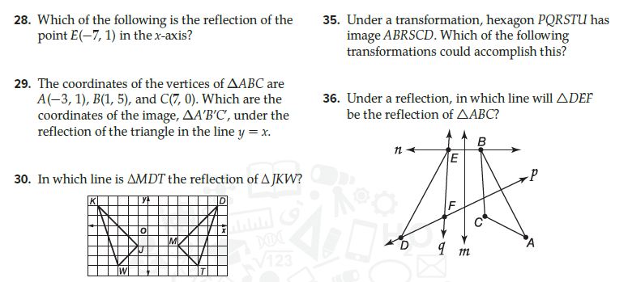
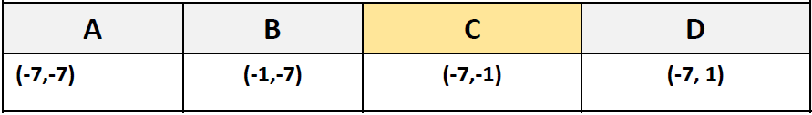
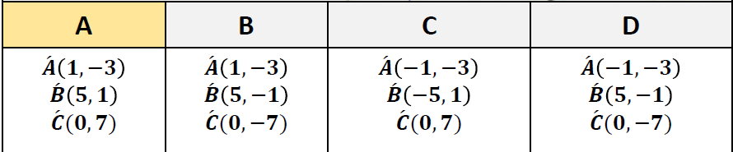
PART 1 : MULTIPLE CHOICES
Q1
LESSON 9.1

Slide 3
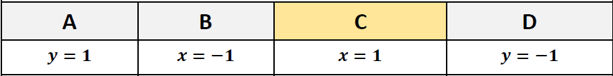

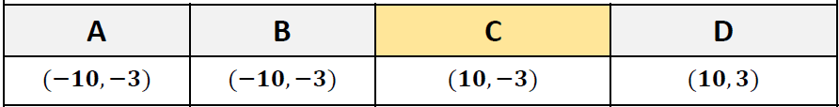
PART 1 : MULTIPLE CHOICES
Q1
LESSON 9.1

Slide 4
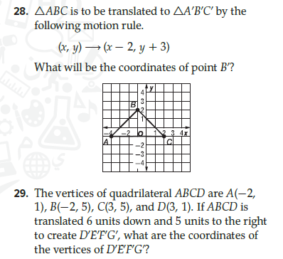
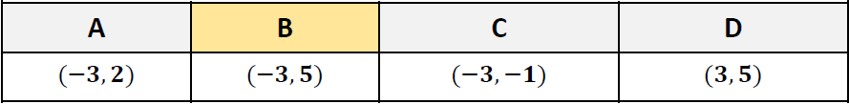
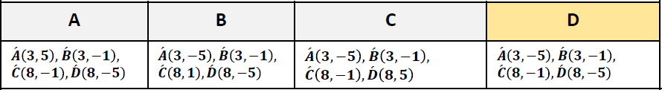
PART 1 : MULTIPLE CHOICES
Q2
LESSON 9.2

Slide 5
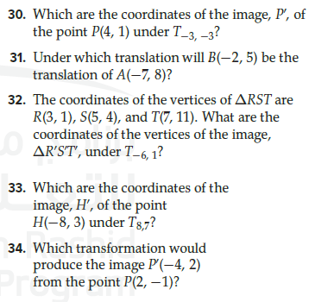
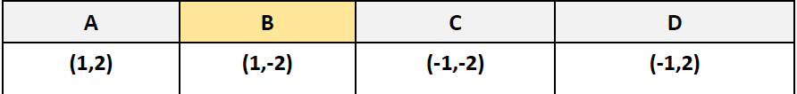
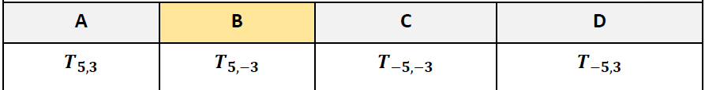
PART 1 : MULTIPLE CHOICES
Q2
LESSON 9.2

Slide 6
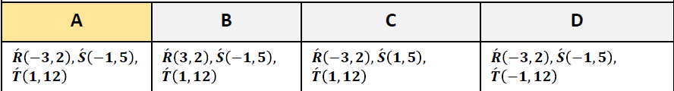
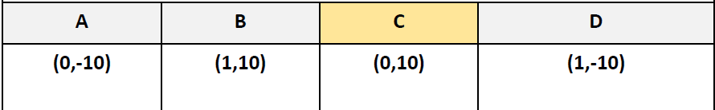
PART 1 : MULTIPLE CHOICES
Q2
LESSON 9.2

Slide 7

PART 1 : MULTIPLE CHOICES
Q2
LESSON 9.2

Slide 8

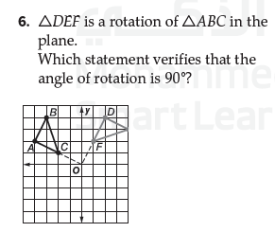

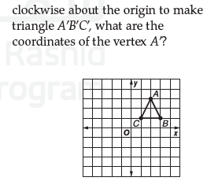

PART 1 : MULTIPLE CHOICES
Q3
lesson 9.3

Slide 9
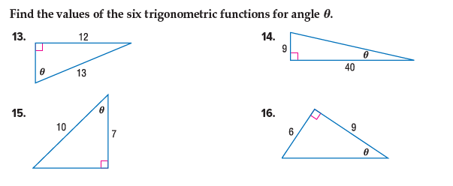
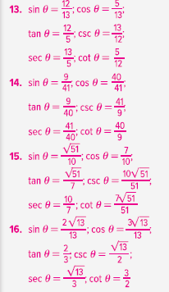
PART 1 : MULTIPLE CHOICES
Q4
LESSON 10.1

Slide 10
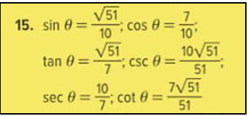
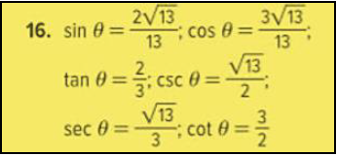
PART 1 : MULTIPLE CHOICES
Q4
LESSON 10.1

Slide 11
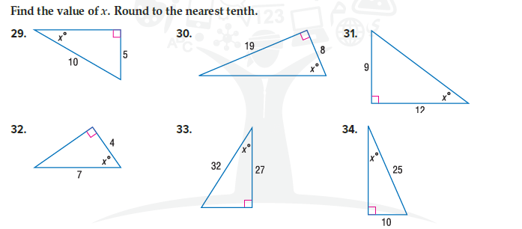
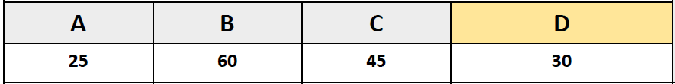
PART 1 : MULTIPLE CHOICES
Q5
LESSON 10..1

Slide 12
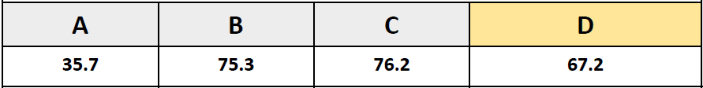
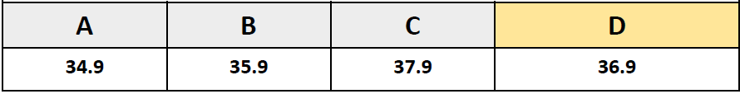
PART 1 : MULTIPLE CHOICES
Q5
LESSON 10..1

Slide 13
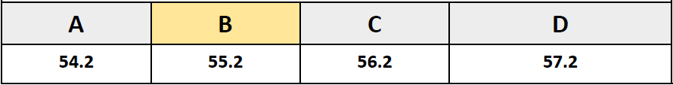
PART 1 : MULTIPLE CHOICES
Q5
LESSON 10..1

Slide 14
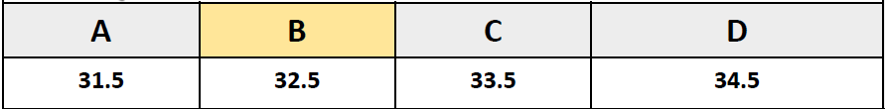
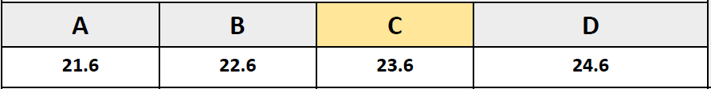
PART 1 : MULTIPLE CHOICES
Q5
LESSON 10..1

Slide 15
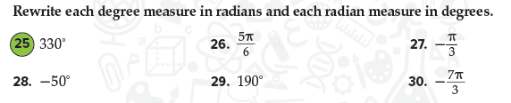



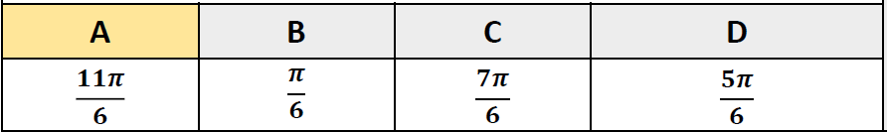

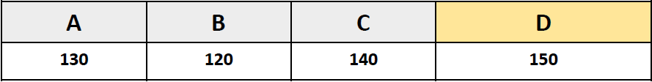
PART 1 : MULTIPLE CHOICES
Q6
LESSON 10.2

Slide 16

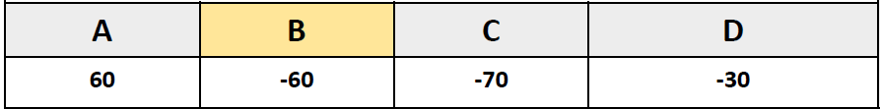
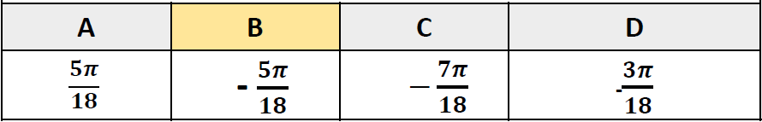

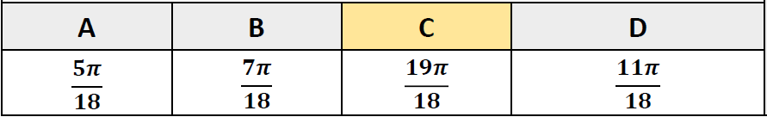
PART 1 : MULTIPLE CHOICES
Q6
LESSON 10.2

Slide 17
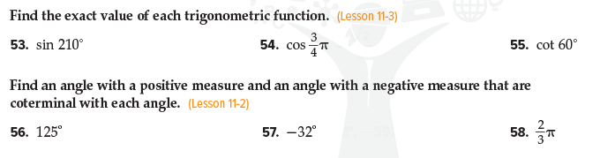
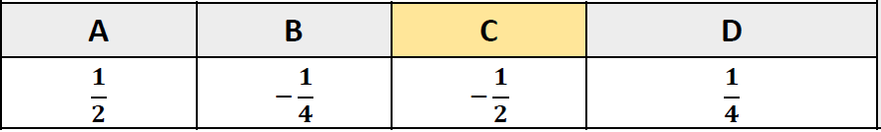
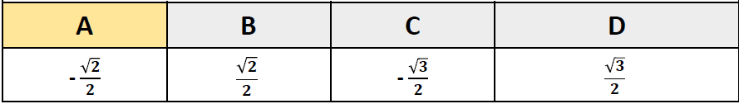
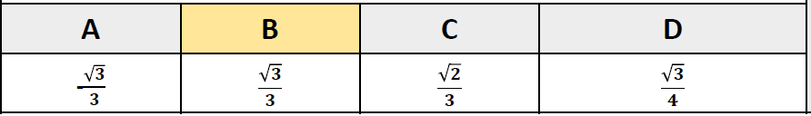
PART 1 : MULTIPLE CHOICES
Q7
Lesson 10.3

Slide 18
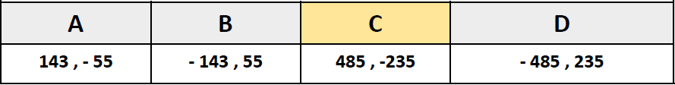
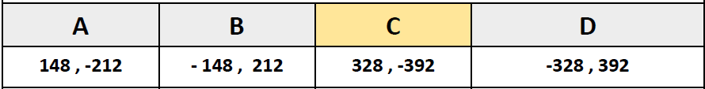
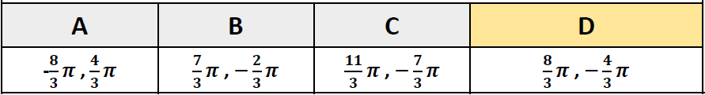
PART 1 : MULTIPLE CHOICES
Q7
Lesson 10.3

Slide 19
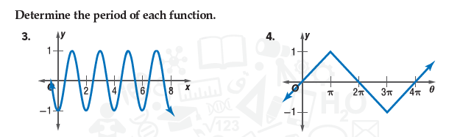
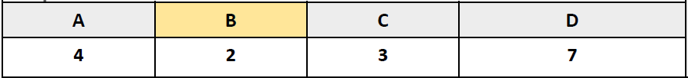
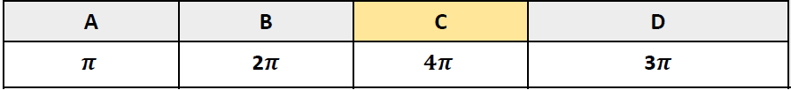
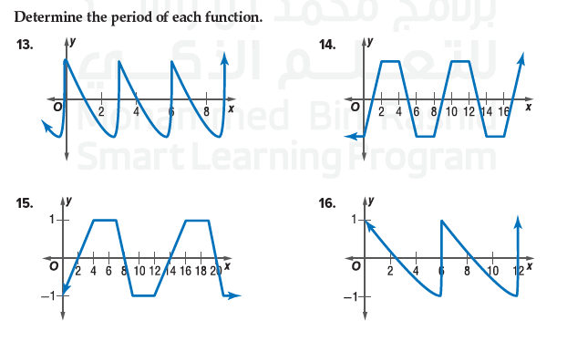
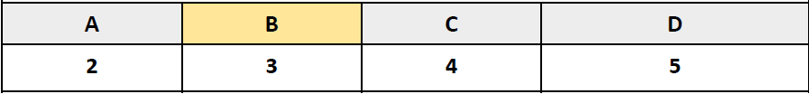
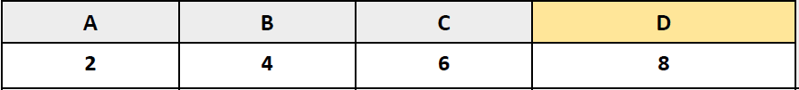
PART 1 : MULTIPLE CHOICES
Q8
LESSON 10.6

Slide 20
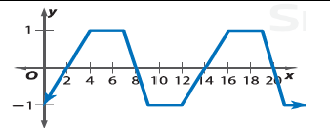
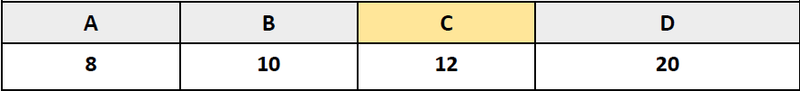
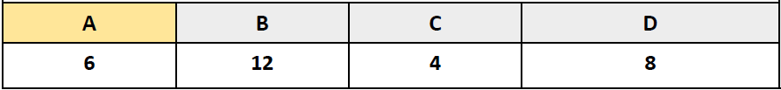
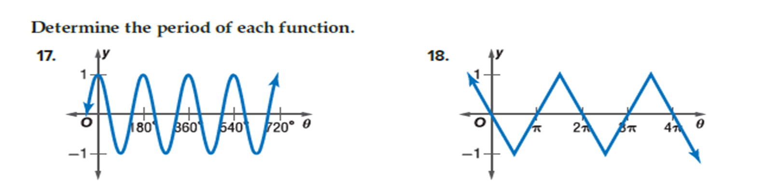
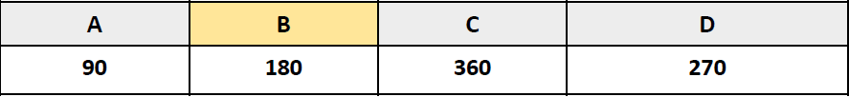

PART 1 : MULTIPLE CHOICES
Q8
LESSON 10.6

Slide 21





PART 1 : MULTIPLE CHOICES
Q9
Lesson 11.1

Slide 22




PART 1 : MULTIPLE CHOICES
Q9
Lesson 11.1

Slide 23




PART 1 : MULTIPLE CHOICES
Q9
Lesson 11.1

Slide 24





PART 1 : MULTIPLE CHOICES SWIFT (BASIC SKILLS)
Q10
LESSON 11.3

Slide 25


PART 1 : MULTIPLE CHOICES SWIFT (BASIC SKILLS)
Q10
LESSON 11.3

Slide 26



PART 2 MCQ - SWIFT
Q11:
5.1

Slide 27




PART 2 MCQ - SWIFT
Q11:
5.1

Slide 28




PART 2 MCQ - SWIFT
Q11:
5.1
FIRST
SECOND
THIRD
FOURTH

Slide 29


PART 2 MCQ - SWIFT
Q12:
5.1
8 CM

Slide 30


PART 2 MCQ - SWIFT
Q12:
5.1
Reflections
Translation
Rotation and Translation
Glide Reflections

Slide 31

PART 2 MCQ - SWIFT
Q13:
5.3

Slide 32



PART 2 MCQ - SWIFT
Q14:
5.5

Slide 33




PART 2 MCQ - SWIFT
Q14:
5.5
1 Hour and 40 minutes
1 Hour and 20 minutes
1 Hour and 30 minutes
1 Hour and 15 minutes

Slide 34




PART 2 MCQ - SWIFT
Q14:
5.5

Slide 35





PART 2 MCQ - SWIFT
Q15:
6.1

Slide 36


PART 2 MCQ - SWIFT
Q15:
6.1

Slide 37



PART 2 MCQ - SWIFT
Q16:
6.3

Slide 38




PART 2 MCQ - SWIFT
Q16:
6.3

Slide 39


PART 2 MCQ - SWIFT
Q16:
6.3

Slide 40


PART 2 MCQ - SWIFT
Q17:
7.1

Slide 41





PART 2 MCQ - SWIFT
Lesson 10.9
Q18:
No solution
No solution

Slide 42


PART 2 MCQ - SWIFT
Lesson 10.9
Q18:
No solution
No solution

Slide 43



PART 2 MCQ - SWIFT
Q19:
Lesson11.1

Slide 44


PART 2 MCQ - SWIFT
Q19:
Lesson11.1

Slide 45


PART 2 MCQ - SWIFT
Q19:
11.1

Slide 46


PART 2 MCQ - SWIFT
Q19:
11.1

Slide 47







PART 2 MCQ - SWIFT
Q20:
Lesson 11.3

Slide 48



PART 3 : PAPER
Q21
LESSON 9.1

Slide 49



PART 3 : PAPER
Q21
LESSON 9.1

Slide 50


PART 3 : PAPER
Q21
LESSON 9.1

Slide 51


PART 3 : PAPER
Q21
LESSON 9.1

Slide 52



PART 3 : PAPER
Q22
LESSON 10.5

Slide 53


PART 3 : PAPER
Q22
LESSON 10.5

Slide 54

PART 3 : PAPER
Q22
LESSON 10.5

Slide 55


PART 3 : PAPER
Q22
LESSON 10.5

Slide 56

PART 3 : PAPER
Q22
LESSON 10.5

Slide 57


PART 3 : PAPER
Q22
LESSON 10.5

Slide 58

PART 3 : PAPER
Q23
LESSON 11.2

Slide 59


PART 3 : PAPER
Q23
LESSON 11.2

Slide 60
PART 3 : PAPER
Q23
LESSON 11.2

Slide 61


PART 3 : PAPER
Q23
LESSON 11.2

Slide 62
PART 3 : PAPER
Q23
LESSON 11.2

Slide 63


PART 3 : PAPER
Q23
LESSON 11.2

