Slide 1




CYCLE 3
ENGLISH LANGUAGE
11 GEN / 10 ADV

Slide 2


TEACHER OVERVIEW
Lesson 29-30
Skill: Reading and Viewing
Topic: Planet Under Stress
Lesson Goal
Students identify the topic and main idea of each paragraph in an article.
Student Learning Outcomes
Read and identify the main points.
Identify and interpret conventional features of text, including, organisation, structure and language, in a wide range of text types when reading.
Key Vocabulary
overpopulation, resources, estimated, distribution, stabilize, growth rate, declining
This lesson is adapted from NI Reading and Writing book page 111-115. Activities to be completed in the coursebook are referenced in the relevant slides. Some activities have been adapted or created using the PowerPoint and/or handouts.
Notes:
Main Outcome: ENG.07.RV.CS.6.1 Read and identify the main points of extended written or multimodal texts on familiar and unfamiliar concrete topics that are clearly structured and may use some nonstandard language or expressions.
Supporting Outcome: ENG.07.RV.S.2.1 Identify and interpret conventional features of text, including, format, appearance, organisation, structure and language, in a wide range of text types when reading extended written or multimodal texts on familiar and unfamiliar concrete topics that are clearly structured and may use some nonstandard language or expressions.
Disclaimer:
The lessons outlined in the Scope and Sequence, along with the corresponding PowerPoint materials, have been designed to align with the Ministry of Education’s cultural and educational expectations. These resources should be regarded as the core content for lesson delivery.
Teachers are strongly advised to use these materials as the primary guide for instruction and to refrain from teaching or referencing any sections of the course book that may contain content deemed culturally sensitive or inappropriate within the local context.

Slide 3
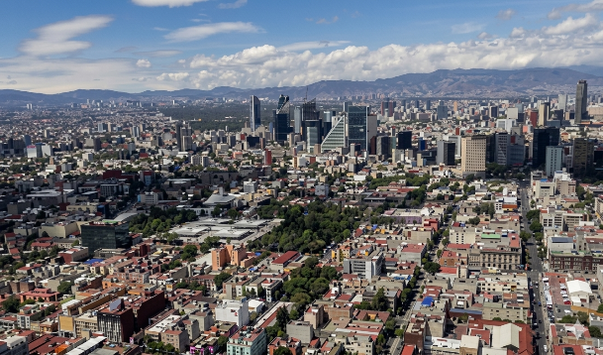
Lesson 29-30: Reading and Viewing
Lesson 29-30
Topic: Planet Under Stress
Warm-up
Lesson Goal
Identify the topic and main idea of each paragraph in an article.
Get ready
Activity 1
Activity 2
In this lesson, I will learn how to…
read and pick out the most important things that a writer is saying.
tell what’s important about how different kinds of text look, how they are organised, how parts fit together and how words are used when I read them.
Activity 3
Cool down
Plenary & Reflection
Key Vocabulary
overpopulation, resources, estimated, distribution, stabilize, growth rate, declining
Notes:
Disclaimer:
The lessons outlined in the Scope and Sequence, along with the corresponding PowerPoint materials, have been designed to align with the Ministry of Education’s cultural and educational
expectations. These resources should be regarded as the core content for lesson delivery.
Teachers are strongly advised to use these materials as the primary guide for instruction and to refrain from teaching or referencing any sections of the course book that may contain content deemed culturally sensitive or inappropriate within the local context.

Slide 4

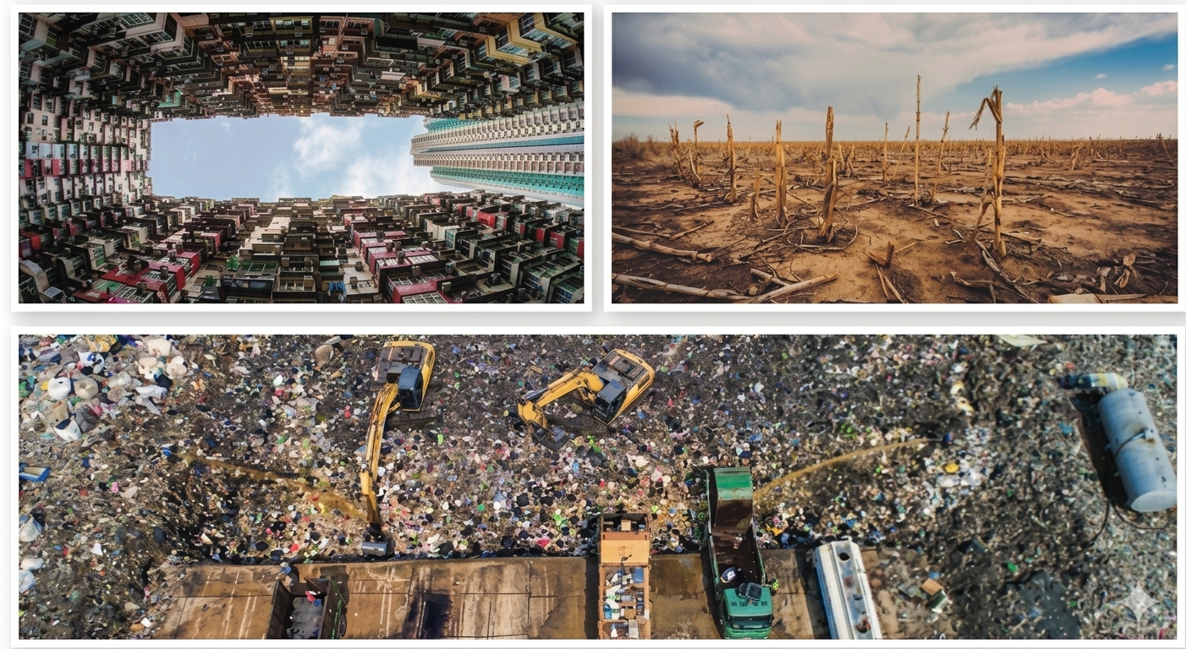
Warm-up
Reading and Writing, page 111, Activity 1
Look at the images. Think of a title for each image and compare your ideas in a group.
Lesson 29-30
Warm-up
Get ready
Activity 1
Activity 2
Activity 3
Cool down
Plenary & Reflection
Notes:
Either direct students to the activity in their coursebook or simply use this slide.
Instruct students to look at the images and think of a title for each. For example, ”Overcrowded”; “Too Much Trash.” etc.
Tell students to discuss and compare their image titles in groups.
Elicit titles from volunteers and write them on the board to help set the lesson theme.
Write any other useful language used on the board.

Slide 5

Vocabulary
Match the words with their definitions.
to stop changing or moving
Lesson 29-30
overpopulation
too many people living in one place
Warm-up
resources
Get ready
becoming less, or smaller; going down
Activity 1
estimated
Activity 2
Useful things that people need, such as water, land, and oil.
distribution
Activity 3
Cool down
the speed at which something increases in size or number
stabilize
Plenary & Reflection
growth rate
a guessed amount or value based in information we have
declining
The way something is shared or spread out over an area.
Notes:
Instruct students to work in pairs and read the words and definitions.
They should match each word with its definition and make a note of their answers in their notebook.
Elicit the answers from students before revealing them on the next slide.
Answer Key
B
D
F
G
A
E
C

Slide 6
Vocabulary
Match the words with their definitions.
to stop changing or moving
Lesson 29-30
overpopulation
too many people living in one place
Warm-up
resources
Get ready
becoming less, or smaller; going down
Activity 1
estimated
Activity 2
useful things that people need, such as water, land, and oil.
distribution
Activity 3
Cool down
the speed at which something increases in size or number
stabilize
Plenary & Reflection
growth rate
a guessed amount or value based in information we have
declining
the way something is shared or spread out over an area.
Notes:
Use this slide as an answer key.
Answer Key
B
D
F
G
A
E
C

Slide 7
Thinking and Predicting
Reading and Writing, page 112, Activity 2
You will read an article about a problem our planet is facing –
overpopulation.
Before you read, think about why overpopulation is a problem and how you can stop it. Brainstorm as many ideas as you can think of and write them in the chart.
Lesson 29-30
Warm-up
Get ready
Activity 1
Effects of Overpopulation | Ways to Stop Overpopulation
Activity 2
Activity 3
Cool down
Plenary & Reflection
Notes:
Direct students to Activity 2 on page 112 of the Reading and Writing book.
Instruct students to work in pairs and think of key ideas, words, and phrases related to the effects of overpopulations and ways to stop it.
Remind students to write notes on what they discussed in the table.
Instruct each pair to compare their answers with another pair.
Draw the table on the board and have volunteers write their notes in it or elicit ideas from the class and write them in the table.
Explain we can see if our ideas match what is in the text when we read it in the next activity.
Answer Key
Answers will vary

Slide 8



Get ready to read and view!
Lesson 29-30
Today we will identify the topic and main idea of each paragraph in a text. We will also practice scanning the text for specific information.
What do you need to do when reading?
Skim each paragraph to understand the main idea.
Scan the text to find answers to specific questions.
Use text structure and organisation to find information quickly.
Don’t try to understand every word, just keep going.
Warm-up
Get ready
Activity 1
Activity 2
Activity 3
Cool down
Plenary & Reflection
Notes:
Use this slide as a reminder of the lesson goal and a what to do when reading.

Slide 9
Skimming for main ideas
Reading and Writing, page 112, Activity 4
Skim the article. Identify the topic and main idea of each paragraph. Write it in the space provided.
Then compare the information with what you predicted.
Example:
Lesson 29-30
Warm-up
Get ready
A
Activity 1
  Humans first reached North America at least 12,000 to 13,000 years ago, crossing the narrow straits between Siberia and Alaska and moving quickly to the southern tip of South America. 10,000 years ago, when agriculture first developed, about five million people lived on Earth, distributed over all the continents except Antarctica. With the new and much more dependable sources of food that became available through agriculture, the human population began to grow more rapidly. 2,000 years ago, an estimated 130 million people lived on Earth. By the year 1650, it reached 500 million and it has grown explosively for the last 300 years.
  Topic: ____________________________________________________________
  Main idea: _______________________________________________________
  _______________________________________________________
Activity 2
Activity 3
Cool down
Plenary & Reflection
The growth of human population throughout history
Human population has grown rapidly on Earth with
more dependable sources of food.
Notes:
Direct students to activity 4 on page 112 of the reading and writing book.
Read the skills focus ’Skimming for ideas’ to the class and use CCQs such as “Do you read slowly when skimming?” (no); ”Do you read every word carefully when skimming?”(no).
Explain they will read each paragraph in the article and identify the topic and main idea. They should write these in the space provided below each paragraph.
Reveal the example by clicking through the animations on the slide.
Give students 10-15 minutes to complete the activity.
Students should then compare their answers with a partner.
Elicit the topic and main idea for each paragraph from volunteers before revealing them on the next slides (slide 10-16).
DIFFERNTIATION
Working Towards GLG – These students are expected to complete paragraphs A-D within the time.
Working at GLG – Students complete the activity as is.
Working Beyond GLG – Challenge these students to write eye-catching headings for each paragraph after completing the activity.
Main Outcome: ENG.07.RV.CS.6.1 Read and identify the main points of extended written or multimodal texts on familiar and unfamiliar concrete topics that are clearly structured and may use some nonstandard language or expressions.
Supporting Outcome: ENG.07.RV.S.2.1 Identify and interpret conventional features of text, including, format, appearance, organisation, structure and language, in a wide range of text types when reading extended written or multimodal texts on familiar and unfamiliar concrete topics that are clearly structured and may use some nonstandard language or expressions.
Answer Key
See slides 9-16

Slide 10
Skimming for main ideas
Reading and Writing, page 112, Activity 4
Suggested answers
Lesson 29-30
B
  The world population reached 7.7 billion people in 2018, and the annual increase now amounts to about 82 million people, which leads to a doubling of that figure in about 53 years. At this rate the world’s population will continue to grow to well over 10 billion by 2055. Such growth cannot continue because our world cannot support it.
  Topic: ____________________________________________________________
  Main idea: _________________________________________________________
  _________________________________________________________
Warm-up
Get ready
Activity 1
World population in 2018 and beyond
Activity 2
Activity 3
If the same rate of growth continues, the Earth will not
be able to support the projected number of people.
Cool down
Plenary & Reflection
Notes:
Use this slide as an answer key.

Slide 11
Skimming for main ideas
Reading and Writing, page 112, Activity 4
Suggested answers
Lesson 29-30
C
  One of the most alarming trends taking place in developing countries is the massive movement to urban centers. For example, Mexico City, one of the largest cities in the world and with problems like smog, traffic, and inadequate waste disposal, has a population of over 21 million people. The prospects of supplying adequate food, water, and sanitation to this city’s people are almost unimaginable.
  Topic: ____________________________________________________________
  Main idea: _________________________________________________________
  _________________________________________________________
Warm-up
Get ready
Activity 1
Activity 2
The population in developing countries
Activity 3
With the problems urban centers in developing
Cool down
countries face, adequate care cannot be provided.
Plenary & Reflection
Notes:
Use this slide as an answer key.

Slide 12
Skimming for main ideas
Reading and Writing, page 112, Activity 4
Suggested answers
Lesson 29-30
D
  In view of the limited resources available on our planet, and the need to learn how to manage these well, the first and most necessary step toward global prosperity is to stabilize the human population. One of the biggest pressures we, as humans, place on the environment is the fact that we’re using 40 percent of the land that can produce food. Given that statistic, a doubling of the human population in 53 years poses extraordinarily severe problems. The facts virtually demand that we restrain population growth.
  Topic: ____________________________________________________________
  Main idea: _________________________________________________________
  _________________________________________________________
Warm-up
Get ready
Activity 1
Activity 2
Activity 3
Earth’s limited resources
Cool down
Stabilizing the human population is necessary
Plenary & Reflection
to save the planet.
Notes:
Use this slide as an answer key.

Slide 13
Skimming for main ideas
Reading and Writing, page 112, Activity 4
Suggested answers
  A key element in the world’s population growth is its uneven distribution among countries. Of the billion people added to the world’s population in the 1990s, 80 percent to 90 percent live in developing countries. And of that number, about 60 percent of the people in the world live in countries that are at least partly tropical or subtropical. An additional 20 percent live in China. The remaining 20 percent live in the so-called developed, or industrialized, countries: Europe, Russia, Japan, the United States, Canada, Australia, and New Zealand. Most of them are making an effort to slow the growth rate of their populations, and there are genuine signs of progress. If it continues, the United Nations estimates that the world’s population may stabilize at 13 to 15 billion people. No one knows whether the world can support so many people indefinitely. Finding a way to do so is the greatest task facing humanity. The quality of life that will be available for your children and grandchildren in the next century will depend to a large extent on our success.
  Topic: ____________________________________________________________
  Main idea: _________________________________________________________
  _________________________________________________________
  _________________________________________________________
Lesson 29-30
E
Warm-up
Get ready
Activity 1
Activity 2
Activity 3
Cool down
Plenary & Reflection
Uneven population distribution
There are efforts underway to stabilize the world
population, but it remains the biggest task facing
humanity.
Notes:
Use this slide as an answer key.

Slide 14
Skimming for main ideas
Reading and Writing, page 112, Activity 4
Suggested answers
Lesson 29-30
F
  The world population growth rate has been declining, from a high of 2.0 percent in the period 1965–70 to 1.3 percent in 2003. The United Nations partly attributes this decline to the increased economic power and social status of women. Some people claim that money is better spent on improving education and the economy in other countries because it would help people become more aware of the issue of population decline. The United Nations certainly supports the improvement of education programs in developing countries but, interestingly, as families get smaller, it seems to have helped increase education levels.
  Topic: ____________________________________________________________
  Main idea: _________________________________________________________
  _________________________________________________________
  _________________________________________________________
Warm-up
Get ready
Activity 1
Activity 2
Activity 3
Cool down
A decline in the world population growth rate
Plenary & Reflection
The increased social and economic power of women
and education is credited to the decline in the world
population growth rate in the 20th and 21st centuries.
Notes:
Use this slide as an answer key.

Slide 15
Skimming for main ideas
Reading and Writing, page 112, Activity 4
Suggested answers
Lesson 29-30
G
  Slowing population growth will help sustain the world’s resources, but per capita consumption – in other words, how much each and every one of us consumes – is also a key factor. Even though the vast majority of the world’s population is in developing countries, the vast majority of resources are used up in the developed world. The wealthiest 20 percent of the world’s population accounts for 80 percent of the world’s consumption of resources, whereas the poorest 20 percent is responsible for only 1.3 percent of consumption. People in the developed world must lessen the impact they make.
  Topic: ____________________________________________________________
  Main idea: _________________________________________________________
  _________________________________________________________
Warm-up
Get ready
Activity 1
Activity 2
Activity 3
Cool down
Key factors to sustain the world’s resources
Plenary & Reflection
Per capita consumption of resources is also a key
factor to sustain the world’s resources.
Notes:
Use this slide as an answer key.

Slide 16
Skimming for main ideas
Reading and Writing, page 112, Activity 4
Suggested answers
Lesson 29-30
H
  It is easy to become discouraged when considering the world’s environmental problems, such as pollution, wasting resources, and population growth, but do not forget that each problem is solvable. A polluted lake can be cleaned; a dirty smokestack can be altered to remove harmful gas; waste of key resources can be stopped; population growth can be restrained. What we need to do is understand the problem clearly and commit ourselves to doing something about it.
  Topic: ____________________________________________________________
  Main idea: _________________________________________________________
  _________________________________________________________
  _________________________________________________________
Warm-up
Get ready
Activity 1
Activity 2
Activity 3
The world’s problems can be solved
Cool down
If we understand the problems that threaten the
Plenary & Reflection
Earth and commit to doing something about them,
the world’s environmental problems can be solved.
Notes:
Use this slide as an answer key.

Slide 17

Skimming for main ideas
Reading and Writing, page 115, Activity 5
Keep each of these questions in mind as you quickly scan the article Planet Under Stress. When you find each answer, underline it.
Lesson 29-30
Warm-up
What’s the estimated world population for 2055?
What other factor is important in sustaining our planet’s resources, apart from population growth?
Get ready
Activity 1
Activity 2
Activity 3
Cool down
Plenary & Reflection
Notes:
Direct students to Activity 5 on page 115 of the Reading and Writing book.
Read the ‘Scanning for Details’ Strategy box to the class or have a volunteer read it. Ask CCQs such as “Do you read every word when scanning?” (no); “Are your eyes moving quickly or slowly?” (Quickly).
Read the two questions to the class and explain they should keep these in mind when reading the text again.
Remind students to make a note of their answers.
Elicit the answers before revealing them on the next slide.
DIFFERNTIATION
Working Towards GLG – Instruct these students to work in pairs. They should look for the answer to one question each.
Working at GLG – Students complete the activity as is.
Working Beyond GLG – Challenge these students to write another question for their partner to scan the text to find.
Supporting Outcome: ENG.07.RV.S.2.1 Identify and interpret conventional features of text, including, format, appearance, organisation, structure and language, in a wide range of text types when reading extended written or multimodal texts on familiar and unfamiliar concrete topics that are clearly structured and may use some nonstandard language or expressions.
Answer Key
Over 10 billion people
Per capita consumption

Slide 18
Skimming for main ideas
Reading and Writing, page 115, Activity 5
Keep each of these questions in mind as you quickly scan the article Planet Under Stress. When you find each answer, underline it.
Lesson 29-30
Warm-up
What’s the estimated world population for 2055?
What other factor is important in sustaining our planet’s resources, apart from population growth?
Get ready
Over 10 billion people
Activity 1
Activity 2
per capita consumption
Activity 3
Cool down
Plenary & Reflection
Notes:
Use this slide as an answer key.

Slide 19
Skimming for main ideas
Reading and Writing, page 115, Activity 6
Read the article Planet Under Stress again to find the
meanings of the following pronouns (underlined in the text).
What does each pronoun refer to?
Lesson 29-30
Warm-up
Get ready
it (Paragraph A, twice) _____________________________________
these (Paragraph D) _______________________________________
its (Paragraph E) ___________________________________________
them (Paragraph E) _______________________________________
it (Paragraph H) ___________________________________________
Activity 1
Activity 2
Activity 3
Cool down
Plenary & Reflection
Notes:
Direct students to Activity 6 on page 115 in the Listening and Speaking book.
Explain that students should find the underlined pronouns in the text, read the text that comes before it, and note down what the pronoun refers to.
Elicit the answers from volunteers before revealing them on the next slide.
DIFFERNTIATION
Working Towards GLG – Students complete the activity in pairs, splitting up the pronouns between them or reading together to confirm each one.
Working at GLG – Students complete the activity as is.
Working Beyond GLG – After completing the activity, challenge students to search for another pronoun in the text and link it to what it is referring to.
Supporting Outcome: ENG.07.RV.S.2.1 Identify and interpret conventional features of text, including, format, appearance, organisation, structure and language, in a wide range of text types when reading extended written or multimodal texts on familiar and unfamiliar concrete topics that are clearly structured and may use some nonstandard language or expressions.
Answer Key
human population
our planet’s resources
world’s population growth
developed or industrialized countries
each problem our planet faces

Slide 20
Skimming for main ideas
Reading and Writing, page 115, Activity 6
Read the article Planet Under Stress again to find the
meanings of the following pronouns (underlined in the text).
What does each pronoun refer to?
Lesson 29-30
Warm-up
Get ready
it (Paragraph A, twice) _____________________________________
these (Paragraph D) _______________________________________
its (Paragraph E) ___________________________________________
them (Paragraph E) _______________________________________
it (Paragraph H) ___________________________________________
Activity 1
human population
our plant’s resources
Activity 2
Activity 3
world’s population growth
Cool down
developed or industrialized countries
Plenary & Reflection
each problem our planet faces
Notes:
Use this slide to reveal the answers.

Slide 21


Thinking and DIscussing
Reading and Writing, page 115, Activity 7
Discuss the questions in groups.
Lesson 29-30
Is your country under- or overpopulated?
Should the population in your country be increased or decreased in the future? Explain why.
How can education help people to be more aware of population decline or increase in your country?
Warm-up
Get ready
Activity 1
Activity 2
Activity 3
Cool down
Plenary & Reflection
Real-World Connection
Notes:
Instruct students to discuss the questions in groups of four.
Listen to students’ discussions and provide guidance/prompts as needed.
Ask for the key points each group discussed.
Answer Key
Answers will vary

Slide 22


BE CREATIVE
Lesson 29-30
In groups, think of three habits we can change to reduce the impacts of overpopulation.
Think about…
Energy
Living space
Travel
Food
Warm-up
Get ready
Activity 1
Activity 2
Activity 3
Cool down
Plenary & Reflection
Notes:
Read the task to the class and tell each group to list ideas for each bullet point (e.g., Use less energy, live in smaller spaces, use public transport rather than driving, eat less meat etc.)
After discussing, have a volunteer from each group write their ideas on the board.
Ask the class which ideas they think are the best.
Answer Key
Answers will vary

Slide 23

Lesson 29-30
Lesson outcome check!
I can read and pick out the most important things that a writer is saying.
I can tell what’s important about how different kinds of text look, how they are organised, how parts fit together and how words are used when I read them.
Warm-up
Get ready
Activity 1
Activity 2
Activity 3
Cool down
Plenary & Reflection
Notes:
1. Use the traffic light (RAG) system where learners rank their confidence for each outcome:
Red: I don’t understand the learning in this lesson.
Amber: It’s not easy, but I’m beginning to understand.
Green: I really understand this lesson.

