Slide 1
Today’s lesson
DATE: 30th November 2022
Unit 3 Lesson 9
Coursebook p.34
Workbook p.34
Communication

Slide 2

LEARNING OBJECTIVES
Communication and social media
Reading practice + T/F/NG

Slide 3
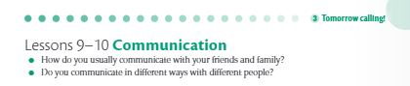
Discussion questions

Slide 4


Vocabulary Words

Slide 5
Key Vocabulary
immersive
tweet
exhibition
upload
decade
virtual
goggles
simultaneously
artificial
dream

Slide 6
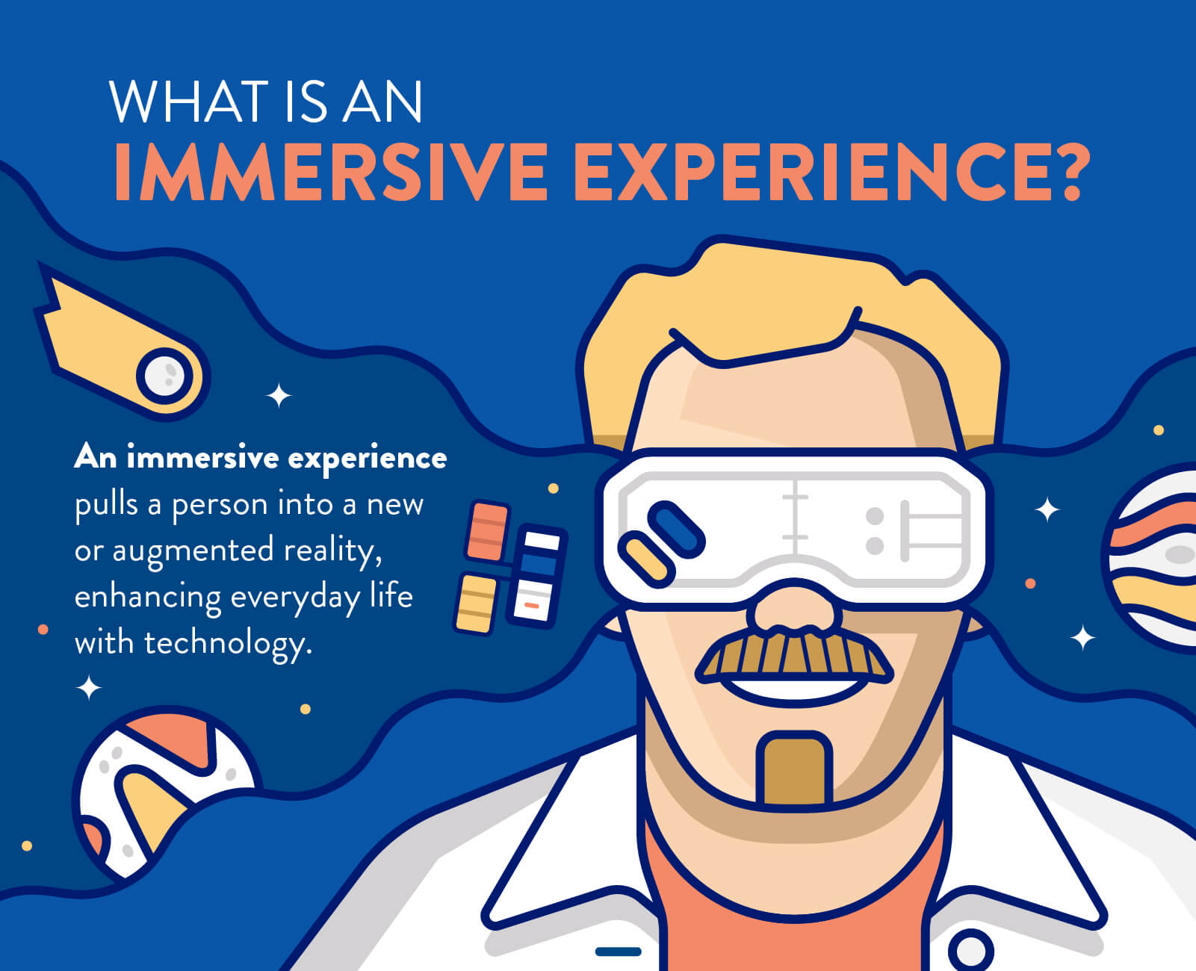
Key vocabulary
immersive
(Of a computer display or system) generating a three-dimensional image which appears to surround the user.

Slide 7
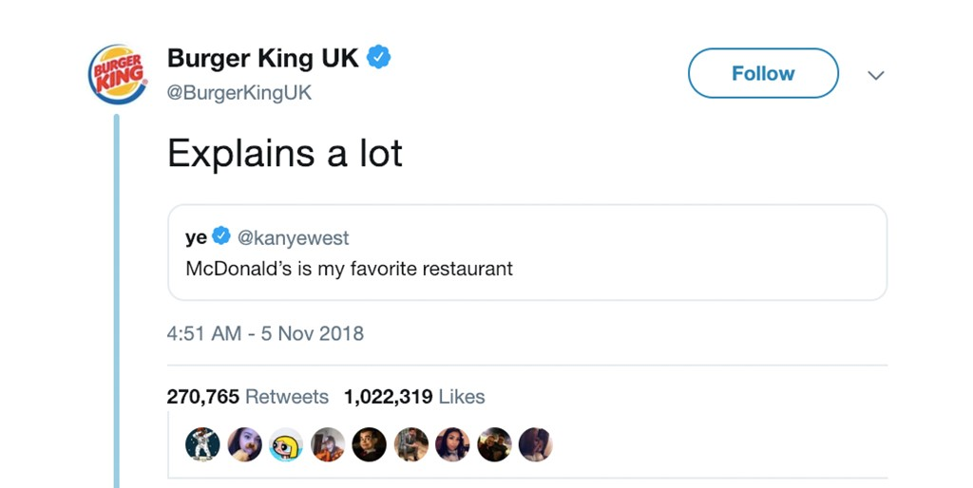
Key vocabulary
tweet
A post made on the social media application Twitter.

Slide 8
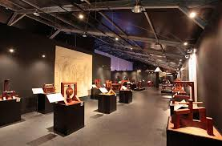
Key vocabulary
exhibition
A public display of works of art or items of interest, held in an art gallery or museum or at a trade fair.

Slide 9

Key vocabulary
upload
Transfer (data) from one computer to another, typically to one that is larger or remote from the user or functioning as a server.

Slide 10
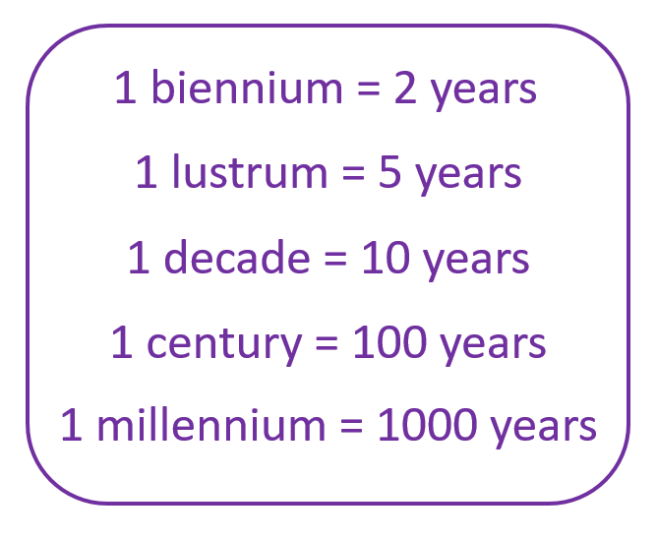
Key vocabulary
decade
A period of ten years.

Slide 11
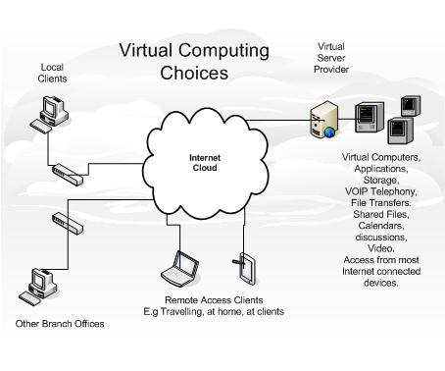
Key vocabulary
virtual
Not physically existing as such but made by software to appear to do so.

Slide 12
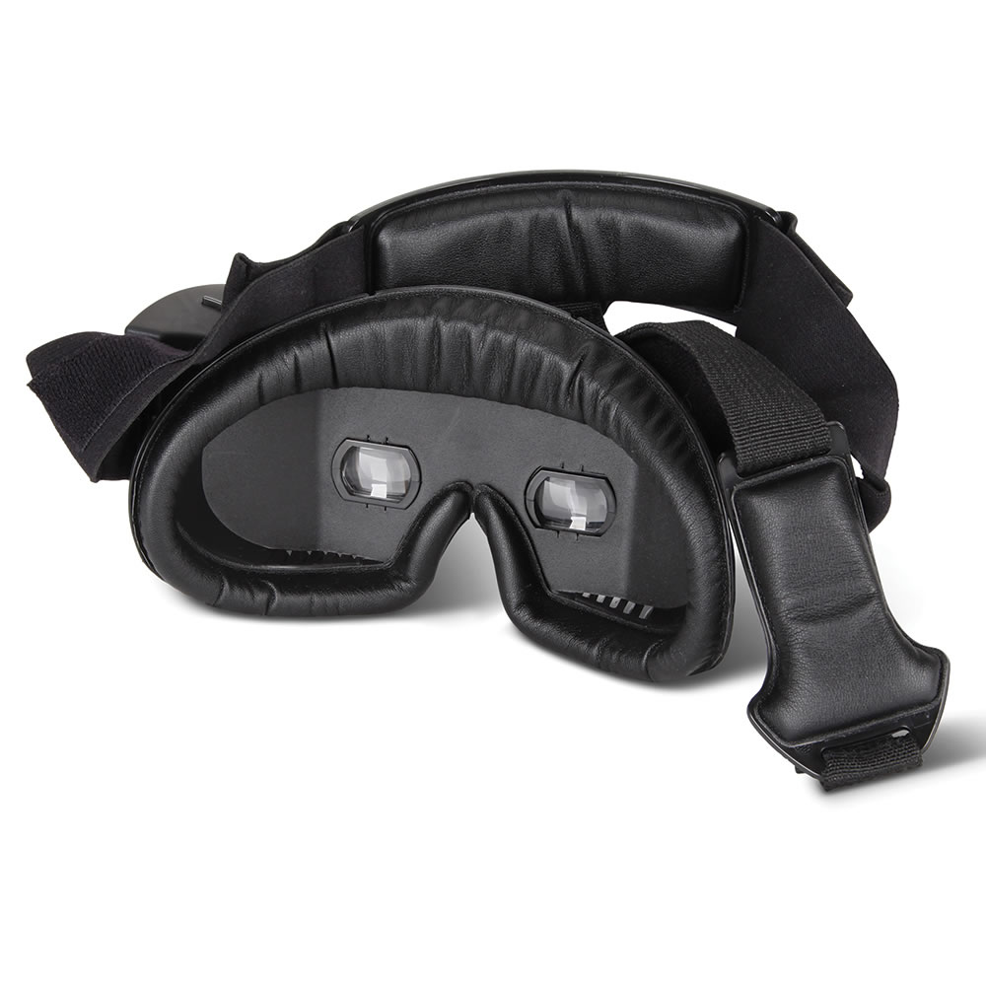
Key vocabulary
goggles
Goggles, any of a variety of protective eyewear set in a flexible frame that sits snugly against the face. Goggles are worn in a number of sports, including skiing, swimming, and motor sports, and in various industries. Virtual reality headsets are also often called goggles.

Slide 13
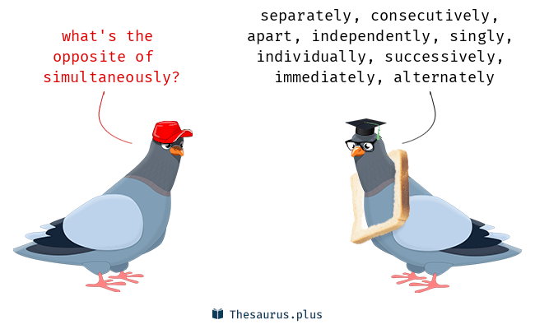
Key vocabulary
simultaneously
“The telethon was broadcast simultaneously on 31 US networks"

Slide 14

Key vocabulary
artificial
The branch of computer sciences that emphasises the development of intelligence machines, thinking and working like humans. For example, speech recognition, problem-solving, learning and planning.

Slide 15

Key vocabulary
dream
A series of thoughts, images, and sensations occurring in a person's mind during sleep.

Slide 16
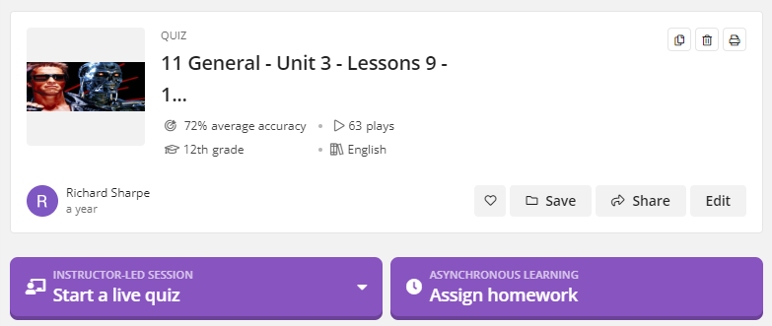
Vocabulary quiz
https://quizizz.com/admin/quiz/616d4e592bb841001d739de8/11-general-unit-3-lessons-9-10-communication?selfCreated=true

Slide 17
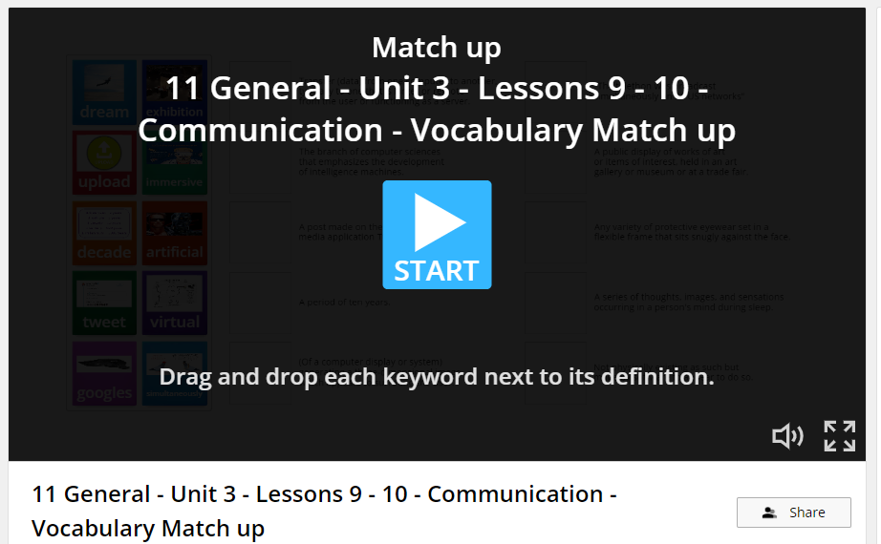
Vocabulary matching
https://wordwall.net/resource/23531337/11-general-unit-3-lessons-9-10-communication-vocabulary-match

Slide 18
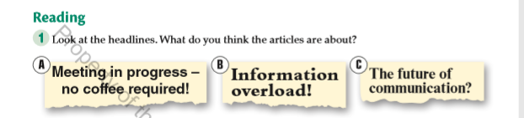
What are the articles about? coursebook p.34
Ex 1

Slide 19
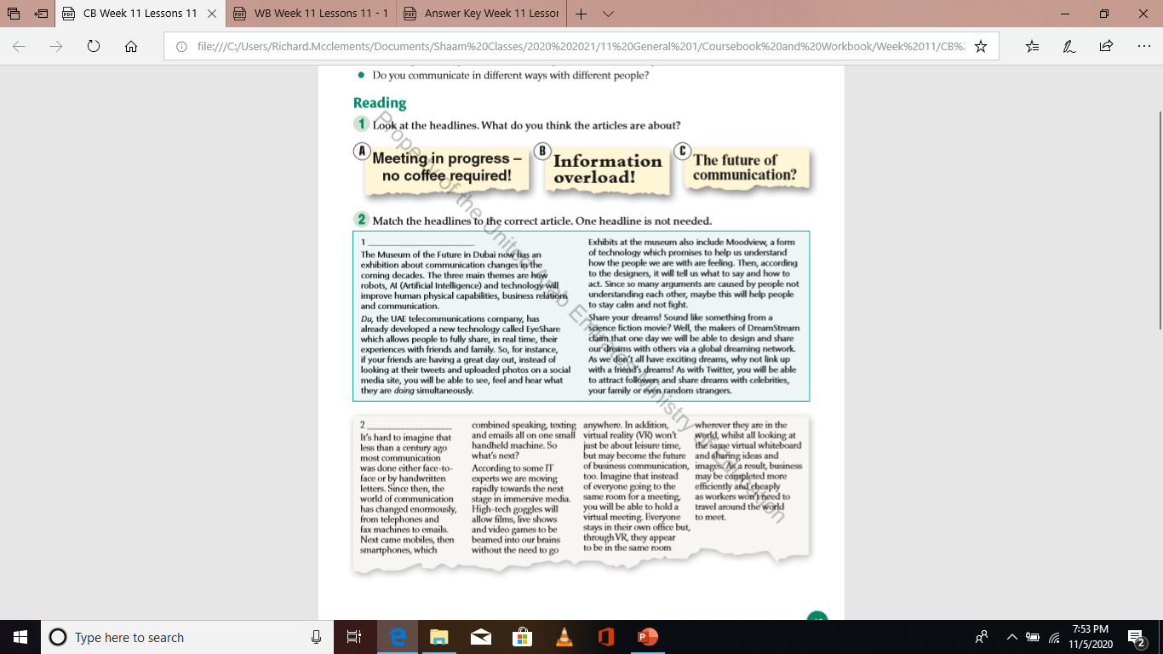
reading practice coursebook p.34
Ex 2
Headline C

Slide 20
reading practice coursebook p.34
Ex 2
Headline A

Slide 21
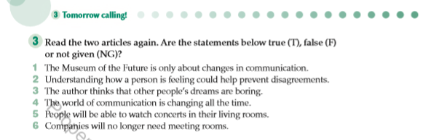
reading comprehension coursebook p.35
Ex 3
False
True
Not given
True
True
Not given

Slide 22
Today’s lesson
DATE: 1st November 2022
Unit 3 Lesson 10
Coursebook p.35
Workbook p.35
Communication

Slide 23
LEARNING OBJECTIVES
Vocabulary review
Link words/Cohesive devices

Slide 24
starter
https://quizizz.com/admin/quiz/616d4e592bb841001d739de8/11-general-unit-3-lessons-9-10-communication?selfCreated=true

Slide 25
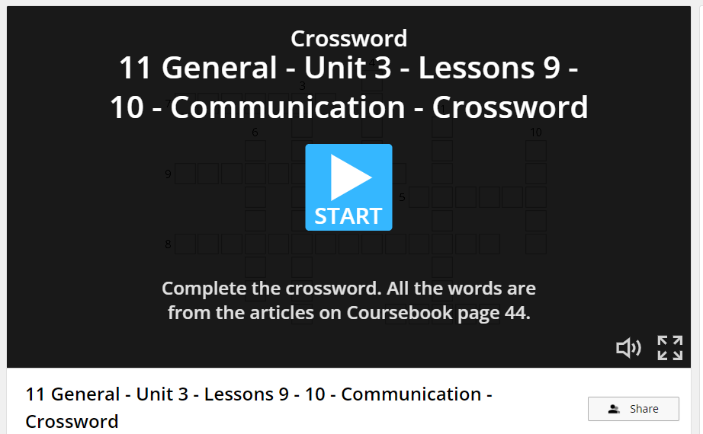
crossword
https://wordwall.net/resource/23538593/11-general-unit-3-lessons-9-10-communication-crossword

Slide 26
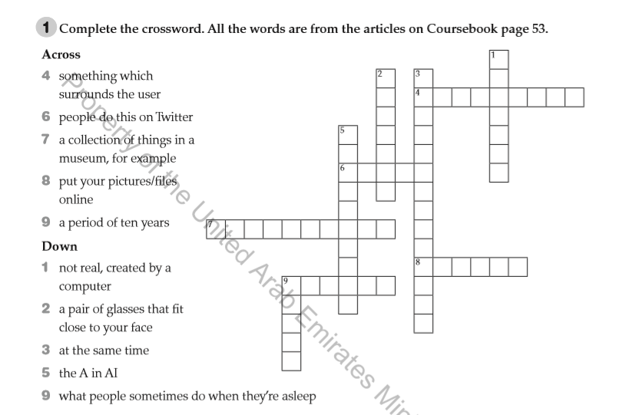
crossword workbook p.34
Ex 1
immersive
tweet
exhibition
upload
decade
virtual
goggles
simultaneously
artificial
dream

Slide 27
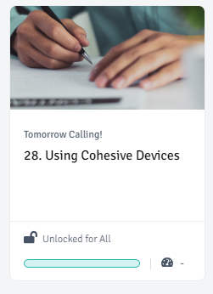
Alef lesson 28 – using cohesive devices

Slide 28
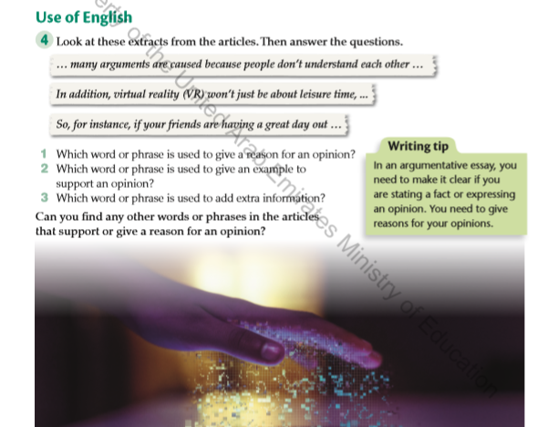
Use of english coursebook p.35
Ex 4
because
for instance
In addition
So, Since, as, As a result

Slide 29
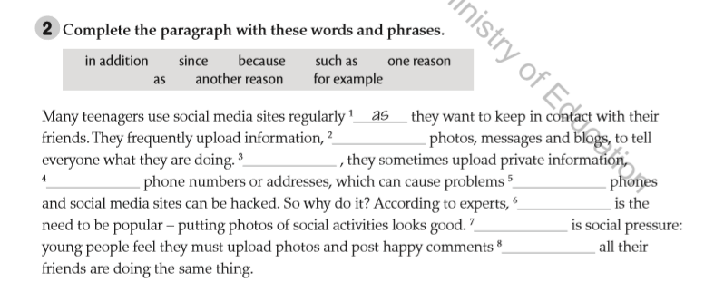
Gap fill workbook p.34
Ex 2
such as/for example
In addition
because/since/as
for example/such as
one reason
Another reason
since/because/as

Slide 30
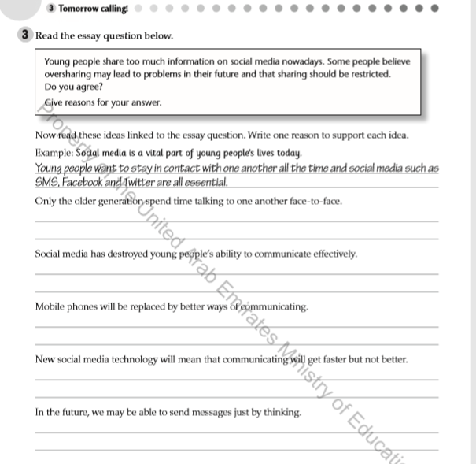
Write one reason to support each idea workbook p.35
Ex 3
One reason older people spend tie talking face-to-face is because it feels more natural for them.
Another reason young people cannot communicate effectively is due to the overuse of social media.
In addition, new technologies may be introduced that will replace mobile phones.
For example, social media technology may become faster, but not necessarily better.
As technology advances, we may be able to send messages just by thinking.

Slide 31
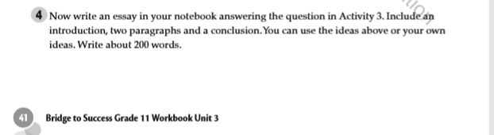
Writing activity workbook p.35
Ex 4

Slide 32

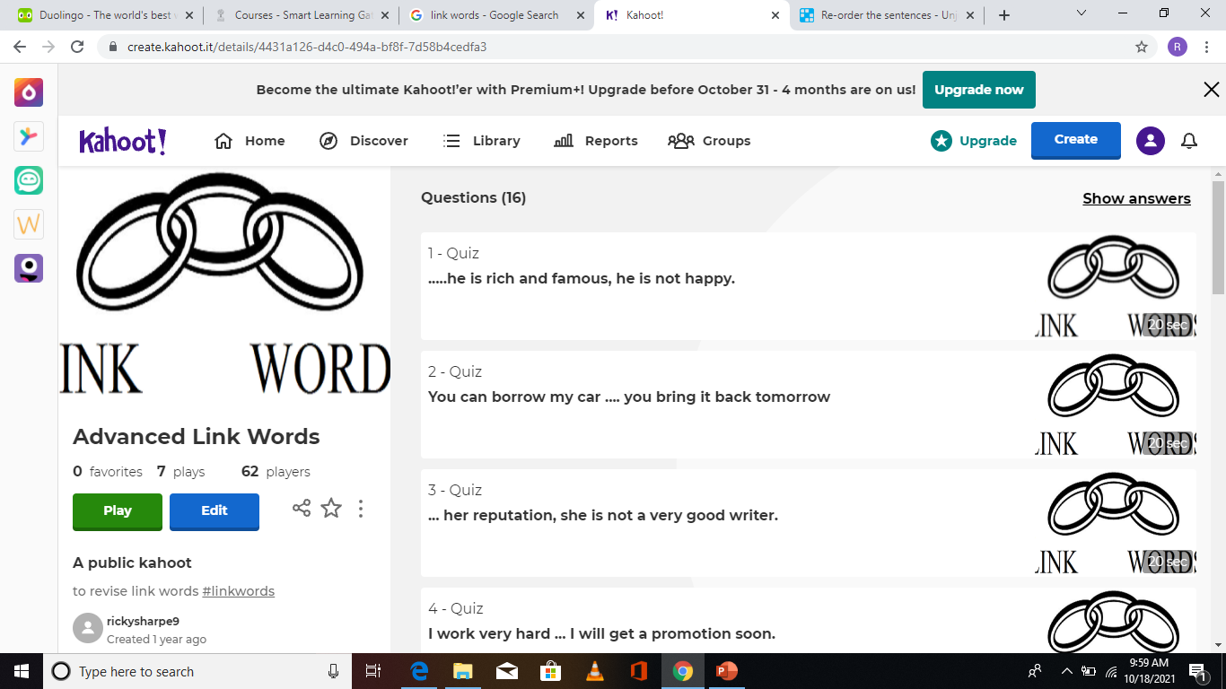
KAHOOT plenary
https://create.kahoot.it/details/4431a126-d4c0-494a-bf8f-7d58b4cedfa3

