Slide 1
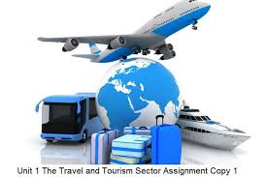
Grade 10 General
Unit 5, Lesson 9-10
Travel and tourist industry

Slide 2
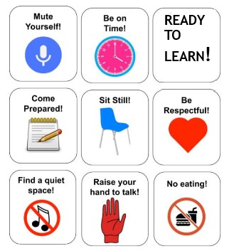
Let’s review the rules

Slide 3
Learning out comes:
*To use vocabulary items related to travel and tourism.
* To practice reading strategies(skimming & scanning
and reading for details).

Slide 4
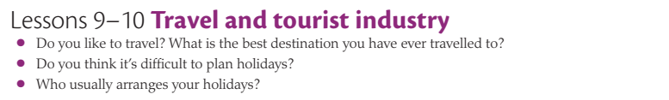
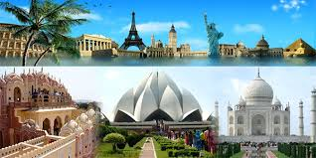
Padlet

Slide 5


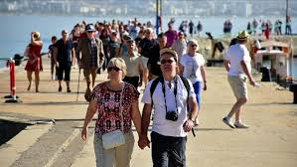
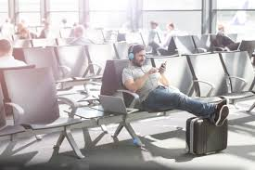
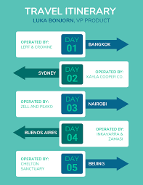
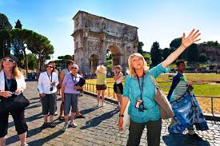
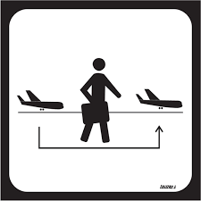

Tourists - سائح
Travel agent- وكيل سفر
Destination - المكان المقصود
Lay over - استلقي
Sightseeing - معالم المدينة
Itinerary - مسار الرحلة
Multi stop trip - رحلة متعددة التوقف
Connecting flights - الرحلات الجوية المتصلة

Slide 6
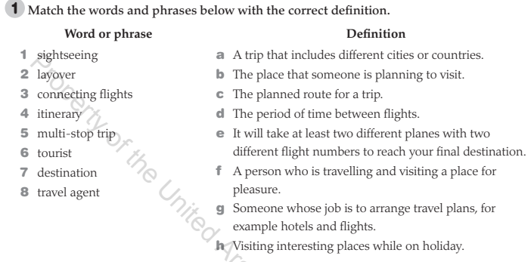
LMS

Slide 7

Answers: 1 h 2 d 3 e 4 c 5 a 6 f 7 b 8 g

Slide 8
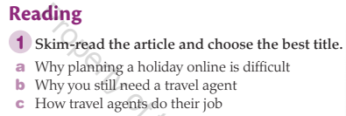
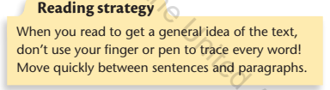
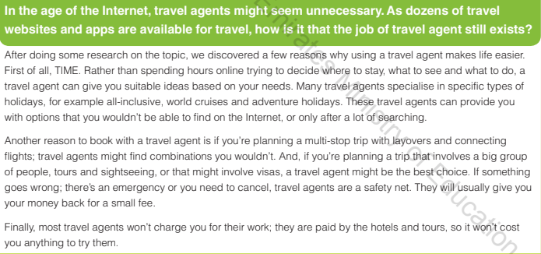

Slide 9
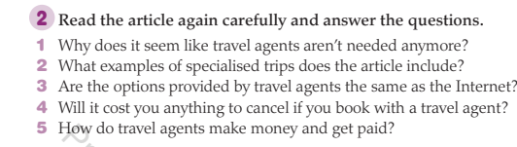
LMS

Slide 10
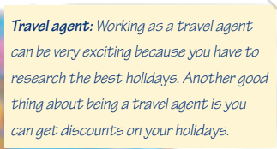
What are the advantages and disadvantages of working as a travel agent?
BREAKOUT ROOMS
PADLET
Thing of more advantages and disadvantages.

Slide 11
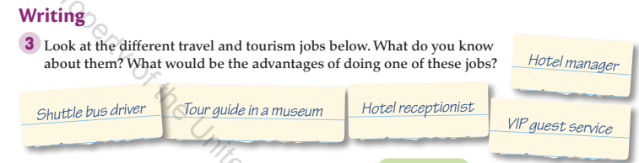
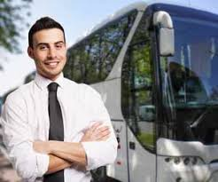
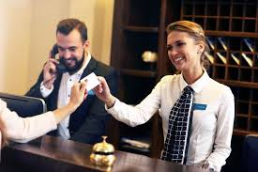
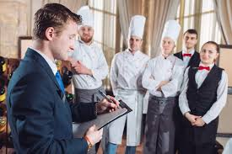
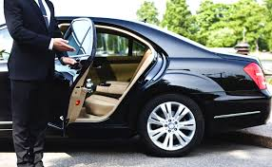
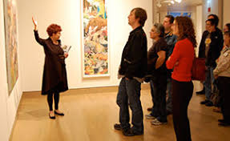
A
B
c
D
E

Slide 12


Could you meet the outcomes?
*To use vocabulary items related to travel and tourism.
* To practice reading strategies(skimming).
Rate your lesson:
I didn’t understand anything
I need some help
I understood everything

