Slide 1
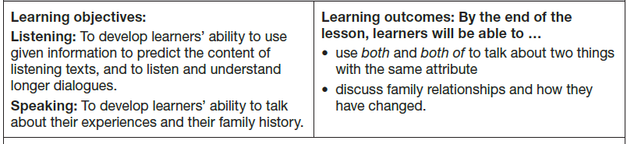
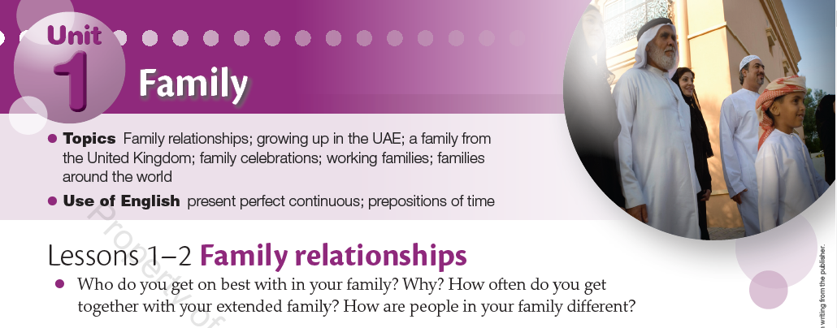
Grade 9 A / 10 G

Slide 2
Practice Vocabulary
https://quizizz.com/admin/quiz/630d2fc396d412001da91bfb?source=quiz_share

Slide 3

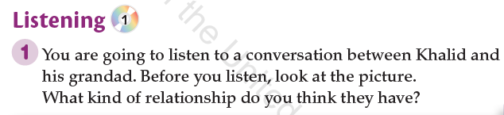
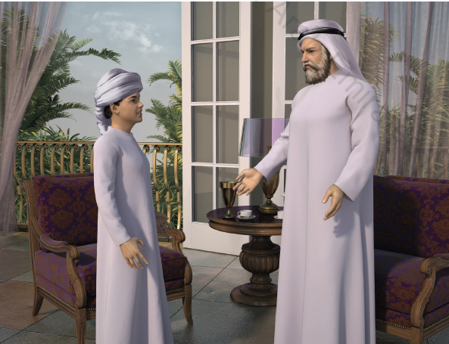
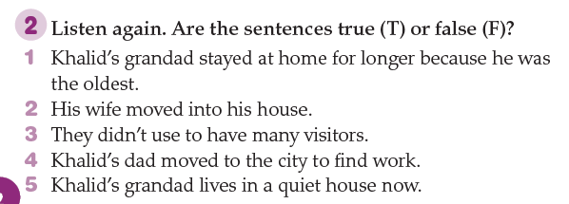
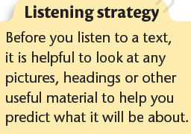
Grade 9 A / 10 G CB. P. 2
F
T
F
T
F

Slide 4
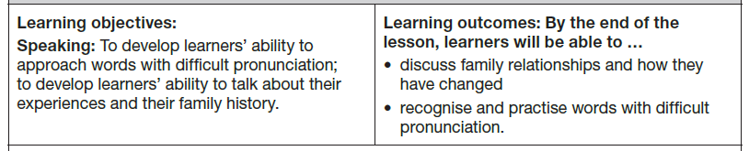
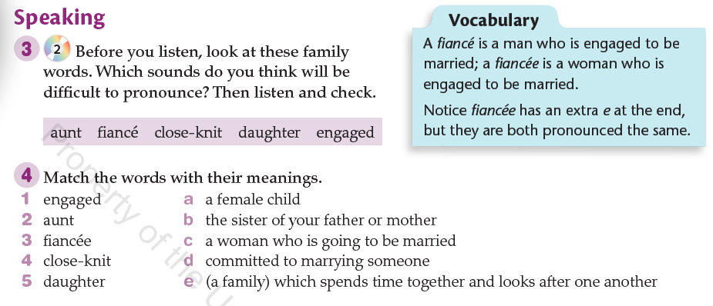

Grade 9 A / 10 G CB. P. 3
d
b
c
e
a

Slide 5
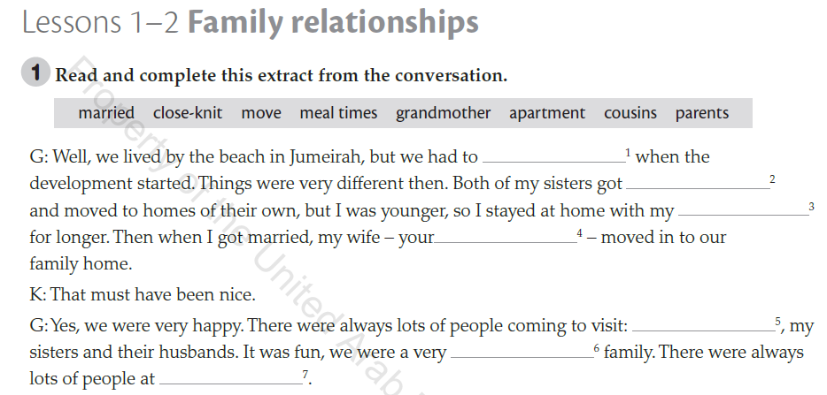
Grade 9 A / 10 G WB. P. 3
Vocabulary
move
married
parents
grandmother
cousins
close-knit
mealtimes

Slide 6
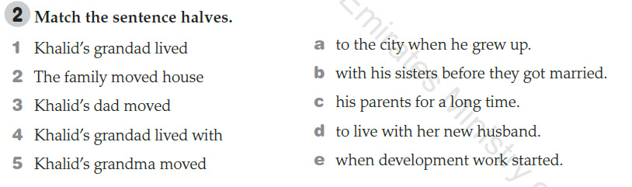
Grade 9 A / 10 G WB. P. 3
b
e
a
c
d

Slide 8
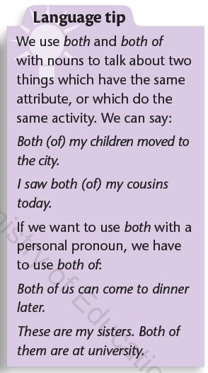
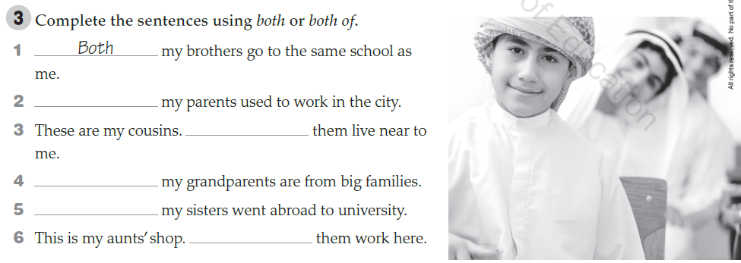
Grade 9 A / 10 G WB. P. 2
Grammar
Both
both of
Both
Both
both of

Slide 9
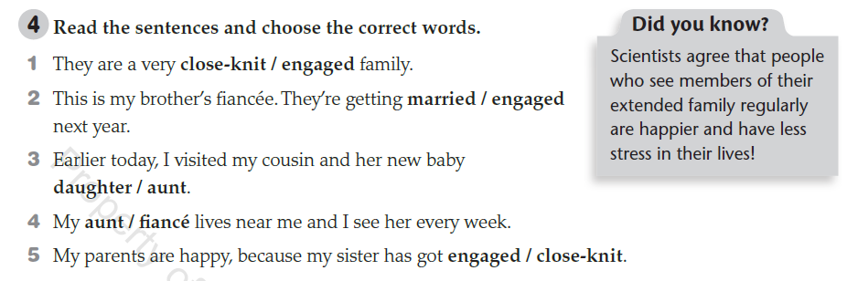
Grade 9 A / 10 G WB. P. 3
Vocabulary

Slide 10
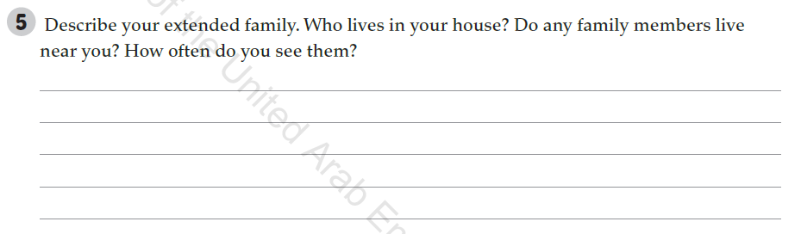
Grade 9 A / 10 G WB. P. 3
WRITING

Slide 11
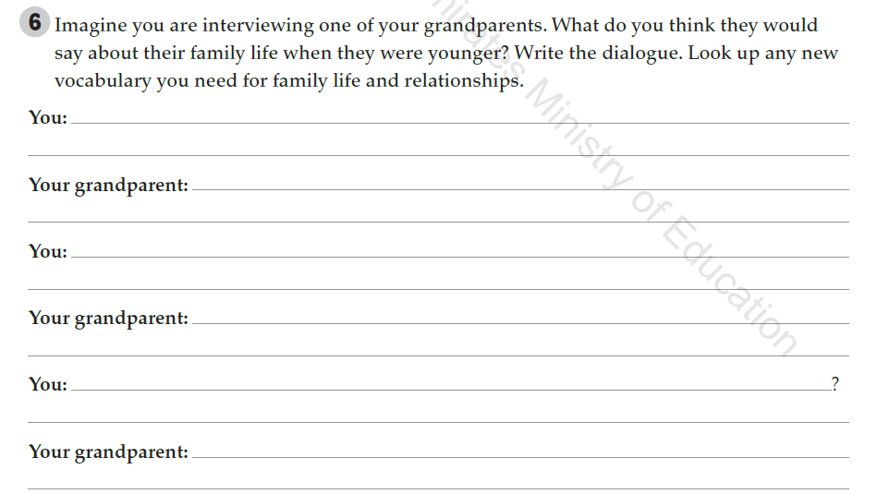
Grade 9 A / 10 G WB. P. 3
WRITING

Slide 12


