Slide 1

Currencies of the World
Unit 6
lessons 7-8
C.B P 45

Slide 2
Learning Objectives
Listen and identify the main points in texts
• Recognise, transcribe and say numbers and figures
Read and identify specific information in texts
Recognise new words related to economics

Slide 3
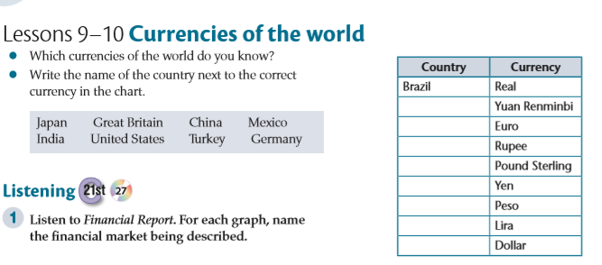
Coursebook ,page44
https://www.liveworksheets.com/1-me2199504ns
China
Germany
India
Great Britain
Japan
Mexico
Turkey
United States

Slide 4
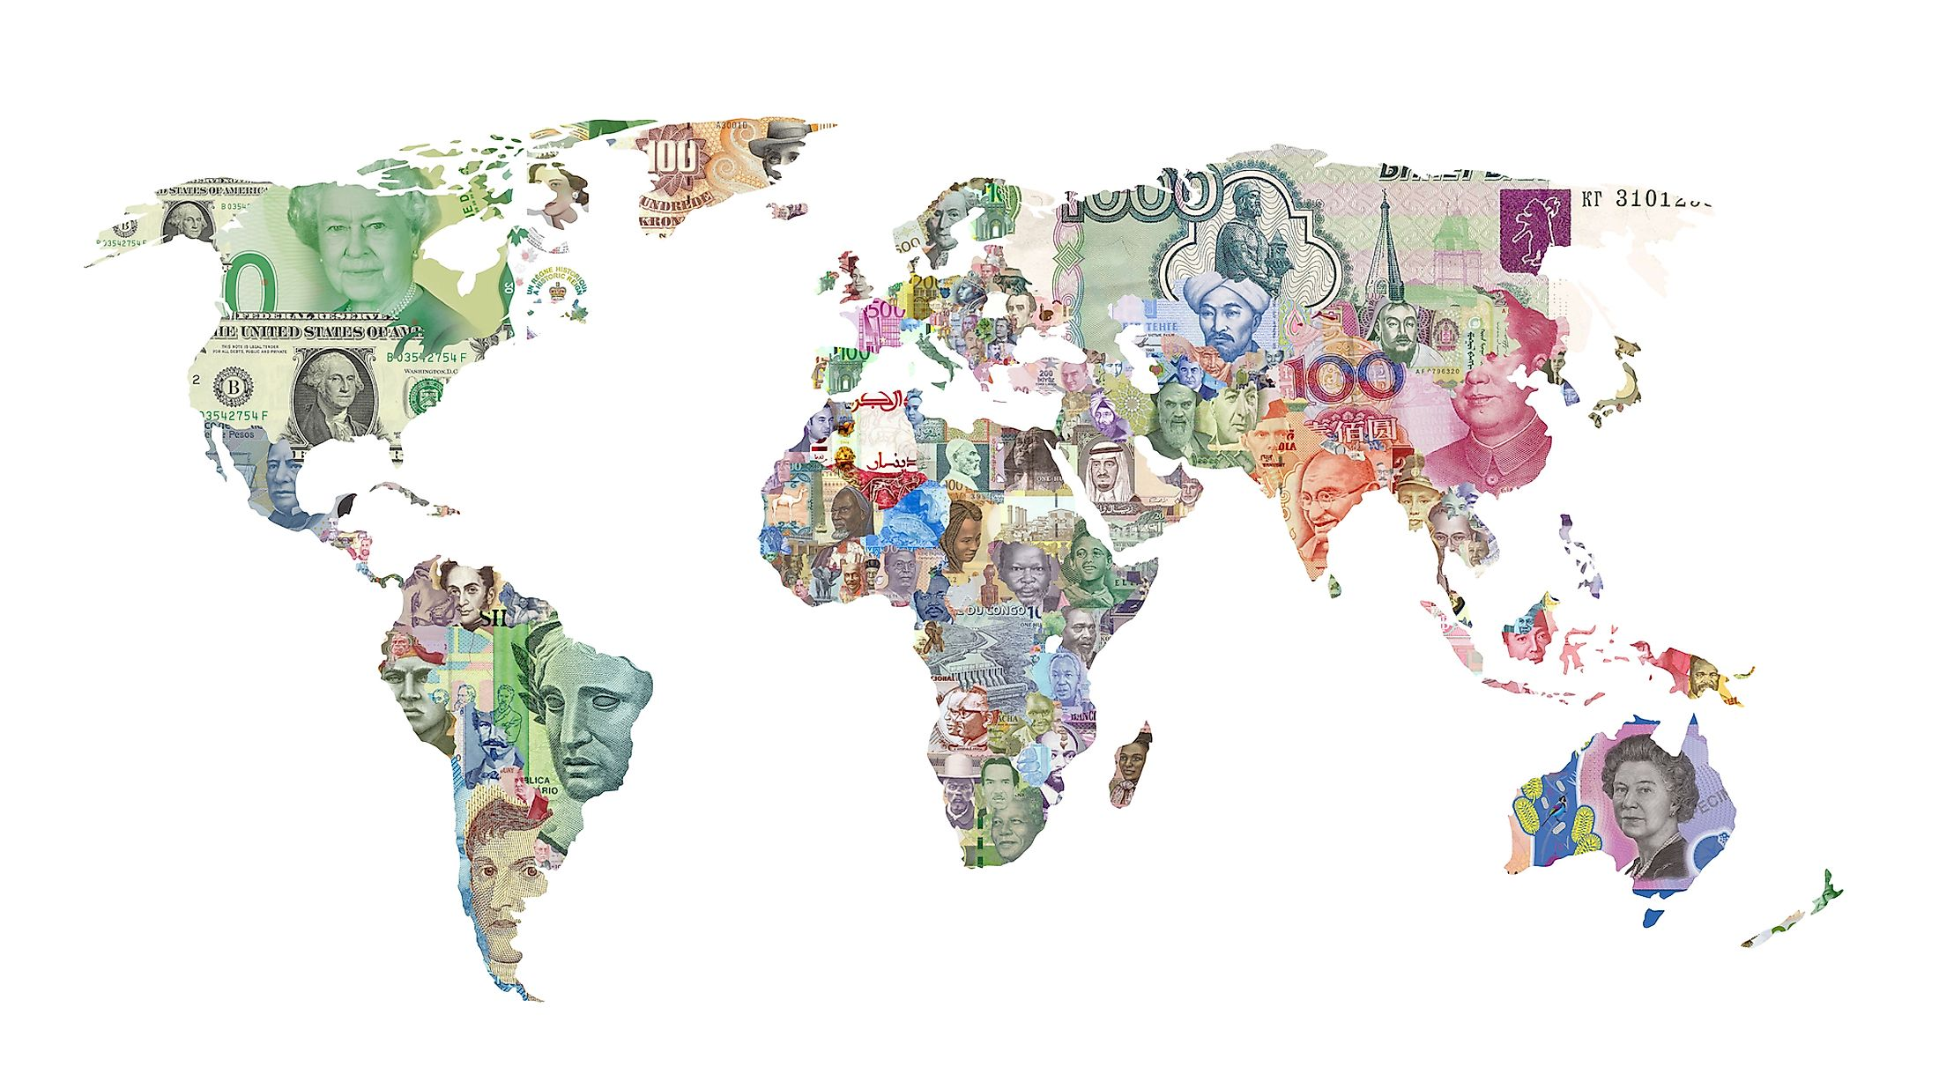
Currency
the money that is used in a particular country at a particular time

Slide 5
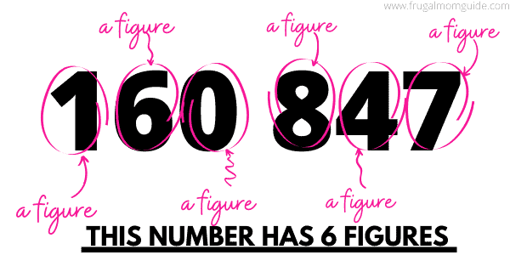
Figure
the symbol for a number or an amount expressed in numbers

Slide 6
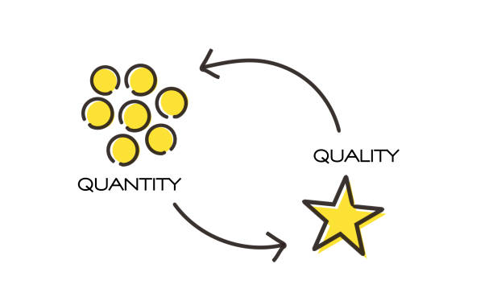
Quantity
the amount or number of something, especially that can be measured

Slide 7

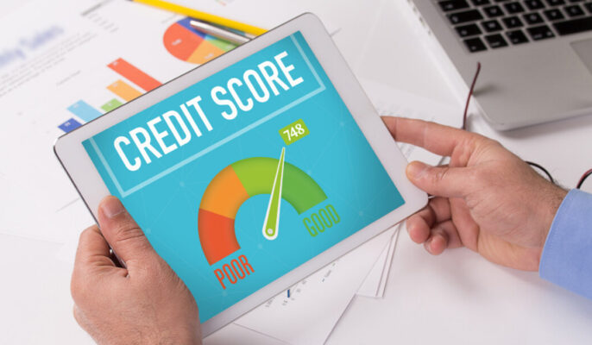
Boost
to improve or increase something

Slide 8
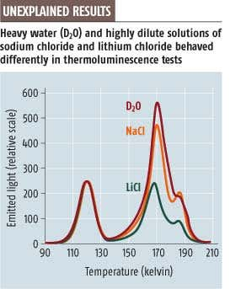
Peak
the highest, strongest, or best point, value, or level of skill

Slide 9
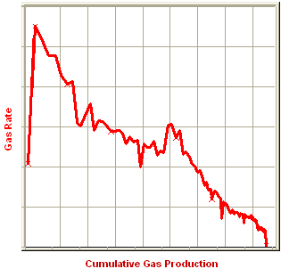

Decline
to gradually become less, worse, or lower

Slide 10
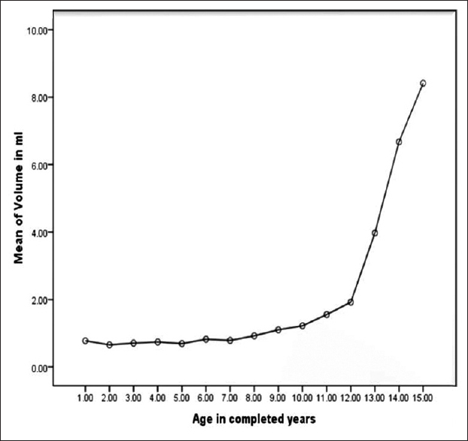
Sharp rise
an increase that is sudden and quick

Slide 11
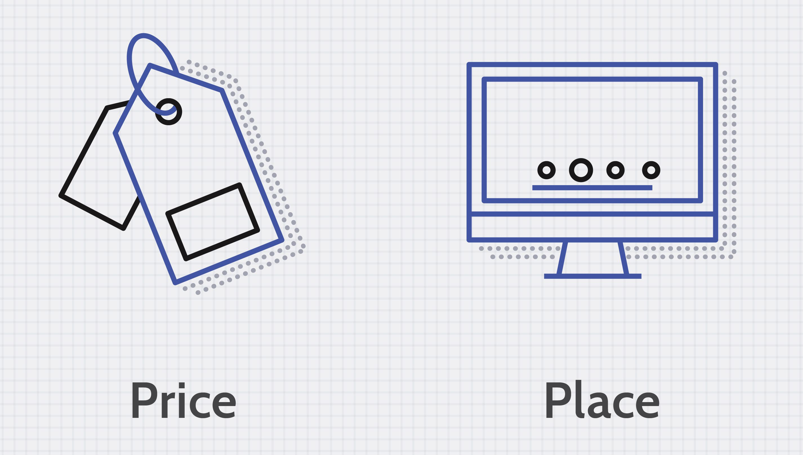
Market
a group of buyers and sellers of a particular good or service

Slide 12
Key Vocabulary
Currency : the money that is used in a particular country at a particular time
Figure: the symbol for a number or an amount expressed in numbers
Quantity: the amount or number of something, especially that can be measured
Boost: to improve or increase something
Peak: the highest, strongest, or best point, value, or level of skill
Decline: to gradually become less, worse, or lower
Sharp rise: an increase that is sudden and quick
Market: a group of buyers and sellers of a particular good or service
https://quizlet.com/637123859/currencies-around-the-world-flash-cards/

Slide 13
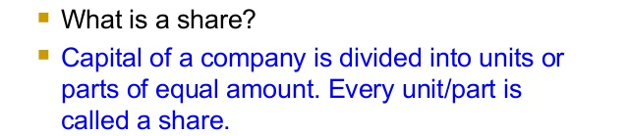
What does these words mean?
shares
stock prices.
Stocks are an investment that allows you to own a portion of a public corporation

Slide 14
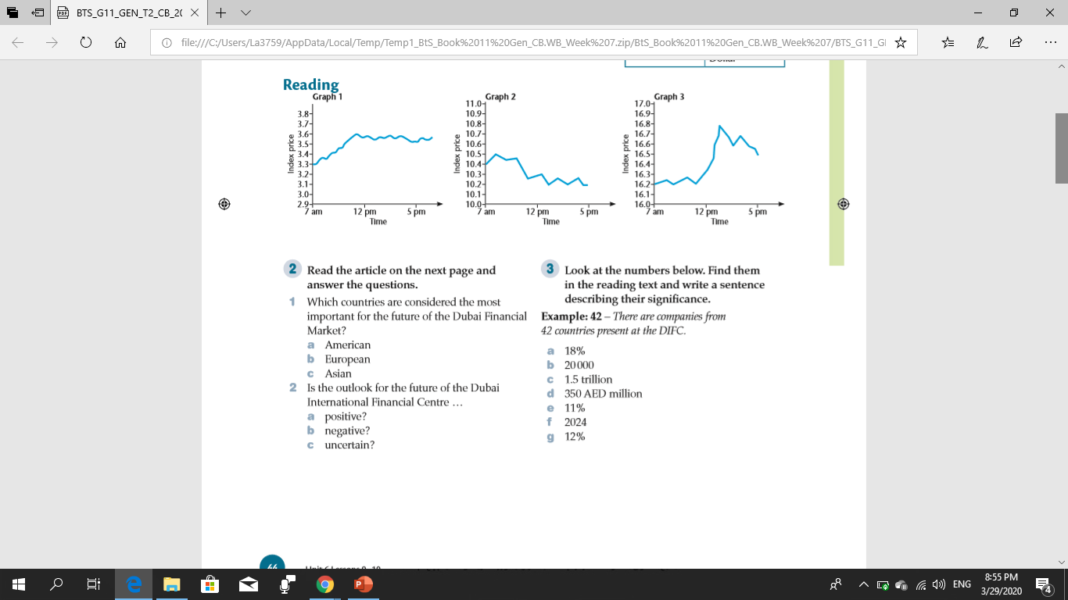

Name the financial market for each graph
(Dubai, New York, Tokyo)
Graph 1: Dubai (good news about green technology investment)
Coursebook
page 44
Graph 2: New York (investigation into Mega corp Industries)
Graph 3: Tokyo (strong sales in automobile industry
https://www.liveworksheets.com/1-rj2199544pq

Slide 15
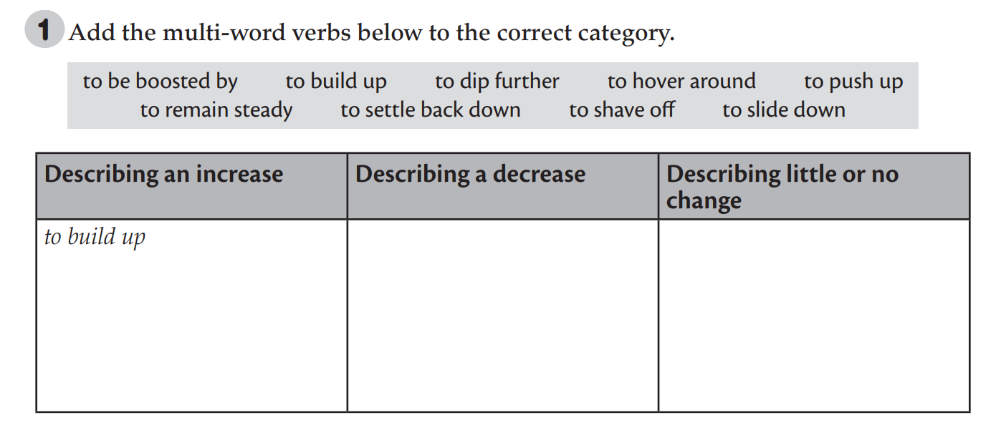
https://www.liveworksheets.com/1-ie2199582ey
to dip further
to hover around
to be boosted by
to settle back down
to remain steady
to push up
to shave off
to slide down
Shares which have been building up in anticipation of the announcement soared this morning to peak at 3600 – a six month high.
Notes:
1. Tell learners that the broadcast uses a number of multi-word verbs to describe trends. Provide an example on the board: to build up. Elicit that this verb describes an increase. Build up is formed with a verb and a preposition. 2. (Optional) Tell learners to complete the chart with other examples of multi-word verbs from the audioscript

Slide 16
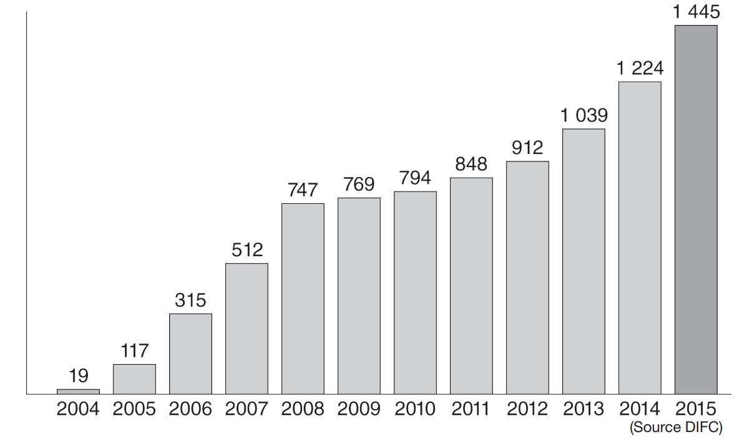
Read the description of the chart and choose the best option.
The bar chart illustrates the number of companies registered with the DIFC from 2004 to 2015. From the opening of the financial market in 2004 to 2008 there was a sharp 1 raise / increasing / rise to a figure of 747 registered companies. The 2 figure / trend / quantity slowed, but continued to grow steadily for the next four years. From 2012 the rate of 3 boost / growth / gain has picked up rapidly to reach a 4 peak / tip / point of 1445 companies registered in 2015. This represents an 18% 5 buck / jump / drive on the previous year.
https://www.liveworksheets.com/1-di2199605xz

Slide 17
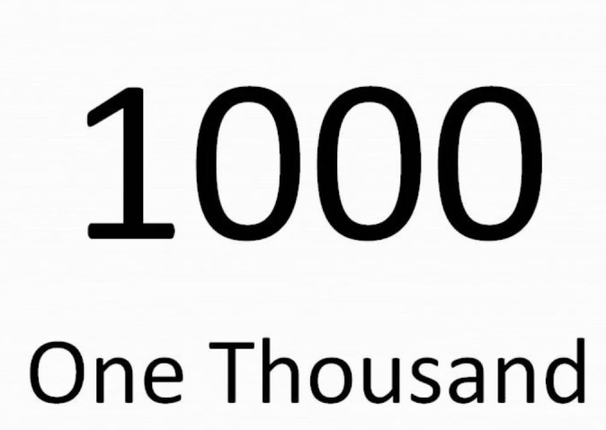
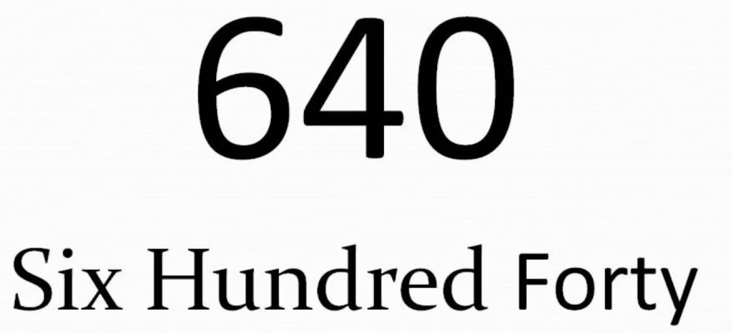
How to stay these numbers
1/5
one fifth
0.4
zero point four
2½
two and a half
80000
Eighty Thousand.

Slide 18
https://www.liveworksheets.com/1-if2199615nj
Match the numbers to the way we say them.
a third
eight thousand four hundred
four hundred thousand
one and a half
seven point five
six million
zero point six
1 ∕3
0.6
1½
7.5
8400
400 000
6 000 000

Slide 19
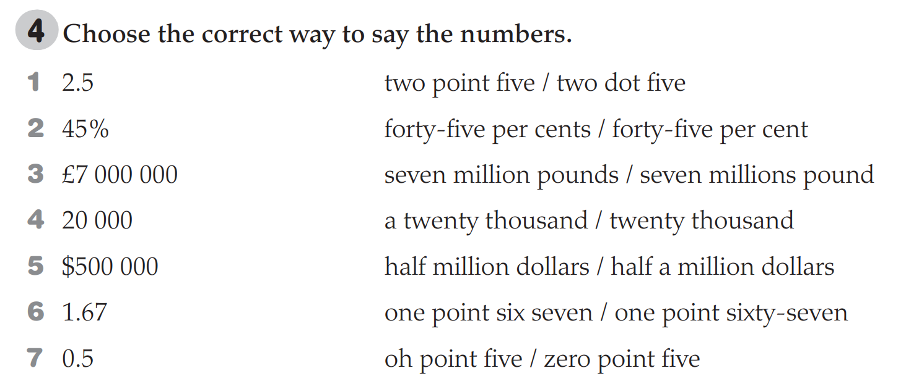

Slide 20
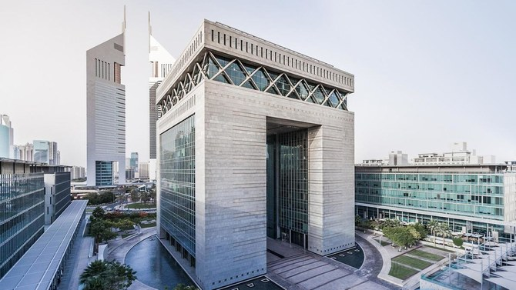
The Dubai Financial Centre
DIFC
مركز دبي المالي العالمي
opened in 2008
home to the Dubai Stock Exchange
a centre for international businesses looking to trade in the Middle East
Notes:
1. Ask learners if they know anything about The Dubai Financial Centre. (Answers: It opened in 2008, home to the Dubai Stock Exchange, it is a centre for international businesses looking to trade in the Middle East.) Remind learners that the graph they saw in the previous lesson was about the DIFC. 2. Tell learners to focus on the two questions and read the article to find out the answers.

Slide 21
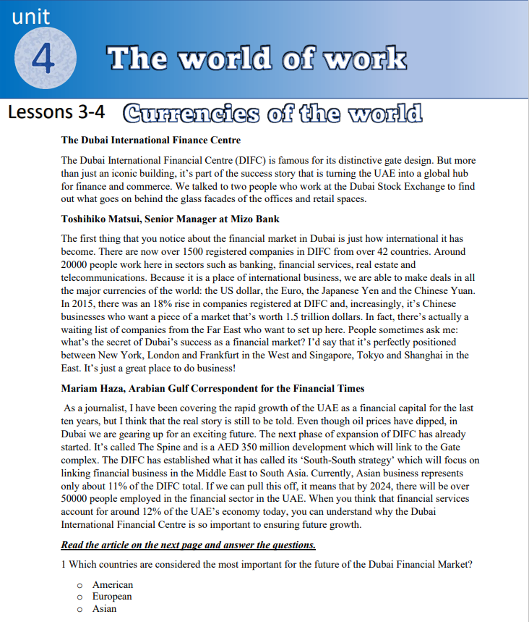
https://www.liveworksheets.com/1-ik2199672pb

Slide 22
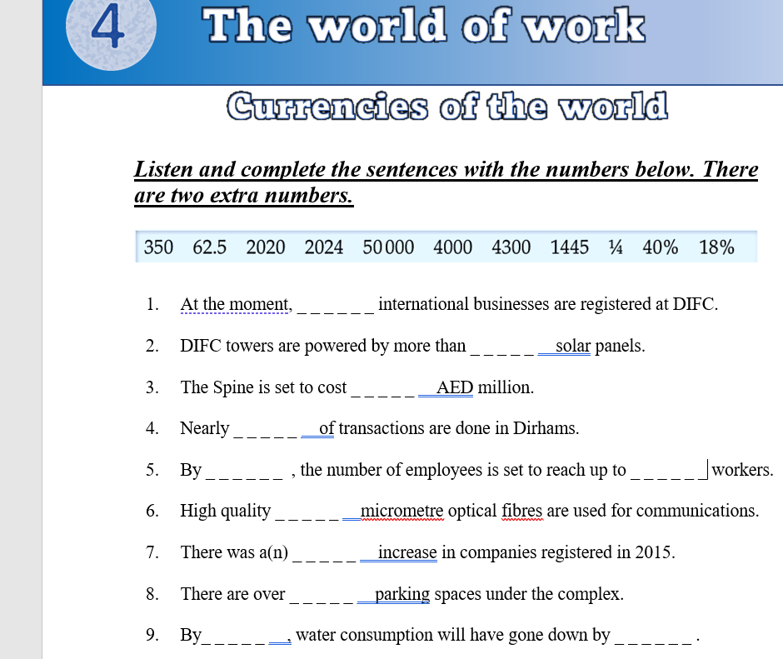
https://www.liveworksheets.com/1-qm2199716if

