Slide 1
Grade 10 advanced
Unit 1 : Looking back
Lessons 1 - 2
Days gone by

Slide 2


Learning outcomes

Slide 3


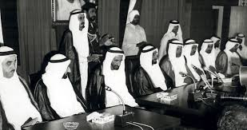
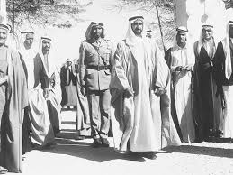
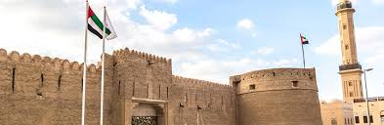

Slide 4


Warming up

Slide 5
What was life like 50 years ago?
was empty desert
simple but harsh
had difficulties
tents - small houses
villages
bedouins - nomads
traditions - customs
few jobs
no medical care
poor people
Fishing - pearling
depended on herbs
donkeys and camels
facing occupations
no oil

Slide 6
*Write the meaning of these words using your online dictionary .
Words | Meaning
Notes:
Unit nine lesson 5

Slide 7
*Write the meaning of these words using your online dictionary .
Words | Meaning
 | :
following the ways of behaving that have continued in a group of people for a long time
from a very long time ago
all the people who are about the same age
happening before this one
before a particular time or event
a member of a group of people who move from one place to another rather than living in one place all of the time:
a group of people, often of related families, who live together,
the beliefs people have,
Notes:
Unit nine lesson 5

Slide 8

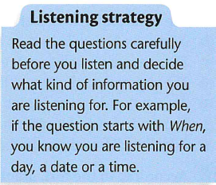

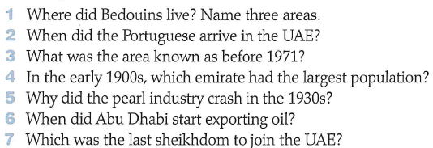
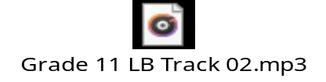

Slide 9

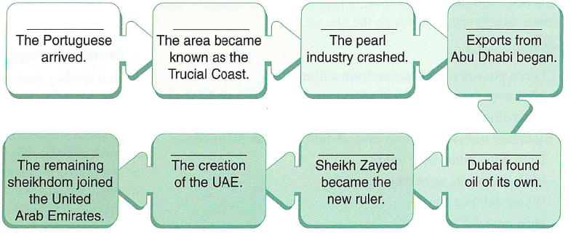

Slide 10

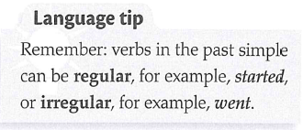
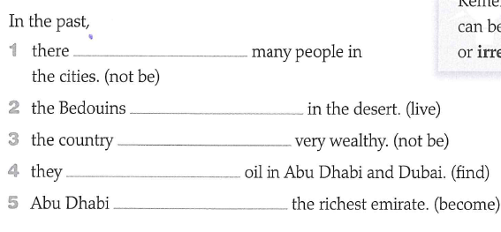

Slide 11
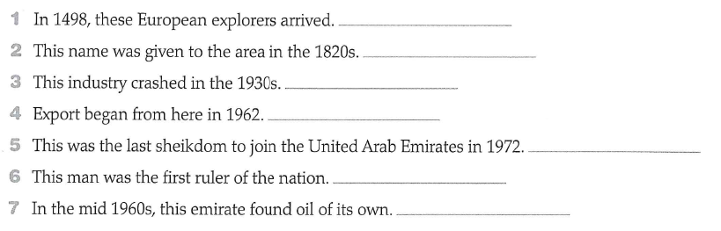

Slide 12

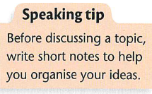
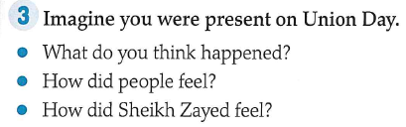

Slide 13
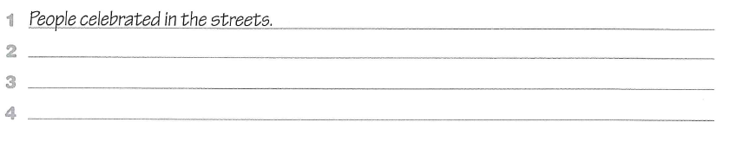

Slide 14

H . W

Slide 15

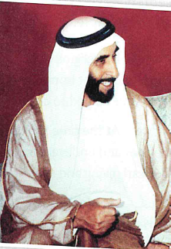

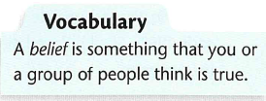

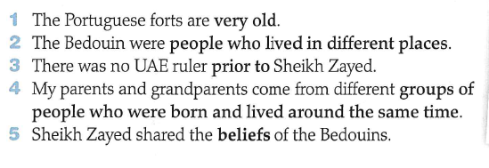

Slide 16
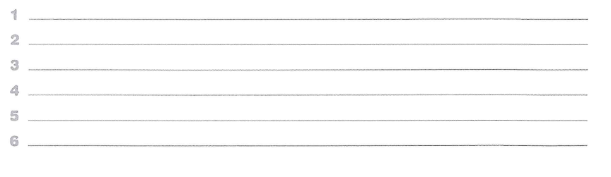

Slide 17


