Slide 1
Unit (2) Lessons (5-6)

Slide 2


Slide 3



Slide 4
Lesson objectives
-Learn the benefits of staying hydrated
-Practise the use of indirect questions

Slide 5
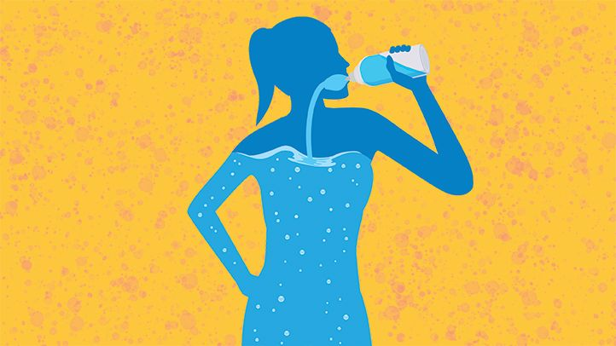
hydrated

Slide 6
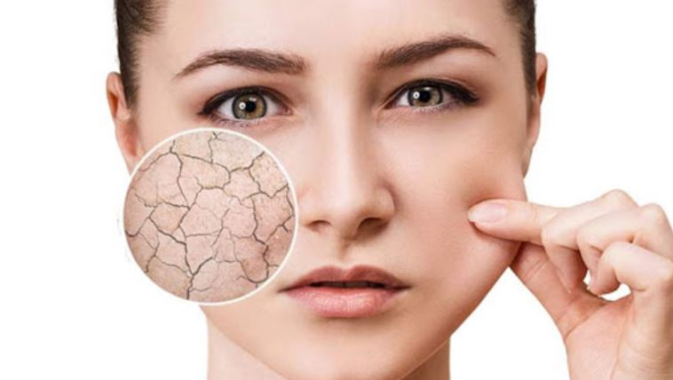
dehydrated

Slide 7

fluid

Slide 8
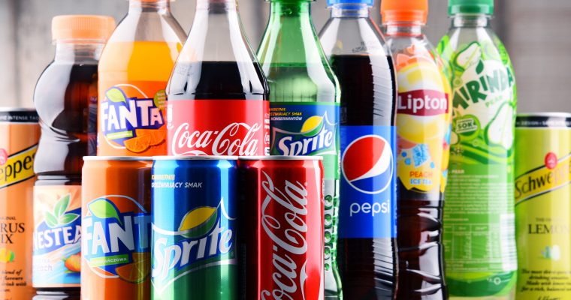
fizzy

Slide 9
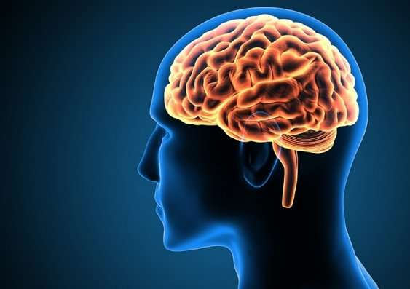
brain

Slide 10

memory

Slide 11
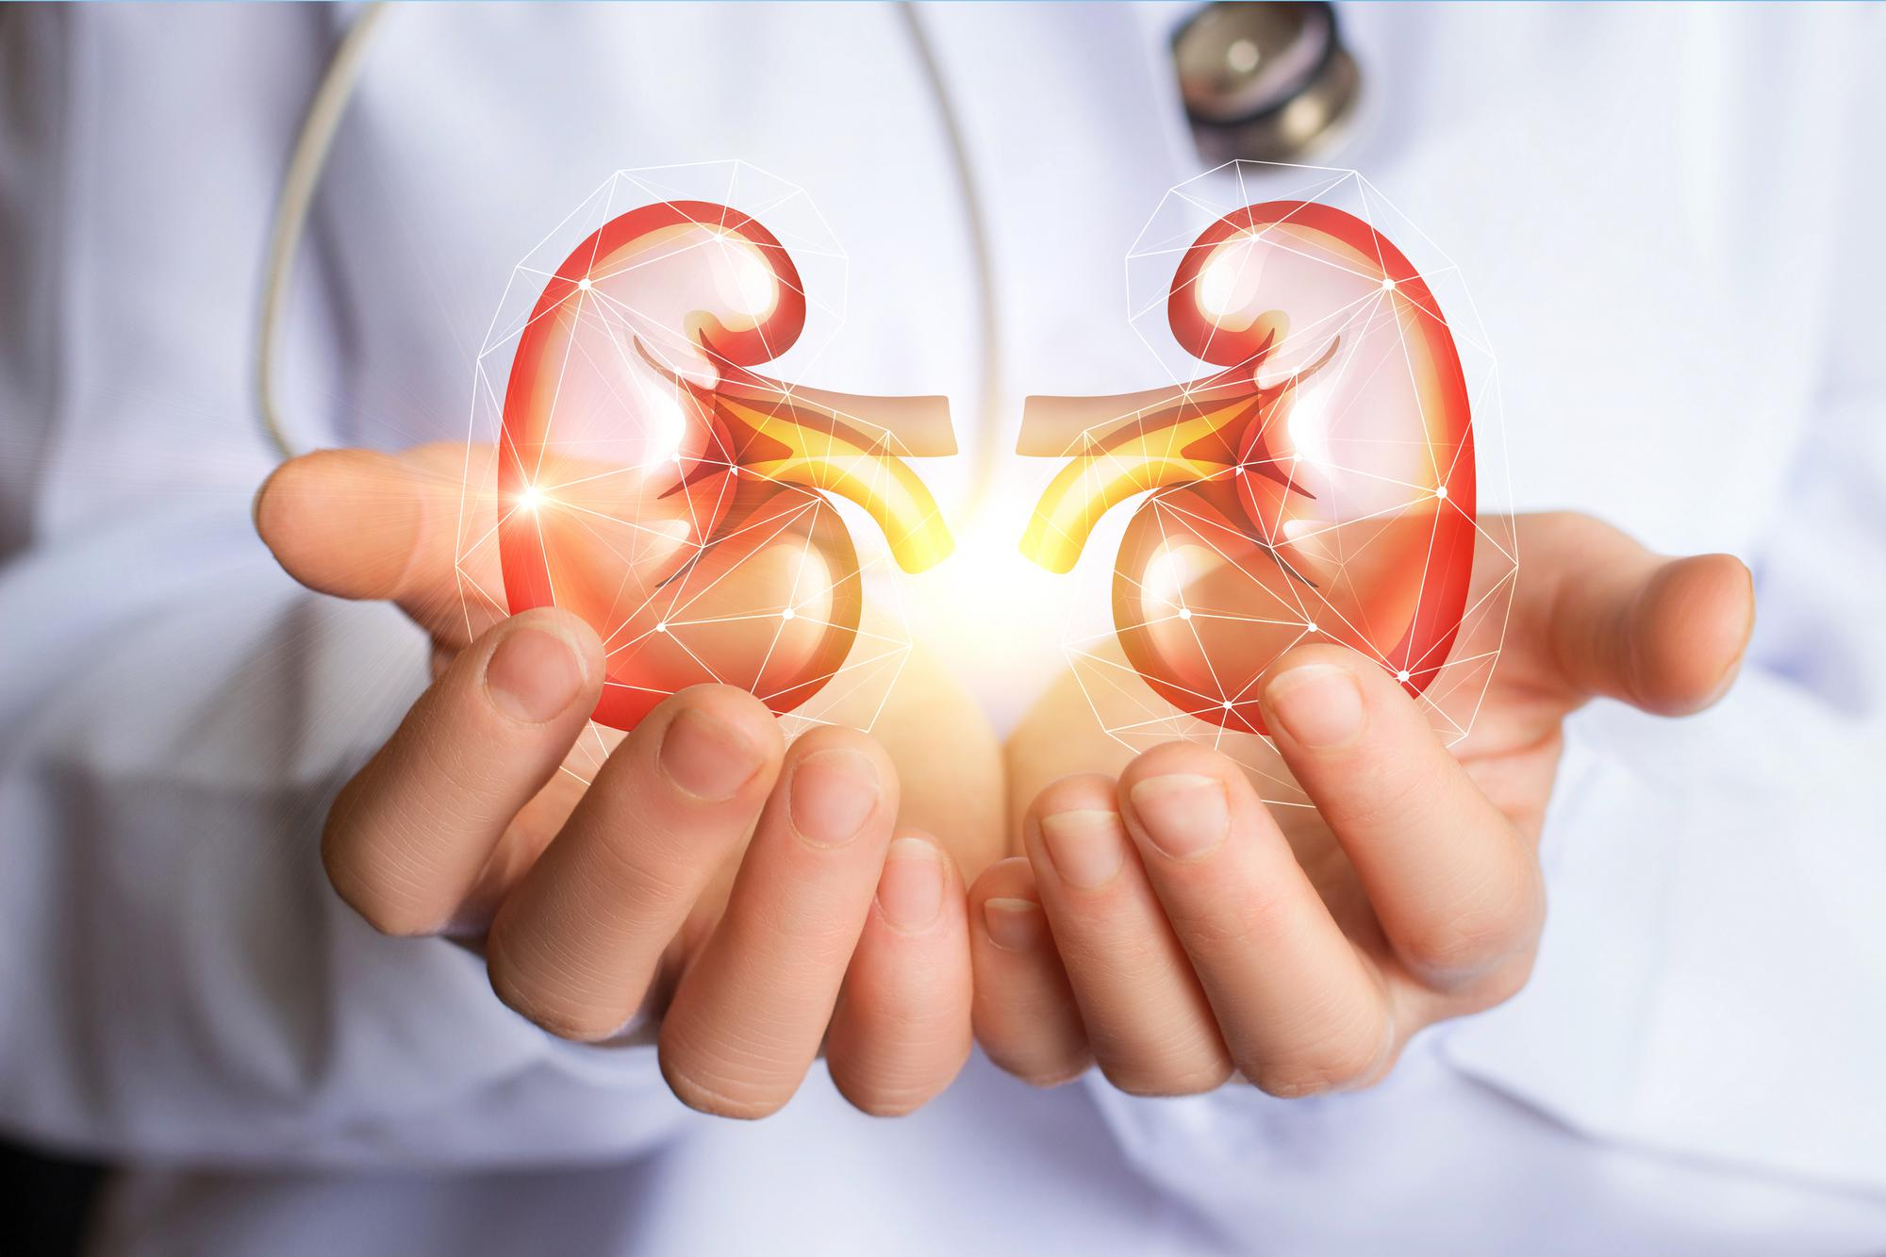
Kidneys

Slide 12
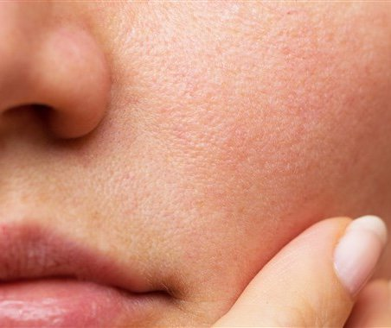
skin

Slide 13
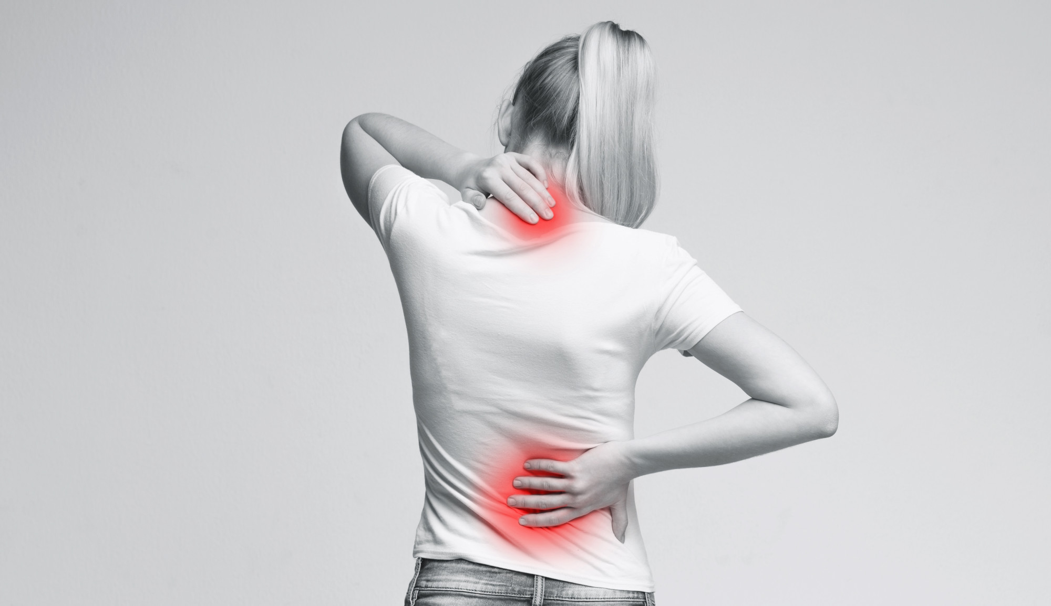
aches-pain

Slide 14
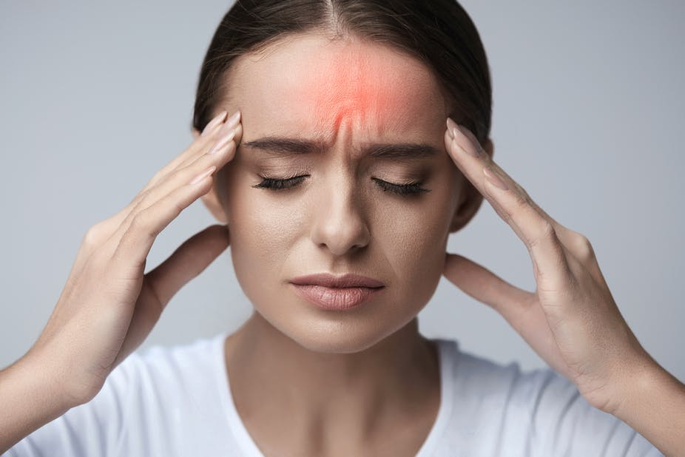
headache

Slide 15

tired

Slide 16
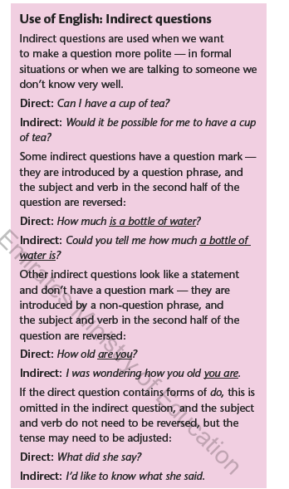

Slide 17
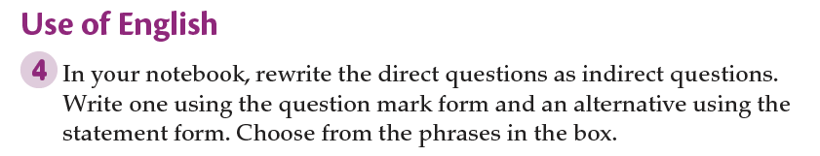

Slide 18
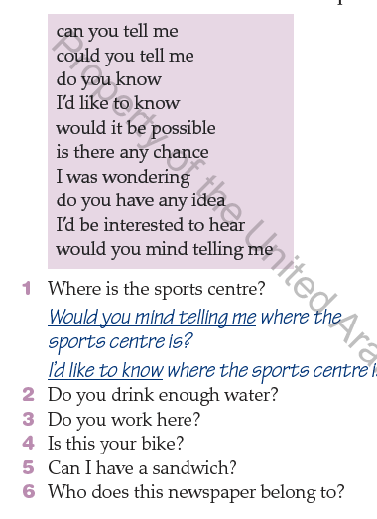

Slide 19


Slide 20
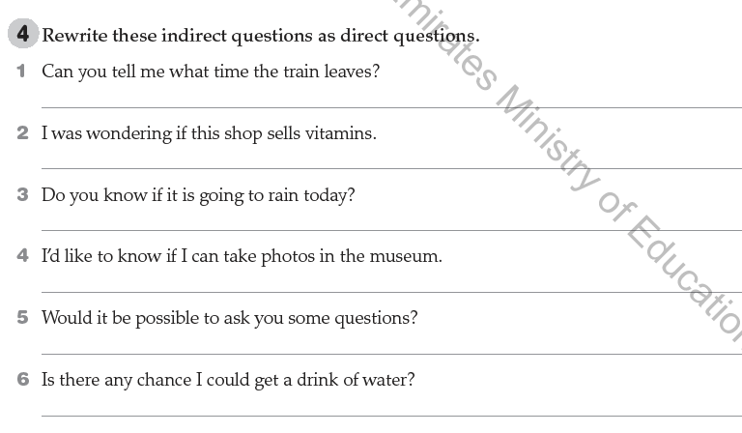

Slide 21
