Slide 1

English Language
Assessment Vocabulary
Level 8.1
Term 3 2022 - 2023

Slide 2
Contents
How to use this resource
03
Assessment coverage
05
Preparation - vocabulary
07

Slide 3

How to use this resource
Within this resource, you will find a selection of vocabulary taken from the texts that students will face during their end of term assessments. The particular lexis has been chosen for inclusion within this resource based on the vocabulary categories in the assessment coverage and its suitability to scaffold the text for students.
The slides within this resource, although detailed, are designed to be used as a starting point for teachers to construct lessons around the vocabulary that is explored here. The slides are intended to be used as a resource within a lesson and to be incorporated as part of instruction incrementally to ensure that students have been exposed to all the vocabulary ahead of their end of term exam. Therefore, the PowerPoint should not be presented at a single event or in its entirety.

Slide 4
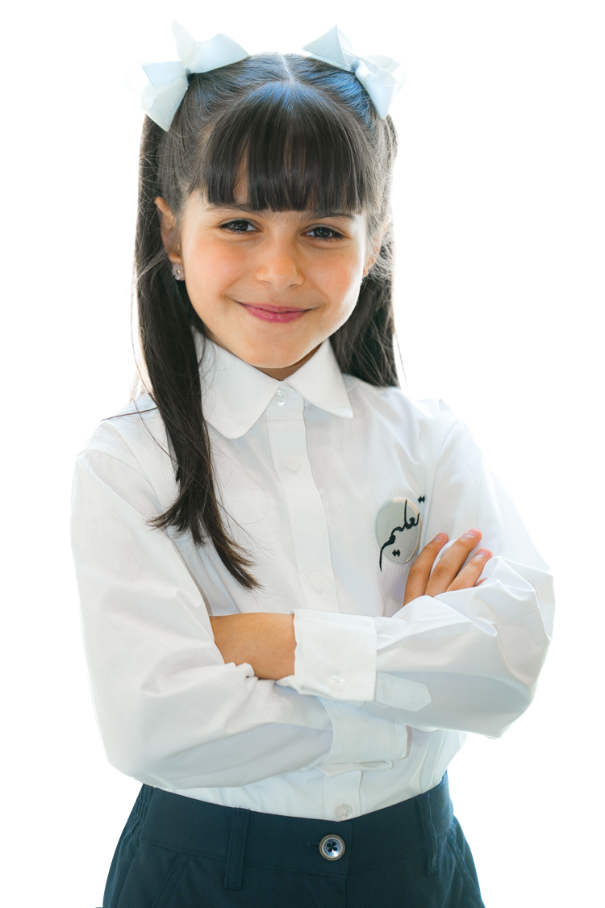
Term 3 Assessment Coverage

Slide 5
Term 3 Assessment Coverage
Topic(s): Environment, science, looking back​
ECFE Grammar​ | GSE Grammar​ | Functional Language​
Future perfect​ | Can use the future perfect with reference to actions to be completed by a specific time in the future. ​ | Expressing preference​ Comparing and contrasting​ Describing past experiences and events​ Describing causes and consequences​
Conjunctions: coordinating​ | Can make complex comparisons between clauses. ​
Adjectives: comparatives​ | Other suitably complex comparatives.​
First conditional​ | Can use 'as if/as though' with the present simple to refer to what appears to be the case. ​
Modals: past modals​ | Can express regrets and preferences with 'would rather/it's time' with past tense clauses. ​
Past perfect passive​ | Can use the past perfect passive. ​

Slide 6
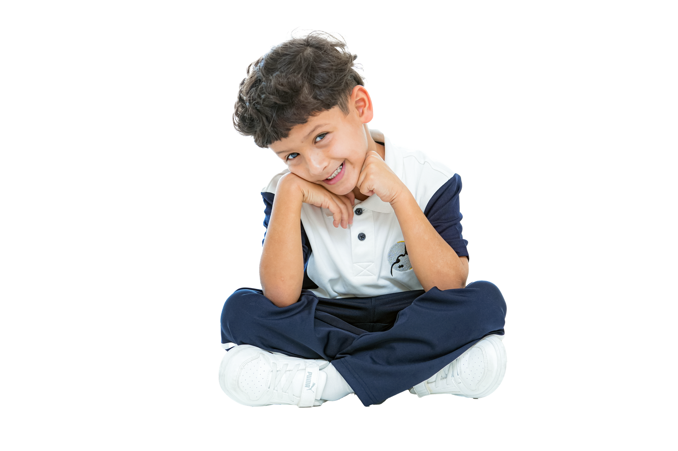
Term 3:
Preparation – Vocabulary

Slide 7
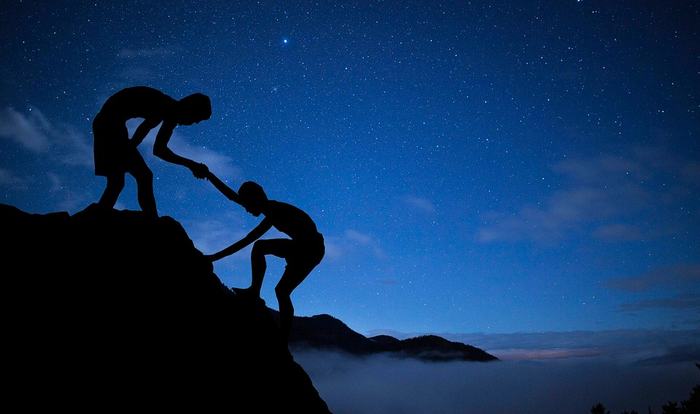

word | class | definition | sentence
determined | adjective | wanting to do something very much, and not letting anyone stop you | They were determined to find a solution to the problem.
Diploma, Clker-Free-Vector-Images, 2014, pixabay
Men, Mohamed Hassan, 2018, Pixabay

Slide 8
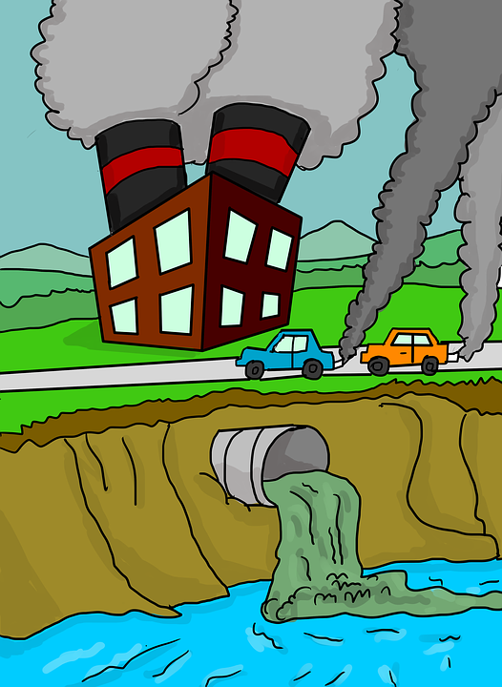
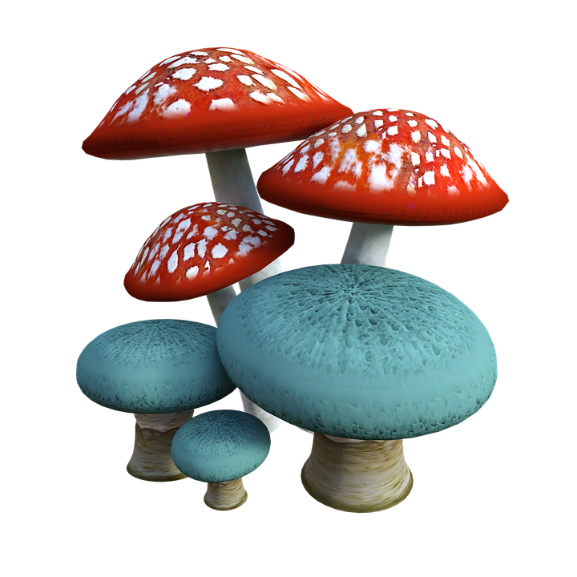
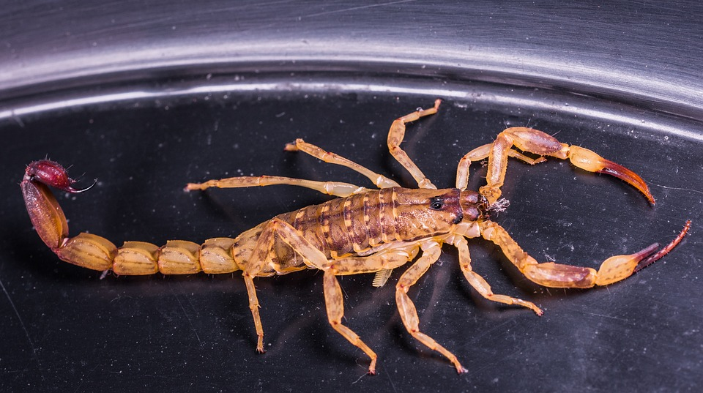

word | class | definition | sentence
poisonous | adjective | containing a substance that can make you very sick if you get it in your body | We found poisonous gases in the house.
Scorpio, Josch13, 2014, pixabay
Mushrooms, Jazella, 2019, pixabay
Air pollution, Lilly Cantabile, 2018, pixabay

Slide 9
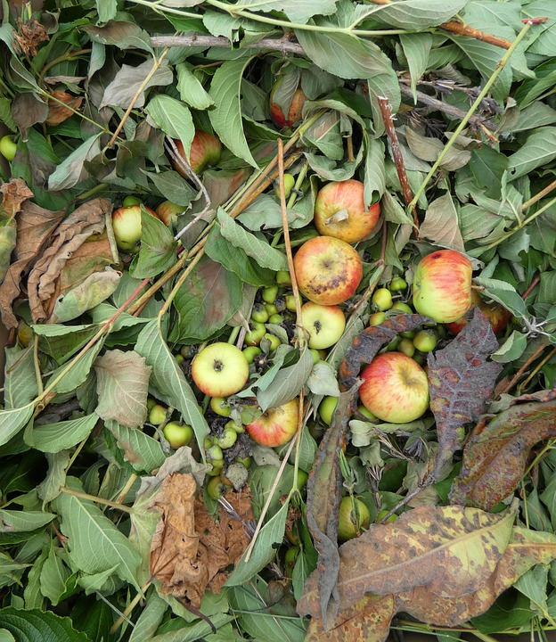

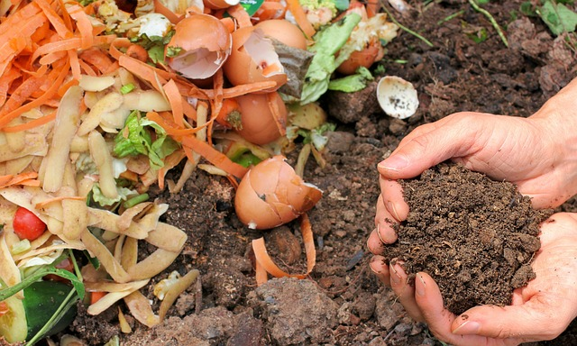


Compost, Mel Green, 2021, pixabay
Fruit Dump, Myriam, 2021, pixabay
word | class | definition | sentence
organic waste | noun phrase | remains of natural living things | We can put organic waste on the soil to help the crops grow.

Slide 10
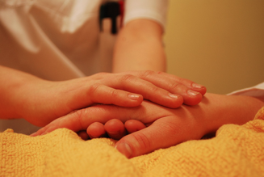
word | class | definition | sentence
sympathetic | adjective | to understand and care about other people’s problems | She was very sympathetic to their cause and gave her support.
Happens, Elisabeth, 2015, pixabay

Slide 11
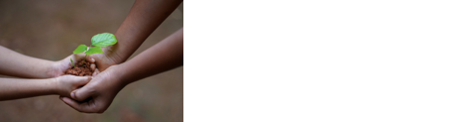
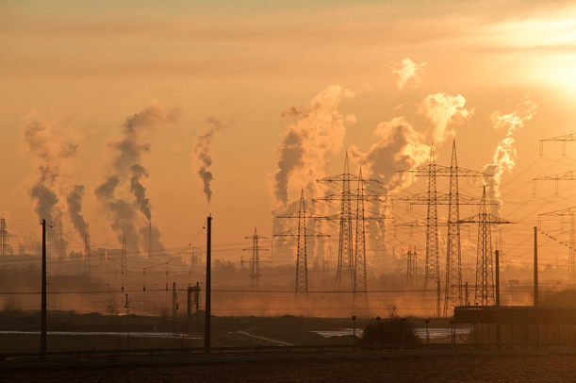

word | class | definition | sentence
concerned | adjective | worried | I am very concerned about global warming.
Hands, Shameer pk, 2018, pixabay
Industry, Ralf Vetterle, 2016, pixabay
Stickman, Clker-Free-Vector-Images, 2014, pixabay

Slide 12


word | class | definition | sentence
guarantee | verb | to promise that something is true or will happen | The scientist couldn’t guarantee that the new fuel was safe for the environment.
Guaranteed, Marian Anbu Juwan, 2021, pixabay
Percentage, Muju_pixel, 2021, pixabay

Slide 13
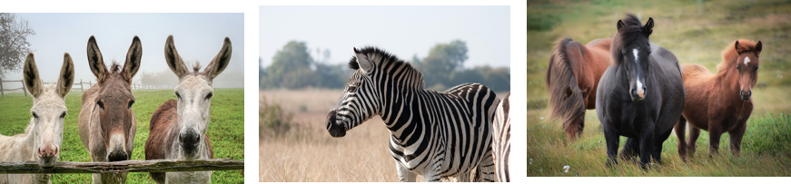
word | class | definition | sentence
species | noun | a group of plants or animals that share similar qualities | They have discovered a rare species of bird in the Amazon rainforest.
Donkey, Albrecht Fietz, 2020, pixabay
Zebra, Lynn Greyling, 2017, pixabay
Iceland, Rebekka D, 2016, pixabay

Slide 14
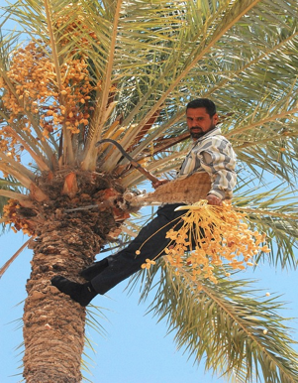
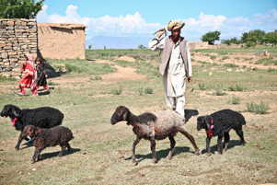

word | class | definition | sentence
agriculture | noun | the work and methods of growing crops and looking after animals that are then used for food | There have been many technological advances in agriculture.
Shepherd, Amber Clay, 2012, pixabay
Dates, Inactive account - ID 12019, 2013, pixabay

Slide 15
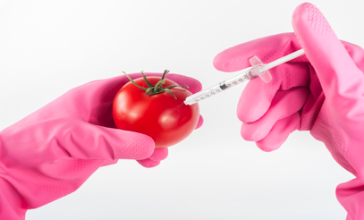
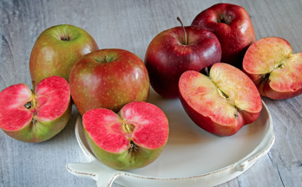
word | class | definition | sentence
genetically modified | adjective | the process of changing the genes (parts which control particular characteristics) of plants or animals | Scientists created the first genetically modified vegetables over 50 years ago.
Apples, Valter Cirillo, 2020, pixabay
Modified, Arturs Budkevics, 2016, pixabay

Slide 16
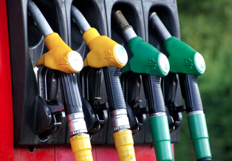

word | class | definition | sentence
consume | verb | to use something, e.g. burning fuel or using wind for energy | When we consume fossil fuels, we pollute the planet.
Fuel, Iade-Michoko, 2016, pixabay
Lightbulb, Colin Behrens, 2018, pixabay

Slide 17
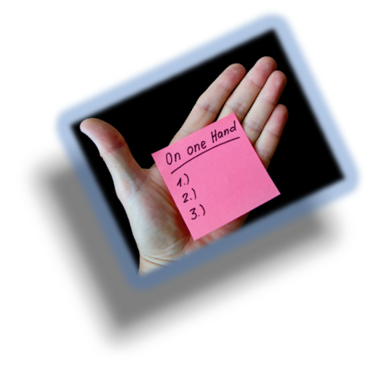
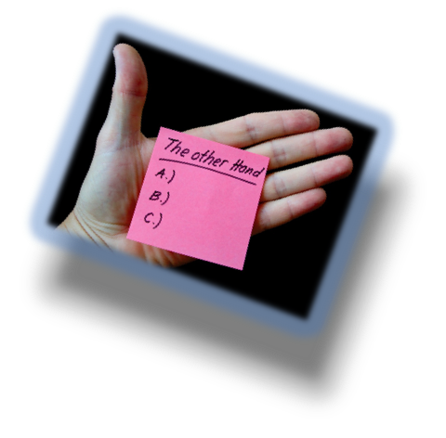

word | class | definition | sentence
controversial | adjective | causing a lot of disagreement or argument | When the government introduced a pollution tax, it was very controversial.
Hand note, ID 422737, 2015, pixabay
Hand, Inactive account - ID 422737, 2015, pixabay

Slide 18
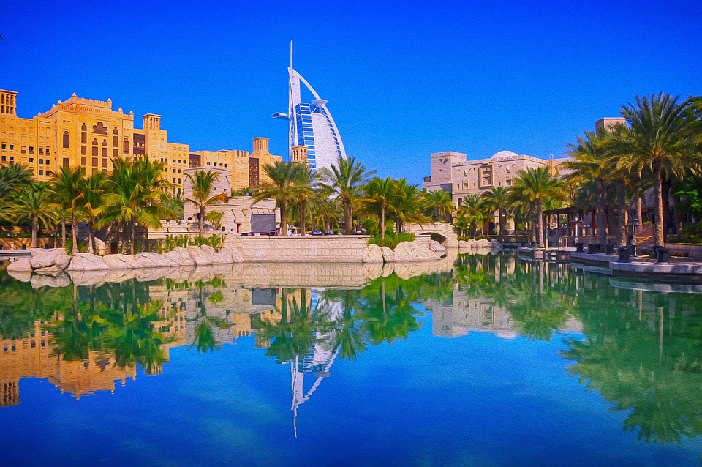
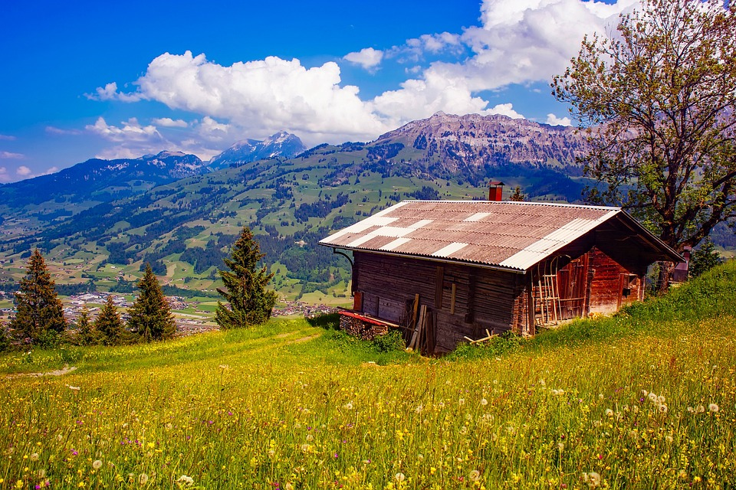
Hotel, George Paris, 2021, pixabay
Switzerland, Inactive account -ID 12019, 2016, pixabay
word | class | definition | sentence
picturesque | adjective | describing a place that is attractive to look at | He owned a picturesque farm in the mountains.

Slide 19


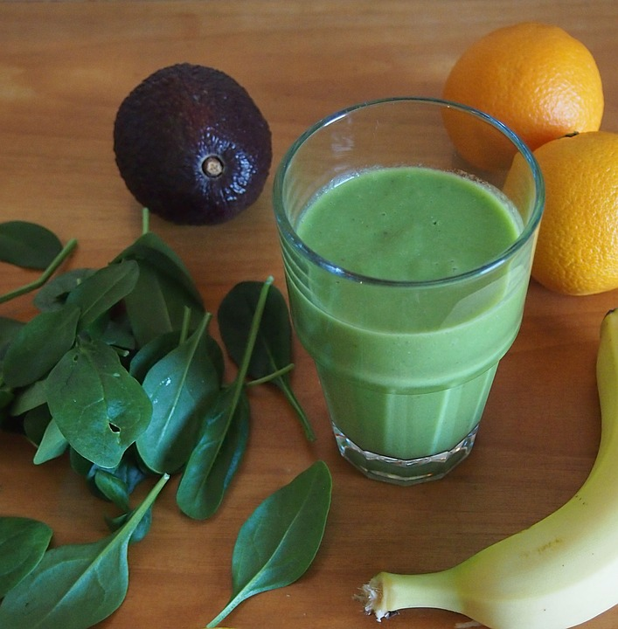


word | class | definition | sentence
non-toxic | adjective | not poisonous or not containing poisonous substances | He used non-toxic paint to decorate the baby’s bedroom.
Sign, Clker-Free-Vector-Images, 2012, pixabay
Splash, Edwin P M, 2017, pixabay
Barrl, OpenClipart-Vectors, 2013, pixabay

Slide 20
Thank you

