Slide 1
Reading and speaking exam
Practice
(grade 1 UAEP1)

Slide 2
Part 1
Say 3 sounds

Slide 3
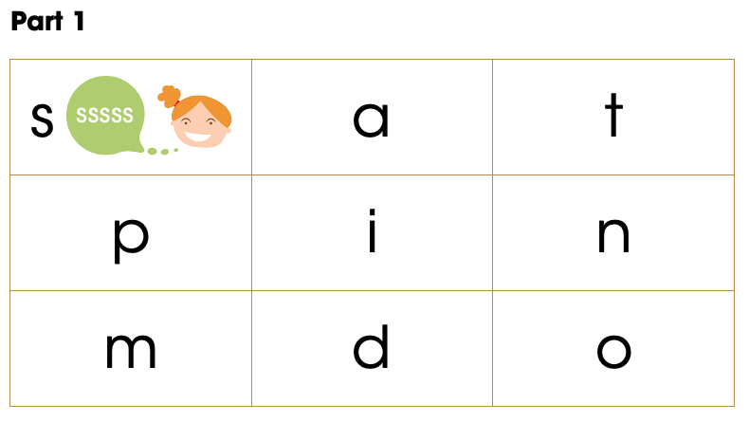

Slide 4
Say the sound
s

Slide 5
a

Slide 6
t

Slide 7
p

Slide 8
i

Slide 9
o

Slide 10
d

Slide 11
n

Slide 12
Part 2
Read 3 words

Slide 13
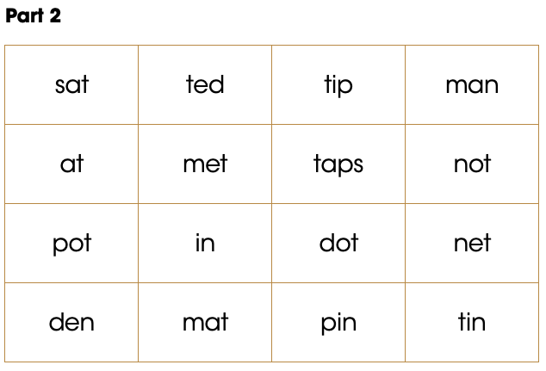

Slide 14
at

Slide 15
sat

Slide 16
pot

Slide 17
mat

Slide 18
ten

Slide 19
not

Slide 20
Part 3
Say the word

Slide 21


Slide 22


Slide 23
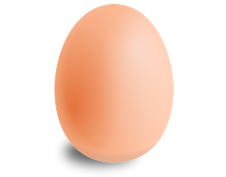

Slide 24
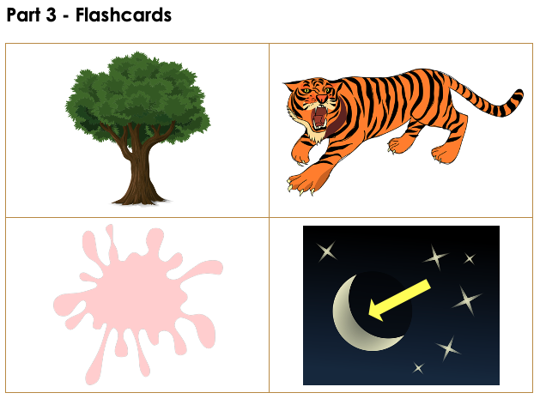

Slide 26


