Slide 1

Emirates Schools Establishment Assessment Unit
Cycle 1 Level 1.1
English Listening and Speaking Task
Term 2 2022
Term 2 Academic Year 2021-2022

Slide 2
Part 1: Preparation – Vocabulary.
Learn these words for the listening task.

Slide 3
square

Slide 4
circle

Slide 5
triangle

Slide 6

blue

Slide 7

red

Slide 8

yellow

Slide 9
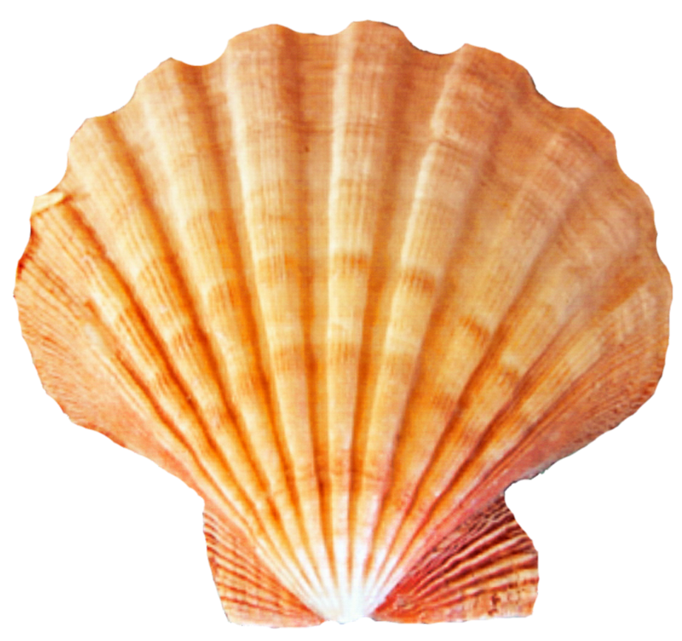
shell

Slide 10

fish

Slide 11
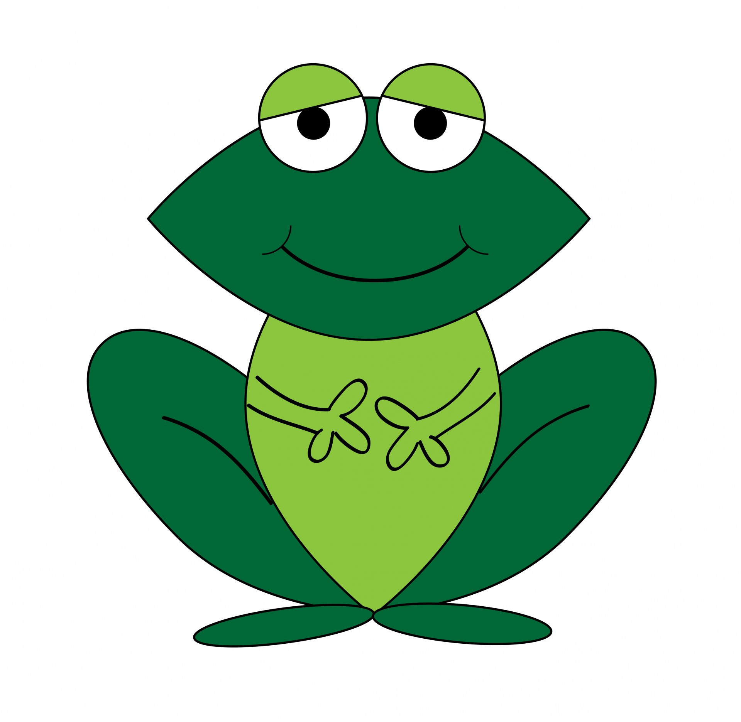
frog

Slide 12
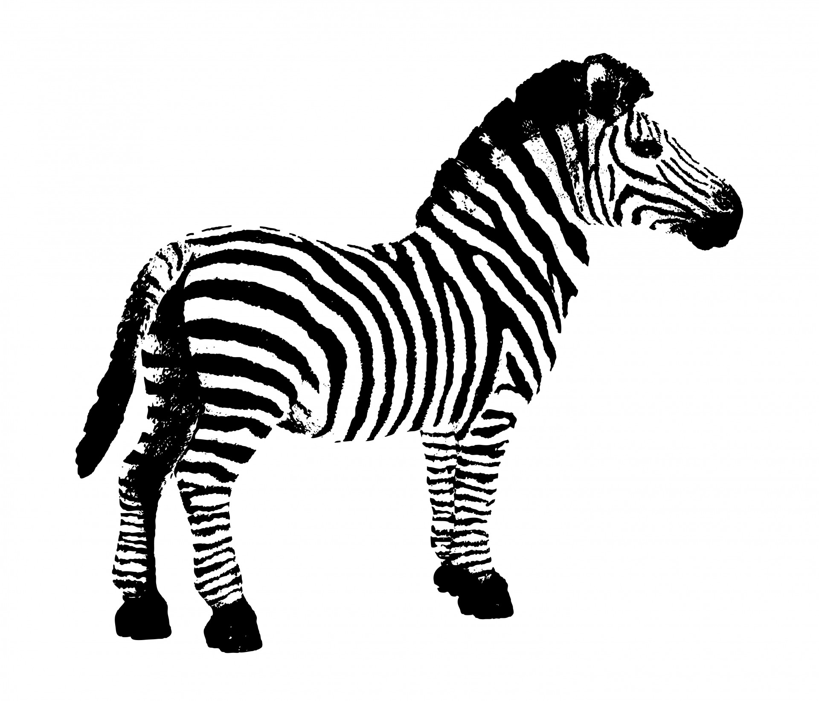
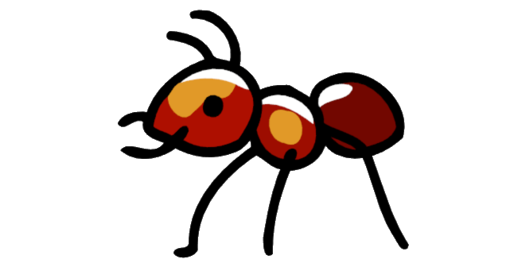
big

Slide 13
small

Slide 14
What is your name ?
My name is …..
How old are you
I am six years old .
What is your favorite color ?
My favorite color is …..

Slide 15
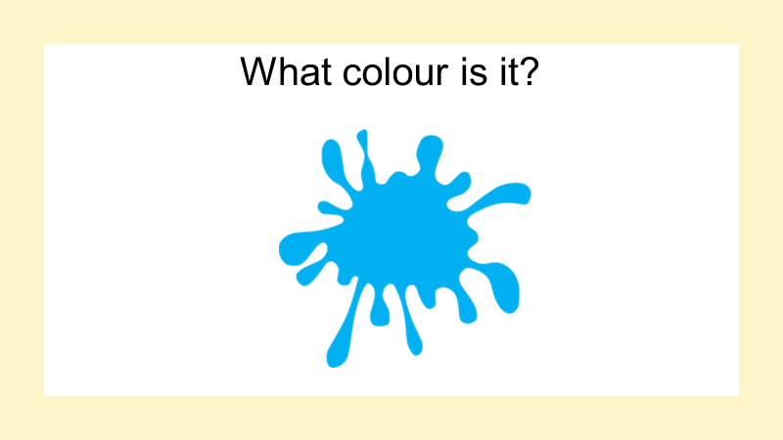
It is blue .

Slide 16
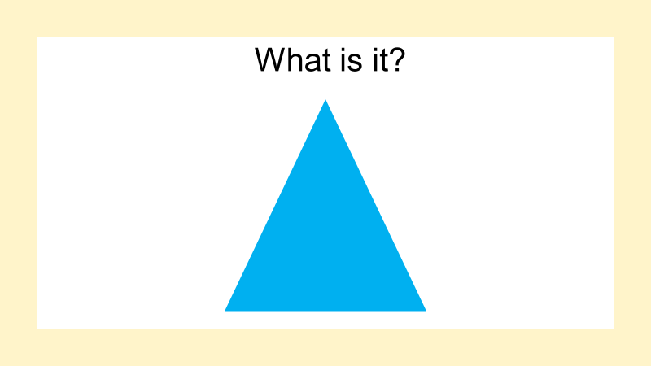
It is a blue triangle .

Slide 17
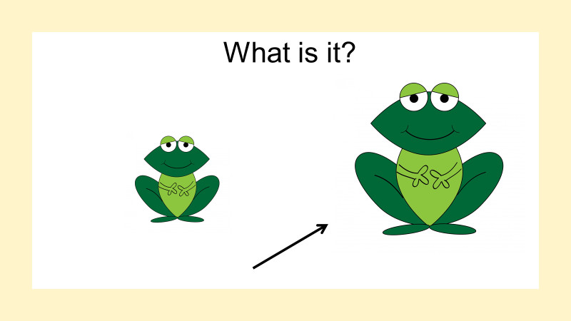
It is a big green frog.

